Slide 1
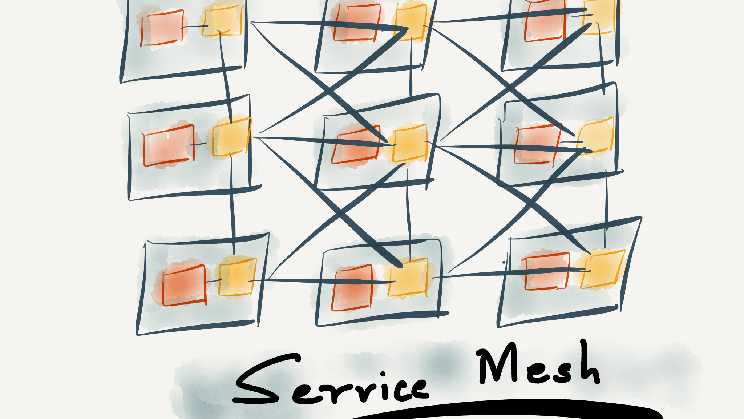
Using Service Mesh to enhance Communications and Governance of Microservices
Hugo Barona @ Meetup - .Net Mafia, C# Mobsters and other Microsoft family

Slide 2


Slide 3






Who am I?
Independent Contractor
10+ years experience in Software Development
Microsoft stack while leveraging the open source technologies
Certified Azure Solutions Architect

Slide 4
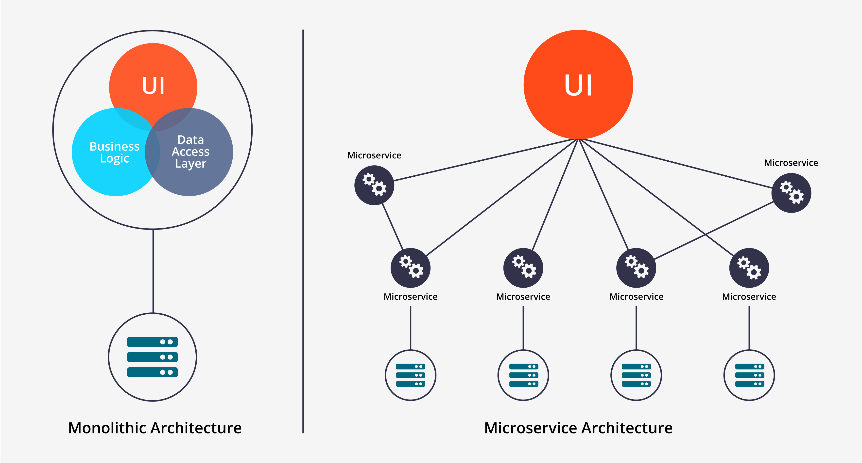

Slide 5
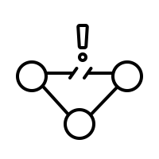



Communication Between Microservices: Common Problems
Fault Tolerance
Dependencies
Logging and
Monitoring
Performance

Slide 6
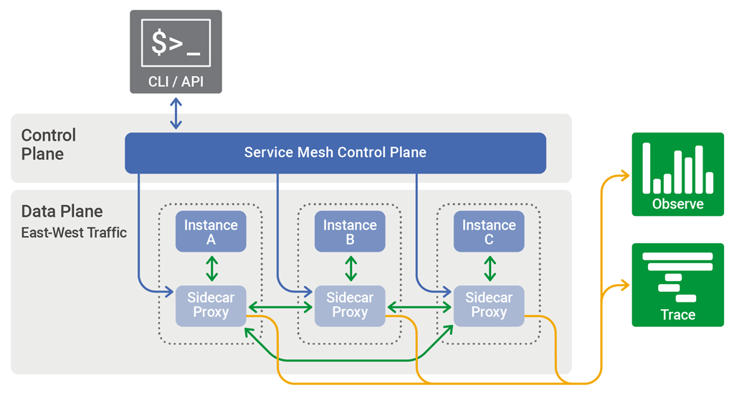
What is Service Mesh?
“A service mesh is an infrastructure layer designed to handle a high volume of network‑based inter-process communication among application services APIs.”

Slide 7
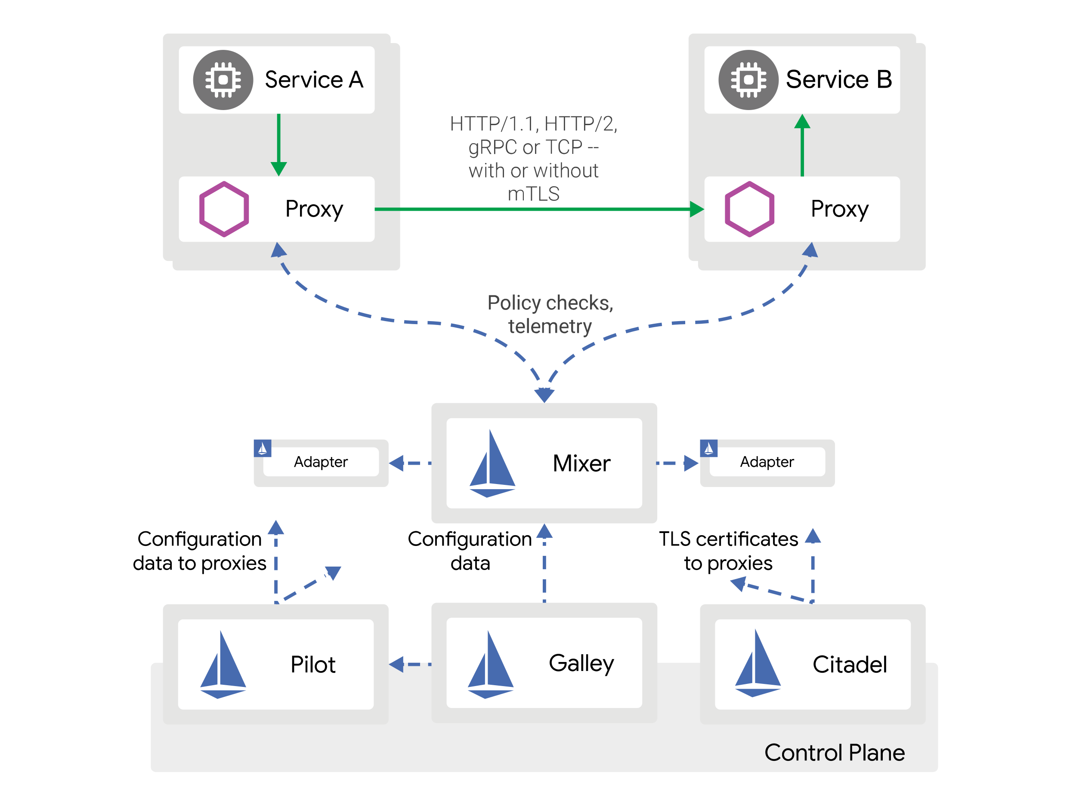
Istio Architecture
Mixer
  Access Control Enforcing
  Usage Policy Enforcing
  Telemetry Data collection
Pilot
  Service Discovery
  Traffic Management (A/B)
  Resiliency (CB)
Citadel
  Strong S2S authentication
  User authentication
  Credential Management
Galley
  Configuration Validation
  Configuration Distribution

Slide 8

Why Service Mesh?
Centralized Traffic Management
Service discovery
Load Balancing (Layer 7)
Secure Inter-Service Communications (encrypted requests/responses)
Authentication and Authorization
Tracing and Monitoring
Availability and Reliability (supports circuit breaker pattern)

Slide 9
Drawbacks of Service Mesh
Significant increase in number of containers
Potential increase in the operating costs
Can be Overkill for small environments

Slide 10
Service Mesh vs. API Gateways
Service Mesh mediates requests “inside” the microservices app
API gateway stands between a group of microservices and the “outside” world
API gateway abstracts the requester from the application
API gateway is for traffic going into and out of the cluster
Service Mesh is for traffic within a cluster

Slide 11




Demo
App
  Demo app – BookingInfo – available on the Istio official website
Components
  Container Orchestration: Kubernetes
  Environment tool: Minikube
  Virtualization: VirtualBox
  Service Mesh: Istio
  Tracing and Monitoring: Grafana
  Service Mesh Configuration: Kiali

Slide 12
References
Reference | Url
Istio Quick Start Evaluation Install | https://istio.io/docs/setup/install/kubernetes/
Bookinfo Demo Application | https://istio.io/docs/examples/bookinfo/
Install Minikube | https://kubernetes.io/docs/tasks/tools/install-minikube/

Slide 13




Let’s Connect!
hugomsbarona@gmail.com
@HmsBarona
linkedin.com/in/hugomiguelbarona/
github.com/hugobarona/twitter-serverless-demo

Slide 14


Questions?

