Slide 1

Serverless Computing and
Event-Driven Architecture
Hugo Barona @ Meetup - .Net Mafia, C# Mobsters and other Microsoft family

Slide 2





Who am I?
Independent Contractor
10+ years experience in Software Development
Certified Microsoft Web Stack Developer
Certified Azure Developer
@HmsBarona

Slide 3
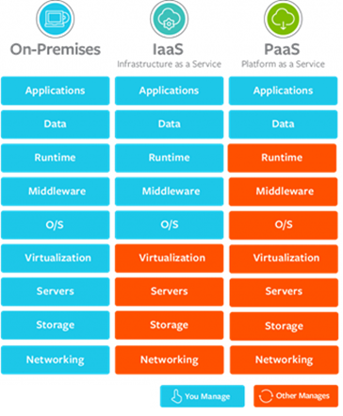
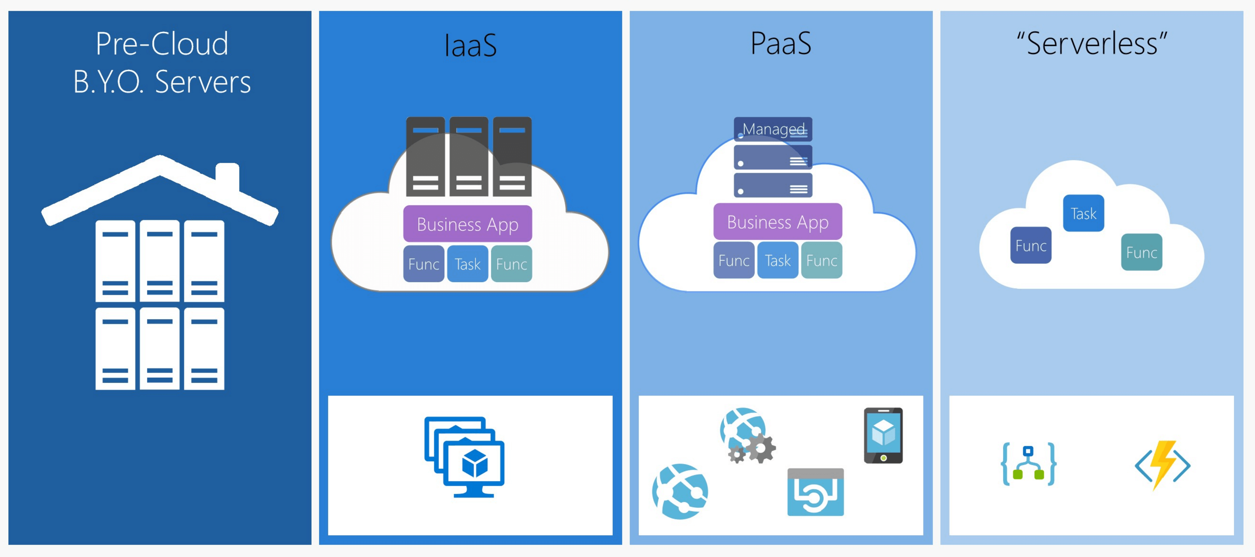
The Cloud Evolution

Slide 4





PaaS vs Serverless
PaaS Monthly fees vs Serverless - Consumption Plans
Serverless offers better auto-scaling capabilities (Azure Functions automatically allocates compute power when your code is running, scaling out as necessary to handle load)
Serverless is more effective at reducing cost and speeding up time to deployment and software releases.
Serverless does not provide so much flexibility in terms of development environment as PaaS, e.g. defined set of programming languages that the developer can use.

Slide 5
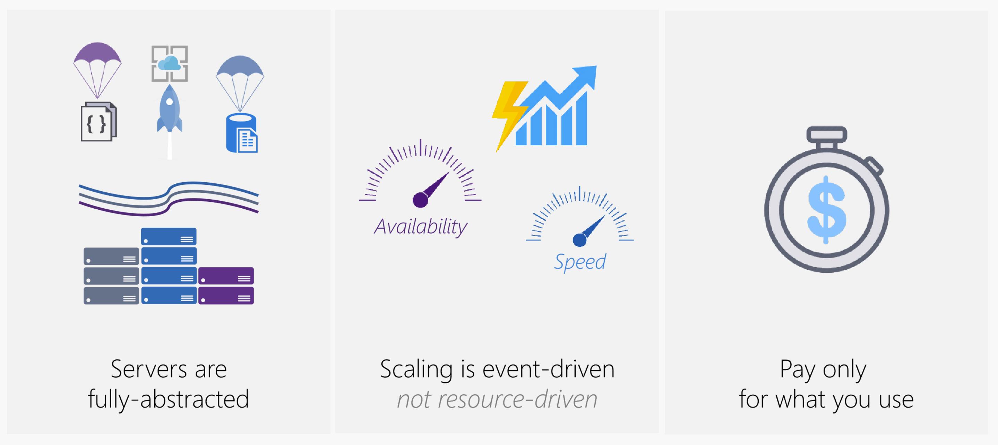
Some of the Serverless benefits…

Slide 6
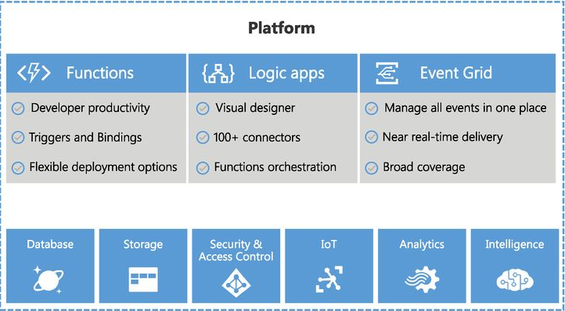
Azure Serverless Platform

Slide 7
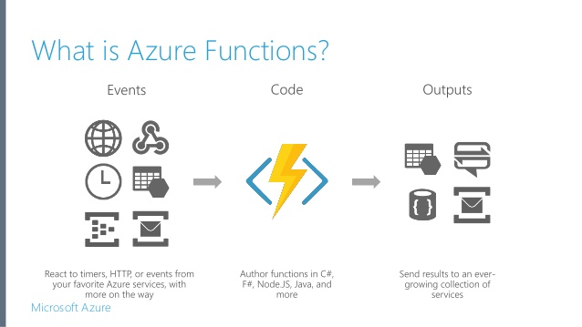

Slide 8
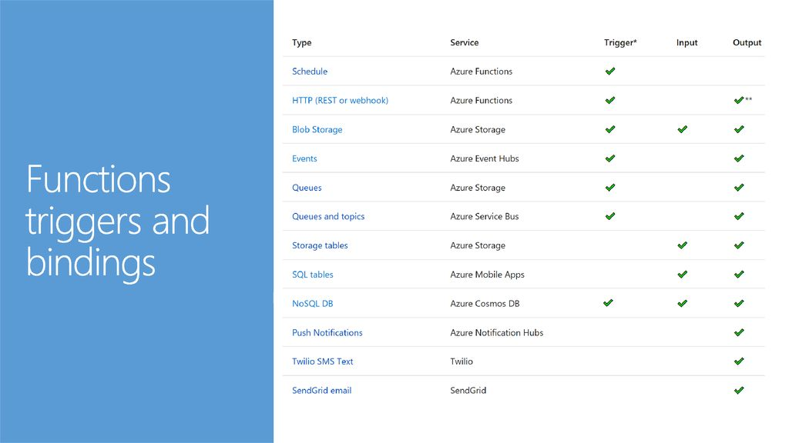

Slide 9
Azure Functions – Pros and Cons
Pros
Benefits from Serverless computing: cost, scalability, abstraction of servers
Boost productivity through triggers and bindings
Cons
Cold start on consumption plan
Stateless nature
Issues with long-running tasks
Choose from a variety of programming languages, such as C#, F#, Javascript, Java, Python
Easy Integration with existing DevOps processes - Continuous Deployment

Slide 10

Durable Functions
- Ability to create workflows
Stateful nature
Simplify Function Coordination
No JSON schemas, No designers, Only Code.
Enable long running functions
When “sleeping”, you are not billed!
Scalable

Slide 11
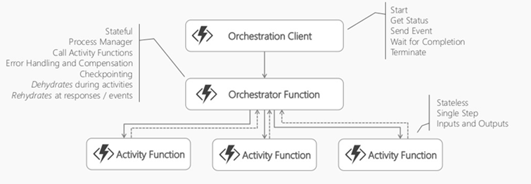
Durable Functions - Components

Slide 12
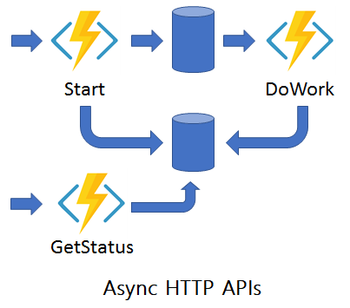
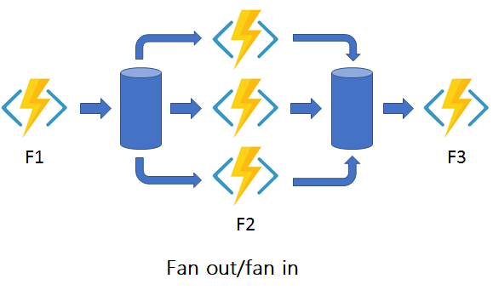
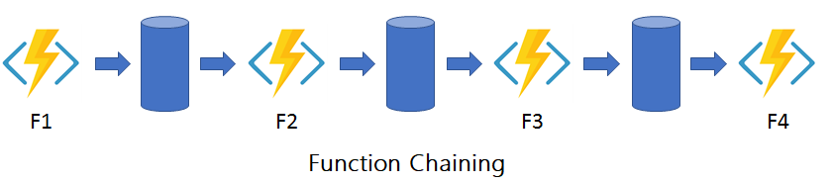
Durable Functions – Patterns

Slide 13
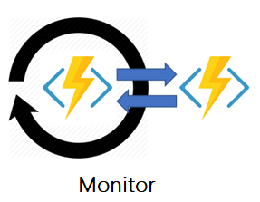
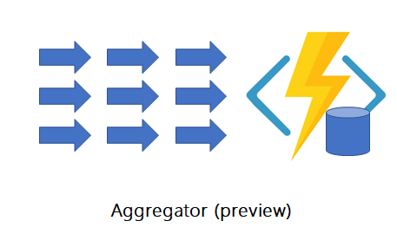
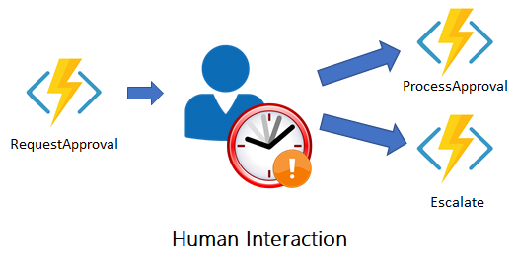
Durable Functions – Patterns

Slide 14
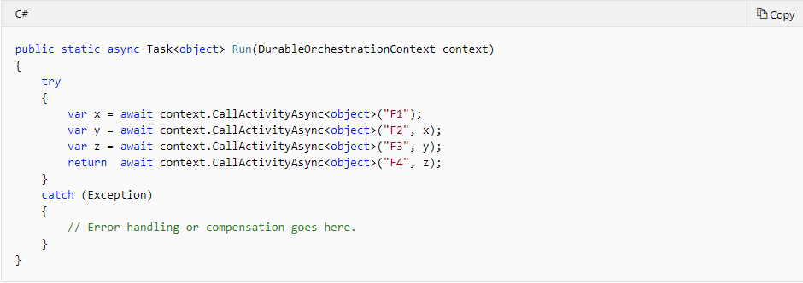
Durable Functions – Orchestrator Function Code Snippet

Slide 15
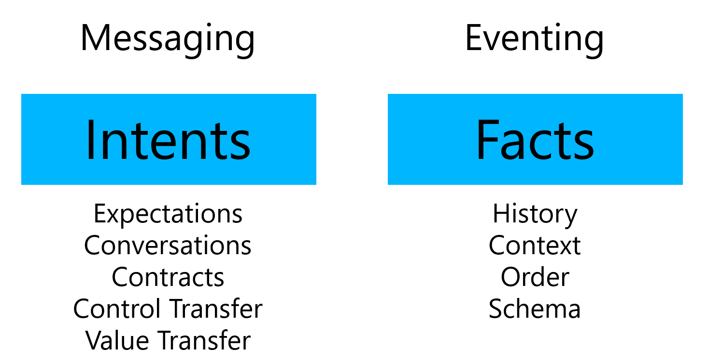
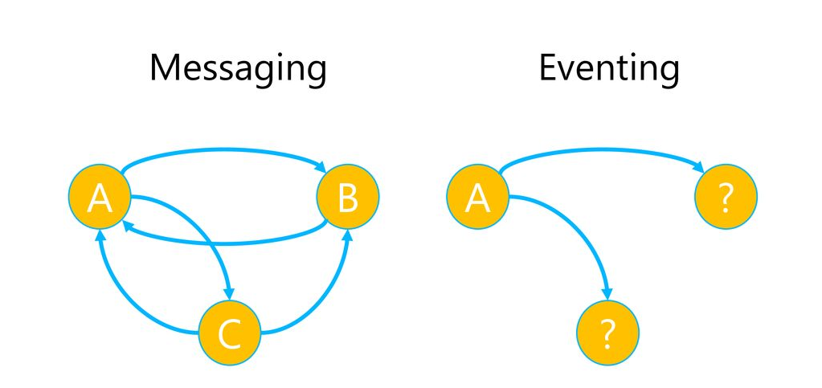
Messaging vs Eventing

Slide 16
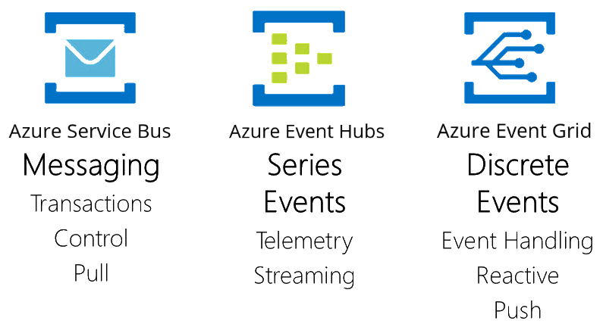

Slide 17
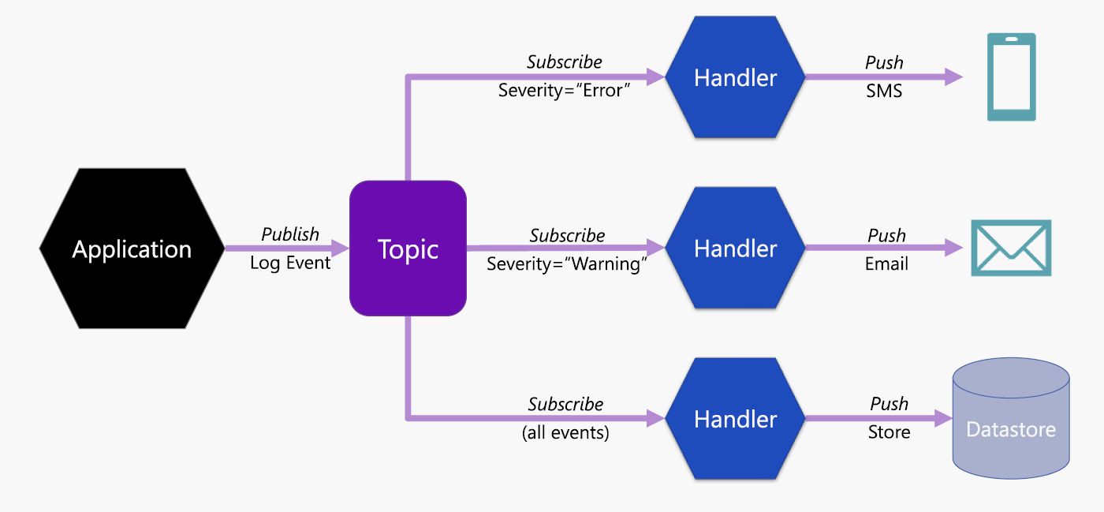
Azure Event Grid Example

Slide 18
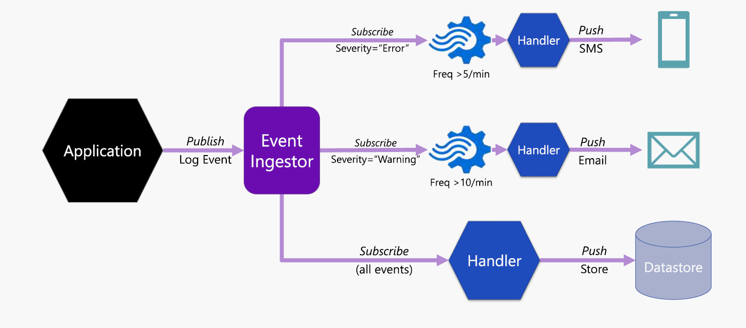
Azure Event Hub Example

Slide 19
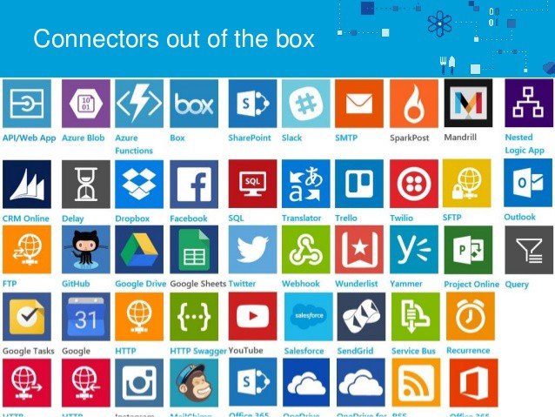
Logic Apps
Visual Drag-drop designer for rapid creation
Dozens of pre-build templates to get started
200+ connectors available to allow easy integration with other services and APIs
Easy workflow creation with built-in triggers and actions

Slide 20
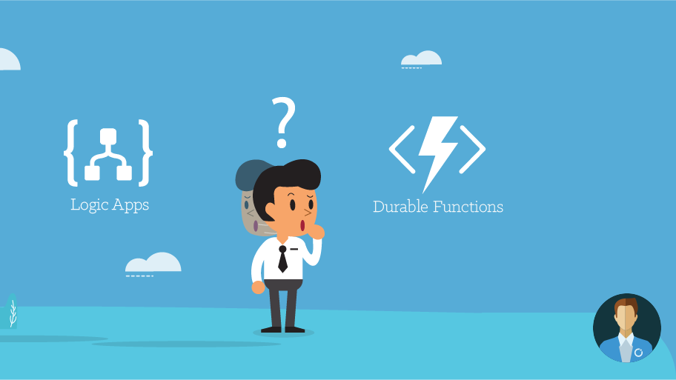

Slide 21
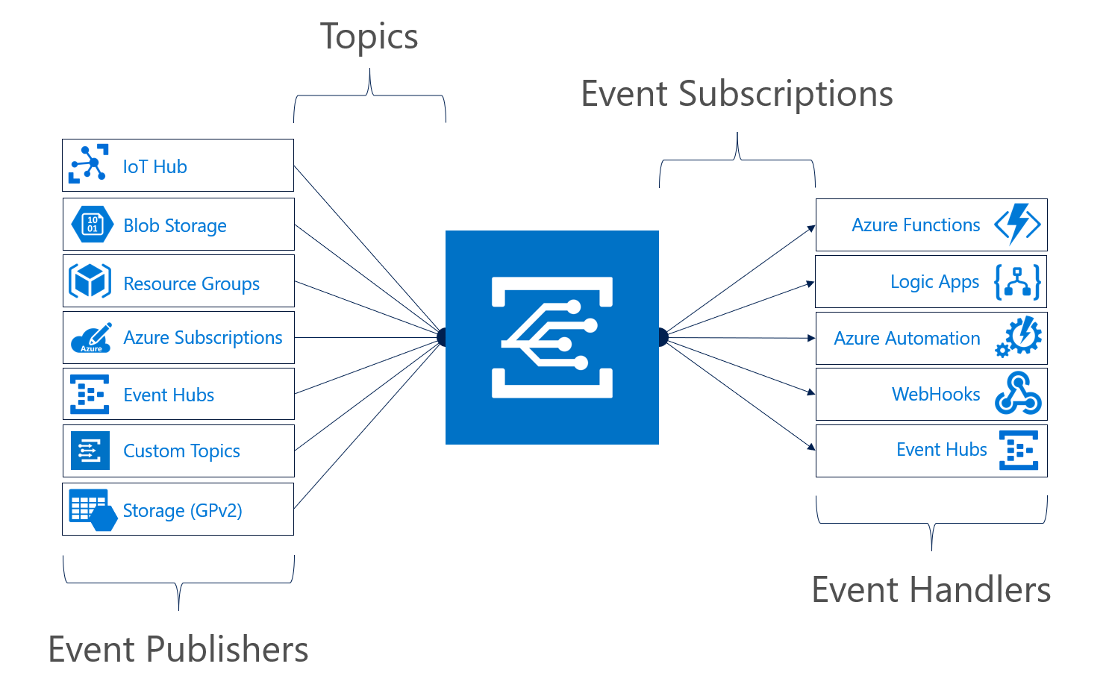
Azure Event Grid
Manage all events in one place
Pay per event
Near real-time delivery
Massive scale-out (10M events/sec)
High Reliability (24h retry mechanism)

Slide 22
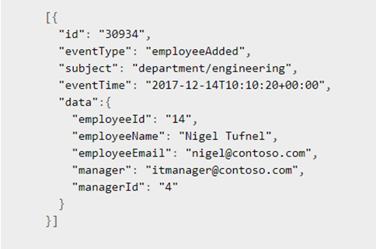
Azure Event Grid Event – Schema Example

Slide 23
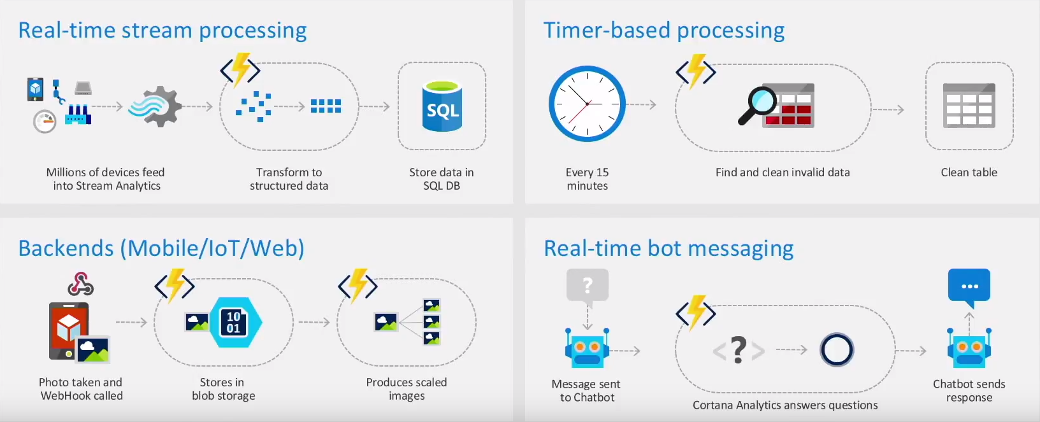
Scenarios for Serverless
Anything that needs to respond to events

Slide 24
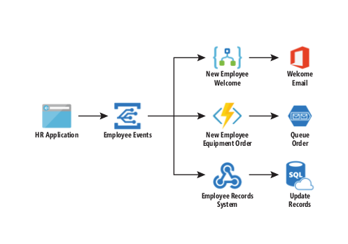
Serverless Event-driven architecture - Example

Slide 25
Serverless Event-driven architecture – Benefits and Challenges
Benefits
Reduced Operational Costs
Loosely coupled system
Highly Scalable
Challenges
Handling Failure
Idempotent actions
Concurrency
(…)
(…)

Slide 26
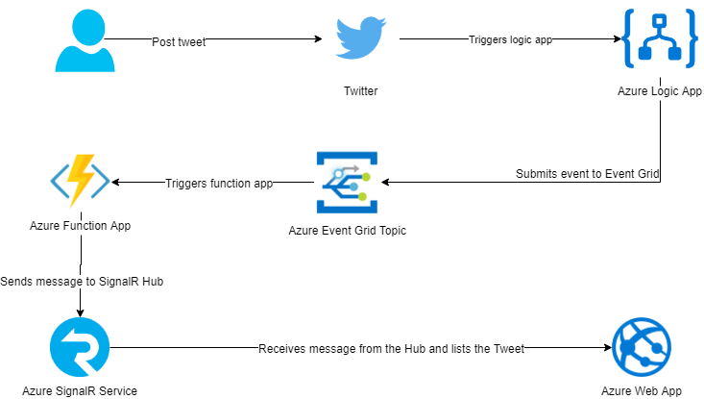
Demo - Architecture

Slide 27
Demo - Steps
Access
Access your Twitter account (https://twitter.com/)
Post
Post a tweet using the following hashtags and mentions
#netmafiameetup #hmbarona
@HarveyNashIrl @HmsBarona @NETMafiaMeetup
e.g. This is a tweet testing the demo at #netmafiameetup with #hmbarona @HarveyNashIrl @HmsBarona
Watch
Watch the magic happening ☺

Slide 28
Resources
Resource | Location
Azure Serverless | http://azure.com/serverless
Azure Logic Apps | https://azure.microsoft.com/en-us/services/logic-apps/
Azure Functions | http://azure.com/functions
Azure Event Grid | http://azure.com/eventgrid
CNCF CloudEvents | https://cloudevents.io/
Azure Solution Architectures | https://azure.microsoft.com/en-us/solutions/architecture/
Azure Durable Functions | https://docs.microsoft.com/en-us/azure/azure-functions/durable/durable-functions-overview

Slide 29




Let’s connect!
hugomsbarona@gmail.com
@HmsBarona
linkedin.com/in/hugomiguelbarona/
github.com/hugobarona/twitter-serverless-demo

