Slide 1
Containerization

Slide 2
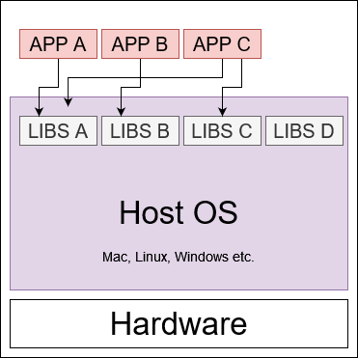
Traditional Development
Frontend Dev Team
  Build the UI
Backend Dev Team
  Build the app business logic
Services Dev Team
  Build different services
  i.e. AI model, 3rd party services etc.
Operations / DevOps Team
  Deploys everything
  app, DB, model, services
Each team has a different focus and works in separately.
Traditional application deployment on a host - sharing host OS libraries and resources

Slide 3
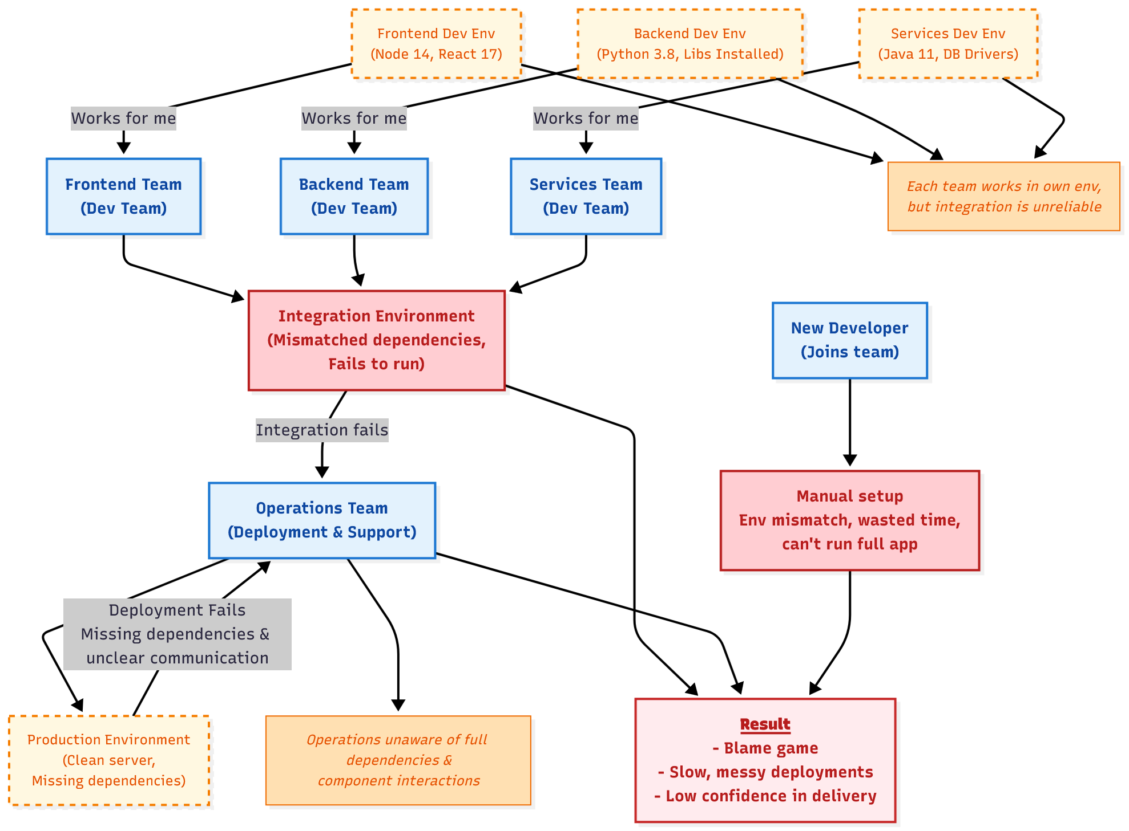
Problem: It Works on My Machine
Result: blame game, failed deployments.
Notes:
flowchart TD
%% Developer teams
FE["Frontend Team<br/>(Dev Team)"]:::role
BE["Backend Team<br/>(Dev Team)"]:::role
SE["Services Team<br/>(Dev Team)"]:::role
%% Environments of each team
FE_ENV["Frontend Dev Env<br/>(Node 14, React 17)"]:::env
BE_ENV["Backend Dev Env<br/>(Python 3.8, Libs Installed)"]:::env
SE_ENV["Services Dev Env<br/>(Java 11, DB Drivers)"]:::env
%% Integration environment where combined code is tested
INTEGRATION["Integration Environment<br/>(Mismatched dependencies,<br/>Fails to run)"]:::failure
%% Operations environment
OPS["Operations Team<br/>(Deployment & Support)"]:::role
OPS_ENV["Production Environment<br/>(Clean server,<br/>Missing dependencies)"]:::env
%% Connections from env to teams
FE_ENV -->|Works for me| FE
BE_ENV -->|Works for me| BE
SE_ENV -->|Works for me| SE
%% Code flow from teams to Integration
FE --> INTEGRATION
BE --> INTEGRATION
SE --> INTEGRATION
%% Integration failure due to env mismatch
INTEGRATION -->|Integration fails| OPS
%% Ops team trying to deploy
OPS --> OPS_ENV
OPS_ENV -->|Deployment Fails<br/>Missing dependencies & unclear communication| OPS
%% Challenges / notes
NOTE1["Each team works in own env,<br/>but integration is unreliable"]:::note
NOTE2["Operations unaware of full dependencies &<br/>component interactions"]:::note
FE_ENV --> NOTE1
BE_ENV --> NOTE1
SE_ENV --> NOTE1
OPS --> NOTE2
%% New dev onboarding issue
NEW_DEV["New Developer<br/>(Joins team)"]:::role
ONBOARD["Manual setup<br/>Env mismatch, wasted time,<br/>can't run full app"]:::failure
NEW_DEV --> ONBOARD
%% Final outcome
RESULT["<b><u>Result</u></b> <br>- Blame game<br/>- Slow, messy deployments<br/>- Low confidence in delivery"]:::challenge
INTEGRATION --> RESULT
OPS --> RESULT
ONBOARD --> RESULT
%% Styling
classDef role fill:#E3F2FD,stroke:#1976D2,stroke-width:2px,color:#0D47A1,font-weight:bold;
classDef env fill:#FFF8E1,stroke:#F57C00,stroke-dasharray: 5 5,color:#E65100,font-size:12px;
classDef failure fill:#FFCDD2,stroke:#B71C1C,stroke-width:2px,color:#B71C1C,font-weight:bold;
classDef note fill:#FFE0B2,stroke:#EF6C00,stroke-width:1px,color:#E65100,font-style:italic,font-size:12px;
classDef challenge fill:#FFEBEE,stroke:#C62828,stroke-width:2px,color:#B71C1C,font-weight:bold;
flowchart TD
%% Developer teams
FE["Frontend Team<br/>(Dev Team)"]:::role
BE["Backend Team<br/>(Dev Team)"]:::role
SE["Services Team<br/>(Dev Team)"]:::role
%% Environments of each team
FE_ENV["Frontend Dev Env<br/>(Node 14, React 17)"]:::env
BE_ENV["Backend Dev Env<br/>(Python 3.8, Required Libs)"]:::env
SE_ENV["Services Dev Env<br/>(Java 11, DB Drivers)"]:::env
%% Works for me
FE_ENV -->|"Works for me"| FE
BE_ENV -->|"Works for me"| BE
SE_ENV -->|"Works for me"| SE
%% Integration stage (code merge)
FE --> INTEGRATION
BE --> INTEGRATION
SE --> INTEGRATION
INTEGRATION["Integration Environment<br/>(Conflicting configs,<br/>fails to run properly)"]:::failure
%% Operations team
OPS["Operations Team<br/>(Deployment)"]:::role
OPS_ENV["Production Env<br/>(Clean server,<br/>missing dependencies)"]:::env
%% From integration to ops
INTEGRATION -->|"Broken build"| OPS
OPS --> OPS_ENV
OPS_ENV -->|"Fails to deploy<br/>Missing requirements"| OPS
%% New dev onboarding issue
NEW_DEV["New Developer<br/>(Joins team)"]:::role
ONBOARD["Manual setup<br/>Env mismatch, wasted time,<br/>can't run full app"]:::failure
NEW_DEV --> ONBOARD
%% Final outcome
RESULT["Result: Blame game<br/>Slow, messy deployments<br/>Low confidence in delivery"]:::challenge
INTEGRATION --> RESULT
OPS --> RESULT
ONBOARD --> RESULT
%% Labels
subgraph Legend
D1["Dev Teams"]:::role
E1["Custom Dev Envs"]:::env
F1["Failures"]:::failure
O1["Ops Team"]:::role
C1["Final Challenge"]:::challenge
end
%% Styling
classDef role fill:#E3F2FD,stroke:#1976D2,stroke-width:2px,color:#0D47A1,font-weight:bold;
classDef env fill:#FFF8E1,stroke:#F57C00,stroke-dasharray: 5 5,color:#E65100;
classDef failure fill:#FFCDD2,stroke:#B71C1C,stroke-width:2px,color:#B71C1C;
classDef challenge fill:#FFEBEE,stroke:#C62828,stroke-width:2px,color:#B71C1C,font-weight:bold;

Slide 4
Where It Breaks
Lack of collaboration among teams
  Software developed on different envs.
Multiple languages & stacks:
  ReactJS, Python, Java/JS/PHP
  Different projects require conflicting versions (vA vs. vB)
  Environment & dependency mismatches cause unreliable reproducibility
Ops team doesn’t know dependencies, configs, versions
Creates a Gap between development and deployment
Result → integration challenges, blame game, slow/messy deployment

Slide 5
Where It Breaks
How do we share it, deploy it, and run it reliably anywhere?
We can share code, but not everyone can run it reliably.
This creates Unreliable reproducibility
Need: A self-contained, portable runtime.

Slide 6
Need: Self-contained, Portable Runtime
A way to package application + dependencies together.
The solution must run identically across:
  Developer laptops
  Test servers
  Production environments
The idea: isolate each app environment to avoid conflicts
Notes:
We need a way to package application + dependencies together.

Slide 7
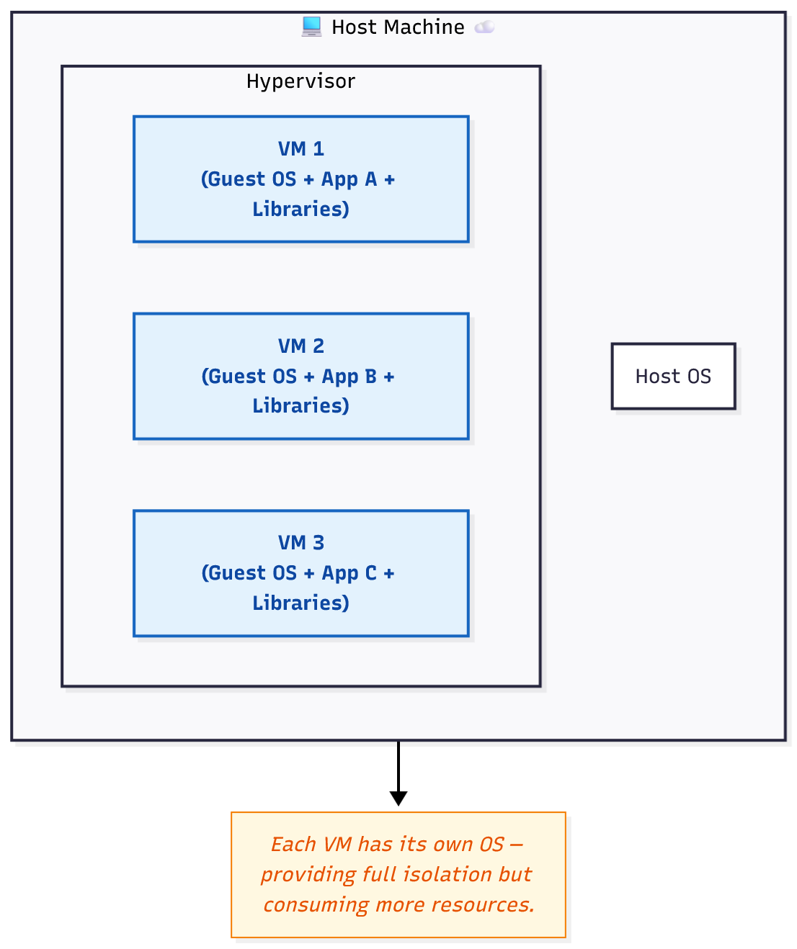
Need: Self-contained, Portable Runtime.
One solution is to make use of Virtual Machines (VMs)
Notes:
flowchart TD
subgraph HOST["💻 Host Machine ☁️"]
OS["Host OS"]
subgraph HYP["Hypervisor"]
VM1["VM 1<br/>(Guest OS + App A + Libraries)"]:::vm
VM2["VM 2<br/>(Guest OS + App B + Libraries)"]:::vm
VM3["VM 3<br/>(Guest OS + App C + Libraries)"]:::vm
end
end
classDef vm fill:#E3F2FD,stroke:#1565C0,stroke-width:2px,color:#0D47A1,font-weight:bold;
%% Explanation Notes
NOTE["Each VM has its own OS — providing full isolation but consuming more resources."]:::note
HOST --> NOTE
classDef note fill:#FFF8E1,stroke:#F57C00,stroke-width:1px,color:#E65100,font-style:italic;

Slide 8
Solution – Use of Virtual Machines
Each VM runs a complete OS (Guest OS) on top of a Hypervisor.
Provides full isolation between applications.
Each VM behaves like a separate physical computer.
Solves dependency and environment conflicts.

Slide 9
Solution – Use of Virtual Machines
Challenges with virtual machines
Run full guest OS: duplicates kernels, services
  Heavy on CPU, RAM, storage.
  Kernel schedules processes → then communicates with host kernel → adds overhead and latency
Slow startup time — each VM boots like a separate system
Managing and updating multiple VMs is complex
Difficult to scale quickly in DevOps pipelines
Large OS + hardware images — less flexible across clouds/environments

Slide 10
Need: Self-contained, Portable Runtime
Isolation without full OS duplication
Fast, lightweight, and easily reproducible environments.
Apps that can run anywhere — without works on my machine.
Notes:
We need a way to package application + dependencies together.

Slide 11
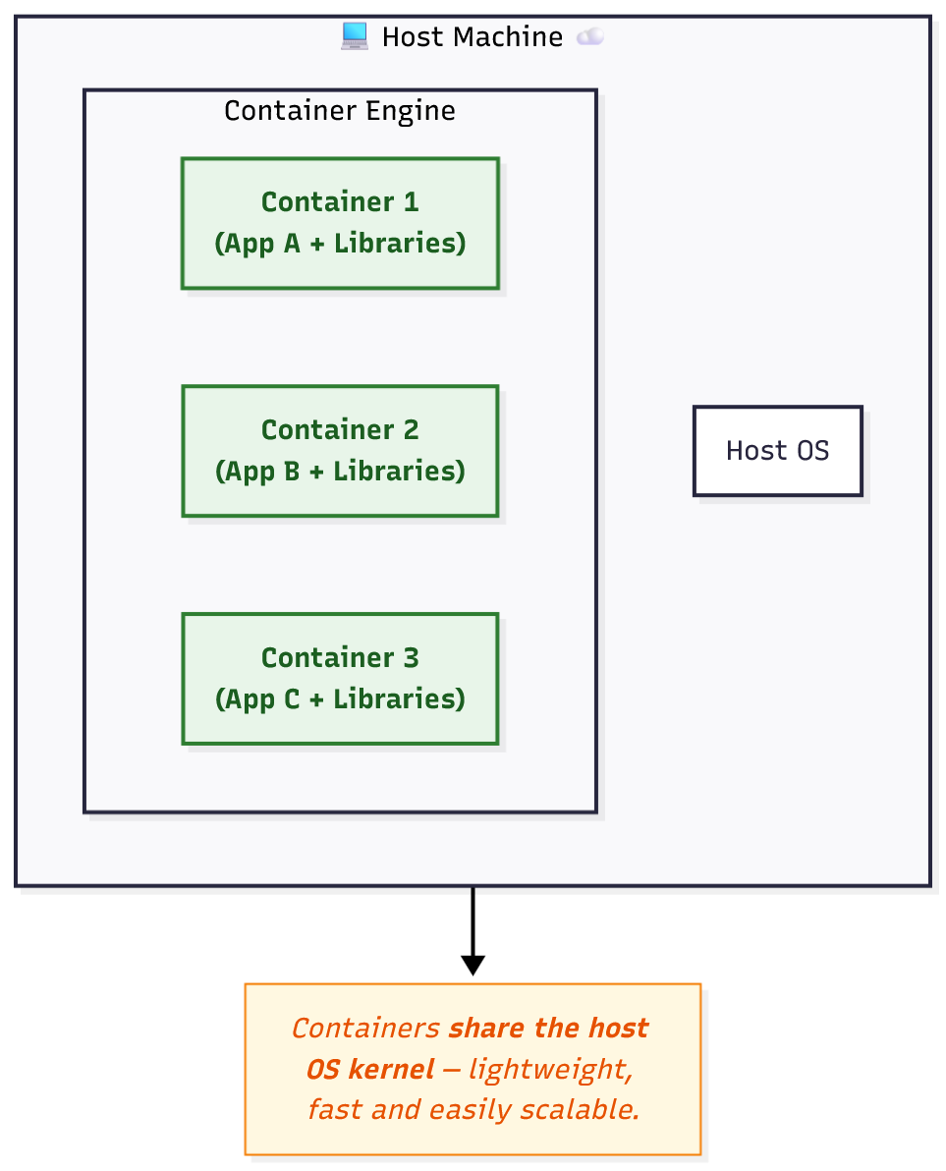
Need: Self-contained, Portable Runtime
Other solution is to make use of containerization
Notes:
flowchart TD
subgraph HOST["💻 Host Machine ☁️"]
OS["Host OS"]
subgraph CE["Container Engine"]
C1["Container 1<br/>(App A + Libraries)"]:::container
C2["Container 2<br/>(App B + Libraries)"]:::container
C3["Container 3<br/>(App C + Libraries)"]:::container
end
end
classDef container fill:#E8F5E9,stroke:#2E7D32,stroke-width:2px,color:#1B5E20,font-weight:bold;
%% Explanation Notes
NOTE["Containers <b>share the host OS kernel</b> — lightweight, fast and easily scalable."]:::note
HOST --> NOTE
classDef note fill:#FFF8E1,stroke:#F57C00,stroke-width:1px,color:#E65100,font-style:italic;

Slide 12
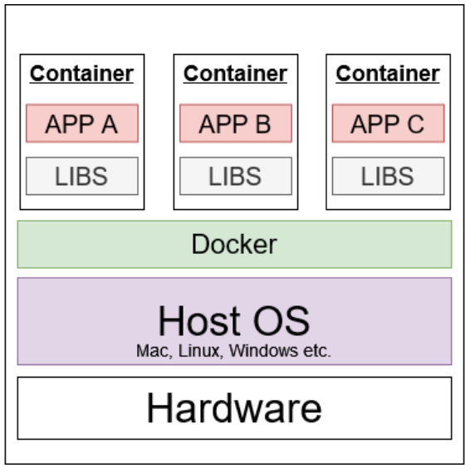
Need: Self-contained, Portable Runtime
Other solution is to make use of containerization
Notes:
flowchart TD
subgraph HOST["💻 Host Machine ☁️"]
OS["Host OS"]
subgraph CE["Container Engine"]
C1["Container 1<br/>(App A + Libraries)"]:::container
C2["Container 2<br/>(App B + Libraries)"]:::container
C3["Container 3<br/>(App C + Libraries)"]:::container
end
end
classDef container fill:#E8F5E9,stroke:#2E7D32,stroke-width:2px,color:#1B5E20,font-weight:bold;
%% Explanation Notes
NOTE["Containers <b>share the host OS kernel</b> — lightweight, fast and easily scalable."]:::note
HOST --> NOTE
classDef note fill:#FFF8E1,stroke:#F57C00,stroke-width:1px,color:#E65100,font-style:italic;

Slide 13
Solution – Use of Containers
Isolate apps in user space (process-level) while sharing the same host OS kernel.
  No need of full Guest OS unlike VMs
  Reducing latency
Host OS kernel directly schedules container processes
  Faster communication with hardware resources.
Start as lightweight processes
  Near-instant startup (seconds or less).
Easy to scale quickly in DevOps pipelines
Containers run isolated processes on the host OS → no duplication of OS components → minimal resource use.

Slide 14
Introduction To Docker & Containers
We package everything
  code, dependencies, runtime into a single container (isolated)
  runs it anywhere
Docker is a high-level tool that promise:
  Package code + dependencies + environment into an image.
  Runs consistently everywhere (laptop, cloud, production).
Notes:
Imagine a web application with:
A frontend that users interact with.
A backend that processes requests.
A database storing sensitive information.
Trusted components:
Your backend server and database (assuming they are secure and under your control).
Untrusted components:
The user input from forms.
Any data from third-party APIs.
Requests from the internet.
You design the system assuming that untrusted components could be malicious, and you sanitize, validate, or sandbox them accordingly.
For instance, if a user submits a comment, the backend should not trust it. It should escape HTML to prevent XSS (cross-site scripting).
The trust boundary is between the server and the clients.

Slide 15
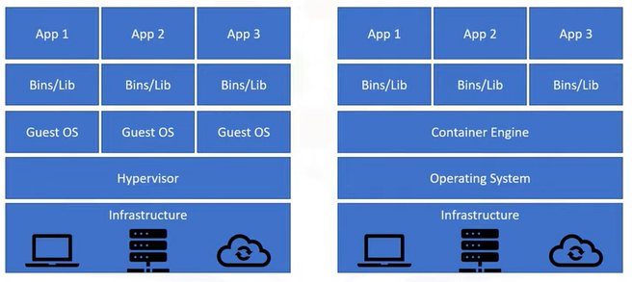
Introduction To Docker & Containers
Container VS Virtual Machines
VMs make high utilization of resources
VMs needs more space as compared to Containers
VMs take more time in boot up process
Docker Shares the Same OS Kernel
Notes:
Imagine a web application with:
A frontend that users interact with.
A backend that processes requests.
A database storing sensitive information.
Trusted components:
Your backend server and database (assuming they are secure and under your control).
Untrusted components:
The user input from forms.
Any data from third-party APIs.
Requests from the internet.
You design the system assuming that untrusted components could be malicious, and you sanitize, validate, or sandbox them accordingly.
For instance, if a user submits a comment, the backend should not trust it. It should escape HTML to prevent XSS (cross-site scripting).
The trust boundary is between the server and the clients.

Slide 16
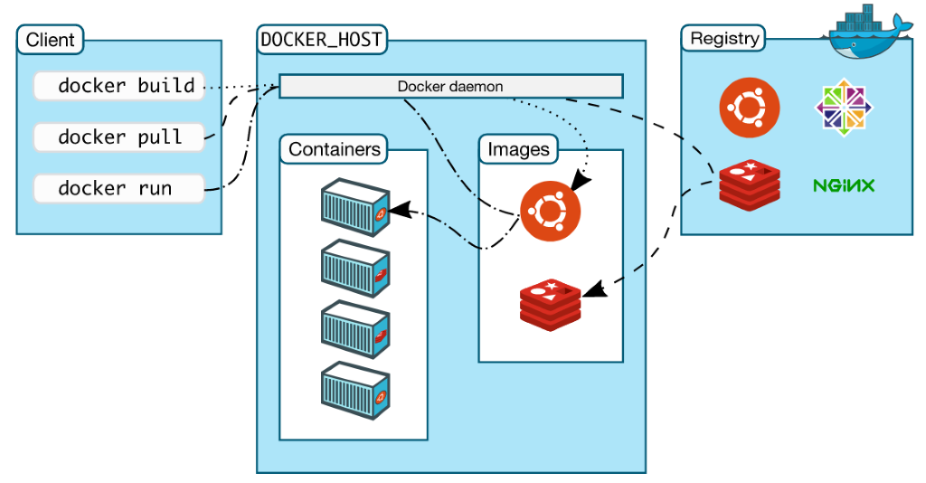
Introduction To Docker & Containers
Docker Architecture
Docker Client – CLI tool used to interact with the Docker daemon
  Sends requests to the server
  Can run on the same machine as the daemon or connect to a remote server
Docker Server (Daemon) – performs core operations:
  Build images, Run containers & Pull/push images
  Listens for API requests from Docker clients

Slide 17
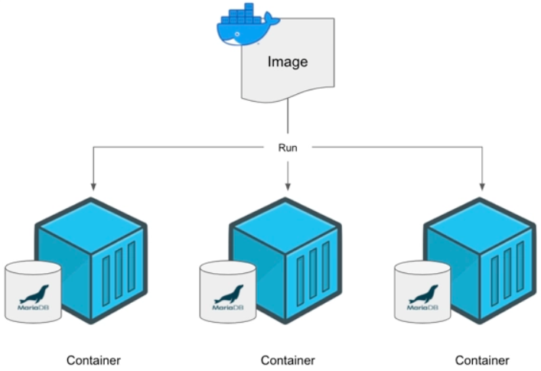
Introduction To Docker & Containers
Docker Core Elements
Images – are read-only templates or blueprints for containers that
  Runtime environment
  Application code
  Any dependencies
  Extra configuration (I.e. Environment variables)
  Commands (I.e. should execute on creating container)
Registries – store images for public or private use
  well-known public registry is Docker Hub
Containers – running instance of an image

Slide 18
Introduction To Docker & Containers
Docker Commands
Pull image from the registry
docker pull <image-name>
Create and launch the container from the image
docker run <image-name>
Create your own custom image
docker build -t <image-name-to-assign>
See other commands in dockercommands.txt file or follow docker docs

Slide 19
Let's Explore Docker Practically

Slide 20
From Isolated Containers to Connected Applications
So far, we have run containers individually — isolated, self-contained units.
But real-world apps are not isolated!
  frontend talks to a backend.
  backend connects to a database.
  db client connects to a database etc
And users need to access services from outside the container world.
Also, apps need data that doesn’t vanish when containers stop.
Questions to answer?
If every container is isolated, how does a web container reach the database?
How can I make my container accessible to others on my network?
If DB container crashes, does the DB data persist?

Slide 21
How Containers Talk to Each Other?
Each container has its own virtual network interface that an run in different networking modes
  bridge (default)
  host
  none
These modes define how containers communicate with:
  Each other
  The host machine
  The outside world
Containers in the same network can talk via container name as hostname.
We can create custom networks to organize microservices.

Slide 22
How Containers Talk to Each Other?
Bridge network (Default)
Each container gets its own private IP inside Docker’s virtual bridge.
Docker uses NAT to allow outbound access
Allows container-to-container communication (with manual or custom network)
  Via container IP
  Via container hostname (i.e. container name)
You must publish ports to access from host.

Slide 23
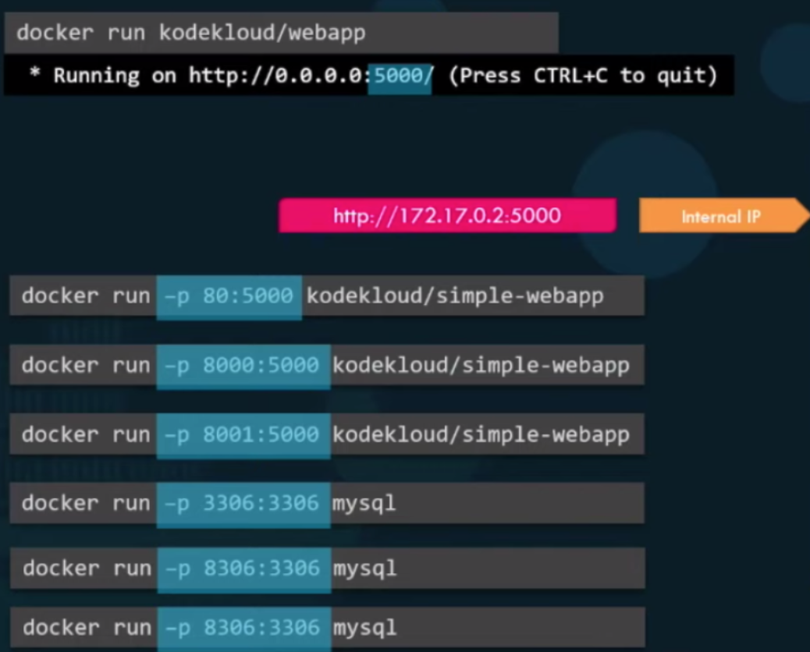
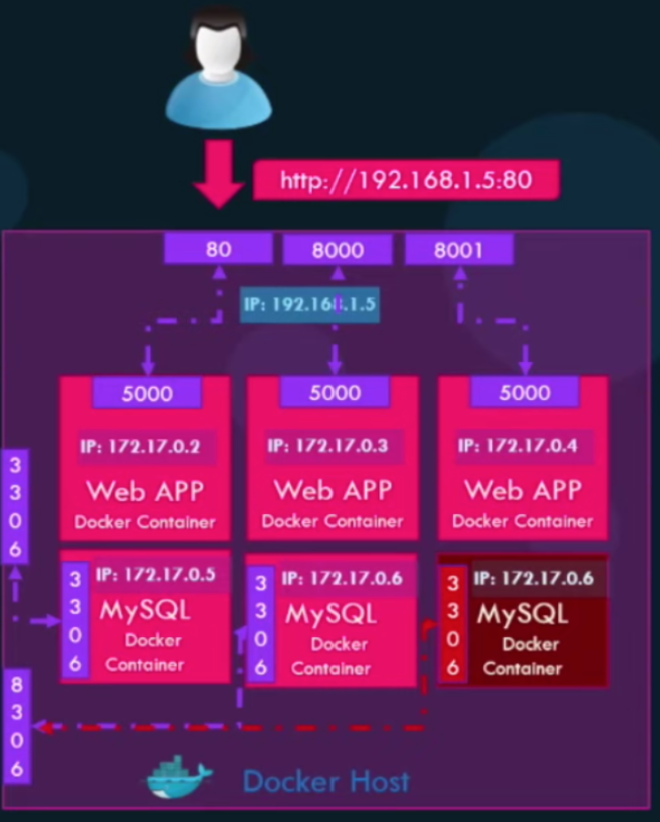
How Containers Talk to Outside World?
Docker Run – Port Mapping
Containers are isolated but how do we talk to them from the outside world?

Slide 24
How Containers Talk to Each Other?
Host network
Container shares host’s network stack.
No isolation between host and container
No separate IP for the container
All ports used by container are directly on host.
No need for -p (port mapping)

Slide 25
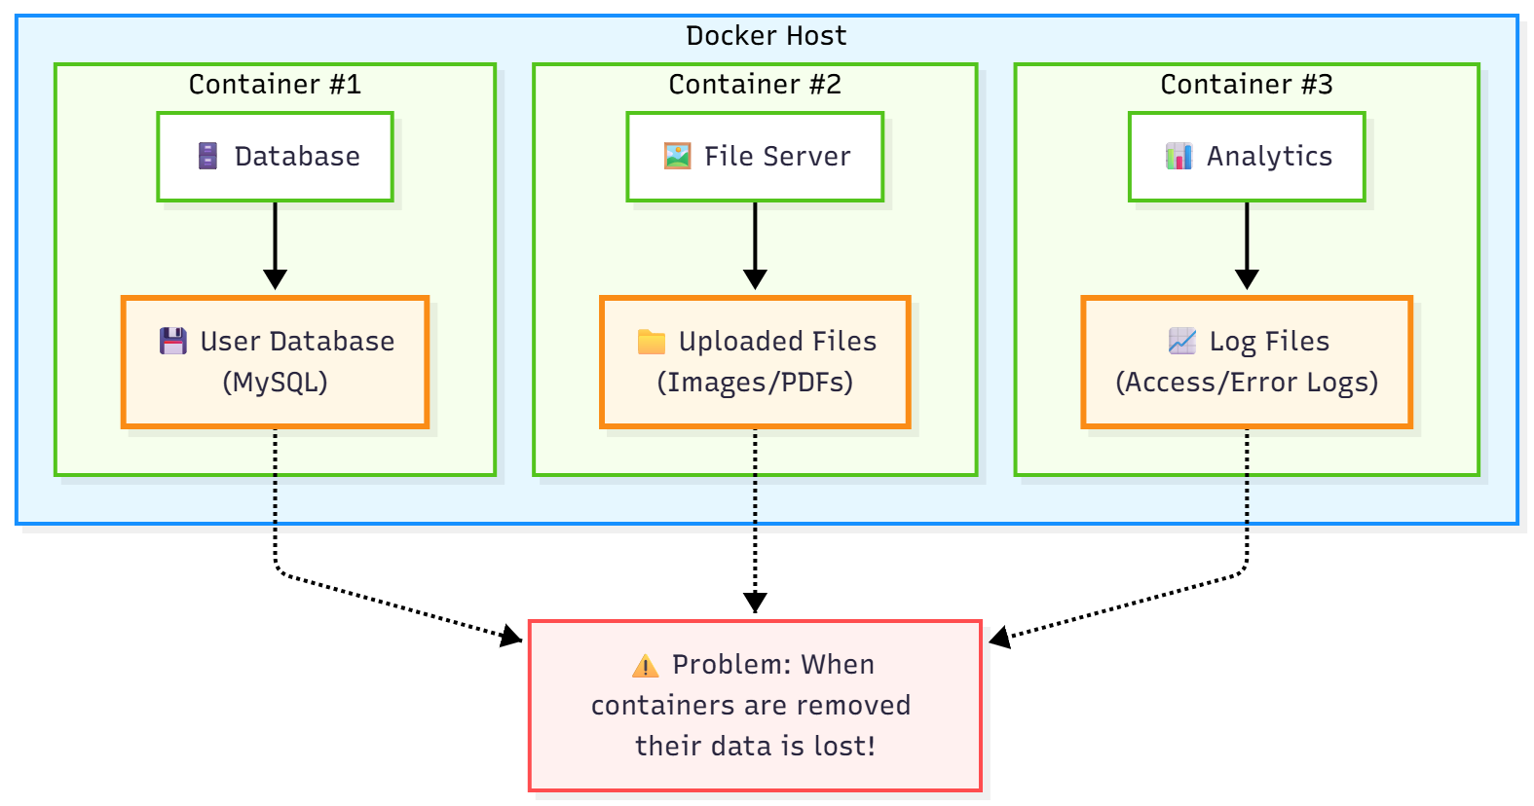
Volumes and Persistent Data
Each container has its own isolated filesystem
Containers are ephemeral: if deleted, internal data is lost
How to Make Container Data Last?
Notes:
graph TB
subgraph DockerHost [Docker Host]
direction LR
subgraph Container1 [Container #1]
App1["🗄️ Database"]
Data1["💾 User Database<br>(MySQL)"]
App1 --> Data1
end
subgraph Container2 [Container #2]
App2["🖼️ File Server"]
Data2["📁 Uploaded Files<br>(Images/PDFs)"]
App2 --> Data2
end
subgraph Container3 [Container #3]
App3["📊 Analytics"]
Data3["📈 Log Files<br>(Access/Error Logs)"]
App3 --> Data3
end
end
ProblemSection["⚠️ Problem: When containers are removed their data is lost!"]
Data1 -.-> ProblemSection
Data2 -.-> ProblemSection
Data3 -.-> ProblemSection
classDef hostStyle fill:#e6f7ff,stroke:#1890ff,stroke-width:2px
classDef containerStyle fill:#f6ffed,stroke:#52c41a,stroke-width:2px
classDef appStyle fill:#ffffff,stroke:#52c41a
classDef dataStyle fill:#fff7e6,stroke:#fa8c16,stroke-width:3px
classDef problemStyle fill:#fff1f0,stroke:#ff4d4f,stroke-width:2px
classDef invisible fill:none,stroke:none
class DockerHost hostStyle
class Container1,Container2,Container3 containerStyle
class App1,App2,App3 appStyle
class Data1,Data2,Data3 dataStyle
class ProblemSection problemStyle
class Invisible1,Invisible2,Space invisible

Slide 26
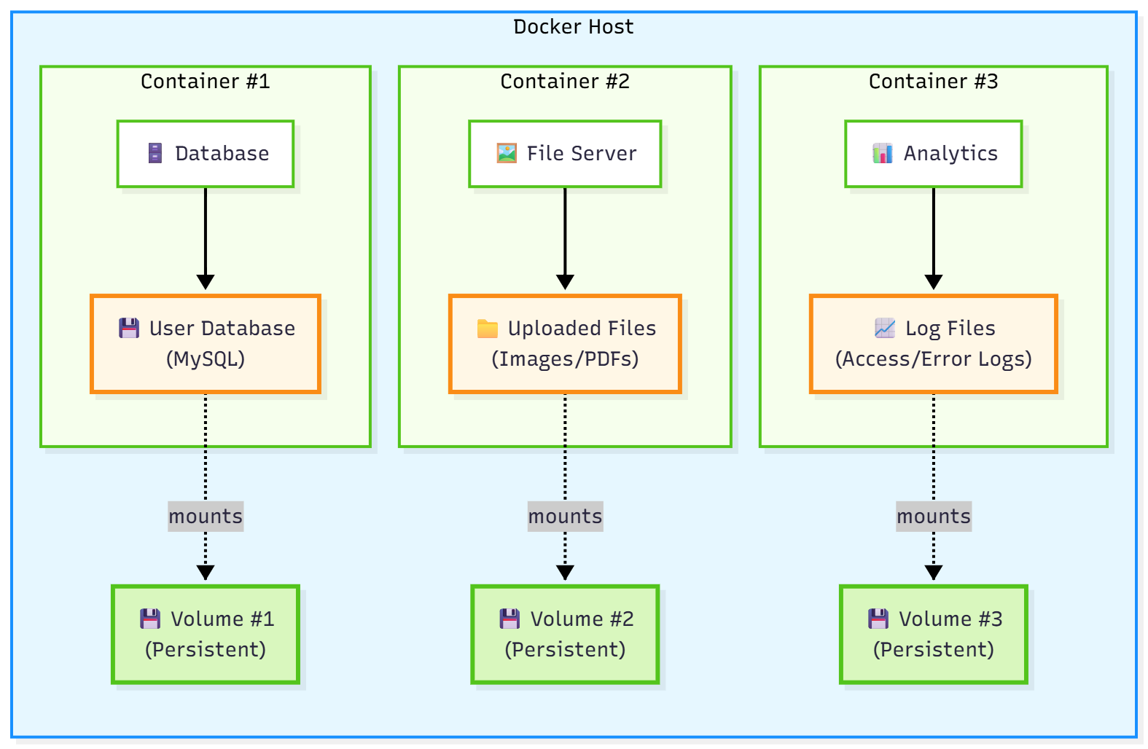
Volumes and Persistent Data
Solution – Docker Volumes
  Separate storage mechanisms that persist data independently of containers
  Stored in a part of the host filesystem which is managed by Docker.
  Can be shared between containers and survive container removal.
Notes:
graph LR
subgraph DockerHost [Docker Host]
subgraph Container1 [Container #1]
direction TB
App1["🗄️ Database"]
Data1["💾 User Database <br>(MySQL)"]
App1 --> Data1
end
subgraph Container2 [Container #2]
direction TB
App2["🖼️ File Server"]
Data2["📁 Uploaded Files <br> (Images/PDFs)"]
App2 --> Data2
end
subgraph Container3 [Container #3]
direction TB
App3["📊 Analytics"]
Data3["📈 Log Files <br> (Access/Error Logs)"]
App3 --> Data3
end
Vol1["💾 Volume #1<br>(Persistent)"]
Vol2["💾 Volume #2<br>(Persistent)"]
Vol3["💾 Volume #3<br>(Persistent)"]
%% subgraph Volumes [Persistent Volumes]
%% direction LR
%% Vol1["💾 Volume #1<br>(Persistent)"]
%% Vol2["💾 Volume #2<br>(Persistent)"]
%% Vol3["💾 Volume #3<br>(Persistent)"]
%% end
end
Data1 -.-> |mounts| Vol1
Data2 -.-> |mounts| Vol2
Data3 -.-> |mounts| Vol3
classDef hostStyle fill:#e6f7ff,stroke:#1890ff,stroke-width:2px
classDef containerStyle fill:#f6ffed,stroke:#52c41a,stroke-width:2px
classDef appStyle fill:#ffffff,stroke:#52c41a
classDef dataStyle fill:#fff7e6,stroke:#fa8c16,stroke-width:3px
classDef volumeStyle fill:#d9f7be,stroke:#52c41a,stroke-width:3px
class DockerHost hostStyle
class Container1,Container2,Container3 containerStyle
class App1,App2,App3 appStyle
class Data1,Data2,Data3 dataStyle
class Vol1,Vol2,Vol3 volumeStyle
class Volumes volumeStyle

Slide 27
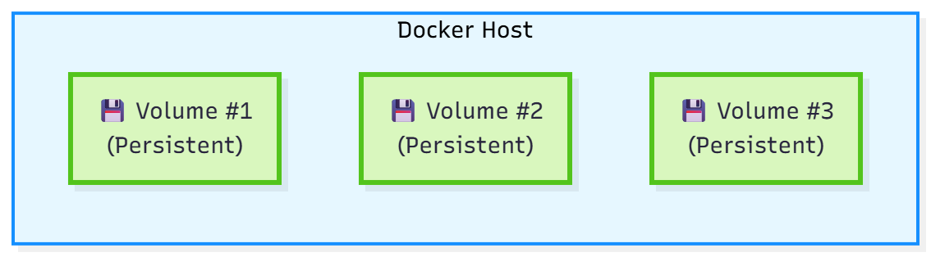
Volumes and Persistent Data
Solution – Docker Volumes
  Volumes persist data even when containers are removed
  Stored in a part of the host filesystem which is managed by Docker.
  Can be shared between containers and survive container removal.
Notes:
graph LR
subgraph DockerHost [Docker Host]
subgraph Container1 [Container #1]
direction TB
App1["🗄️ Database"]
Data1["💾 User Database <br>(MySQL)"]
App1 --> Data1
end
subgraph Container2 [Container #2]
direction TB
App2["🖼️ File Server"]
Data2["📁 Uploaded Files <br> (Images/PDFs)"]
App2 --> Data2
end
subgraph Container3 [Container #3]
direction TB
App3["📊 Analytics"]
Data3["📈 Log Files <br> (Access/Error Logs)"]
App3 --> Data3
end
Vol1["💾 Volume #1<br>(Persistent)"]
Vol2["💾 Volume #2<br>(Persistent)"]
Vol3["💾 Volume #3<br>(Persistent)"]
%% subgraph Volumes [Persistent Volumes]
%% direction LR
%% Vol1["💾 Volume #1<br>(Persistent)"]
%% Vol2["💾 Volume #2<br>(Persistent)"]
%% Vol3["💾 Volume #3<br>(Persistent)"]
%% end
end
Data1 -.-> |mounts| Vol1
Data2 -.-> |mounts| Vol2
Data3 -.-> |mounts| Vol3
classDef hostStyle fill:#e6f7ff,stroke:#1890ff,stroke-width:2px
classDef containerStyle fill:#f6ffed,stroke:#52c41a,stroke-width:2px
classDef appStyle fill:#ffffff,stroke:#52c41a
classDef dataStyle fill:#fff7e6,stroke:#fa8c16,stroke-width:3px
classDef volumeStyle fill:#d9f7be,stroke:#52c41a,stroke-width:3px
class DockerHost hostStyle
class Container1,Container2,Container3 containerStyle
class App1,App2,App3 appStyle
class Data1,Data2,Data3 dataStyle
class Vol1,Vol2,Vol3 volumeStyle
class Volumes volumeStyle

Slide 28
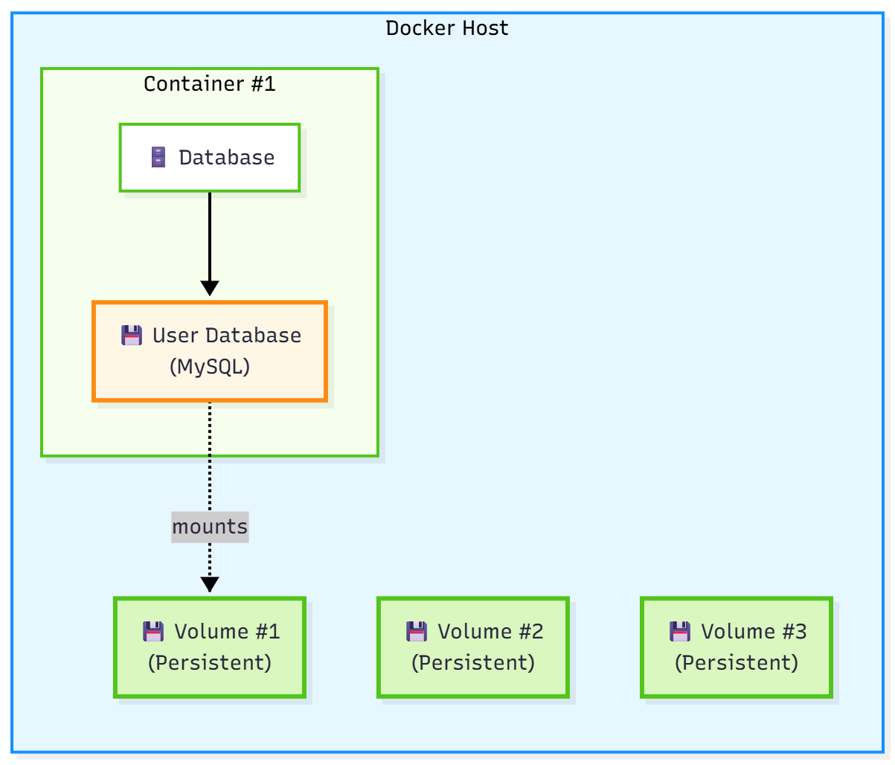
Volumes and Persistent Data
Solution – Docker Volumes
  New container can mount to the same volume and access all the data that was previously stored
Notes:
graph LR
subgraph DockerHost [Docker Host]
subgraph Container1 [Container #1]
direction TB
App1["🗄️ Database"]
Data1["💾 User Database <br>(MySQL)"]
App1 --> Data1
end
subgraph Container2 [Container #2]
direction TB
App2["🖼️ File Server"]
Data2["📁 Uploaded Files <br> (Images/PDFs)"]
App2 --> Data2
end
subgraph Container3 [Container #3]
direction TB
App3["📊 Analytics"]
Data3["📈 Log Files <br> (Access/Error Logs)"]
App3 --> Data3
end
Vol1["💾 Volume #1<br>(Persistent)"]
Vol2["💾 Volume #2<br>(Persistent)"]
Vol3["💾 Volume #3<br>(Persistent)"]
%% subgraph Volumes [Persistent Volumes]
%% direction LR
%% Vol1["💾 Volume #1<br>(Persistent)"]
%% Vol2["💾 Volume #2<br>(Persistent)"]
%% Vol3["💾 Volume #3<br>(Persistent)"]
%% end
end
Data1 -.-> |mounts| Vol1
Data2 -.-> |mounts| Vol2
Data3 -.-> |mounts| Vol3
classDef hostStyle fill:#e6f7ff,stroke:#1890ff,stroke-width:2px
classDef containerStyle fill:#f6ffed,stroke:#52c41a,stroke-width:2px
classDef appStyle fill:#ffffff,stroke:#52c41a
classDef dataStyle fill:#fff7e6,stroke:#fa8c16,stroke-width:3px
classDef volumeStyle fill:#d9f7be,stroke:#52c41a,stroke-width:3px
class DockerHost hostStyle
class Container1,Container2,Container3 containerStyle
class App1,App2,App3 appStyle
class Data1,Data2,Data3 dataStyle
class Vol1,Vol2,Vol3 volumeStyle
class Volumes volumeStyle

Slide 29
Docker Volumes – Named Volumes
Managed by Docker and stored in a specific location on the host.
  Volumes are stored under /var/lib/docker/volumes/
Recommended approach for most use cases.
  Why?, will see later insha’Allah
Step1: Create docker volume
docker volume create <vol-name>
docker volume create db-data
Step2: Mount the volume to the container
–v <vol-name>:<target-path-on-container>
docker run -v db-data:/var/lib/mysql mariadb

Slide 30
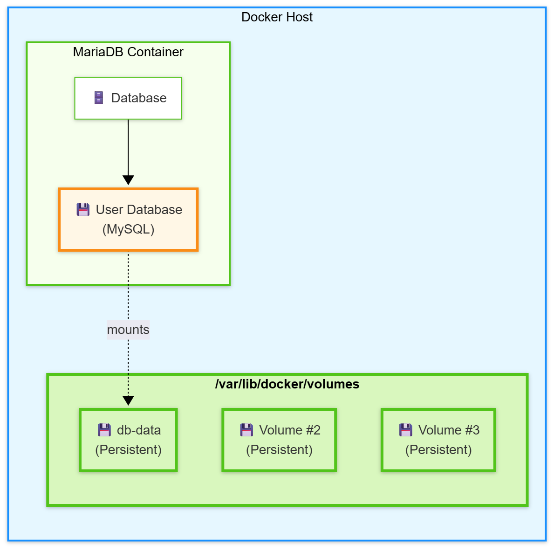
Docker Volumes – Named Volumes
Notes:
graph LR
subgraph DockerHost [Docker Host]
subgraph Container1 [MariaDB Container]
direction TB
App1["🗄️ Database"]
Data1["💾 User Database <br>(MySQL)"]
App1 --> Data1
end
%% subgraph Container2 [Container #2]
%% direction TB
%% App2["🖼️ File Server"]
%% Data2["📁 Uploaded Files <br> (Images/PDFs)"]
%% App2 --> Data2
%% end
%% subgraph Container3 [Container #3]
%% direction TB
%% App3["📊 Analytics"]
%% Data3["📈 Log Files <br> (Access/Error Logs)"]
%% App3 --> Data3
%% end
%% Vol1["💾 Volume #1<br>(Persistent)"]
%% Vol2["💾 Volume #2<br>(Persistent)"]
%% Vol3["💾 Volume #3<br>(Persistent)"]
subgraph Volumes ["<b>/var/lib/docker/volumes</b>"]
direction LR
Vol1["💾 db-data<br>(Persistent)"]
Vol2["💾 Volume #2<br>(Persistent)"]
Vol3["💾 Volume #3<br>(Persistent)"]
end
end
Data1 -.-> |mounts| Vol1
%% Data2 -.-> |mounts| Vol2
%% Data3 -.-> |mounts| Vol3
classDef hostStyle fill:#e6f7ff,stroke:#1890ff,stroke-width:2px
classDef containerStyle fill:#f6ffed,stroke:#52c41a,stroke-width:2px
classDef appStyle fill:#ffffff,stroke:#52c41a
classDef dataStyle fill:#fff7e6,stroke:#fa8c16,stroke-width:3px
classDef volumeStyle fill:#d9f7be,stroke:#52c41a,stroke-width:3px
class DockerHost hostStyle
class Container1,Container2,Container3 containerStyle
class App1,App2,App3 appStyle
class Data1,Data2,Data3 dataStyle
class Vol1,Vol2,Vol3 volumeStyle
class Volumes volumeStyle

Slide 31
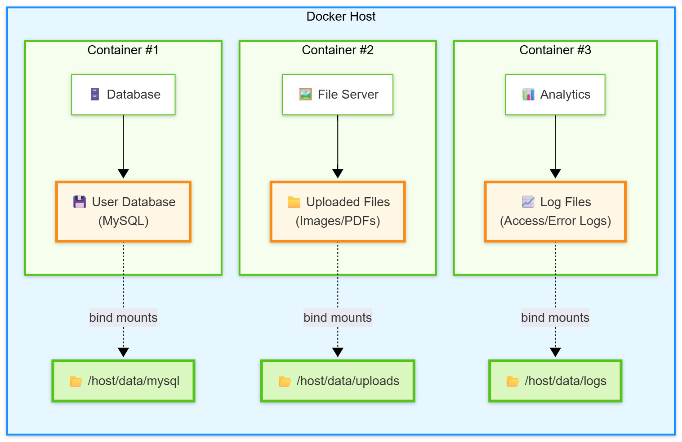
Docker Volumes – Bind Mounts
Map a specific file or directory on the host to a location in the container.
docker run -v /host/data/mysql:/var/lib/mysql mariadb
Give direct access to host files
Notes:
graph LR
subgraph DockerHost [Docker Host]
subgraph Container1 [Container #1]
direction TB
App1["🗄️ Database"]
Data1["💾 User Database <br>(MySQL)"]
App1 --> Data1
end
subgraph Container2 [Container #2]
direction TB
App2["🖼️ File Server"]
Data2["📁 Uploaded Files <br> (Images/PDFs)"]
App2 --> Data2
end
subgraph Container3 [Container #3]
direction TB
App3["📊 Analytics"]
Data3["📈 Log Files <br> (Access/Error Logs)"]
App3 --> Data3
end
Bind1["📂 /host/data/mysql"]
Bind2["📂 /host/data/uploads"]
Bind3["📂 /host/data/logs"]
end
Data1 -.-> |bind mounts| Bind1
Data2 -.-> |bind mounts| Bind2
Data3 -.-> |bind mounts| Bind3
classDef hostStyle fill:#e6f7ff,stroke:#1890ff,stroke-width:2px
classDef containerStyle fill:#f6ffed,stroke:#52c41a,stroke-width:2px
classDef appStyle fill:#ffffff,stroke:#52c41a
classDef dataStyle fill:#fff7e6,stroke:#fa8c16,stroke-width:3px
classDef bindMountStyle fill:#d9f7be,stroke:#52c41a,stroke-width:3px
class DockerHost hostStyle
class Container1,Container2,Container3 containerStyle
class App1,App2,App3 appStyle
class Data1,Data2,Data3 dataStyle
class Bind1,Bind2,Bind3 bindMountStyle

Slide 32
When to Use Named vs Bind Mount Volumes?
Use Named Volumes for Persistent Data
  Persistent storage across container restarts or rebuilds
  Databases (e.g., Postgres, MySQL) storing internal data files
  Logs, backups, and other runtime data that needs to be saved
  Migrating data between containers or environments
  Avoiding tight coupling to host filesystem structure
Why?

Slide 33
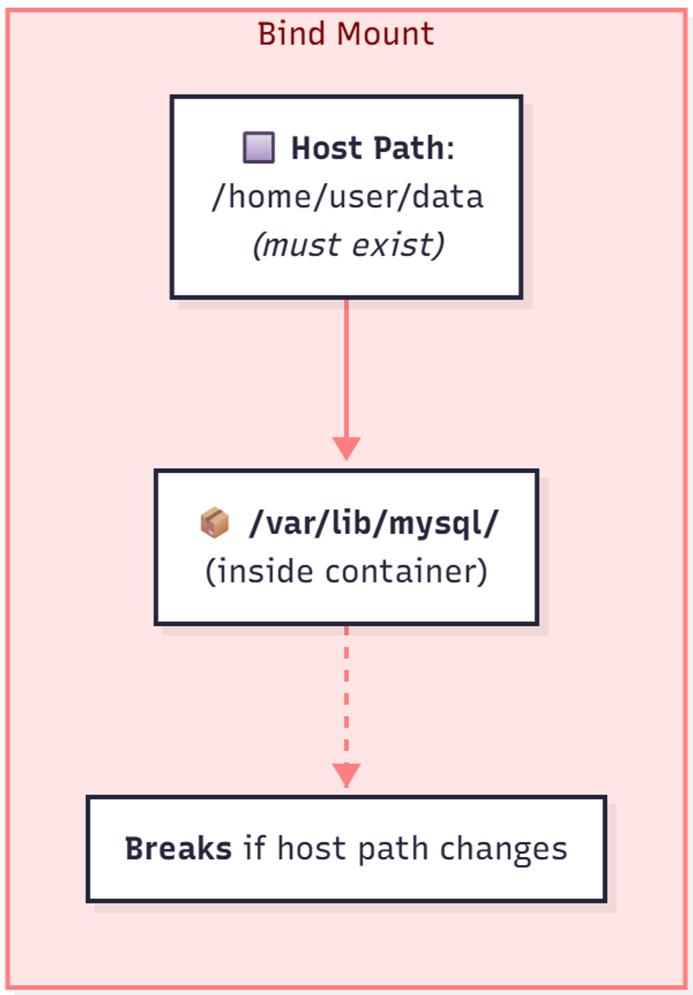
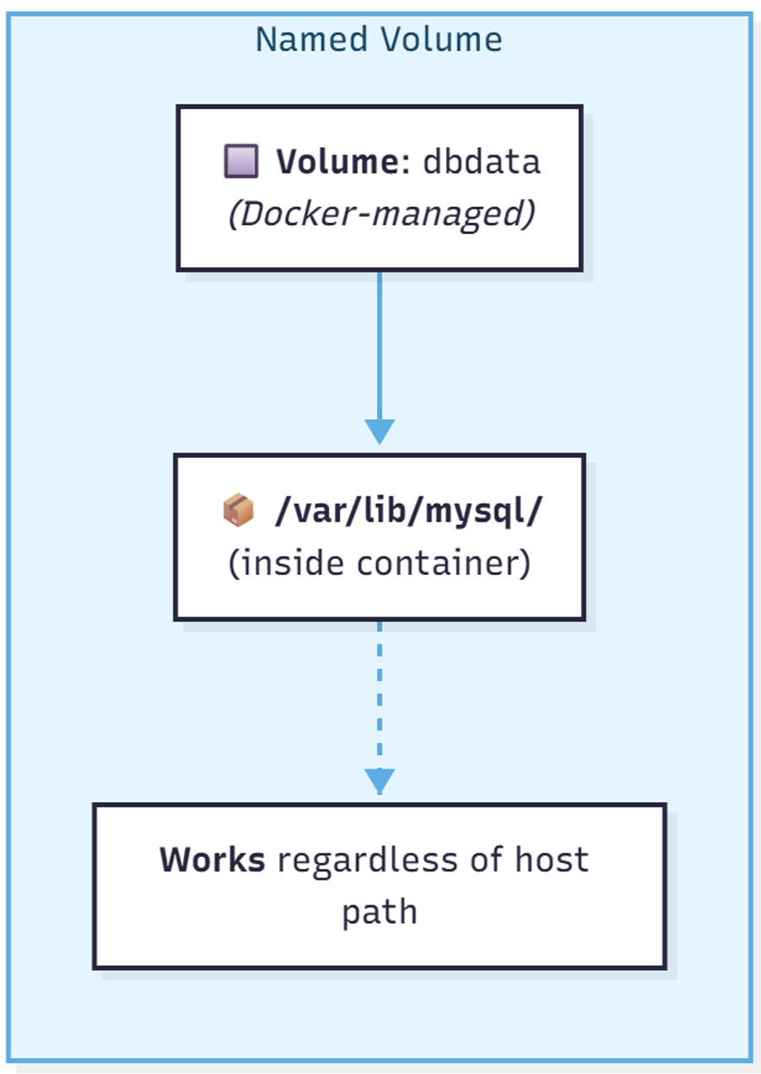
Use of Named vs Bind Mount Volumes?
Use Named Volumes for Persistent Data
Host Path Dependency
Notes:
flowchart LR
%% Nodes
subgraph bind[Bind Mount]
A1["🔲 <b>Host Path</b>:<br>/home/user/data<br><i>(must exist)</i>"]
A2["📦 <b>/var/lib/mysql/</b><br>(inside container)"]
A3[" <b>Breaks</b> if host path changes"]
end
subgraph volume[Named Volume]
B1["🔲 <b>Volume</b>: dbdata<br><i>(Docker-managed)</i>"]
B2["📦 <b>/var/lib/mysql/</b><br>(inside container)"]
B3[" <b>Works</b> regardless of host path"]
end
%% Arrows
A1 --> A2
A2 --> A3
B1 --> B2
B2 --> B3
%% Styling
classDef bind fill:#ffe5e5,stroke:#ff7f7f,color:#800000
classDef volume fill:#e5f5ff,stroke:#5dade2,color:#154360
class bind bind
class volume volume
%% Labels
linkStyle 0 stroke:#ff7f7f,stroke-width:2px
linkStyle 1 stroke:#ff7f7f,stroke-width:2px,stroke-dasharray: 5, 5
linkStyle 2 stroke:#5dade2,stroke-width:2px
linkStyle 3 stroke:#5dade2,stroke-width:2px,stroke-dasharray: 5, 5

Slide 34
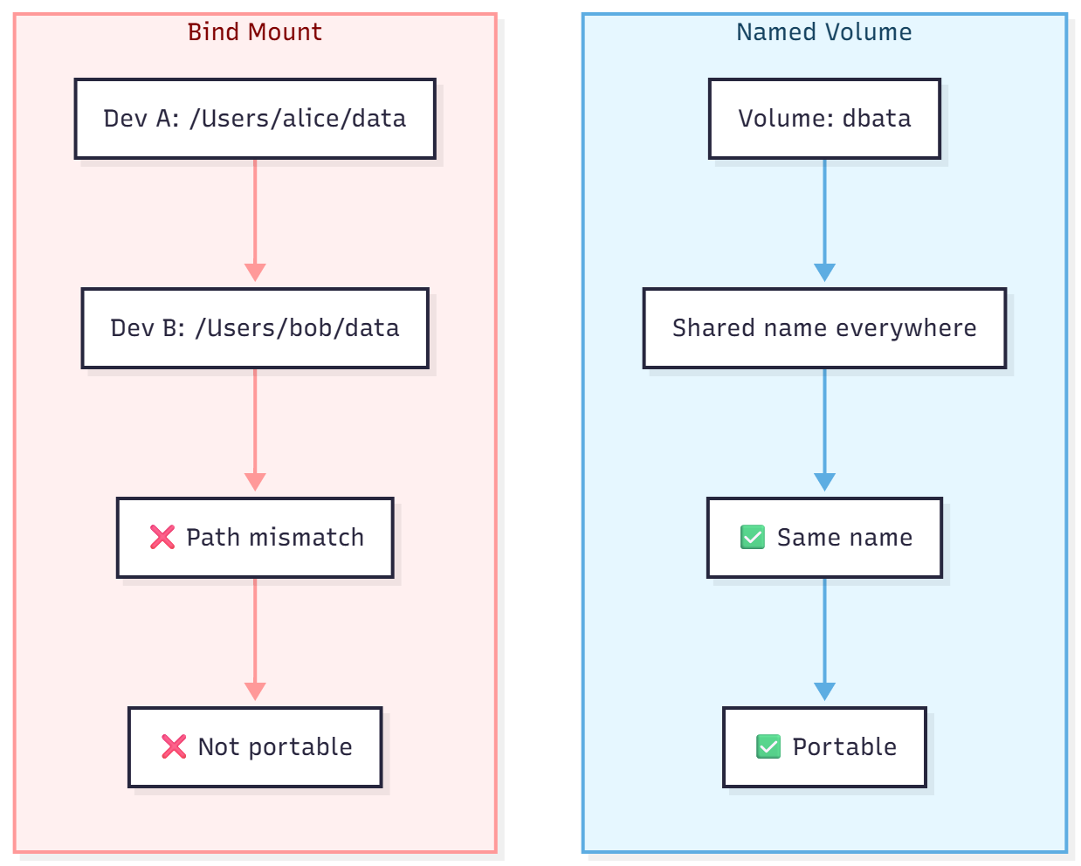
Use of Named vs Bind Mount Volumes?
Use Named Volumes for Persistent Data
Portability Across Environments
Notes:
flowchart LR
%% Bind Mount Cluster
subgraph bind["Bind Mount"]
direction TB
A1["Dev A: /Users/alice/data"]
A2["Dev B: /Users/bob/data"]
A3["❌ Path mismatch"]
A4["❌ Not portable"]
A1 --> A2 --> A3 --> A4
end
%% Named Volume Cluster
subgraph volume["Named Volume"]
direction TB
B1["Volume: dbata"]
B2["Shared name everywhere"]
B3["✅ Same name"]
B4["✅ Portable"]
B1 --> B2 --> B3 --> B4
end
%% Keep subgraphs side by side
bind --- volume
%% Styling
classDef bind fill:#fff0f0,stroke:#ff9999,color:#800000
classDef volume fill:#e6f7ff,stroke:#5dade2,color:#154360
class bind bind
class volume volume
%% Link styles
linkStyle 0 stroke:#ff9999,stroke-width:2px
linkStyle 1 stroke:#ff9999,stroke-width:2px
linkStyle 2 stroke:#ff9999,stroke-width:2px
linkStyle 3 stroke:#5dade2,stroke-width:2px
linkStyle 4 stroke:#5dade2,stroke-width:2px
linkStyle 5 stroke:#5dade2,stroke-width:2px
linkStyle 6 stroke:#fff,stroke-width:2px

Slide 35
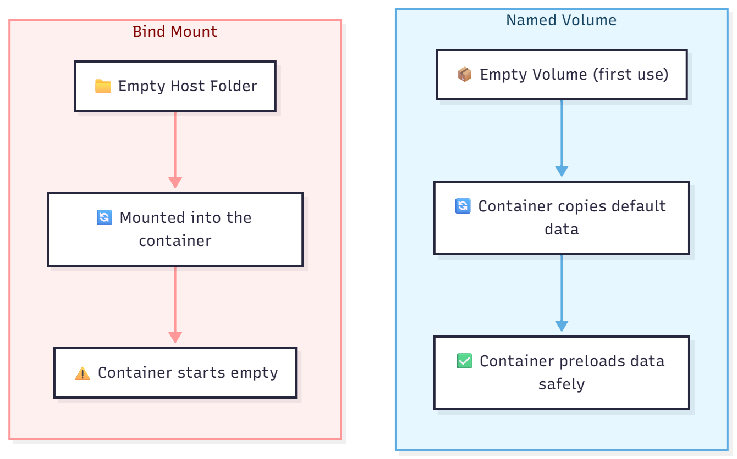
Use of Named vs Bind Mount Volumes?
Use Named Volumes for Persistent Data
Risk of Overwriting Data
Notes:
flowchart LR
%% Bind Mount Cluster
subgraph bind["Bind Mount"]
direction TB
A1["📁 Empty Host Folder"]
A2["🔄 Mounted into container"]
A3["⚠️ Container starts empty"]
A1 --> A2 --> A3
end
%% Named Volume Cluster
subgraph volume["Named Volume"]
direction TB
B1["📦 Empty Volume (first use)"]
B2["🔄 Container copies default data"]
B3["✅ Container preloads data safely"]
B1 --> B2 --> B3
end
%% Keep subgraphs side by side
bind --- volume
%% Styling
classDef bind fill:#fff0f0,stroke:#ff9999,color:#800000
classDef volume fill:#e6f7ff,stroke:#5dade2,color:#154360
class bind bind
class volume volume
%% Link styles
linkStyle 0 stroke:#ff9999,stroke-width:2px
linkStyle 1 stroke:#ff9999,stroke-width:2px
linkStyle 2 stroke:#5dade2,stroke-width:2px
linkStyle 3 stroke:#5dade2,stroke-width:2px
linkStyle 4 stroke:#fff,stroke-width:2px

Slide 36
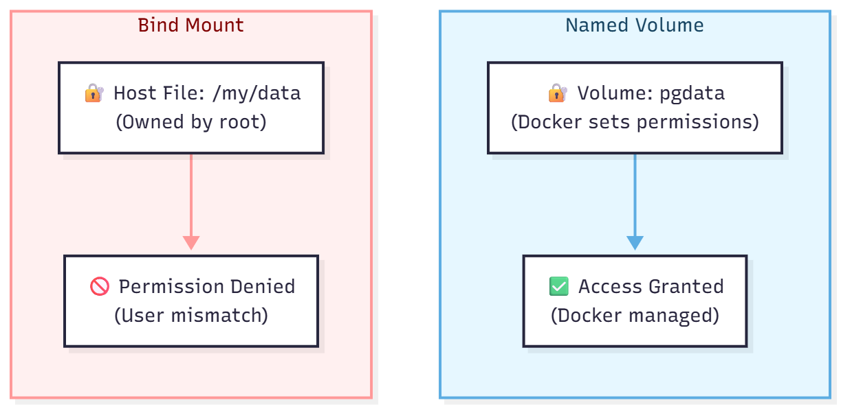
Use of Named vs Bind Mount Volumes?
Use Named Volumes for Persistent Data
Permission Management
Notes:
flowchart LR
%% Bind Mount Cluster
subgraph bind["Bind Mount"]
direction TB
A1["🔐 Host File: /my/data<br>(Owned by root)"]
A2["🚫 Permission Denied<br>(User mismatch)"]
A1 --> A2
end
%% Named Volume Cluster
subgraph volume["Named Volume"]
direction TB
B1["🔐 Volume: pgdata<br>(Docker sets permissions)"]
B2["✅ Access Granted<br>(Docker managed)"]
B1 --> B2
end
%% Invisible link to keep them side-by-side
bind --- volume
%% Styling
classDef bind fill:#fff0f0,stroke:#ff9999,color:#800000
classDef volume fill:#e6f7ff,stroke:#5dade2,color:#154360
class bind bind
class volume volume
%% Link styles
linkStyle 0 stroke:#ff9999,stroke-width:2px
linkStyle 1 stroke:#5dade2,stroke-width:2px
linkStyle 2 stroke:#fff,stroke-width:2px

Slide 37
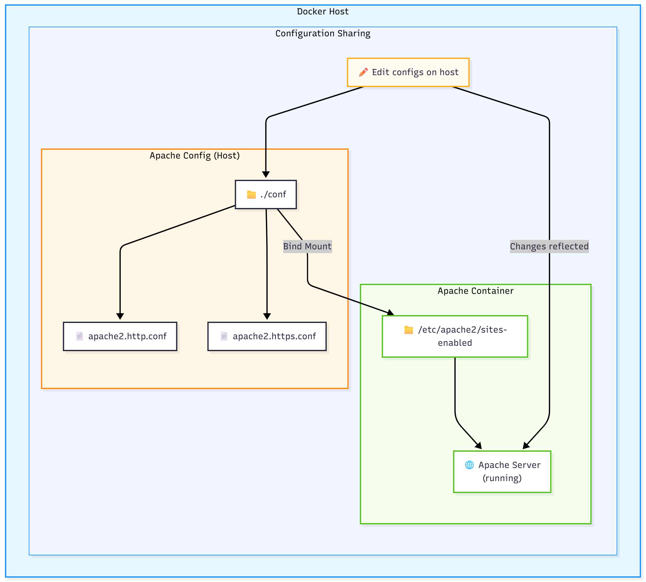
When to Use Named vs Bind Mount Volumes?
Use Bind mounts for:
Sharing config files, source code, or other data between the host and container that must sync in real time
Notes:
graph TB
subgraph DockerHost [Docker Host]
subgraph ConfigSetup [Configuration Sharing]
subgraph HostConfig ["Apache Config (Host)"]
ConfFolder["📁 ./conf"]
HttpConf["📄 apache2.http.conf"]
HttpsConf["📄 apache2.https.conf"]
ConfFolder --> HttpConf
ConfFolder --> HttpsConf
end
subgraph WebContainer [Apache Container]
SitesEnabled["📁 /etc/apache2/sites-enabled"]
ApacheServer["🌐 Apache Server<br>(running)"]
SitesEnabled --> ApacheServer
end
ConfFolder -- "Bind Mount" --> SitesEnabled
Edit["✏️ Edit configs on host"]
Edit --> ConfFolder
Edit -->|"Changes reflected"| ApacheServer
end
end
classDef hostStyle fill:#e6f7ff,stroke:#1890ff,stroke-width:2px
classDef configStyle fill:#f0f5ff,stroke:#1890ff,stroke-width:1px
classDef containerStyle fill:#f6ffed,stroke:#52c41a,stroke-width:2px
classDef sourceStyle fill:#fff7e6,stroke:#fa8c16,stroke-width:2px
classDef appStyle fill:#ffffff,stroke:#52c41a
classDef editStyle fill:#fffbf0,stroke:#faad14,stroke-width:2px
class DockerHost hostStyle
class ConfigSetup configStyle
class WebContainer containerStyle
class HostConfig sourceStyle
class SitesEnabled,ApacheServer appStyle
class Edit editStyle

Slide 38
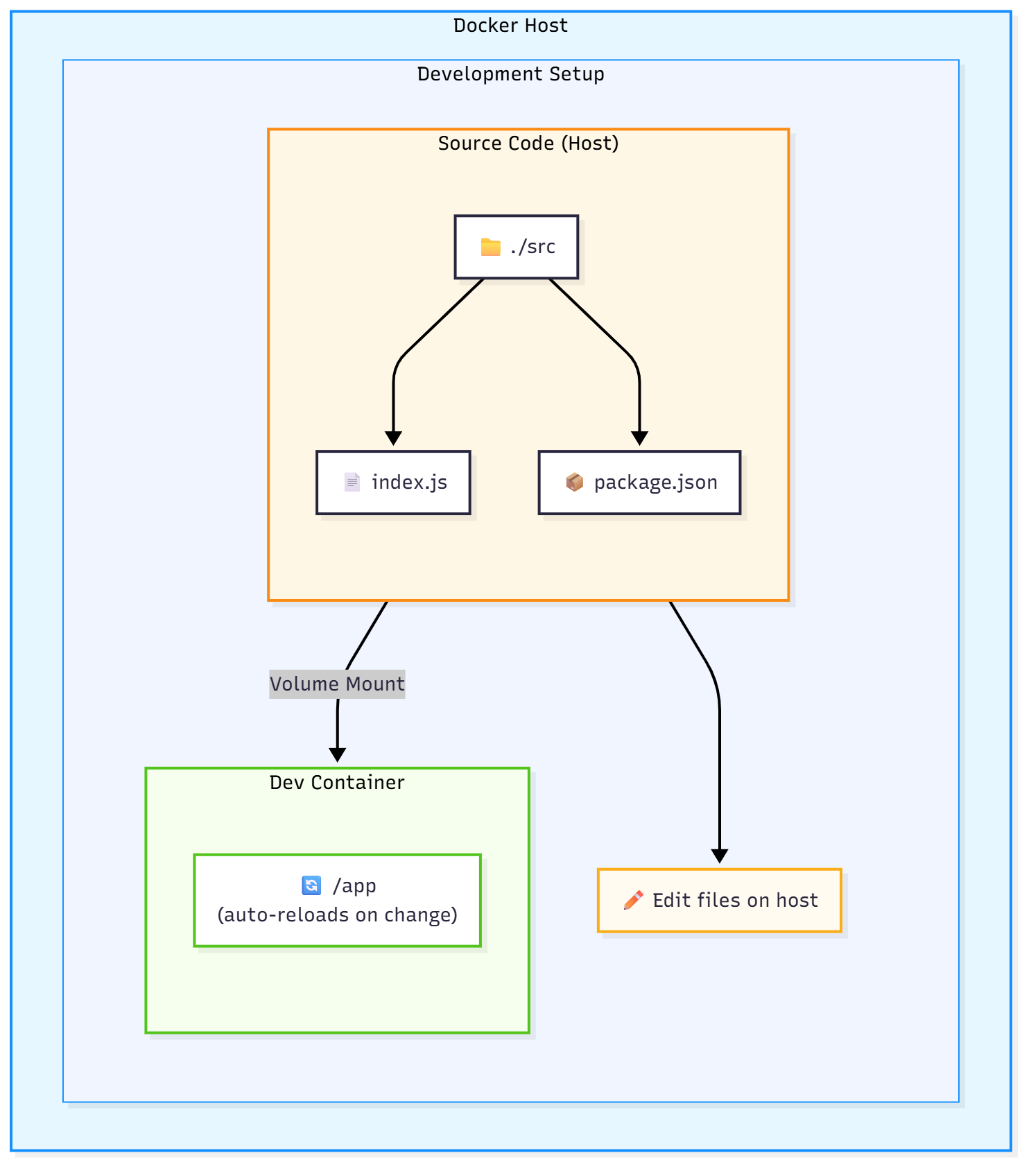
When to Use Named vs Bind Mount Volumes?
Use Bind mounts for:
Sharing config files, source code, or other data between the host and container that must sync in real time
Notes:
graph TB
subgraph DockerHost [Docker Host]
subgraph DevSetup [Development Setup]
subgraph HostSource ["Source Code (Host)"]
Src["📁 ./src"]
Index["📄 index.js"]
Package["📦 package.json"]
Src --> Index
Src --> Package
end
subgraph DevContainer [Dev Container]
App["🔄 /app<br>(auto-reloads on change)"]
end
HostSource -- "Volume Mount" --> DevContainer
Edit["✏️ Edit files on host"]
HostSource --> Edit
end
end
classDef hostStyle fill:#e6f7ff,stroke:#1890ff,stroke-width:2px
classDef devSetupStyle fill:#f0f5ff,stroke:#1890ff,stroke-width:1px
classDef containerStyle fill:#f6ffed,stroke:#52c41a,stroke-width:2px
classDef sourceStyle fill:#fff7e6,stroke:#fa8c16,stroke-width:2px
classDef appStyle fill:#ffffff,stroke:#52c41a
classDef editStyle fill:#fffbf0,stroke:#faad14,stroke-width:2px
class DockerHost hostStyle
class DevSetup devSetupStyle
class DevContainer containerStyle
class HostSource sourceStyle
class App appStyle
class Edit editStyle

Slide 39
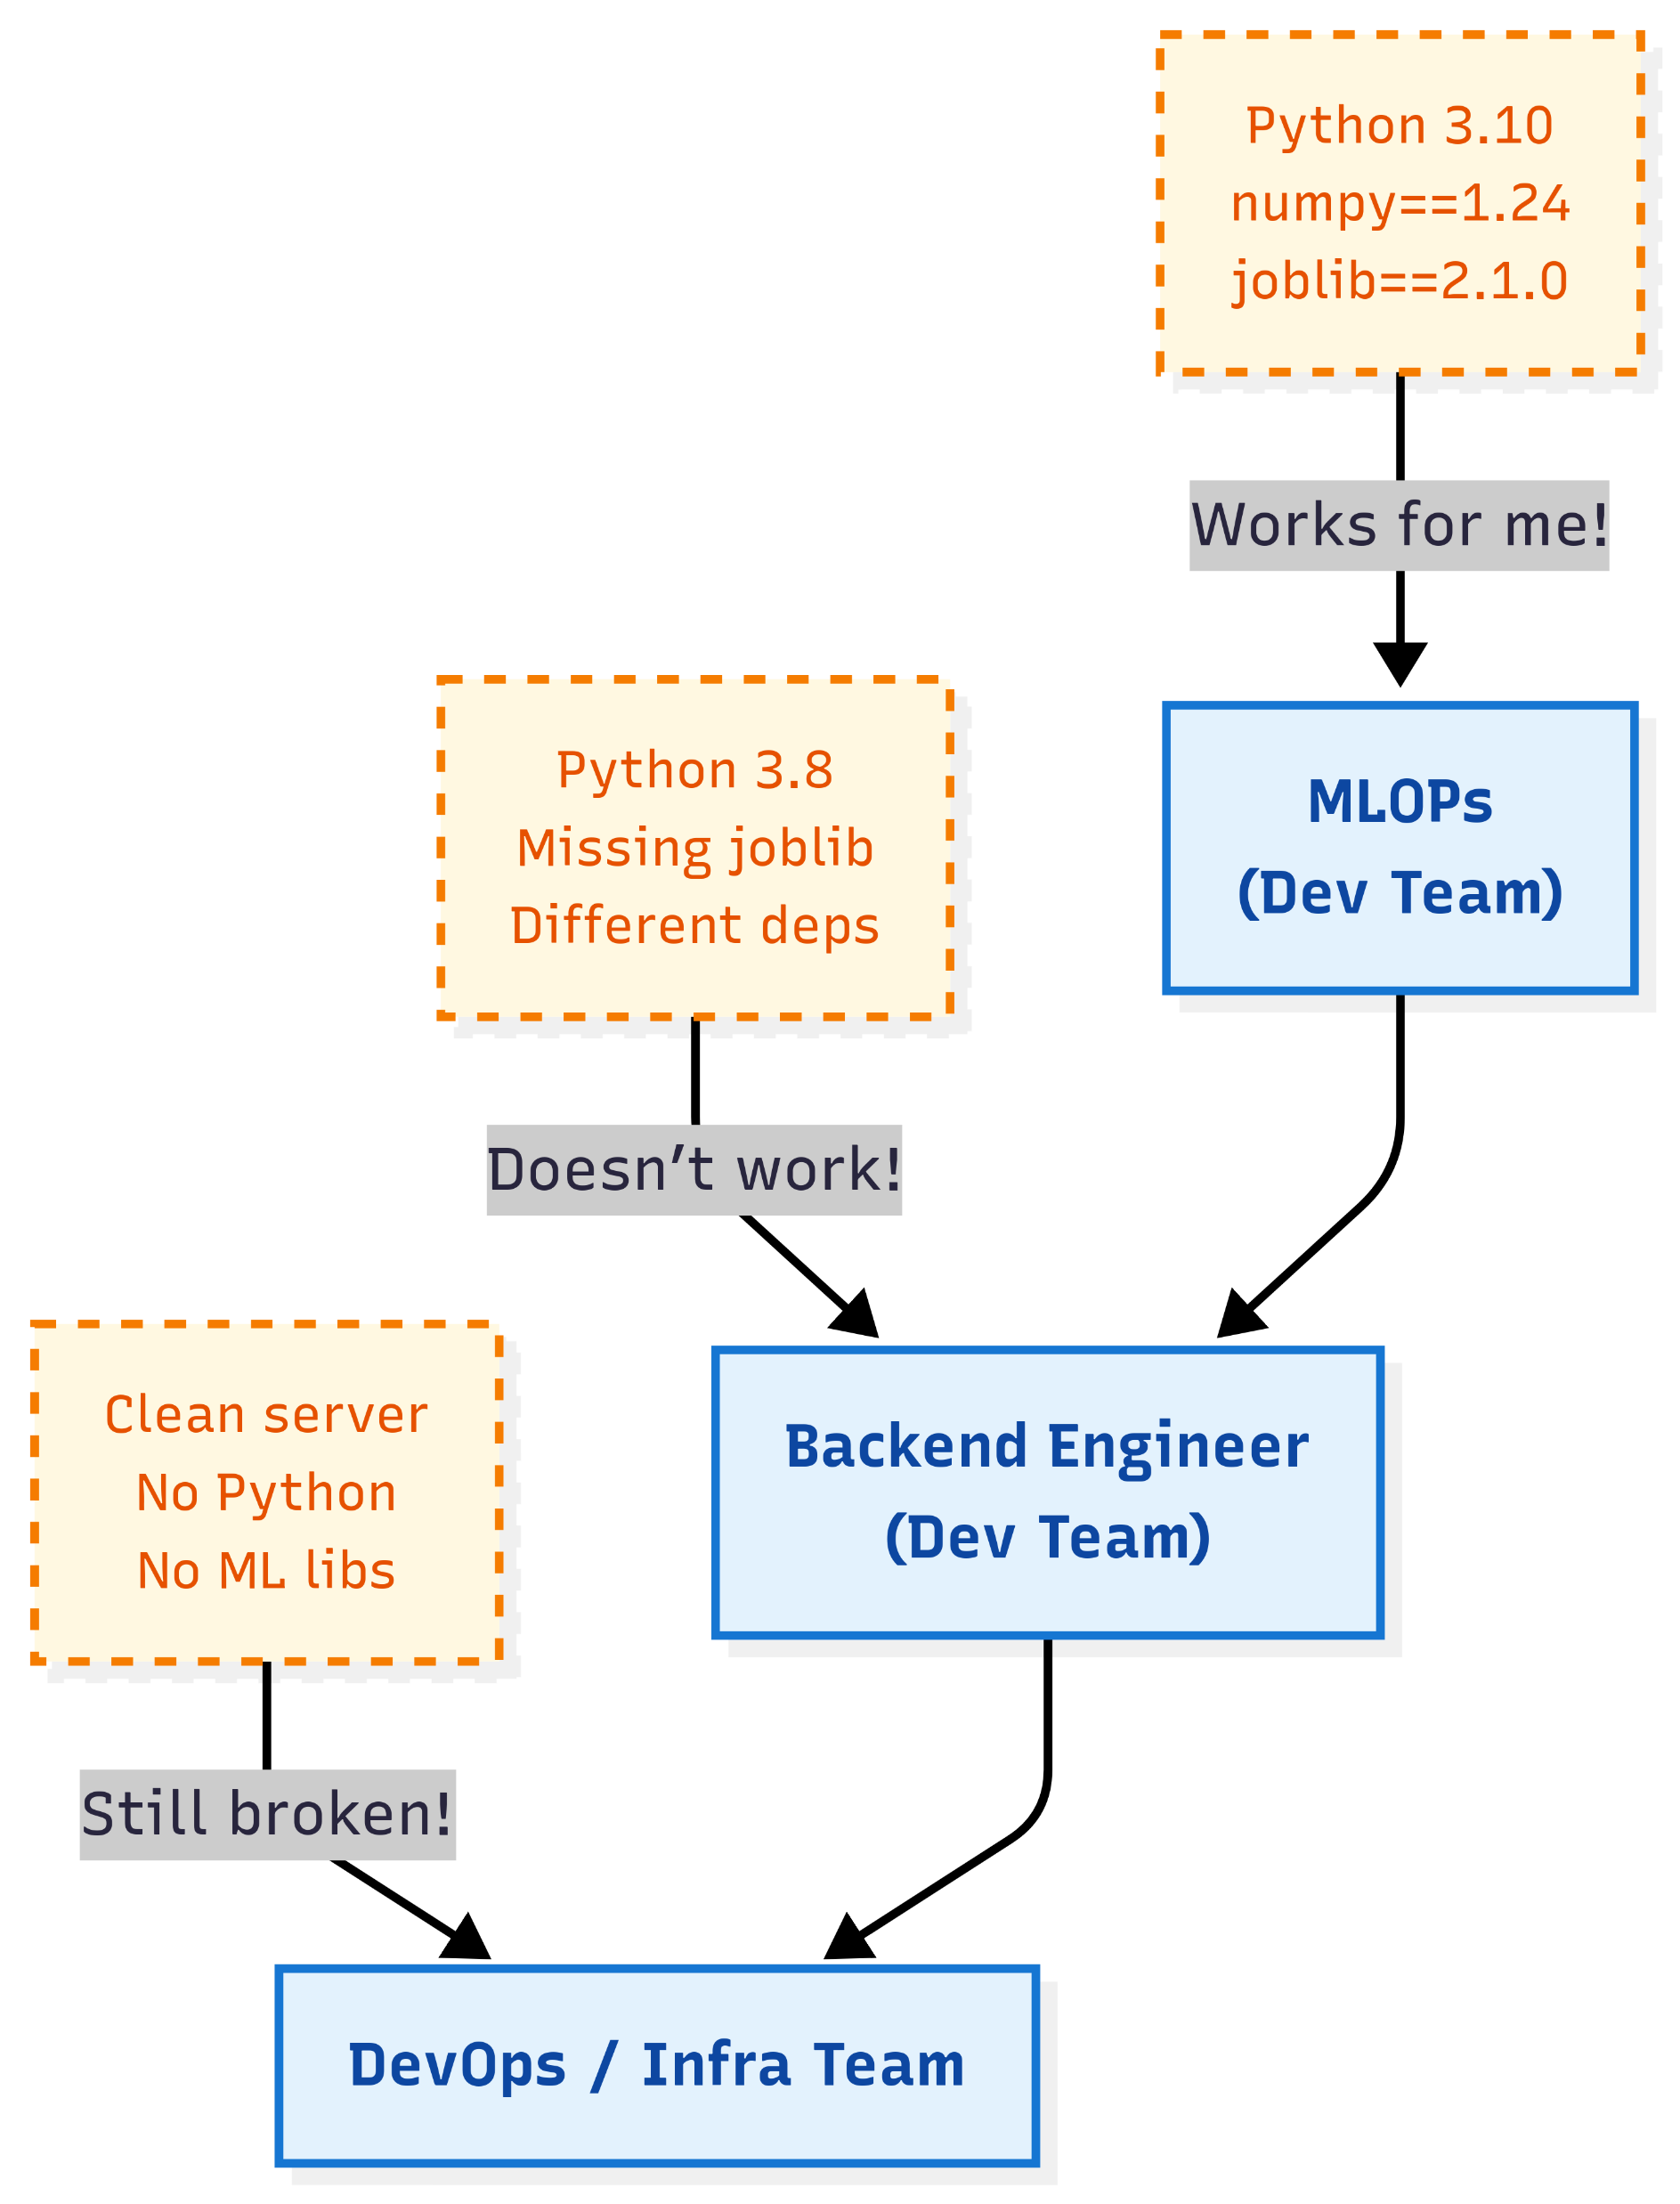
Remember – Sharing the App
Because environment mismatch across teams that leads to unreliable reproducibility.
Traditional application deployment on a host - sharing host OS libraries and resources
Need: A self-contained, portable runtime.
Notes:
Imagine a web application with:
A frontend that users interact with.
A backend that processes requests.
A database storing sensitive information.
Trusted components:
Your backend server and database (assuming they are secure and under your control).
Untrusted components:
The user input from forms.
Any data from third-party APIs.
Requests from the internet.
You design the system assuming that untrusted components could be malicious, and you sanitize, validate, or sandbox them accordingly.
For instance, if a user submits a comment, the backend should not trust it. It should escape HTML to prevent XSS (cross-site scripting).
The trust boundary is between the server and the clients.

Slide 40
Now we Know – Docker
Can package everything
  Package code + dependencies + environment into an image
  Runs consistently everywhere (laptop, cloud, production)
How do we package app or service as an image?
Notes:
Imagine a web application with:
A frontend that users interact with.
A backend that processes requests.
A database storing sensitive information.
Trusted components:
Your backend server and database (assuming they are secure and under your control).
Untrusted components:
The user input from forms.
Any data from third-party APIs.
Requests from the internet.
You design the system assuming that untrusted components could be malicious, and you sanitize, validate, or sandbox them accordingly.
For instance, if a user submits a comment, the backend should not trust it. It should escape HTML to prevent XSS (cross-site scripting).
The trust boundary is between the server and the clients.

Slide 41
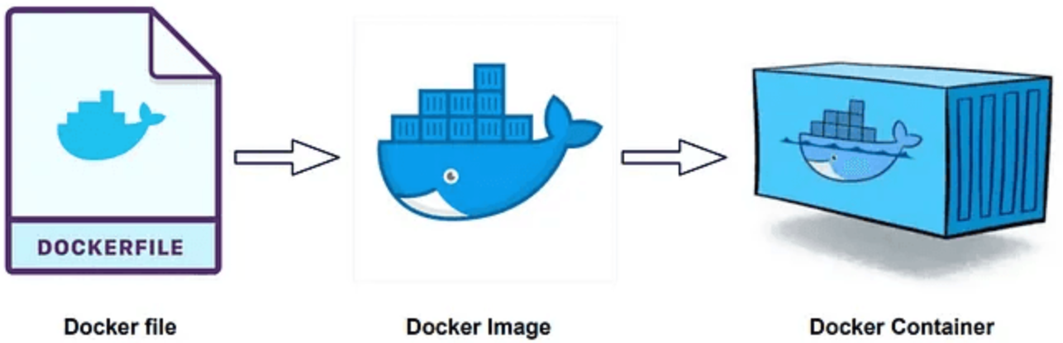
Creating Docker Images
Dockerfile – The Blueprint
  Defines how to build a Docker image
  Contains step-by-step instructions
Image – The Application Package
  Built from a Dockerfile
  Immutable (read-only) snapshot of app + environment
  Think of it as a template or base for containers
Container – The Running Instance
  A live instance created from an image
  Adds a writable layer on top of the image
  Isolated, portable, and runs just like any other process
Notes:
Imagine a web application with:
A frontend that users interact with.
A backend that processes requests.
A database storing sensitive information.
Trusted components:
Your backend server and database (assuming they are secure and under your control).
Untrusted components:
The user input from forms.
Any data from third-party APIs.
Requests from the internet.
You design the system assuming that untrusted components could be malicious, and you sanitize, validate, or sandbox them accordingly.
For instance, if a user submits a comment, the backend should not trust it. It should escape HTML to prevent XSS (cross-site scripting).
The trust boundary is between the server and the clients.

Slide 42
Creating Docker Images
FROM python:3.10-slim
WORKDIR /app
COPY ./app/ .
EXPOSE 80
CMD ["python", "main.py"]
main.py
print("AoA and Hello to all")
Build docker image
docker build -t my-first-image .
Notes:
Imagine a web application with:
A frontend that users interact with.
A backend that processes requests.
A database storing sensitive information.
Trusted components:
Your backend server and database (assuming they are secure and under your control).
Untrusted components:
The user input from forms.
Any data from third-party APIs.
Requests from the internet.
You design the system assuming that untrusted components could be malicious, and you sanitize, validate, or sandbox them accordingly.
For instance, if a user submits a comment, the backend should not trust it. It should escape HTML to prevent XSS (cross-site scripting).
The trust boundary is between the server and the clients.

Slide 43
Creating Docker Images
See lab-04 demos for details
FROM python:3.10-slim
WORKDIR /app
COPY requirements.txt .
RUN pip install --no-cache-dir -r requirements.txt
COPY ./app/ .
EXPOSE 80
CMD ["uvicorn", "main:app", "--host", "0.0.0.0", "--port", "80"]
Build docker image
docker build -t ai-model-service .
Notes:
Imagine a web application with:
A frontend that users interact with.
A backend that processes requests.
A database storing sensitive information.
Trusted components:
Your backend server and database (assuming they are secure and under your control).
Untrusted components:
The user input from forms.
Any data from third-party APIs.
Requests from the internet.
You design the system assuming that untrusted components could be malicious, and you sanitize, validate, or sandbox them accordingly.
For instance, if a user submits a comment, the backend should not trust it. It should escape HTML to prevent XSS (cross-site scripting).
The trust boundary is between the server and the clients.

Slide 44
Creating Docker Images
ENTRYPOINT and CMD
ENTRYPOINT defines the main executable that should always run when the container starts.
CMD provides default arguments to that executable, this argument can be overridden at runtime
ENTRYPOINT ["echo"]
CMD [“this is the default message"]
Notes:
Imagine a web application with:
A frontend that users interact with.
A backend that processes requests.
A database storing sensitive information.
Trusted components:
Your backend server and database (assuming they are secure and under your control).
Untrusted components:
The user input from forms.
Any data from third-party APIs.
Requests from the internet.
You design the system assuming that untrusted components could be malicious, and you sanitize, validate, or sandbox them accordingly.
For instance, if a user submits a comment, the backend should not trust it. It should escape HTML to prevent XSS (cross-site scripting).
The trust boundary is between the server and the clients.

Slide 45
Sharing Docker Images to Public Repository
Step 1: Tag your image
docker tag my-python sajidaligiki/my-python
Step 2: Log in to Docker Hub
docker login
Step 3: Push the image to Docker Hub
docker push sajidaligiki/my-python
Notes:
Imagine a web application with:
A frontend that users interact with.
A backend that processes requests.
A database storing sensitive information.
Trusted components:
Your backend server and database (assuming they are secure and under your control).
Untrusted components:
The user input from forms.
Any data from third-party APIs.
Requests from the internet.
You design the system assuming that untrusted components could be malicious, and you sanitize, validate, or sandbox them accordingly.
For instance, if a user submits a comment, the backend should not trust it. It should escape HTML to prevent XSS (cross-site scripting).
The trust boundary is between the server and the clients.

Slide 46
Sharing Docker Images to Private Local Repository
Step 1: Run a local Docker registry
docker run -d -p 7000:5000 --name local-repo registry:2
Step 2: Tag your image
docker tag my-python localhost:7000/my-python
Step 3: Push the image to local repository
docker push localhost:7000/my-python
Notes:
Imagine a web application with:
A frontend that users interact with.
A backend that processes requests.
A database storing sensitive information.
Trusted components:
Your backend server and database (assuming they are secure and under your control).
Untrusted components:
The user input from forms.
Any data from third-party APIs.
Requests from the internet.
You design the system assuming that untrusted components could be malicious, and you sanitize, validate, or sandbox them accordingly.
For instance, if a user submits a comment, the backend should not trust it. It should escape HTML to prevent XSS (cross-site scripting).
The trust boundary is between the server and the clients.

Slide 47
Sharing Docker Images to Private Local Repository
On other PC
Step 1: Open /etc/docker/daemon.json with sudo permissions
sudo nano /etc/docker/daemon.json
Step 2: Add
{
"insecure-registries": ["10.1.134.219:7000"]
}
Step 3: Restart Docker
sudo systemctl restart docker
Step 4: Pull the image from local registry
docker pull 10.1.134.219:7000/my-python
Notes:
Imagine a web application with:
A frontend that users interact with.
A backend that processes requests.
A database storing sensitive information.
Trusted components:
Your backend server and database (assuming they are secure and under your control).
Untrusted components:
The user input from forms.
Any data from third-party APIs.
Requests from the internet.
You design the system assuming that untrusted components could be malicious, and you sanitize, validate, or sandbox them accordingly.
For instance, if a user submits a comment, the backend should not trust it. It should escape HTML to prevent XSS (cross-site scripting).
The trust boundary is between the server and the clients.

