Slide 1
Popular Visualizations In POWER BI
By Ahmad Mousa

Slide 2
Class Objectives
By the end of this lesson, you will be able to:
Create a Power BI Report
Add a filter to a Report in Power BI
Create Report with Interactions
Publish, save and Share Reports in Power BI

Slide 3

Notes:
1.1 - temp

Slide 4

Visualizations in a report view

Slide 5
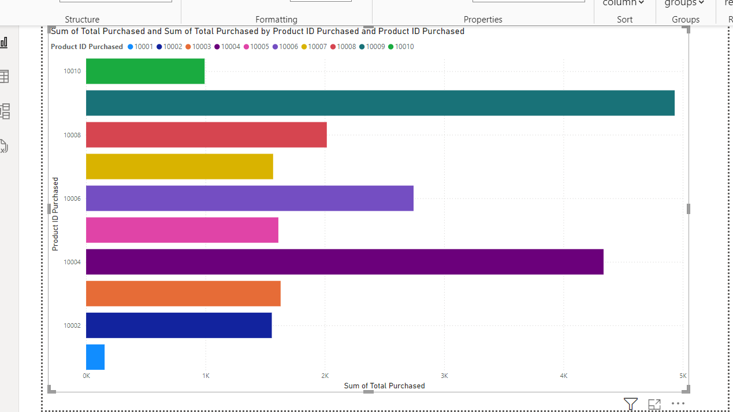

Slide 6
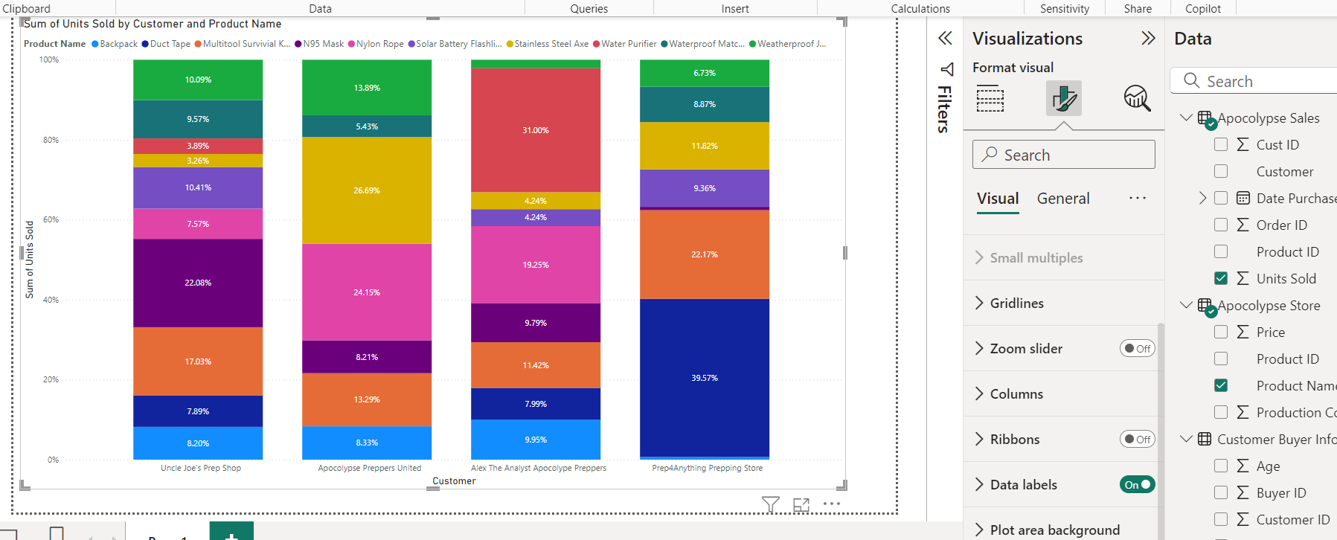

Slide 7
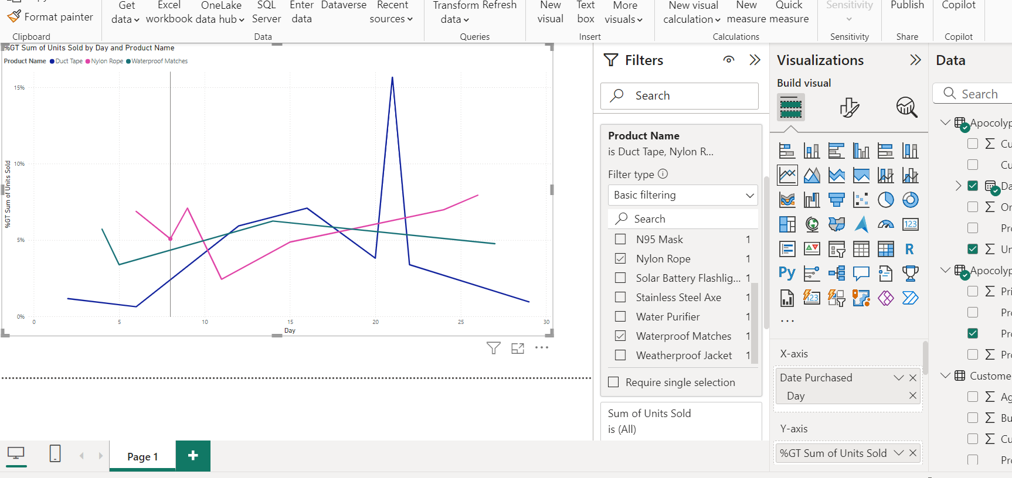

Slide 8
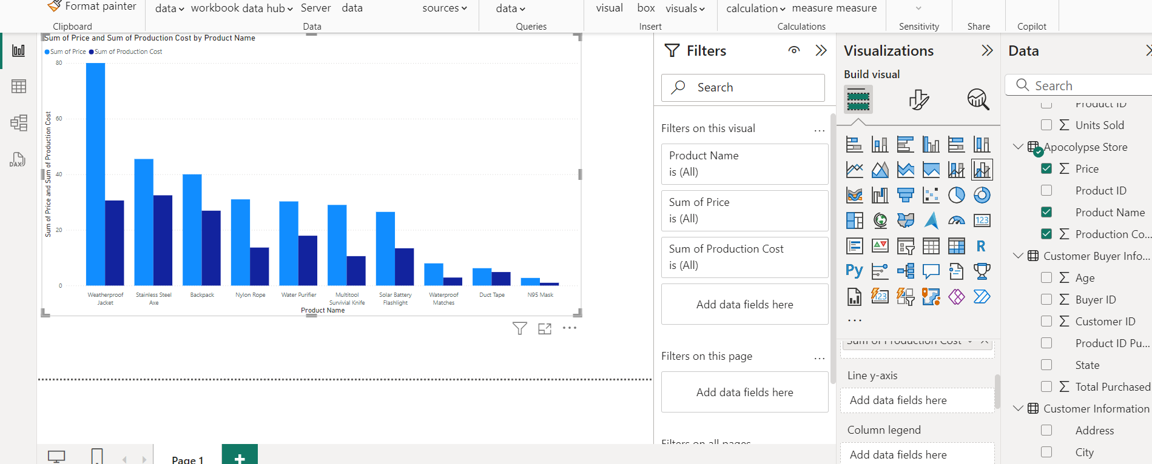

Slide 9
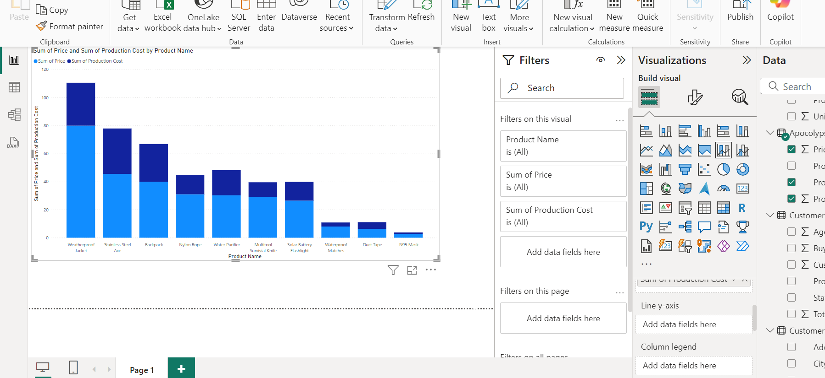

Slide 10
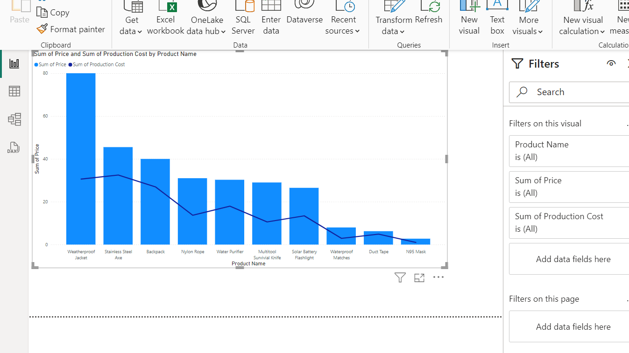

Slide 11


Instructor Demonstration: Create a Power BI Report
10 Minutes
Suggested Time:
25 minutes
Notes:
1.2

Slide 12

Questions ?

Slide 13

Students Do: Create a Power BI Report
10 Minutes
Suggested Time:
20 minutes
Notes:
1.2

Slide 14

Activity: Explore Data
Using film data do:
Hint:
  Don’t forget to save the file once finished.
Notes:
2.2

Slide 15


Slide 16
Custom visualization

Slide 17
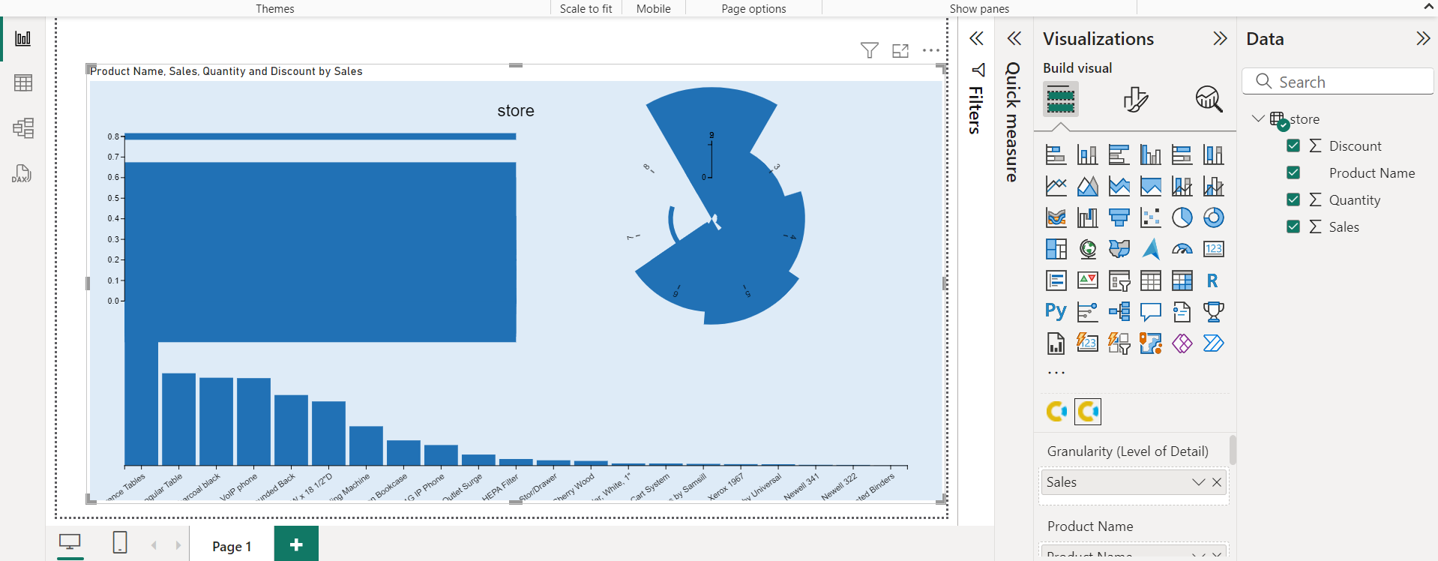
Notes:
https://charts.powerbi.tips/

Slide 18
Instructor Demonstration: Report filter and Interactions
10 Minutes
Suggested Time:
20 minutes
Notes:
1.2

Slide 19
Everyone Do: Report filter
10 Minutes
Suggested Time:
15 minutes
Notes:
1.2

Slide 21
Drill down in a visualization

Slide 22
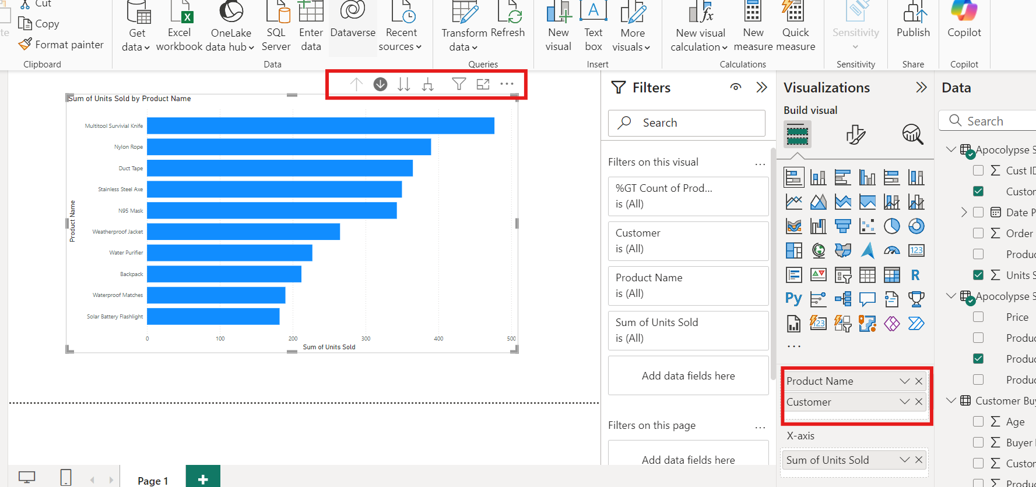

Slide 23
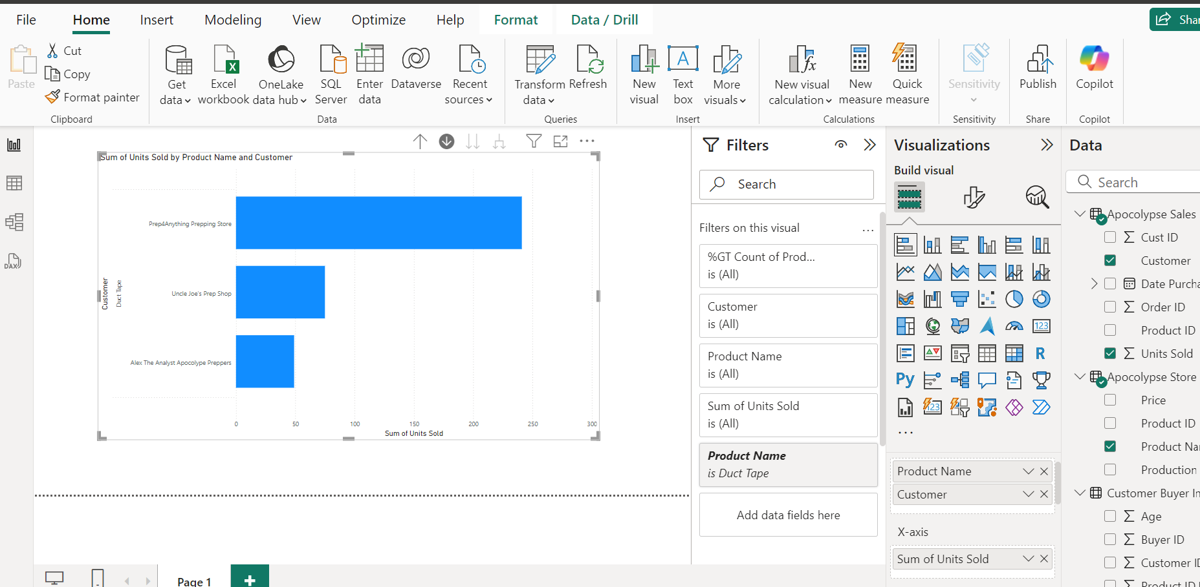

Slide 24
Instructor Demonstration: Report filter and Interactions
10 Minutes
Suggested Time:
20 minutes
Notes:
1.2

Slide 25
Everyone Do: Report filter
10 Minutes
Suggested Time:
10 minutes
Notes:
1.2

Slide 27


