Slide 1
Introduction to Power BI
By Ahmad Mousa

Slide 2
Class Objectives
By the end of this lesson, you will be able to:
Exploring the Power BI Desktop Interface
Connecting to various data source
Import and join data within Power BI
Create and style worksheets and stories in Power BI

Slide 3

Notes:
1.1 - temp

Slide 4


Instructor Demonstration: Power BI Exploration
10 Minutes
Suggested Time:
5 minutes
Notes:
https://learn.microsoft.com/en-us/power-bi/

Slide 5

Why we need BI
Helps you Know your business better
Improves Decision Making
Support decision making
Know your business
Business Query
Understanding current and potential risks
Fast answer to any business Query
Reduces the risk
Real Time
Identify Opportuniti
Identify possible Opportunities
Enables Real-Time Analysis with Quick Navigation

Slide 6
Power BI main component
Power BI Desktop
Power BI Service

Slide 7

Everyone Do: Power BI Installation
In this activity, everyone will install Power BI Desktop.
Power BI Desktop is a free version of the Power BI software that includes most of the features available in Power BI Pro.
10 Minutes
Suggested Time:
10 minutes
Notes:
1.2

Slide 8
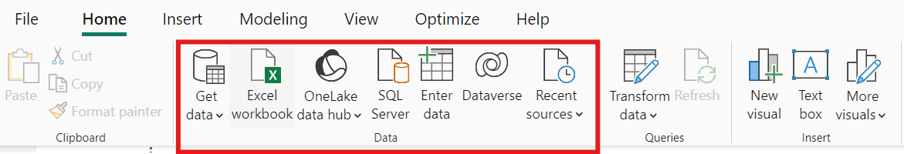
Instructor Do: Loading Data
Power BI can connect to a wide variety of data sources, including file types like CSV, Excel, and JSON, as well as a range of servers such as SQL Server, MySQL, and Azure.
Power BI enables users to seamlessly integrate data from different sources without needing to convert it into another format, such as a Pandas DataFrame. It offers built-in tools for loading, exploring, and transforming data, making it easier to manipulate and analyze without the need for additional external processing.
Notes:
2.1

Slide 9
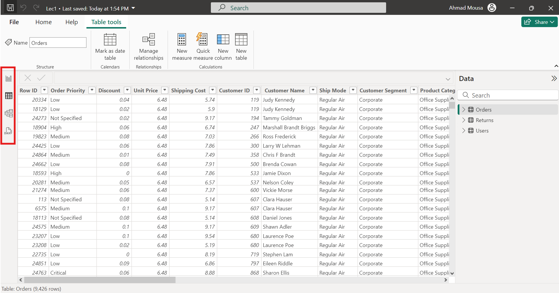

Slide 10
Instructor Demonstration: Loading Data
10 Minutes
Suggested Time:
5 minutes
Notes:
1.2

Slide 11
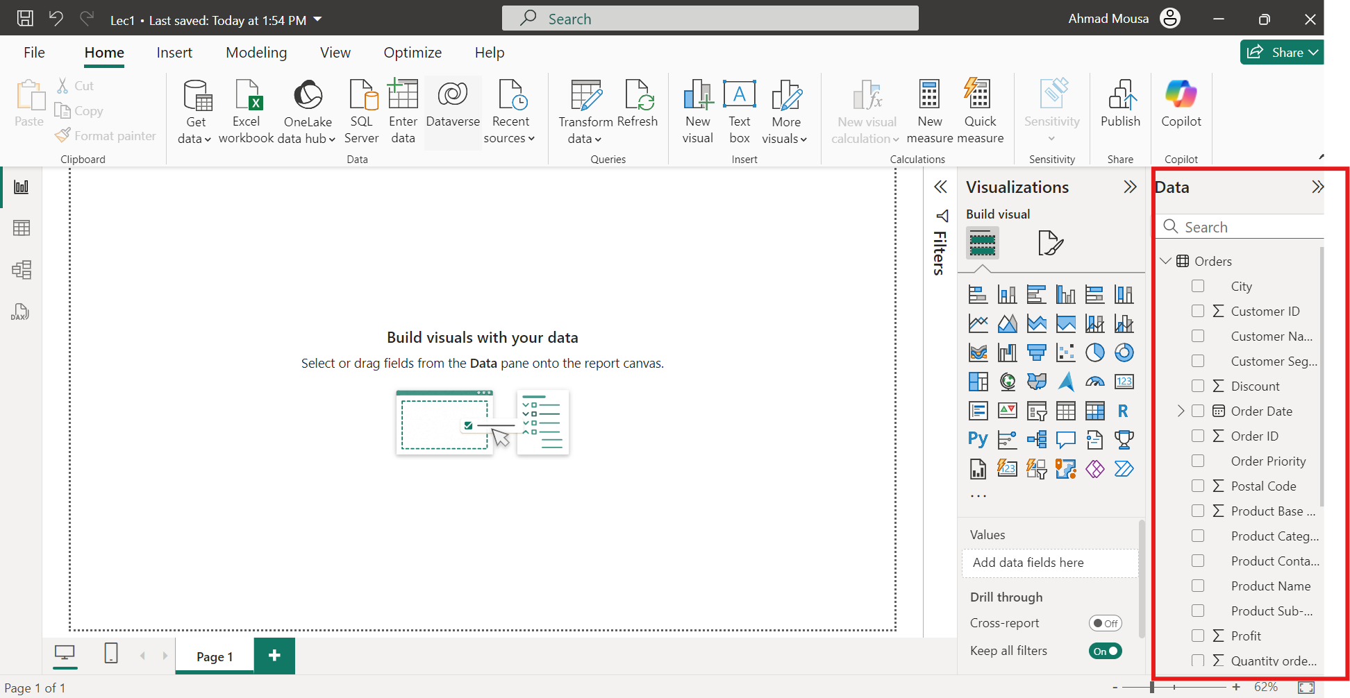

Slide 12
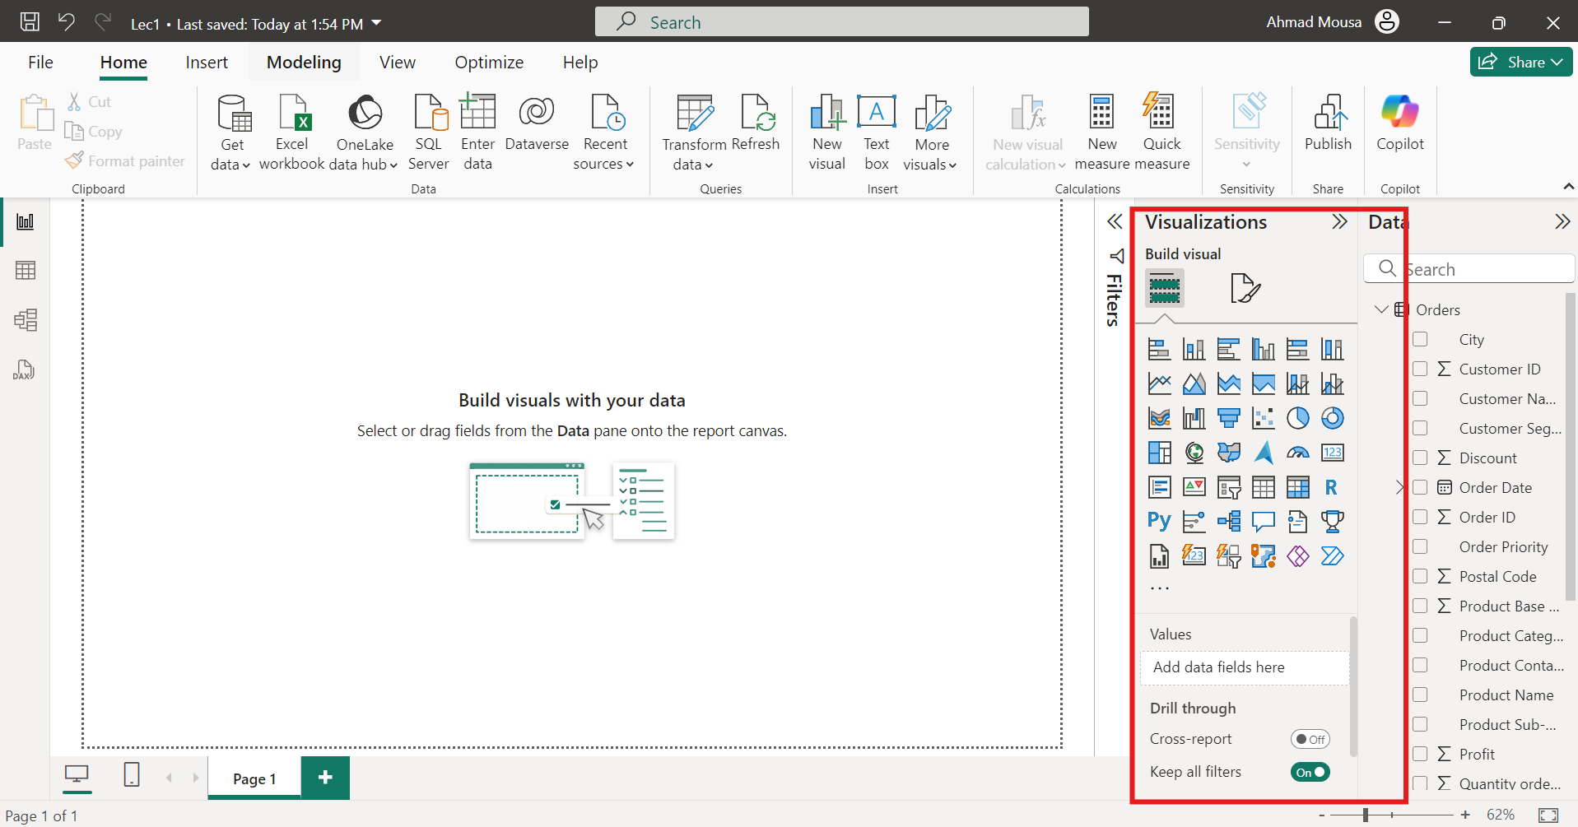

Slide 13
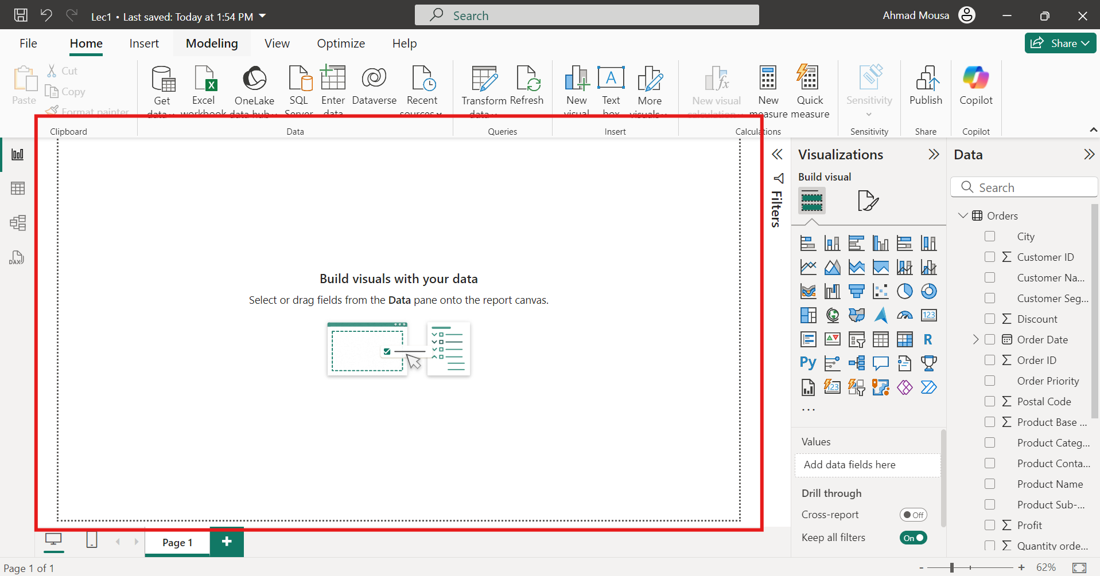

Slide 14
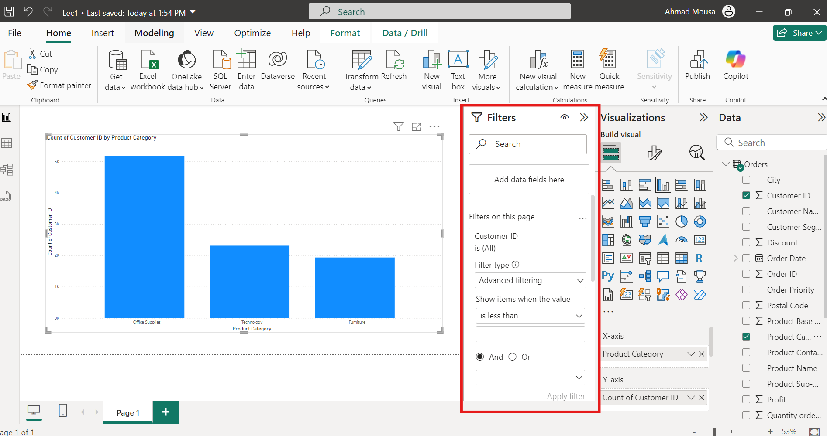

Slide 15
Instructor Demonstration: Simple visualization (Global Rentals)
10 Minutes
Suggested Time:
5 minutes
Notes:
1.2

Slide 16

Questions ?

Slide 17
Student Do: Global Rentals visualization
In this activity, you will be given visualizations that you will attempt to recreate using Power BI.
10 Minutes
Suggested Time:
15 minutes
Notes:
1.2

Slide 18

Activity: Explore Data
Using GlobalRentals.xlsx, visualize the following data:
  The customers with the highest amount of paid fees
  The customers with more than 150 rental days
  The rental days by continent and rating
Bonus:
  If you finish early, try experimenting with other possible visualization!
Hint:
  Don’t forget to save the file once finished.
Notes:
2.2

Slide 19


Slide 20
Student Do: UltimateCandy visualization
In this activity, you will be given visualizations that you will attempt to recreate using Power BI.
10 Minutes
Suggested Time:
15 minutes
Notes:
1.2

Slide 21
Activity: Explore Data
Using UltimateCandy.xlsx, visualize the following data:
Create a pair of bar graphs that chart the win percentage of each candy.
Create a scatter plot comparing the sugar percentage against the win percentage
Bonus:
  If you finish early, try experimenting with other possible visualization!
Hint:
  Don’t forget to save the file once finished.
Notes:
2.2

Slide 23


