Slide 1
Power Query and Data Transformation Power BI
By Ahmad Mousa

Slide 2
Class Objectives
By the end of this lesson, you will be able to:
Understand and Utilize Power Query
Perform Data Import and Transformation
Create and Apply Custom Data Transformations
Enhance Data Quality and Consistency

Slide 3

Notes:
1.1 - temp

Slide 4
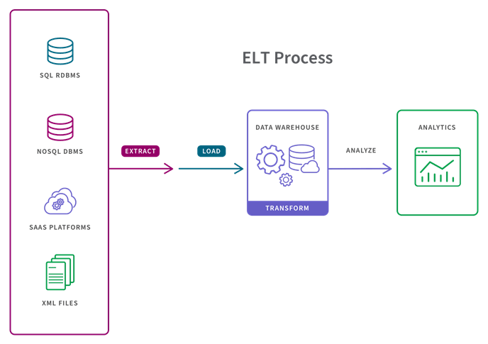

Slide 5

Data cleaning
Headers
Out layers
Missing
Irrelevant
Data type
Inconsistent
De-pivotting
Duplicate

Slide 6
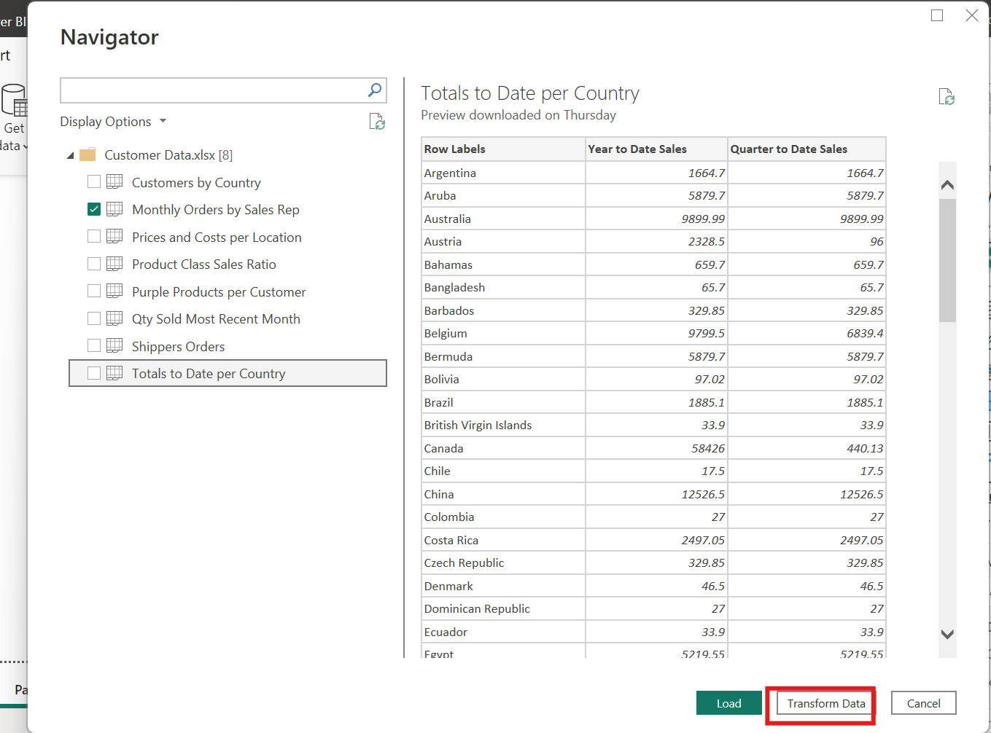

Slide 7
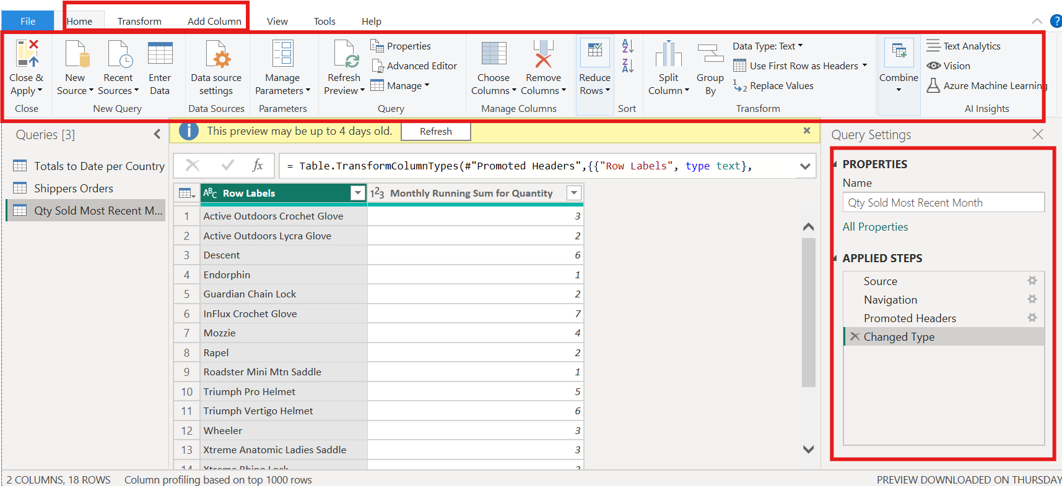

Slide 8


Instructor Demonstration: Power Query and Data Transformations
10 Minutes
Suggested Time:
15 minutes
Notes:
1.2

Slide 9

Questions ?

Slide 10
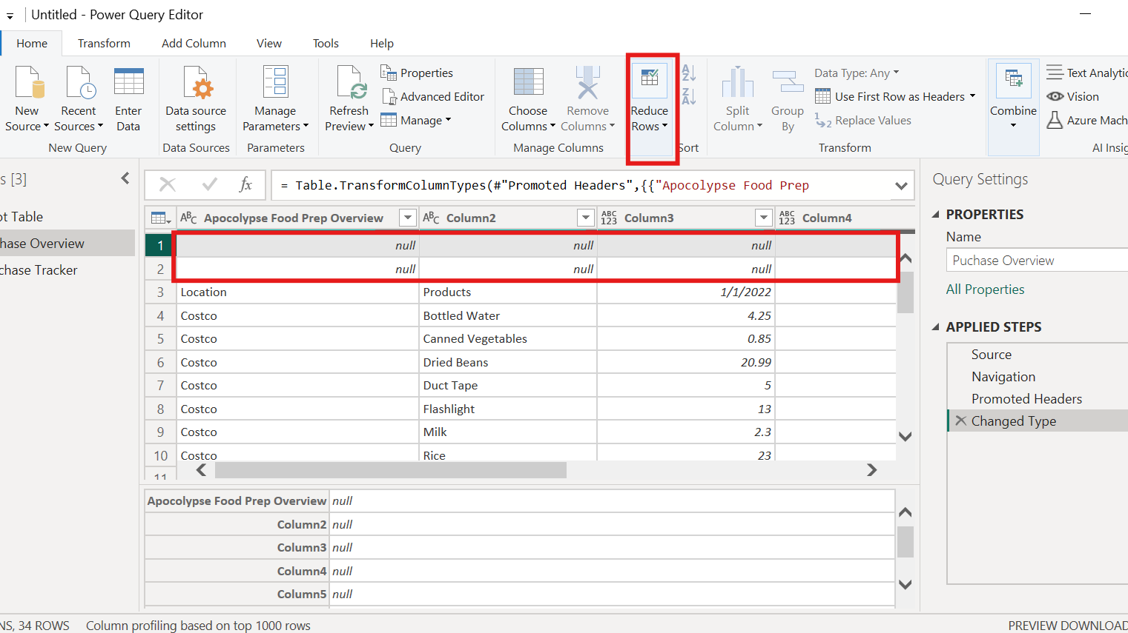

Slide 11
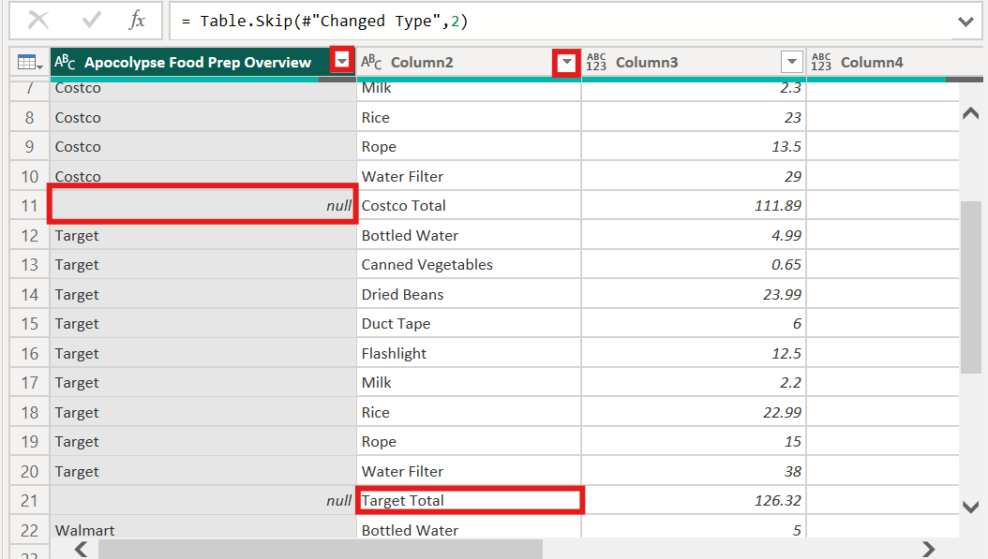

Slide 12
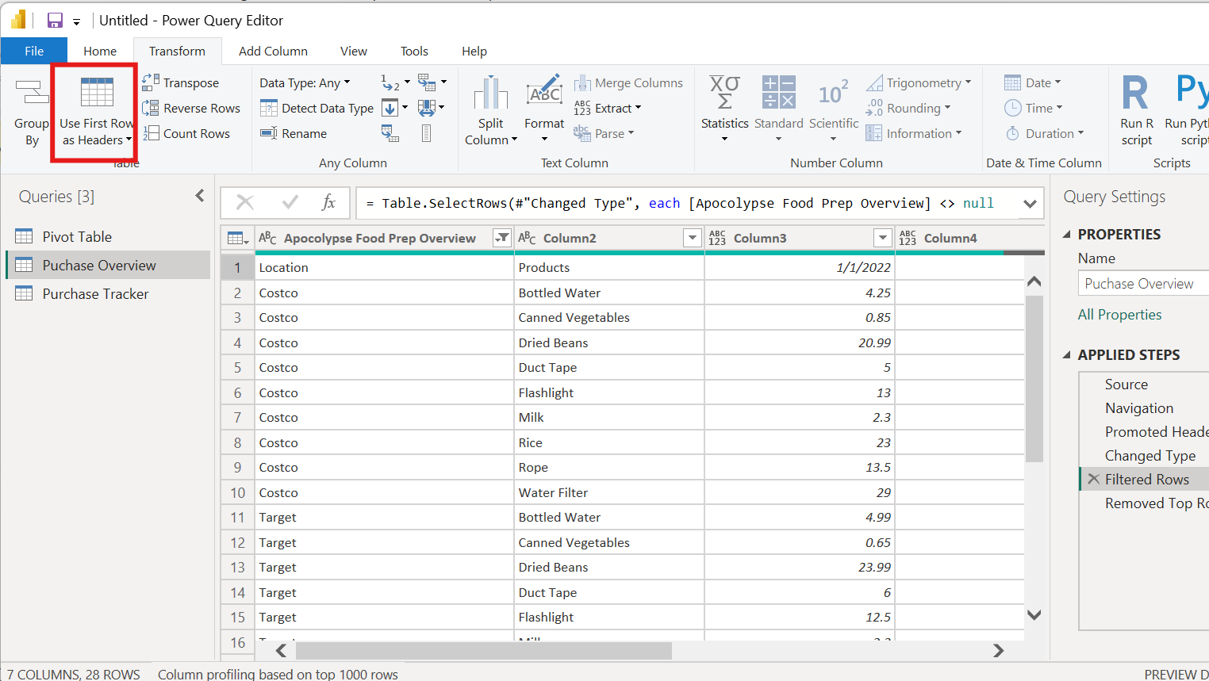

Slide 13
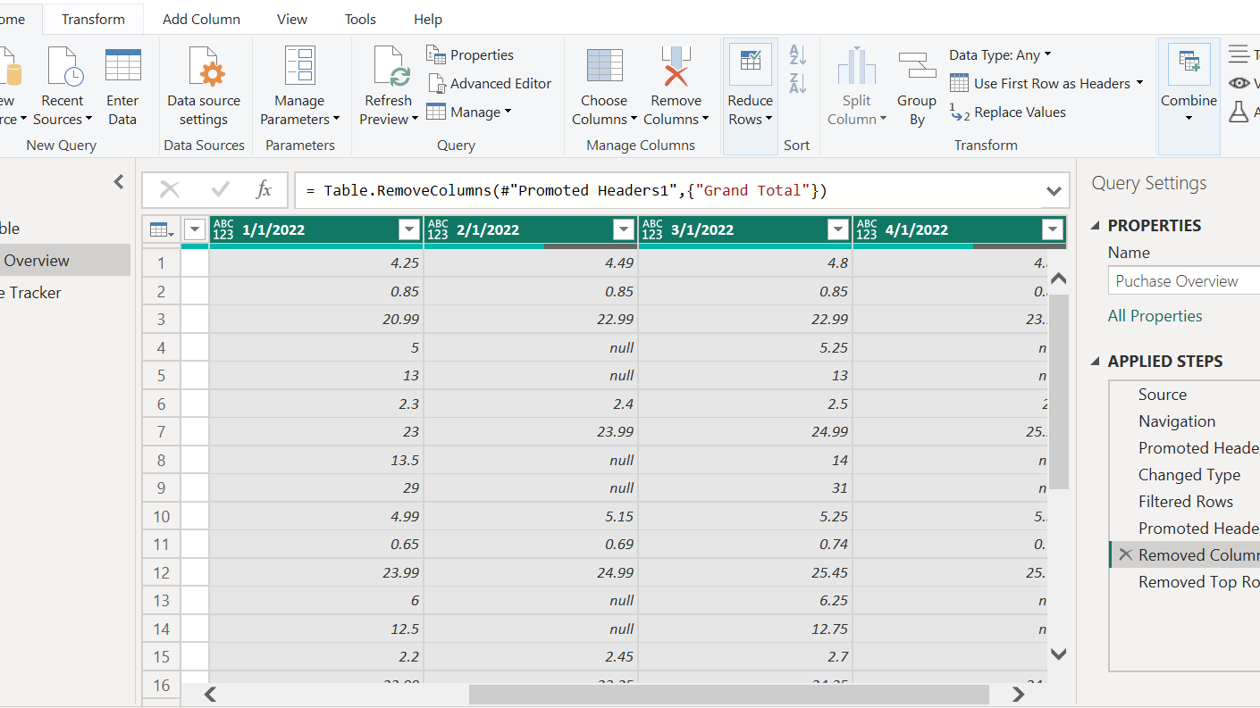

Slide 14
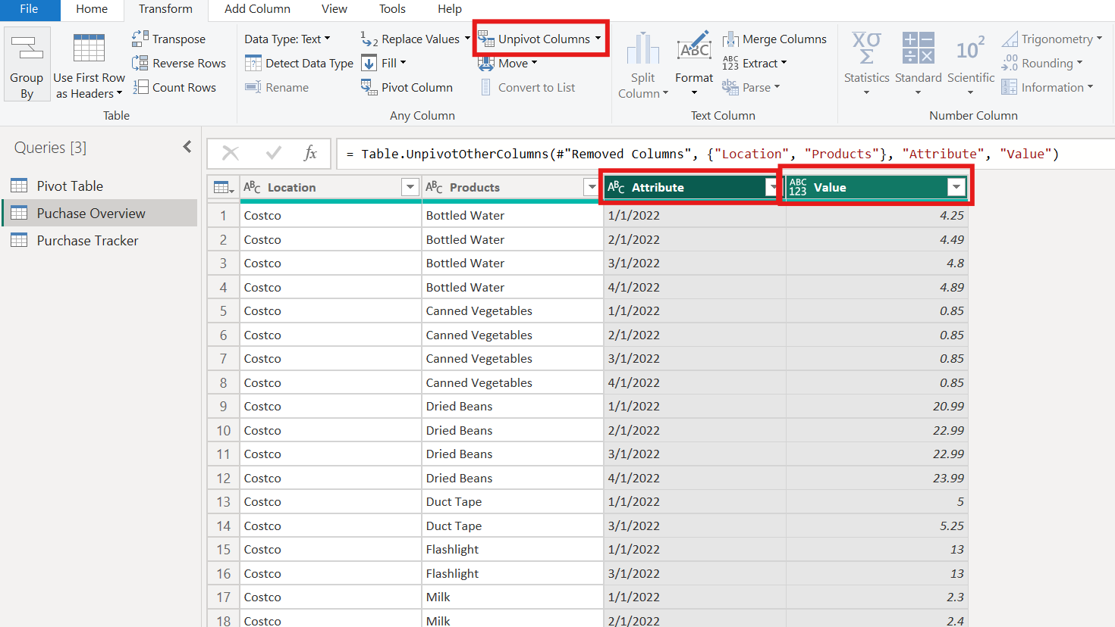

Slide 15

Students Do: IPEDS Data Transformations
10 Minutes
Suggested Time:
20 minutes
Notes:
1.2

Slide 16


Slide 17
Instructor Demonstration: separate columns and fix data types.
10 Minutes
Suggested Time:
10 minutes
Notes:
1.2

Slide 18
Questions ?

Slide 19
Everyone Do: Apocalypse Food Prep Transformations
10 Minutes
Suggested Time:
20 minutes
Notes:
1.2

Slide 20

Activity: Explore Data
Using Apocalypse Food.xlsx, do the following:
  Change the names of the table
  Fix the header of the tables
  Remove the row that have missing value
  Fix the data type and the format
  Unpevot the date
Hint:
  Don’t forget to save the file once finished.
Notes:
2.2

Slide 22
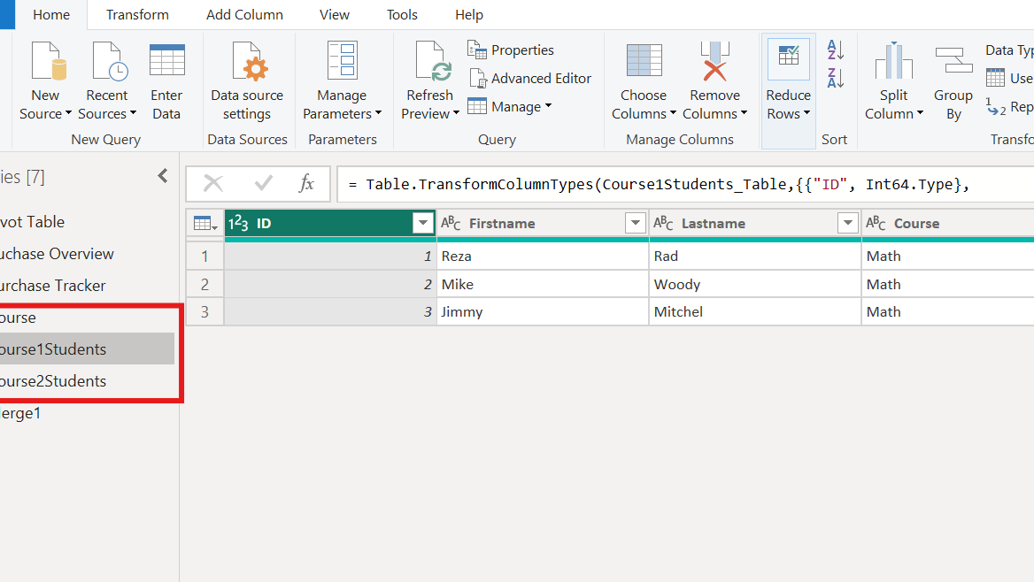

Slide 23

Join

Slide 24
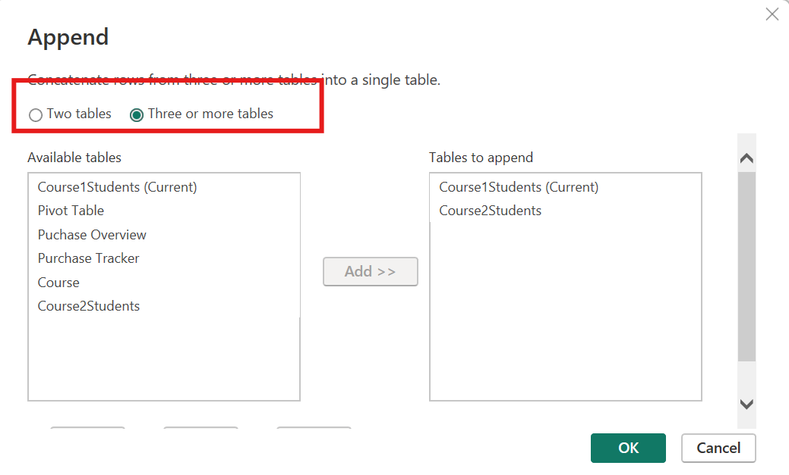

Slide 25
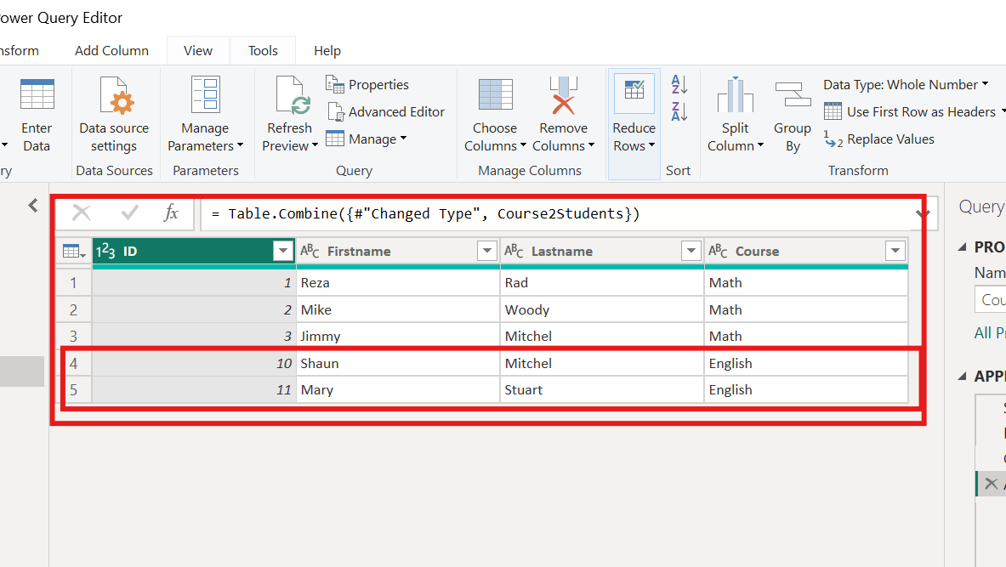

Slide 26
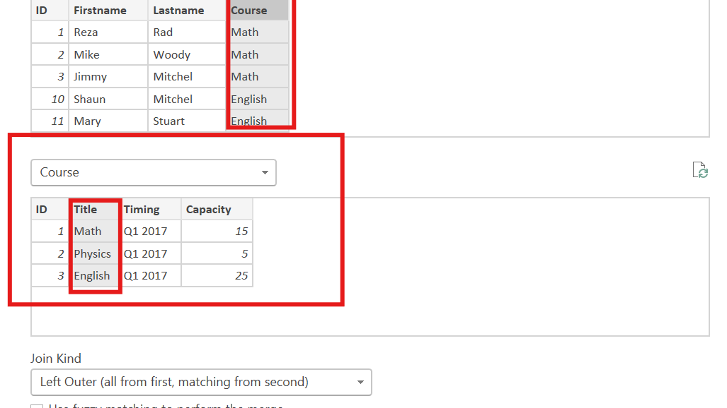

Slide 27
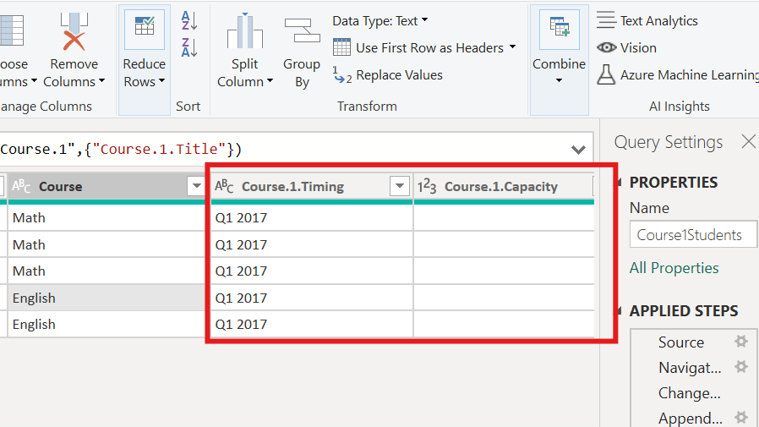

Slide 28
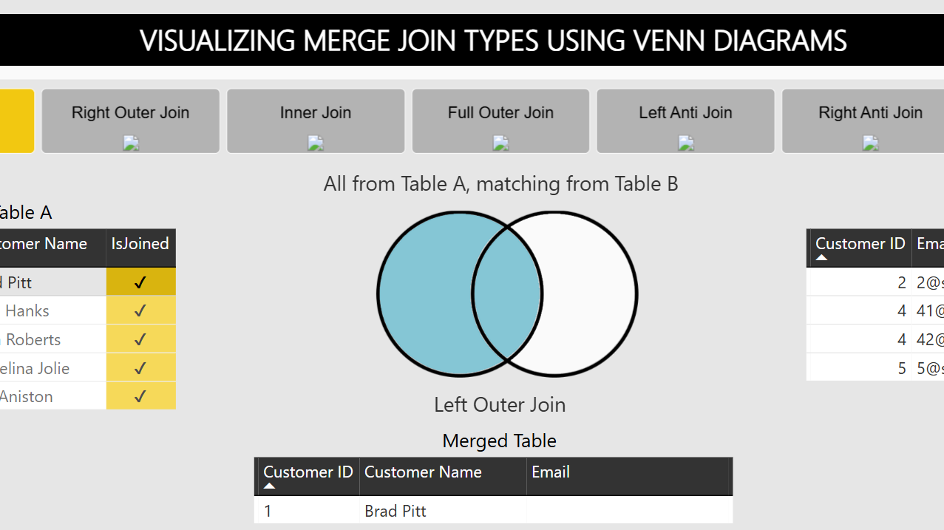
Notes:
https://community.fabric.microsoft.com/t5/Data-Stories-Gallery/Visualizing-Merge-Join-Types-in-Power-BI/m-p/219906

Slide 29
Everyone Do: Join Rental
10 Minutes
Suggested Time:
15 minutes
Notes:
1.2

Slide 30
Activity: Explore Data
Using GolobalRental1.xlsx, do the following:
Append GolobalRental1 and GolobalRental2.
Join film.xlsx to GolobalRental1.xlx Table in the appropriate column
Hint:
  Don’t forget to save the file once finished.
Notes:
2.2

Slide 32

10 Minutes
Suggested Time:
25 minutes
Notes:
1.2

Slide 34


