Slide 1
DATA MODELING IN POWER BI
By Ahmad Mousa

Slide 2
Class Objectives
By the end of this lesson, you will be able to:
Understand Data model
Perform Data Different type of data filter
Create Measure and Calculated columns
Utilize Dax (Data Analysis Expressions)

Slide 3

Notes:
1.1 - temp

Slide 4

Data Model

Slide 5

Visualization
DAX
Relationships
Power Query
Data Modeling

Slide 6
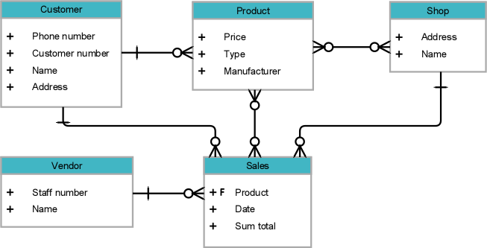

Slide 7
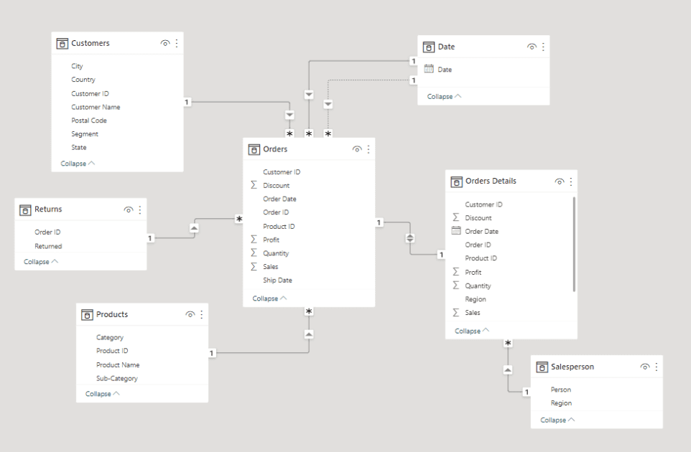

Slide 8
Data Modeling
Data modeling is the process of analyzing and defining all the different data types your business collects and produces, as well as the relationships

Slide 9
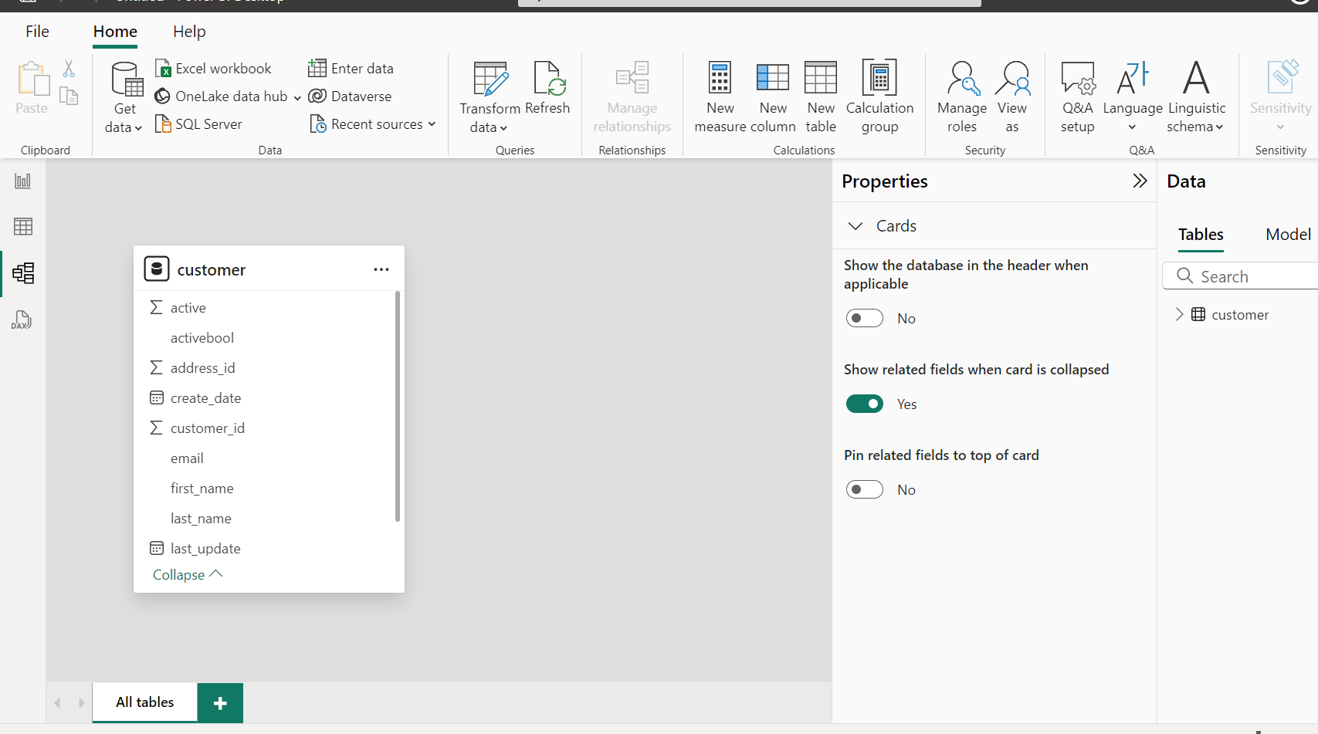

Slide 10
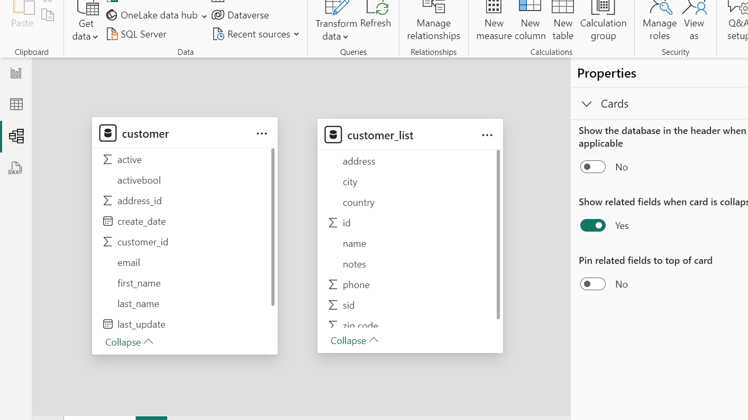

Slide 11
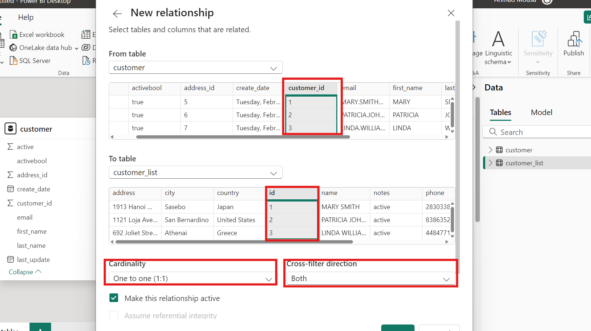

Slide 12
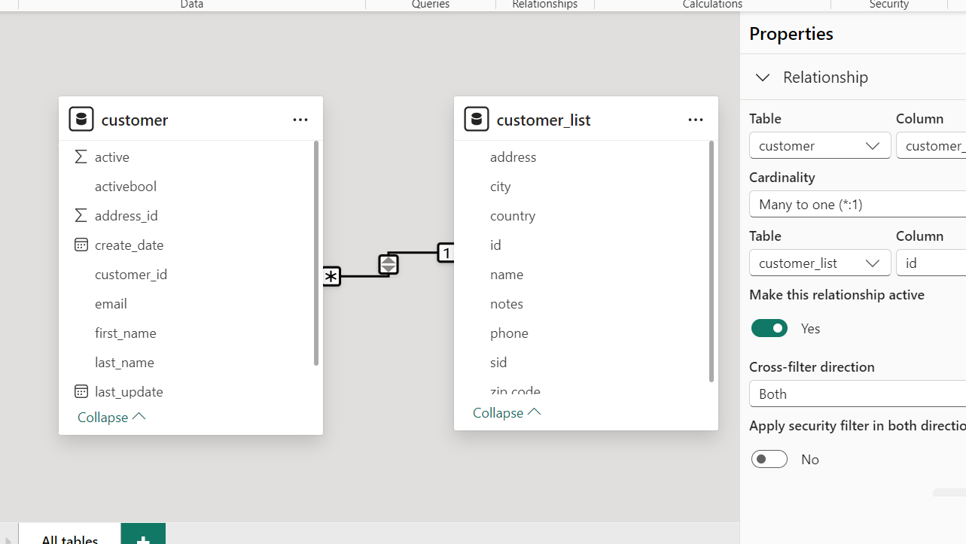

Slide 13


Instructor Demonstration: Modeling customer data
10 Minutes
Suggested Time:
15 minutes
Notes:
1.2

Slide 14

Questions ?

Slide 15

Students Do: Film data Modeling
10 Minutes
Suggested Time:
20 minutes
Notes:
1.2

Slide 16

Activity: Explore Data
Film data Modeling:
Actor.
City
Film
Film actor
Inventory
Rental
Hint:
  Don’t forget to save the file once finished.
Notes:
2.2

Slide 17


Slide 18
Data Filter

Slide 19
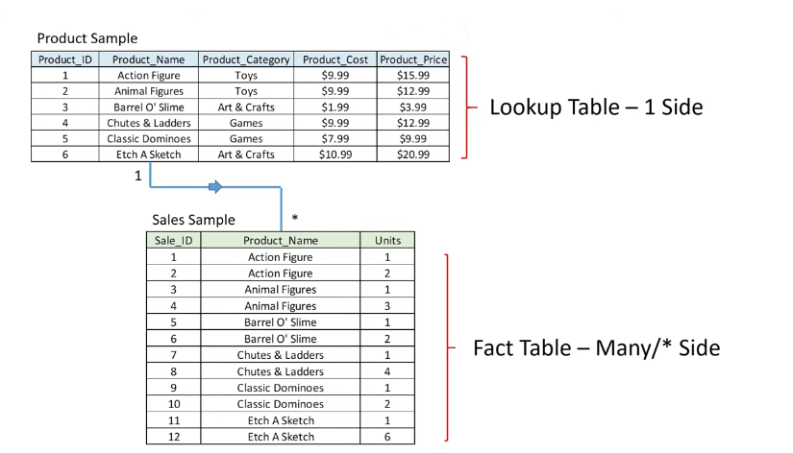

Slide 20
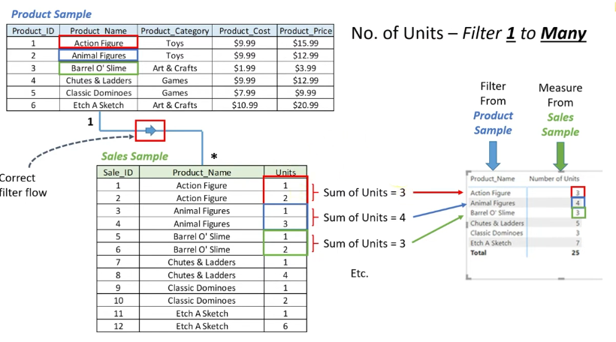

Slide 21
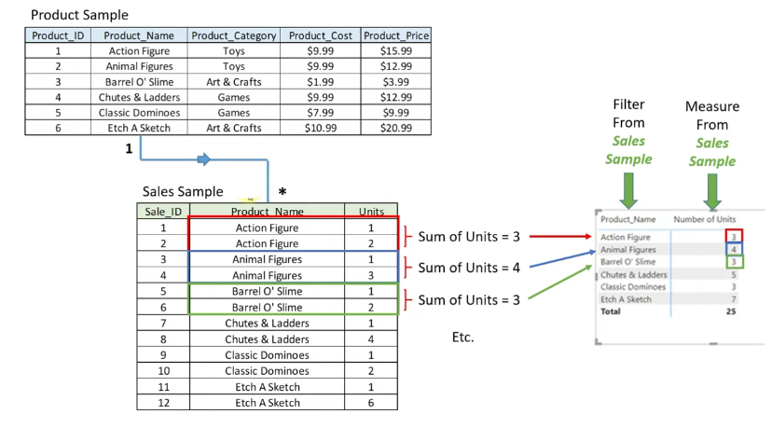

Slide 22
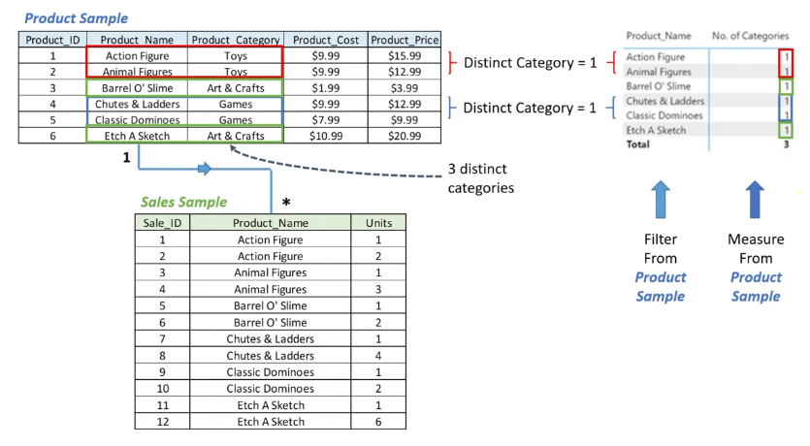

Slide 23
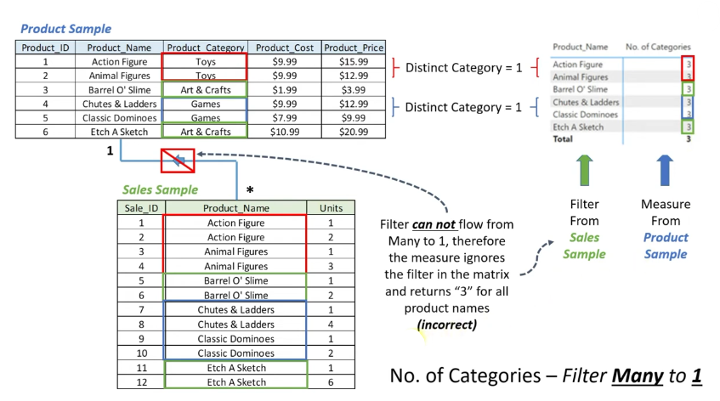

Slide 24
Instructor Demonstration: Data filter on the store data
10 Minutes
Suggested Time:
10 minutes
Notes:
1.2

Slide 25
Everyone Do: Data filter store dataset
10 Minutes
Suggested Time:
10 minutes
Notes:
1.2

Slide 27
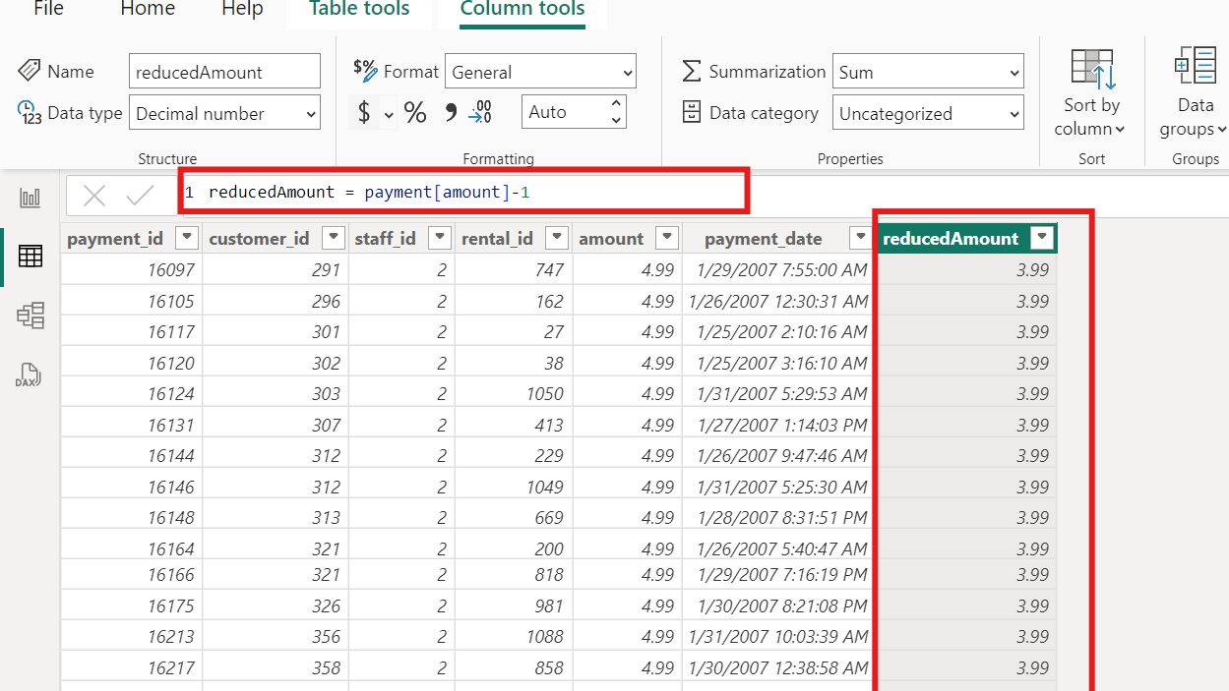

Slide 28
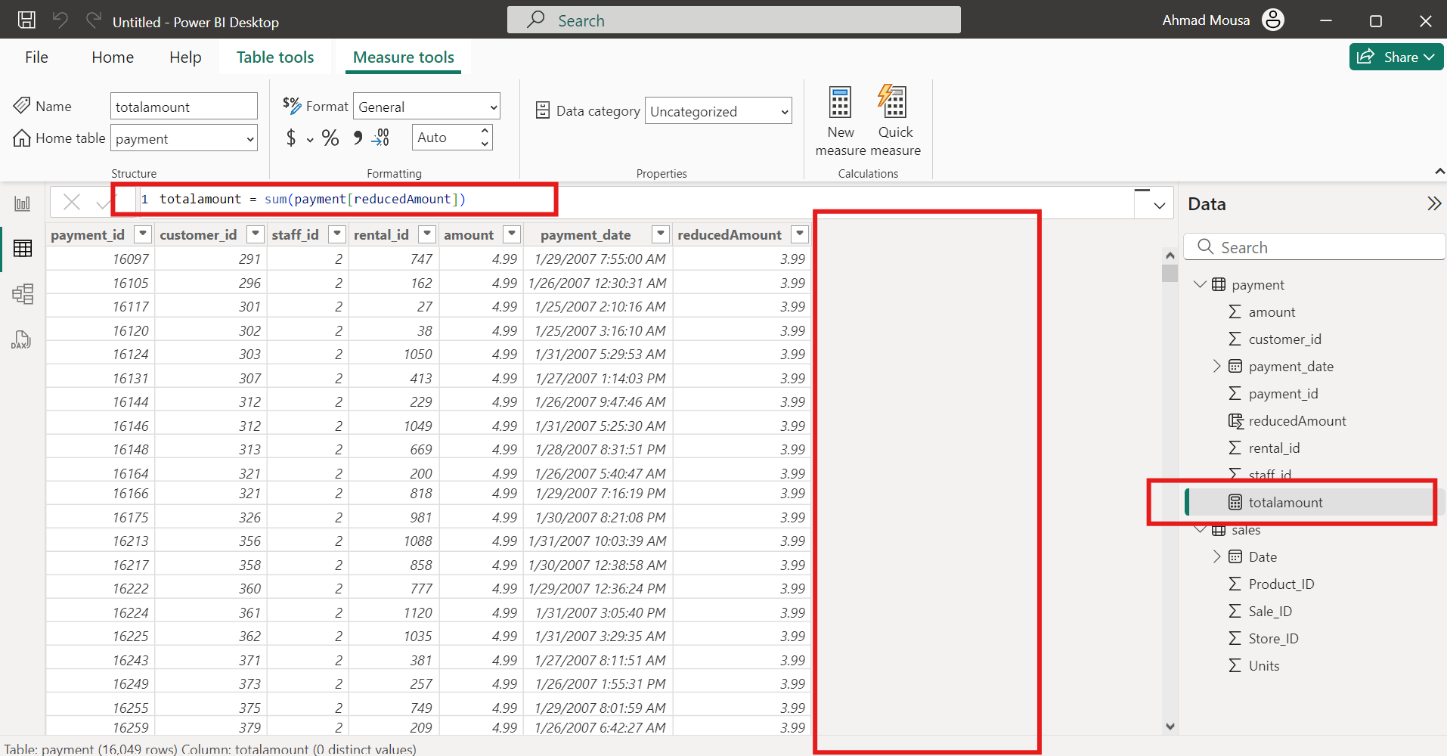

Slide 29
Instructor Demonstration: Calculated column and Measure
10 Minutes
Suggested Time:
5 minutes
Notes:
1.2

Slide 30
DAX

Slide 31
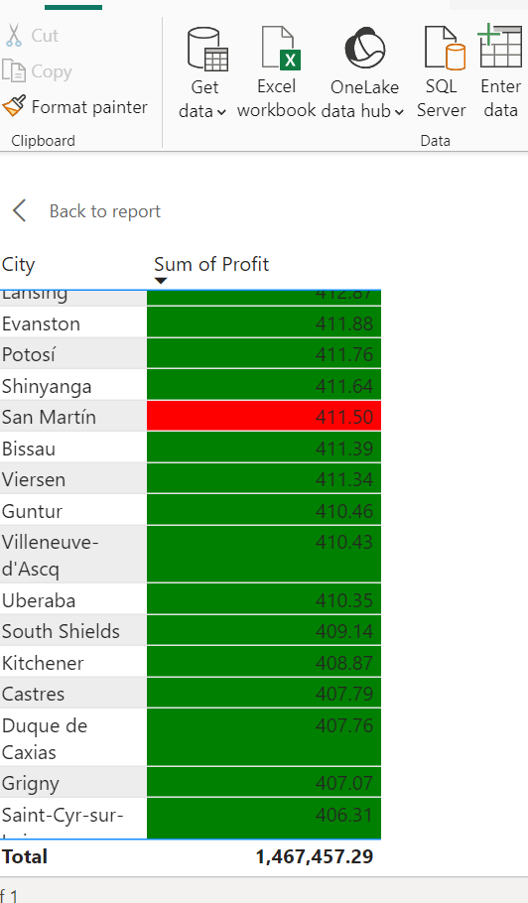
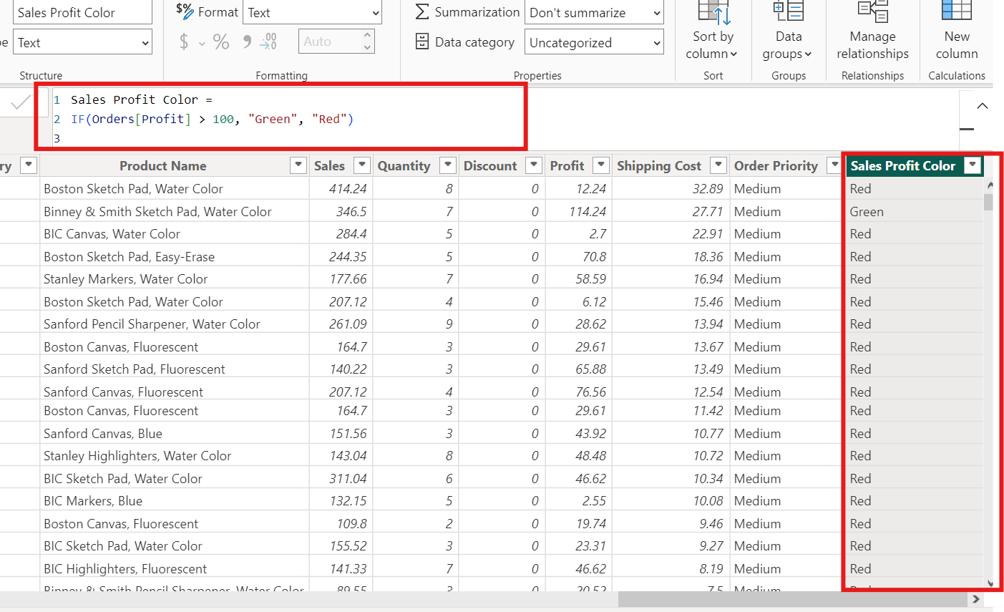

Slide 32
Instructor Demonstration: Dax logic
10 Minutes
Suggested Time:
20 minutes
Notes:
1.2

Slide 33
Everyone Do: Dax traffic data
10 Minutes
Suggested Time:
20 minutes
Notes:
1.2

Slide 34
Instructions:
Try to create visualizations for the following questions:
What are the most dangerous hours that produce casualties?
What are the most dangerous months that produce casualties?
What speed limit is the most common for accidents to occur in?
Does the speed limit impact the average number of casualties?
What are the most common weather conditions for accidents?
Do light conditions have any impact on accidents?
Are there any possible problems or issues with these visualizations?
Use calculations and logical statements to enhance your visualizations,
Notes:
2.2

Slide 36


