Slide 1
REPORTS IN POWER BI
By Ahmad Mousa

Slide 2
Class Objectives
By the end of this lesson, you will be able to:
Create a Power BI Report
Add a filter to a Report in Power BI
Create Report with Interactions
Publish, save and Share Reports in Power BI

Slide 3

Notes:
1.1 - temp

Slide 4

Create a Power BI Report

Slide 5
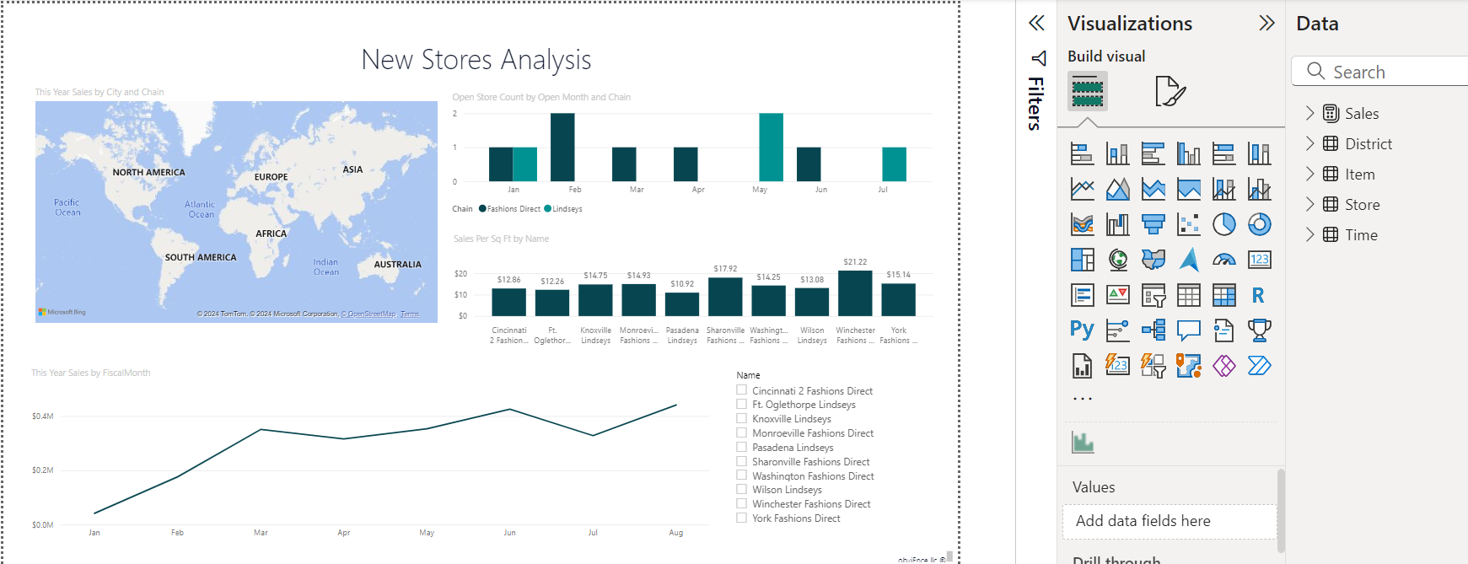

Slide 6


Instructor Demonstration: Create a Power BI Report
10 Minutes
Suggested Time:
25 minutes
Notes:
1.2

Slide 7

Questions ?

Slide 8

Students Do: Create a Power BI Report
10 Minutes
Suggested Time:
20 minutes
Notes:
1.2

Slide 9


Slide 10
Reports Filter and Interactions

Slide 11
Instructor Demonstration: Report filter and Interactions
10 Minutes
Suggested Time:
25 minutes
Notes:
1.2

Slide 12
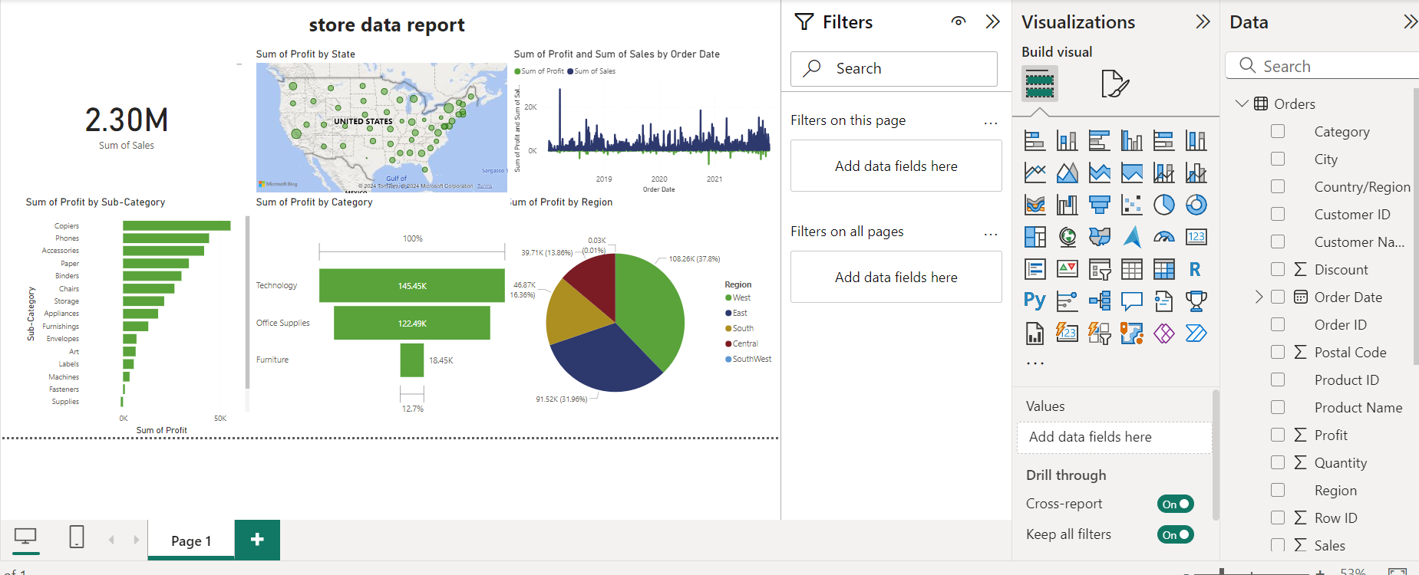

Slide 13
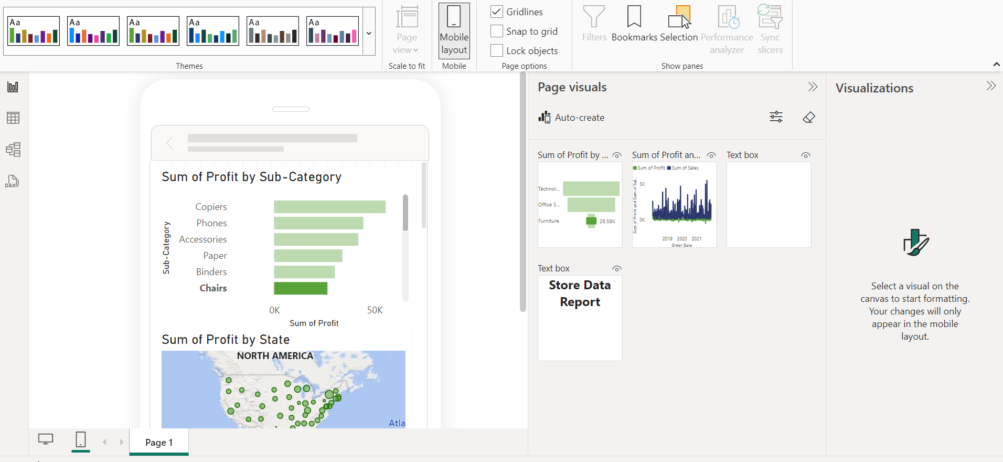

Slide 14
Everyone Do: Report filter
10 Minutes
Suggested Time:
10 minutes
Notes:
1.2

Slide 16


