Slide 1
TABLEAU DESKTOP
By Ahmad Mousa

Slide 2
Class Objectives
By the end of this lesson, you will be able to:
Exploring the Tableau Desktop Interface
Connecting to various data source
Import and join data within Tableau
Create and style worksheets and stories in Power BI

Slide 3

Notes:
1.1 - temp

Slide 4


Instructor Demonstration: Tableau Exploration
10 Minutes
Suggested Time:
5 minutes
Notes:
https://learn.microsoft.com/en-us/power-bi/

Slide 5
Tableau Features
tableau server provides a centralized location to manage all of the organization’s published data sources.
As it does not require high level of programming expertise
Speed of Analysis
Centralized Data
Self-Reliant
Tableau can filter, sort, and discuss data on the fly and embed a live dashboard
Tableau does not need a complex software setup.
Real-Time Collaboration
Visual Discovery
Blend Diverse Data Sets
Tableau allows you to blend different
The user explores and analyzes the data by using visual tools like colors

Slide 6

Everyone Do: Tableau Installation
In this activity, everyone will install Tableau Desktop.
10 Minutes
Suggested Time:
10 minutes
Notes:
1.2

Slide 7
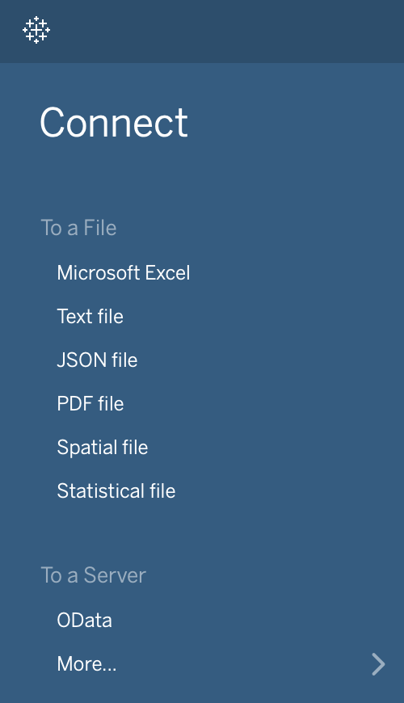
Not only can Tableau connect to many types of data files, like CSV, XLS, and JSON, it can also connect to a multitude of servers, such as MySQL, MongoDB, and Google Cloud.
Tableau allows users to mix and match data from vastly different sources without the need to translate the data into something like a Pandas DataFrame. The loading, exploration, and manipulation of data are all built-in.
Note: Hadoop can only be connected in Tableau Desktop, not Public
Notes:
2.1

Slide 8
Instructor Demonstration: Loading Data
10 Minutes
Suggested Time:
5 minutes
Notes:
1.2

Slide 9
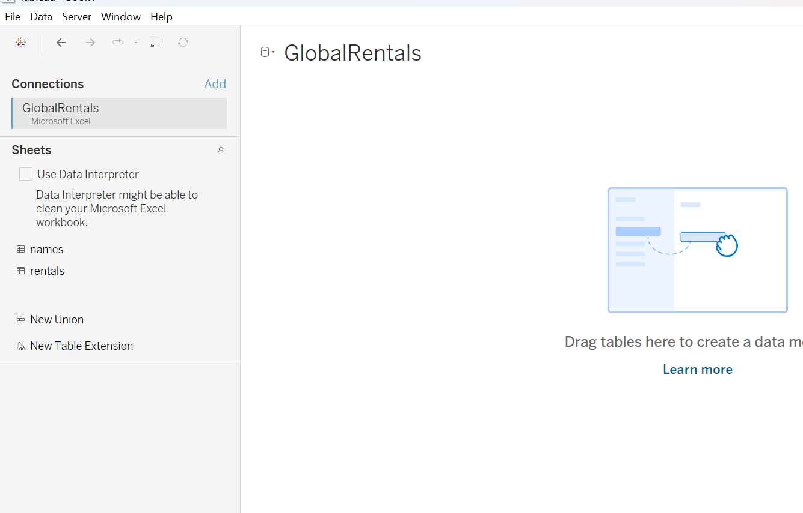

Slide 10
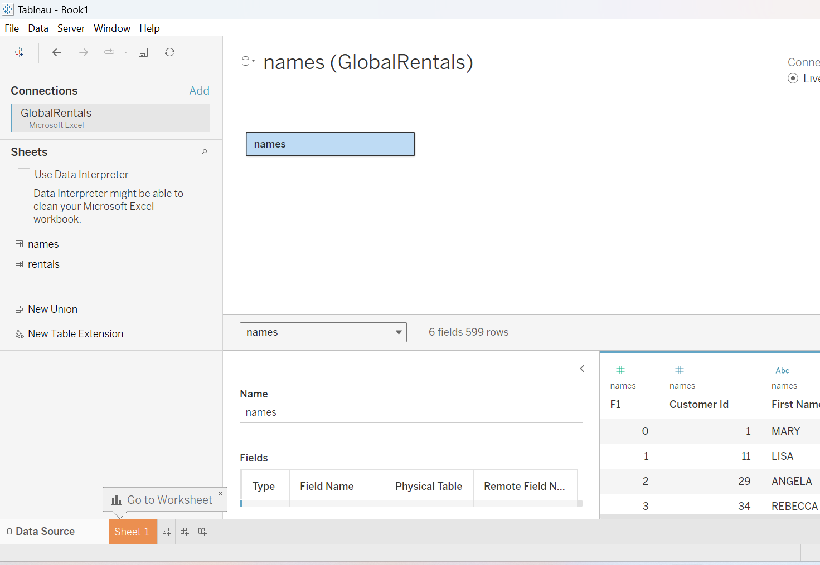

Slide 11
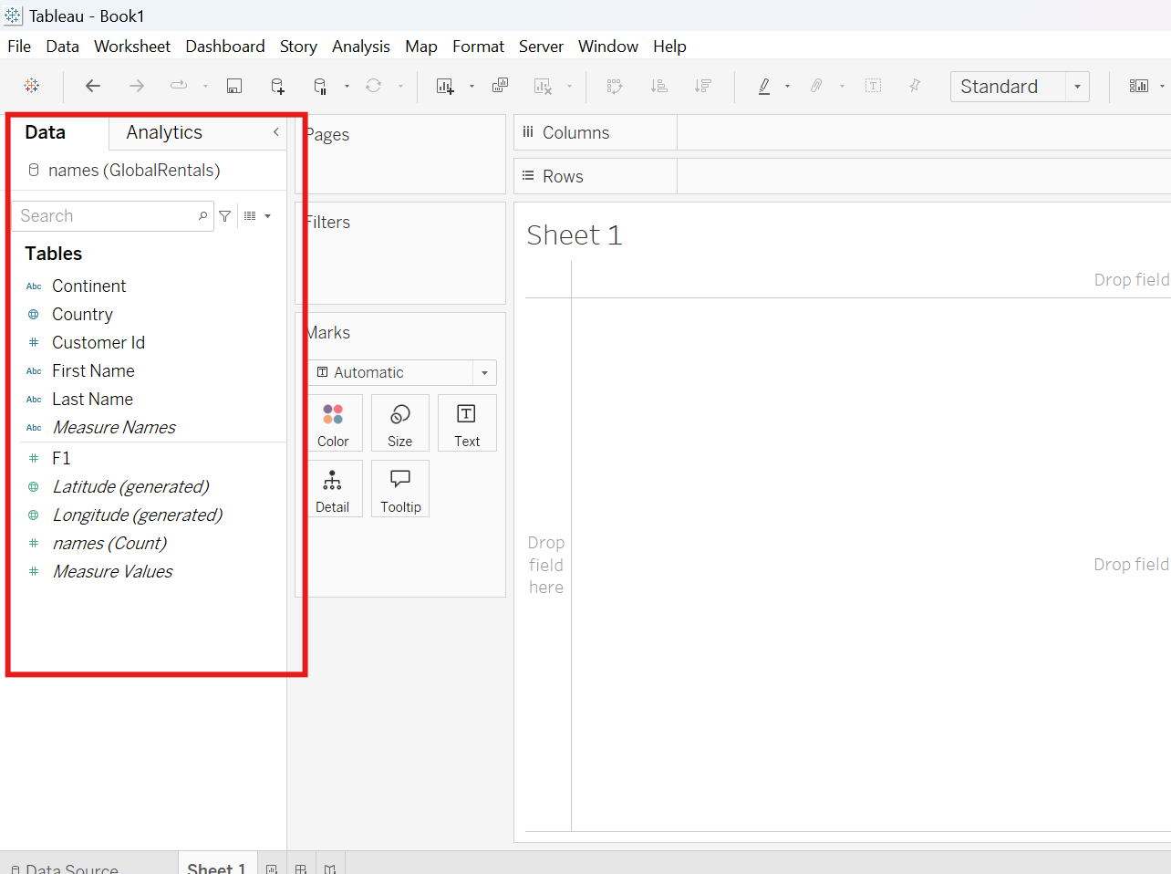

Slide 12
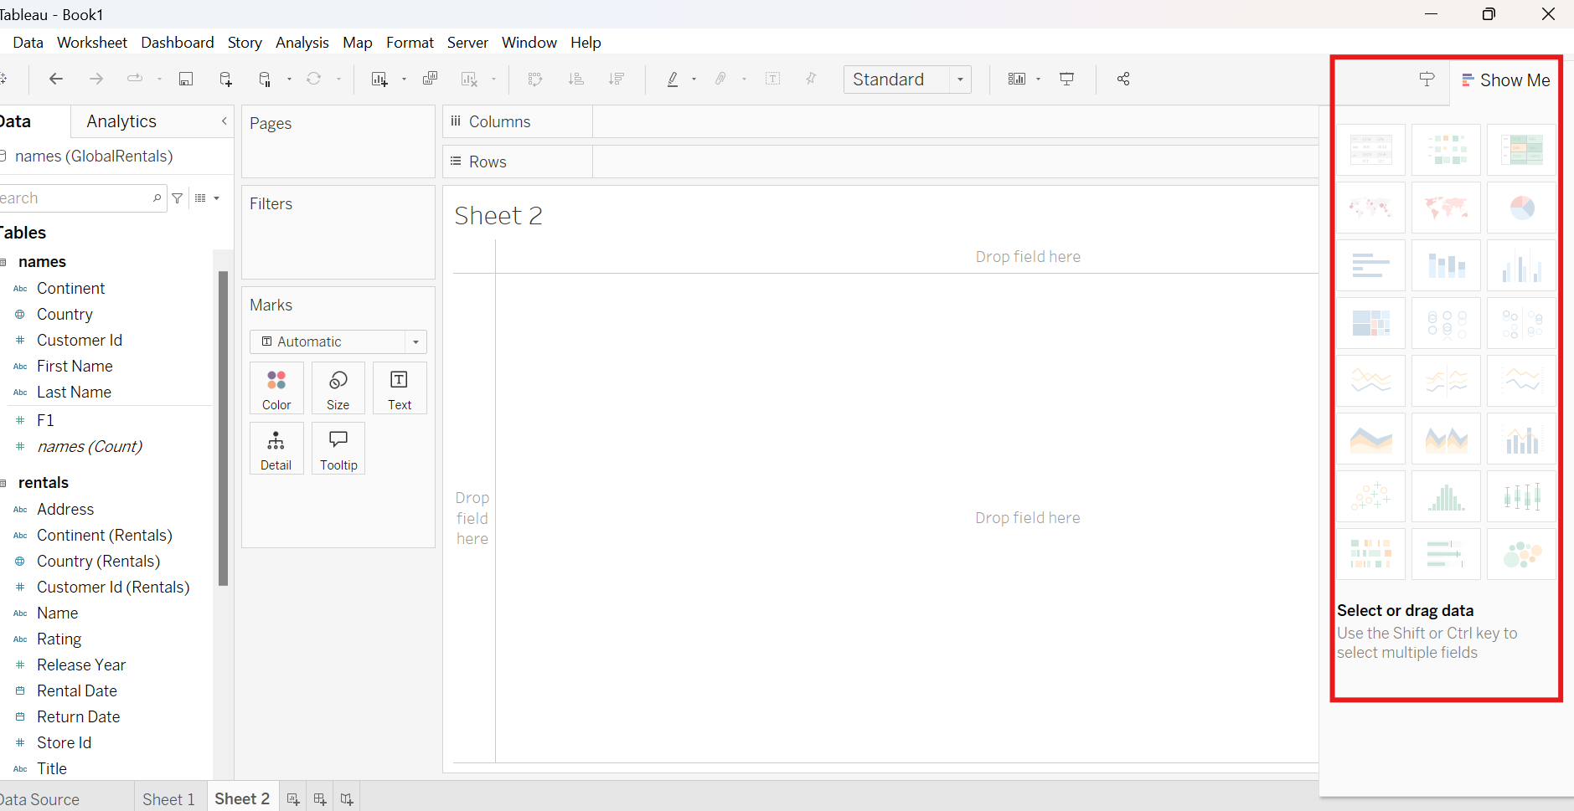

Slide 13
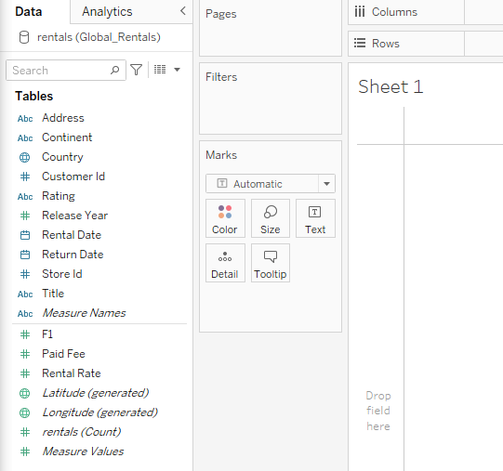
Creating visualizations in Tableau is nearly identical to creating pivot tables in Excel. Users click and drag the headers of their original dataset into specific fields—Columns, Rows, Filters, etc.—to create a chart
Vocabulary: Dimensions are categorical fields that can be used to split up data. Measures are the metrics or numbers that users would like to analyze.
Notes:
2.1

Slide 14
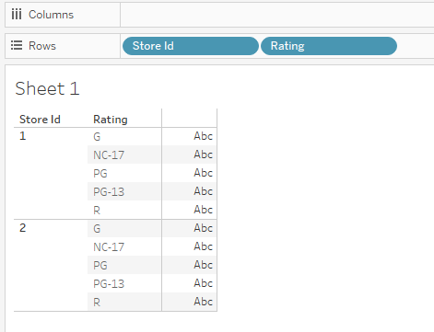
Instructor Do: Building Basic Visuals
Drag the Store Id pill from the Dimensions panel into Rows. This creates a small table with the two store ids from the dataset.
By dragging Rating into Rows and placing it after the Store Id pill, the table is made slightly more complex. Now, each store id within the visualization has been split into five distinct parts
Notes:
2.1

Slide 15
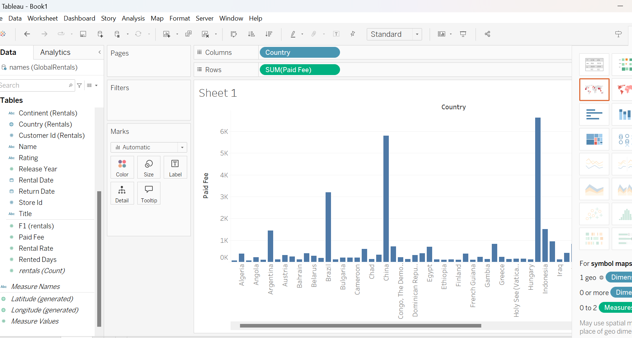
The blue color is for discrete, and
The green color is for continuous fields.

Slide 16
Instructor Demonstration: Simple visualization (Global Rentals)
10 Minutes
Suggested Time:
5 minutes
Notes:
1.2

Slide 17
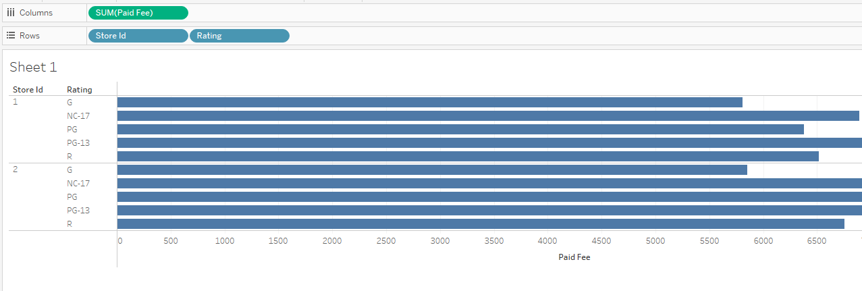
Instructor Do: Building Basic Visuals
Dragging "Paid Fee" from the Measurements panel and placing it within Columns, finally, creates a true visualization: a bar chart showing the total paid rental fees per rating for each store.
Notes:
2.1

Slide 18
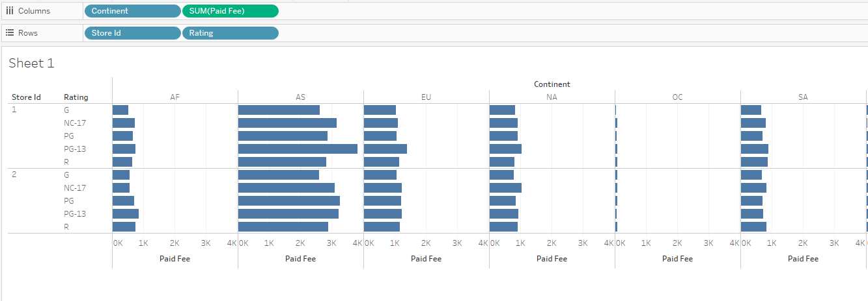
Instructor Do: Building Basic Visuals
The chart can then be made more detailed by adding more elements. By adding Continent into Columns, for example, multiple charts are created to show the paid rental fees per rating by continent for each store.
Notes:
2.1

Slide 19
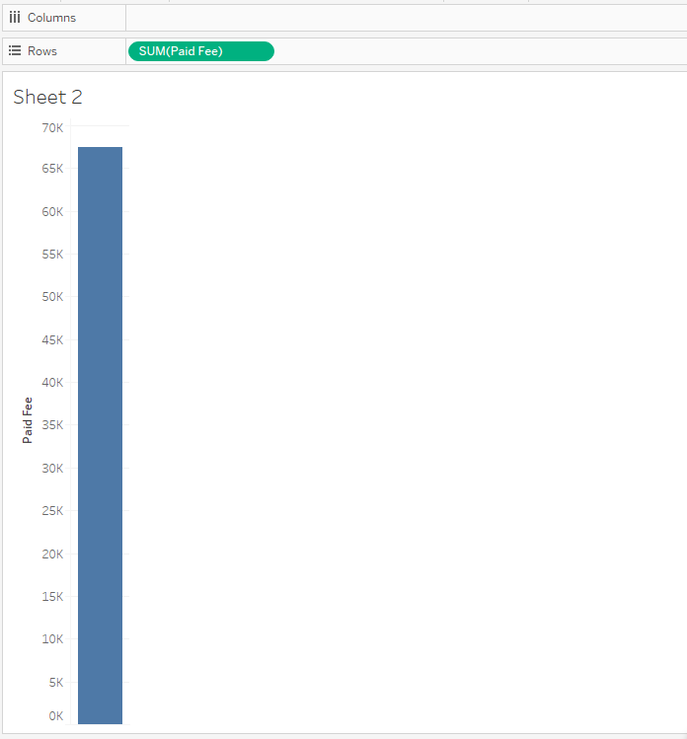
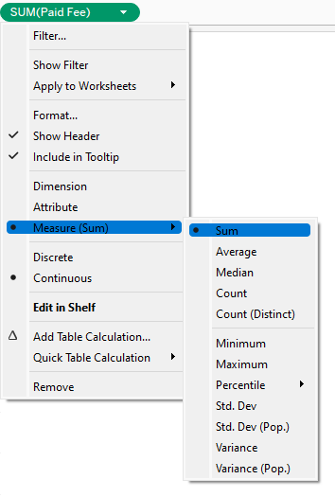
Instructor Do: Building Basic Visuals
Create a new worksheet within Tableau by clicking the "New Worksheet" button in the bottom left-hand menu. Drag Paid Fee into the Rows section.
The Paid Fee pill is being measured by its sum by default.
The type of calculation performed on a Measures pill can be changed by clicking on the pill, selecting Measure from the drop-down menu, and then picking one of the available calculation types.
Notes:
2.1

Slide 20
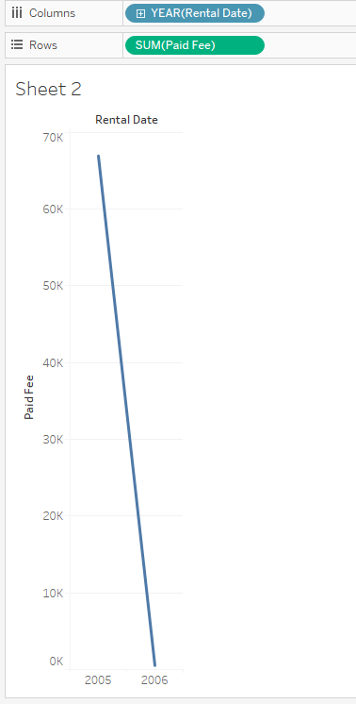
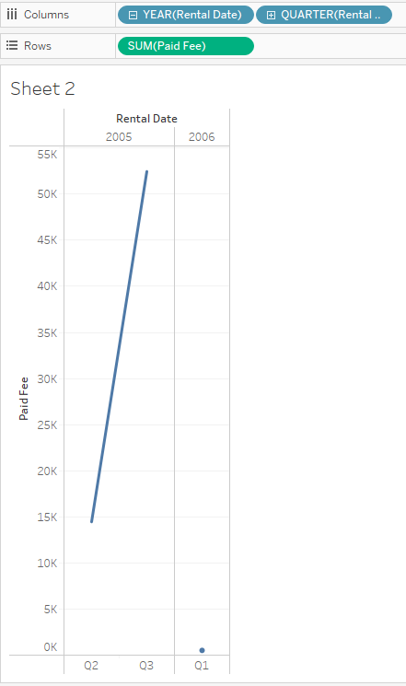
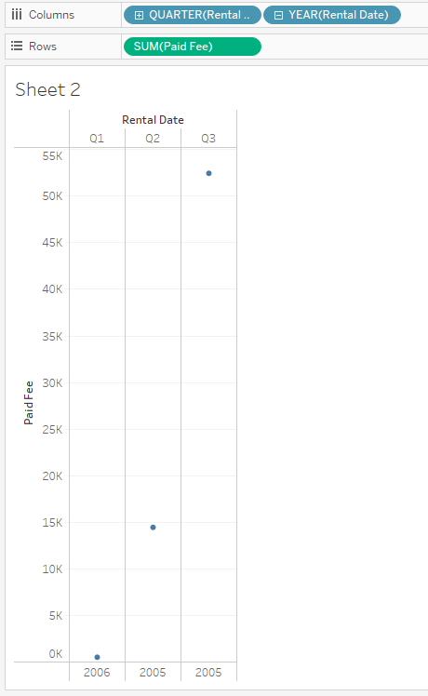
Instructor Do: Building Basic Visuals
Now, drag “Rental Date” into the Columns field to create a line chart. Tableau has aggregated the dates at the year level. To include quarters, simply click the plus symbol within the YEAR pill.
Notes:
2.1

Slide 21

Questions ?

Slide 22
Student Do: Global Rentals visualization
In this activity, you will be given visualizations that you will attempt to recreate using Tableau.
10 Minutes
Suggested Time:
15 minutes
Notes:
1.2

Slide 23

Activity: Explore Data
Using GlobalRentals.xlsx, visualize the following data:
  The customers with the highest amount of paid fees
  The customers with more than 150 rental days
  The rental days by continent and rating
Bonus:
  If you finish early, try experimenting with other possible visualization!
Hint:
  Don’t forget to save the file once finished.
Notes:
2.2

Slide 24


Slide 25
What is Tableau Prep?
Self-service data preparation
Regardless of your skill level with data preparation, Tableau Prep makes it easier to combine, clean, shape, and share your data. With a visual interface giving a complete picture of the data and smart features to make cleaning, automating and administering easier than ever, Tableau Prep will help your organization role out a complete, self-service data preparation solution.

Slide 26
Tableau Public
It is a free version of the software.
It allows you to save your work on the Tableau server.
Tableau Public is:
Free software, similar to Tableau Corporate,
A public website where vizzes are saved,
Semi-private, (You can NOT securely store your company’s budget viz on Tableau Public)
Storage for your public portfolio.
Note: Hadoop can only be connected in Tableau Desktop, not Public

Slide 27
When should you use Tableau Prep?
Fundamentally, Tableau Prep helps you explore, clean, integrate, and reshape data. If your primary goal is to perform one or more of those tasks, that’s a good sign that Tableau Prep is the right solution.
When your primary goal isn’t to explore, clean, integrate, or reshape data, remember that all the data preparation abilities of Tableau Desktop still exist! If a combination of the data interpreter, a pivot, or joins and unions gets your data into the form you need, use Tableau Desktop.
Want maximum flexibility? Use both!
At the end of the day, you never need to use just Tableau Prep or just Tableau Desktop. Both are integrated into the Tableau Platform along with Tableau Server and Online. We imagine the dashboard authoring experience as moving seamlessly from data preparation to visual analytics to sharing and collaborating, but in reality, it is an iterative, back-and-forth experience.
An insight in Tableau Desktop sends you to back to Tableau Prep to change your flow, or a data discovery in Prep inspires you to make a quick web edit to your dashboard in Tableau Server. Using multiple pieces of the Tableau Platform can make moving from disparate, messy data to actionable insight fast and easy.

Slide 28
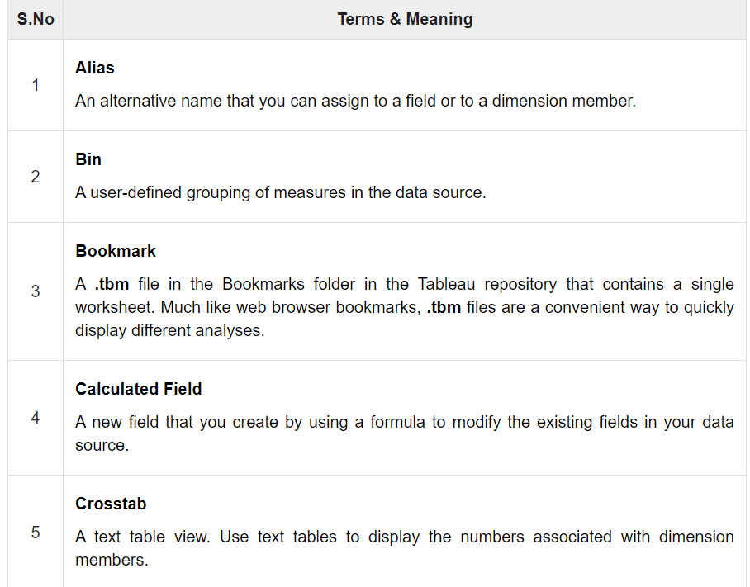
Data Terminology

Slide 29
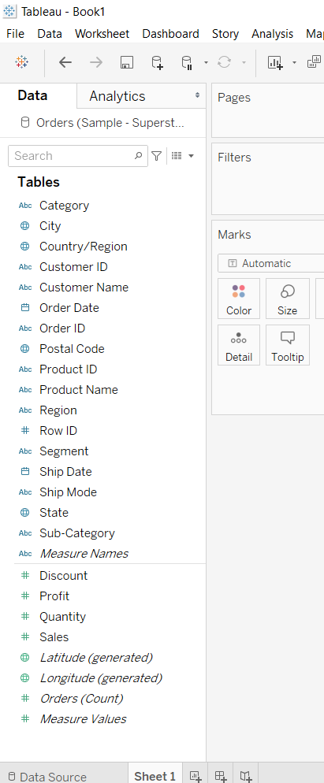
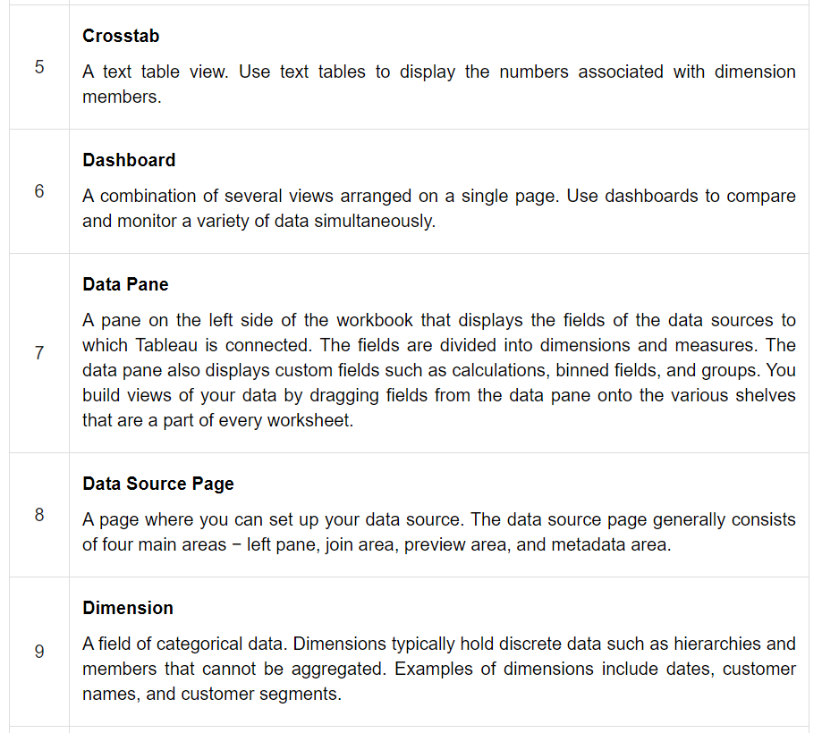


Slide 30
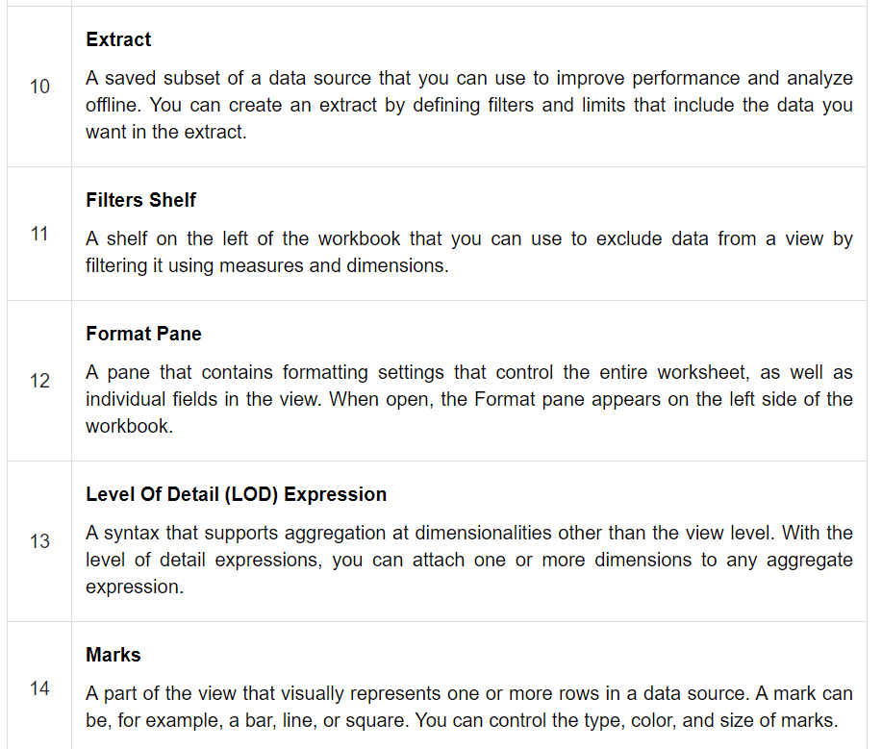

Slide 31
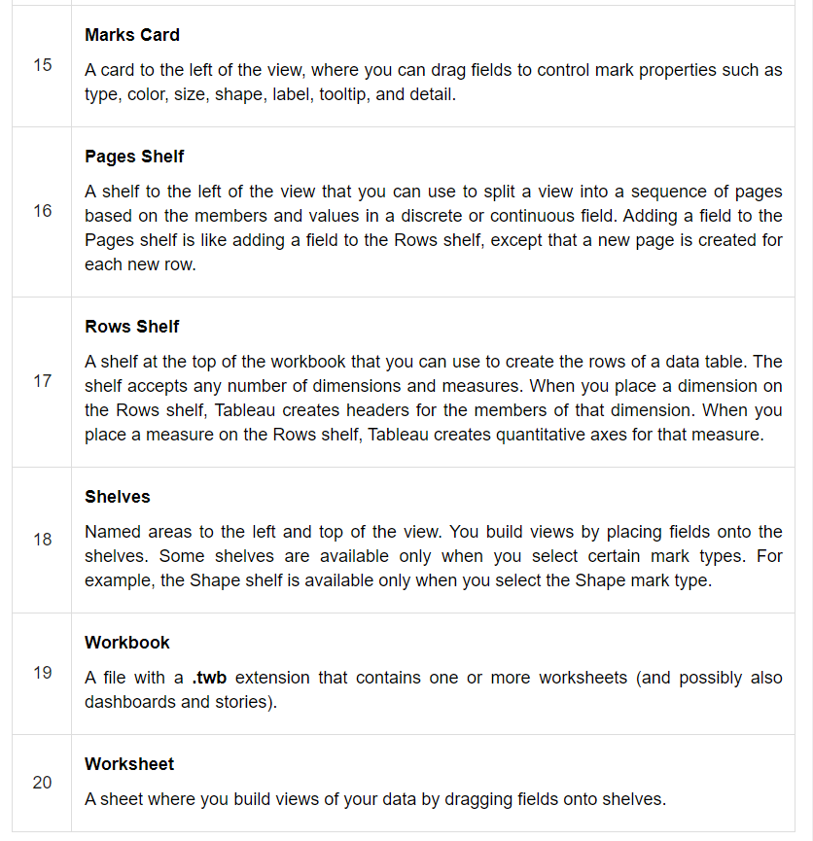

Slide 32
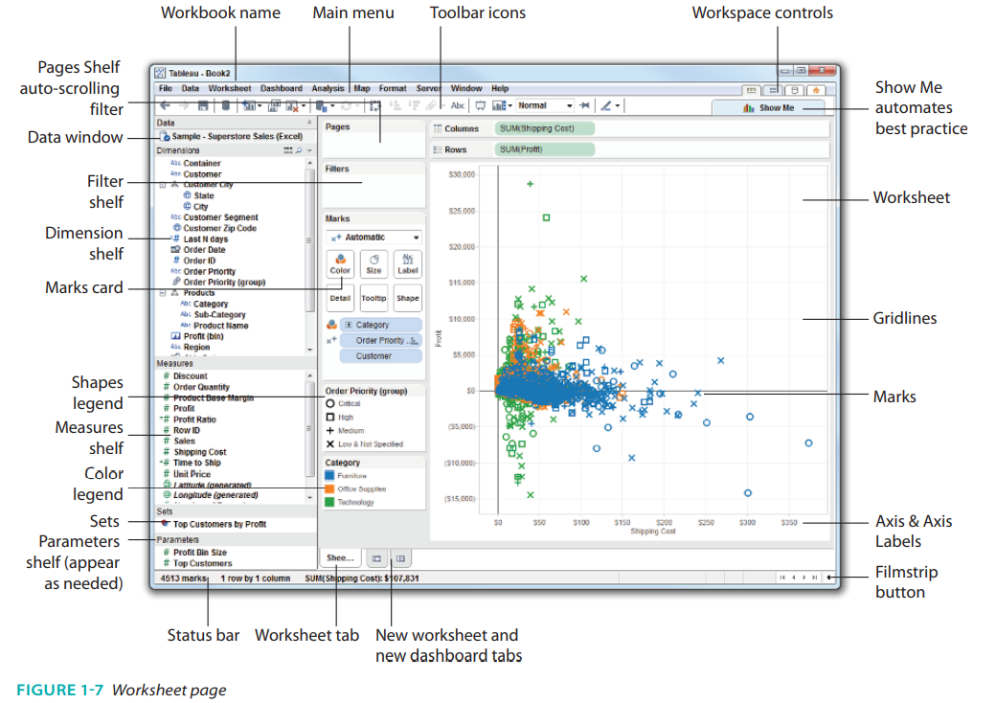
Tableau Workspace
Figure 1-7 is worksheet-connected to the Sample-Superstore Sales-Excel data set used to create scatter plots.
These Dimension shelf and
Measure shelf are for previous version of Tableau, in new version they are just separated by line

Slide 33
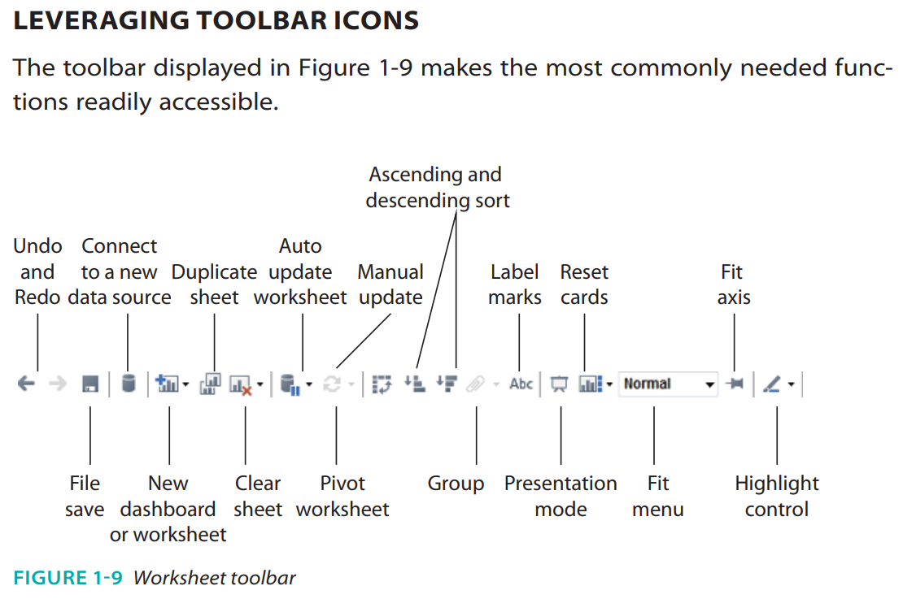

Note: for new versions of Tableau you may have some more icons , one of them is Show Mark Labels

Slide 34
Student Do: Noshow visualization
In this activity, you will be given visualizations that you will attempt to recreate using Tableau.
10 Minutes
Suggested Time:
15 minutes
Notes:
1.2

Slide 35
Activity: Explore Data
Create a line chart that compares the ages of patients against the total number of appointments. Then, split this graph based on scholarship and whether the patient showed up to their appointment.
  For this first step, you'll need to convert Age from a Measure to a Dimension.
Create a pair of bar charts that compare how many patients showed up to appointments versus how many were no-shows in different neighborhoods.
Create a stacked bar chart that compares no-shows to those who made it to their appointment based on the day of the week.
Create a pair of line graphs to compare age and diabetes in patients who showed up to appointments versus those who were no-shows.
Create a pair of line graphs to compare age and alcoholism in patients who showed up to appointments versus those who were no-shows.
Notes:
2.2

Slide 37
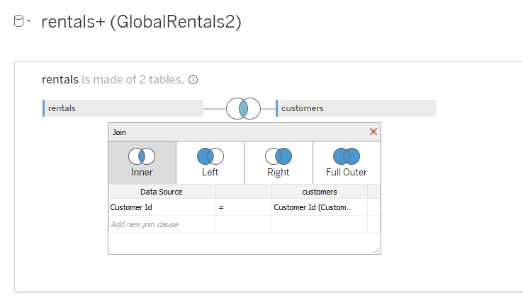
Instructor Do: Joins and Splitting Made Easy
Joins are a constant in data science, and they are often considered tedious and complex. Tableau, however, simplifies joins so much that even complex joins can be performed in just a few clicks.
Notes:
To change what type of join is used, simply click on the interlacing circles at the top of the application, and select what form of join to use from the menu, as in the following image; this same menu can be used to modify what columns to merge on.

Slide 38
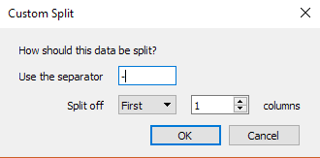
Instructor Do: Joins and Splitting Made Easy
Another interesting feature of Tableau is that columns containing text can be split to extract data
To do so, navigate to the first sheet and scroll through the data to select the column header whose values should be split, then right-click, and select "Transform" then "Custom Split" from the drop-down menu.
Select what character to split the text on, whether to split from the beginning or the end of the string, and then how many times the text should be split.
Split the "Rent Code" column on the first hyphen one time; this will extract the store id in which a movie was rented from the initial string.
Notes:
2.1

Slide 39
Instructor Demonstration: Easy Join
10 Minutes
Suggested Time:
5 minutes
Notes:
1.2

Slide 40
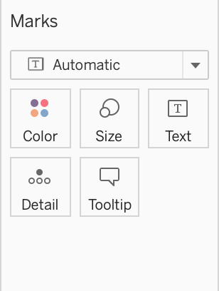
Instructor Do: Sizing, Coloring, and Labels
Marks, on the left side of the workbook, can be used to differentiate or add details to a chart's visuals.
Color lets users modify the color of chart elements.
Size lets users modify the size of chart elements.
Label lets users position text next to points on the chart.
Detail and Tooltip act like labels but only appear when the cursor hovers over the associated point or element on a chart.
Pills can be dragged to these marks to create visual effects.
Notes:
2.1

Slide 41
Student Do: UltimateCandy visualization
In this activity, you will be given visualizations that you will attempt to recreate using Tableau.
10 Minutes
Suggested Time:
15 minutes
Notes:
1.2

Slide 42
Activity: Explore Data
Using UltimateCandy.xlsx, visualize the following data:
Create a pair of bar graphs that chart the win percentage of each candy.
Create a scatter plot comparing the sugar percentage against the win percentage
Bonus:
  If you finish early, try experimenting with other possible visualization!
Hint:
  Don’t forget to save the file once finished.
Notes:
2.2

Slide 44


