Slide 1
RUHR-UNIVERSITÄT BOCHUM
[ RUB logo ]
Evaluating Germany's Proposed
Capacity Mechanism “Kraftwerksstrategie”
A two-layer evaluation: CRM literature review + a PyPSA model of the 2030 German power system
Group project · Energy Systems / Energy Economics · June 2026
Group members: [Name 1] · [Name 2] · [Name 3] · [Name 4]
Notes:
Good morning. Our project evaluates Germany's proposed capacity mechanism, the Kraftwerksstrategie. We do it in two layers: first a literature-based evaluation of capacity mechanisms, and then our own PyPSA model of the 2030 German power system that tests those ideas with real numbers. I'll introduce the team and then walk through both parts.

Slide 2
Agenda — Two Analytical Layers
PART 1 — Literature-based evaluation
• German electricity market & the 2030 fleet
• The Kraftwerksstrategie: what is planned
• Capacity-mechanism (CRM) taxonomy
• Where the policy sits in the taxonomy
• What the literature finds about CRMs
• Expected impact on electricity prices
PART 2 — Model-based evaluation
• The PyPSA model & two scenarios (A vs B)
• Data, assumptions and the code
• Prices, security of supply, gas use
• Curtailment and dispatch
• Results summary (A vs B)
• Synthesis, limitations & conclusion
Ruhr-Universität Bochum · Kraftwerksstrategie · June 2026
2
Notes:
The talk has two halves. Part 1 is the theory: we explain the German market, the policy itself, and what the academic literature says capacity mechanisms do. Part 2 is our own evidence: a PyPSA model that compares 2030 without the policy (Scenario A) against 2030 with it (Scenario B). We end by checking whether our model agrees with the literature.

Slide 3
Motivation & Research Question
PART 1 · Literature
Germany is removing firm capacity (nuclear gone, coal exiting) while adding weather-dependent wind and solar. This raises a classic worry: will there be enough controllable power on a cold, dark, windless evening?
The policy under evaluation
• The Kraftwerksstrategie pays for ~10 GW of new hydrogen-ready gas to guarantee that firm capacity.
Research question
In 2030, how does adding the Kraftwerksstrategie's firm capacity change Germany's security of supply, electricity prices, gas use and CO₂ emissions?
Ruhr-Universität Bochum · Kraftwerksstrategie · June 2026
3
Notes:
Based on literature sources only. The motivation is simple: Germany is shutting down nuclear and coal while leaning more on wind and solar, which don't blow or shine on demand. The policy's answer is to fund about ten gigawatts of new hydrogen-ready gas. Our research question is what that firm capacity actually does in 2030 to security of supply, prices, gas use and emissions.

Slide 4
The German Market & the 2030 Fleet
PART 1 · Literature
Where the system is heading
• Energy-only market: generators earn only from selling energy, not for being available
• Nuclear phased out (2023); coal exiting under the KVBG coal-exit law
• Renewables scaling fast under the EEG 2023 (target: 80% of demand by 2030)
• Gap on low-wind, low-sun hours must be covered by firm, controllable capacity
• Concern: the “missing-money” problem may under-reward new firm plants
Planned 2030 capacity (official targets)
• Solar PV: 215 GW (EEG 2023)
• Wind onshore / offshore: 115 / 30 GW (EEG 2023)
• Lignite / hard coal: 9 / 8 GW (KVBG ceiling)
• Existing gas (CCGT + OCGT): 20 + 14 GW
• Storage (battery + pumped-hydro): 25 + 9.4 GW (NEP)
• + Policy: 10 GW new H₂-ready gas (Scenario B)
Ruhr-Universität Bochum · Kraftwerksstrategie · June 2026
4
Notes:
Based on literature sources only. Two things to take away. On the left, Germany runs an energy-only market and is removing firm capacity while adding renewables, which creates the adequacy concern. On the right are the official 2030 fleet targets we use: huge solar and wind, much less coal, the existing gas fleet, storage, and the policy's extra ten gigawatts of new gas in Scenario B. These come from the EEG, the coal-exit law, and the grid operators' scenario.

Slide 5
The Kraftwerksstrategie — What Is Planned
PART 1 · Literature
Feb 2024
15 Jan 2026
2026
by 2031
2032 → 2045
Initial strategy
agreed (draft)
Agreement with
EU Commission
Tender 12 GW
(10 GW long-run gas)
New plants enter
operation
Capacity market;
full H2 by 2045
Key facts (BMWE, 15 January 2026)
• 12 GW of new controllable capacity tendered in 2026; 10 GW carry a long-running criterion (efficient gas)
• All plants hydrogen-ready and fully decarbonised by 2045; early-conversion incentives
• Followed by a comprehensive, technology-open capacity market introduced in 2027 and operating from 2032
• Support is paid for availability via auction (not for energy) → a capacity remuneration mechanism
Ruhr-Universität Bochum · Kraftwerksstrategie · June 2026
5
Notes:
Based on literature sources only. The policy was settled with the European Commission on 15 January 2026. The first step tenders 12 GW of new controllable capacity, of which 10 GW must run for long periods — in practice efficient, hydrogen-ready gas, online by 2031. It is followed by a permanent capacity market from 2032. Crucially, plants are paid for being available, which is what makes this a capacity remuneration mechanism — the object of our study.

Slide 6
Capacity Mechanisms — A Taxonomy
PART 1 · Literature
Two axes: TARGETED vs MARKET-WIDE, and price-based vs quantity-based (a volume is set, an auction finds the price).
TARGETED
MARKET-WIDE
Strategic reserve
Quantity-based · held outside the market (DE, SE, FI)
Capacity payment
Price-based · fixed €/MW to all (Spain, hist.)
Tender for new capacity
Quantity-based · auction for specific new plant
Central-buyer capacity market
Quantity-based · auction (GB, PL, IE)
Capacity obligation
On suppliers (FR)
Reliability options
+ refund above strike (IT, IE)
Highlighted = the Kraftwerksstrategie's first-stage instrument. Sources: Bublitz et al. (2019); ACER & CEER (2013).
Ruhr-Universität Bochum · Kraftwerksstrategie · June 2026
6
Notes:
Based on literature sources only. Capacity mechanisms split on two axes. Targeted ones pay only a ring-fenced subset, like a strategic reserve; market-wide ones pay all eligible capacity. Price-based fix the payment; quantity-based fix a volume and let an auction set the price. Germany's tender for new capacity — highlighted — is a targeted, quantity-based instrument.

Slide 7
Where the Kraftwerksstrategie Sits
PART 1 · Literature
A two-stage shift: from a minimal reserve, to a targeted tender, toward an enduring market-wide market.
PAST
STAGE 1 (now)
STAGE 2 (2032)
Strategic reserve
Targeted · held outside
the market
Tender for new capacity
Targeted · quantity-based
auction (~10 GW gas)
Market-wide capacity market
Market-wide · quantity-based
(technology-open)
Classification
• Stage 1 = a targeted, quantity-based tender for new capacity; Stage 2 = a market-wide capacity market.
• A clear departure from Germany's decade-long preference for an energy-only market plus a strategic reserve.
Ruhr-Universität Bochum · Kraftwerksstrategie · June 2026
7
Notes:
Based on literature sources only. The Kraftwerksstrategie is really two instruments. Stage one, now, is a targeted tender for about ten gigawatts of new gas. Stage two, from 2032, is a market-wide capacity market. This is a major shift, because for a decade Germany deliberately relied on an energy-only market plus a small strategic reserve. Our model focuses on Stage one — the ten gigawatts.

Slide 8
Literature: How CRMs Affect Markets
PART 1 · Literature
Cramton & Stoft (2005); Joskow (2008)
"Missing money": energy-only markets under-reward firm capacity; price caps truncate scarcity rents.
Bublitz et al. (2019)
CRMs cut price spikes and volatility, shifting remuneration from energy rents to stable capacity payments.
Bhagwat et al. (2017)
CRMs improve adequacy and damp the investment cycle — but add capacity and consumer cost; sensitive to the target.
Newbery (2016)
Interconnectors are partial substitutes for capacity; "missing markets" justify forward capacity auctions.
European Parliament (2017)
Market-wide payments can hand windfall profits to incumbent plants; reliability options curb this.
Ruhr-Universität Bochum · Kraftwerksstrategie · June 2026
8
Notes:
Based on literature sources only. Five strands matter. Cramton and Stoft, and Joskow, define the missing-money problem. Bublitz and colleagues show CRMs cut price spikes and shift income to capacity payments. Bhagwat and colleagues show they improve adequacy but raise cost. Newbery stresses interconnectors as substitutes. And the European Parliament warns about windfall profits for existing plants. These become the predictions we test.

Slide 9
Expected Impact on Prices — Part 1 Synthesis
PART 1 · Literature
From the literature, adding firm capacity to a high-renewable system should:
• Reduce scarcity (loss-of-load) hours
• Reduce unserved energy
• Lower or keep the average price
• Strongly reduce price volatility & spikes
• Lower the utilisation of existing gas (dilution)
• Leave renewable curtailment roughly unchanged
• Raise total system cost (textbook view) — unless efficient plant displaces costlier generation
• Ambiguous effect on CO₂ (coal vs imports)
These become our test hypotheses
• Part 2 builds a model of the 2030 system and checks each expectation against real model output.
Ruhr-Universität Bochum · Kraftwerksstrategie · June 2026
9
Notes:
Based on literature sources only. This slide is the bridge to our model. Theory predicts less scarcity, lower and far less volatile prices, lower gas utilisation, roughly unchanged curtailment, higher cost in the textbook view, and an ambiguous carbon effect. In Part 2 we test every one of these against our own results.

Slide 10
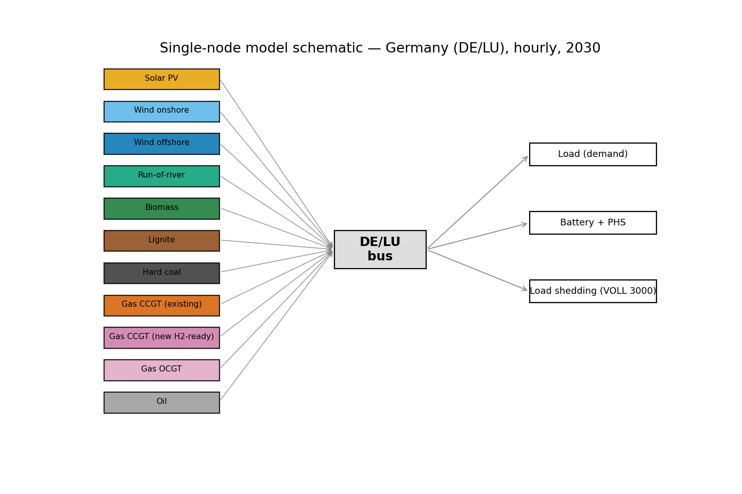
Part 2 — The PyPSA Model
PART 2 · Model
• Single-node (DE/LU) hourly dispatch model
• Open-source PyPSA, solved with HiGHS
• 8,760 hours; least-cost dispatch each hour
• Calibrated on real 2025 data (0.4% price error), then projected to 2030
Two scenarios
• A — WITHOUT new capacity (0 GW): no CRM
• B — WITH new capacity (+10 GW H₂-ready CCGT)
Ruhr-Universität Bochum · Kraftwerksstrategie · June 2026
10
Notes:
All values from the uploaded PyPSA model output (comparison_table.csv); identical to the report. Our model treats Germany as one bus, dispatching every hour of the year at least cost with the open-source PyPSA and HiGHS tools. We first reproduced the real 2025 price to within half a percent, then projected to 2030 and compared two scenarios: without the new capacity (A) and with the policy's ten gigawatts (B).

Slide 11
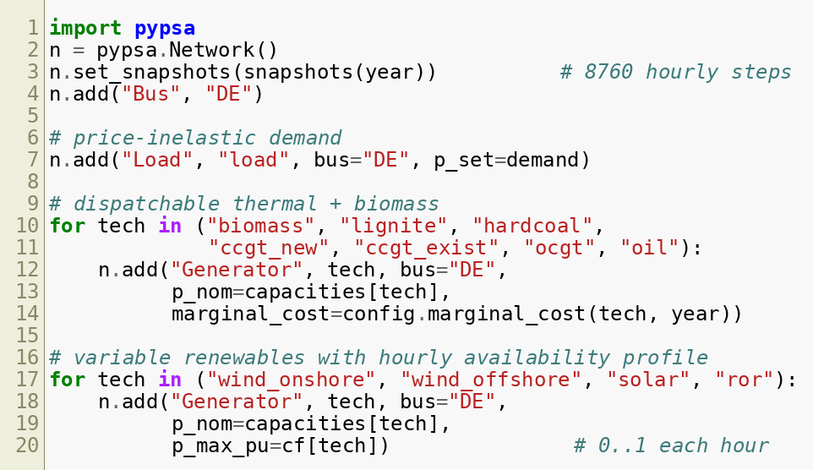
Inside the Model — Code Highlight
PART 2 · Model
What the code does
• Creates one electricity bus
• Adds demand for every hour
• Adds each generator with its capacity and marginal cost
• Renewables enter with their hourly availability profile
Extract from model.py (built with PyPSA).
Ruhr-Universität Bochum · Kraftwerksstrategie · June 2026
11
Notes:
All values from the uploaded PyPSA model output; identical to the report. This is a real extract of our model code. It builds the single bus, adds hourly demand, and adds each power plant with its capacity and running cost; renewables come in with their real hourly availability. The full runnable code is in the project folder, so every result is reproducible.

Slide 12
Key Data & Assumptions (2030)
PART 2 · Model
Parameter | Value | Source
Gross electricity demand | 680 TWh | NEP Szenariorahmen 2025
Solar / onshore / offshore wind | 215 / 115 / 30 GW | EEG 2023; NEP 2025
Lignite / hard coal (2030) | 9 / 8 GW | KVBG coal-exit
Existing gas CCGT / OCGT | 20 / 14 GW | ENTSO-E / BNetzA
New H₂-ready CCGT (Scenario B) | +10 GW (η 60%) | Kraftwerksstrategie; Danish Energy Agency
Battery / pumped-hydro storage | 25 / 9.4 GW | NEP 2025
CO₂ (EUA) price | 110 EUR/t | NEP / Langfristszenarien
Gas / hard-coal fuel price | 30 / 11 EUR/MWh_th | Scenario assumption
Value of lost load (VOLL) | 3000 EUR/MWh | ACER / ENTSO-E ERAA
Cross-border imports | <=20 GW at 150 EUR/MWh | ~German NTC; stress price
Ruhr-Universität Bochum · Kraftwerksstrategie · June 2026
12
Notes:
All values from the uploaded model output; identical to the report. These are the main inputs for 2030: the renewable targets from the EEG, coal capped by the coal-exit law, a carbon price of 110 euros, and a value of lost load of 3000 euros per megawatt-hour that prices scarcity. Only one number changes between scenarios — the ten gigawatts of new gas.

Slide 13
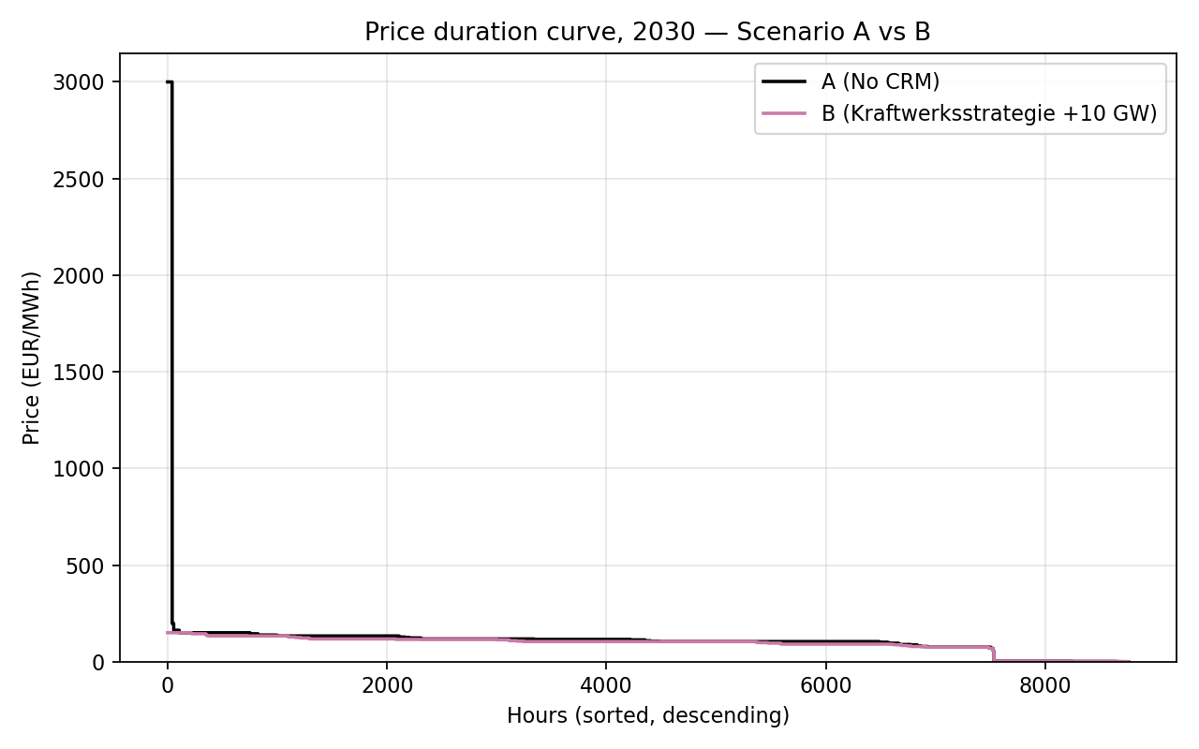
Wholesale Prices — Without (A) vs With (B)
PART 2 · Model
Mean price €113 → €93/MWh; volatility -80%. The new capacity removes the extreme price spikes.
Price-duration curve, 2030 — Scenario A (no CRM) vs Scenario B (+10 GW).
Ruhr-Universität Bochum · Kraftwerksstrategie · June 2026
13
Notes:
All values from the uploaded PyPSA model output (comparison_table.csv); identical to the report. In scenario A a few hours spike to the value of lost load. Adding the gas in B caps those hours, so the average price falls about eighteen per cent and volatility about eighty per cent, while the typical hour barely changes — exactly what the literature predicted.

Slide 14
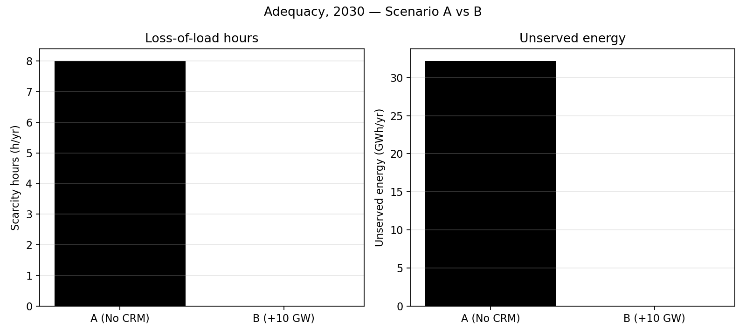
Security of Supply — Without (A) vs With (B)
PART 2 · Model
Scarcity hours 8 -> 0; unserved energy 32 -> 0 GWh.
Loss-of-load hours and unserved energy, 2030 — Scenario A vs B.
Ruhr-Universität Bochum · Kraftwerksstrategie · June 2026
14
Notes:
All values from the uploaded PyPSA model output; identical to the report. This is the clearest result: the new capacity removes the residual loss-of-load hours entirely, taking unserved energy to zero. Even with imports available, scenario A keeps a small adequacy gap that the policy closes.

Slide 15
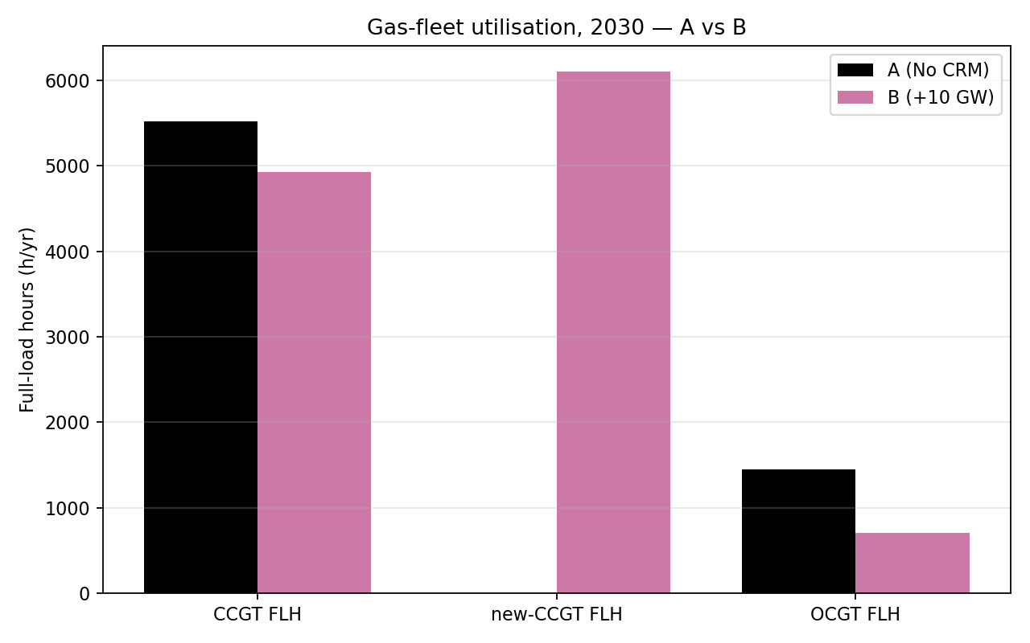
Gas-Fleet Utilisation — Without (A) vs With (B)
PART 2 · Model
CCGT full-load hours 5517 -> 4926 (-11%): the capacity-dilution effect.
Gas-fleet full-load hours, 2030 — Scenario A vs B.
Ruhr-Universität Bochum · Kraftwerksstrategie · June 2026
15
Notes:
All values from the uploaded model output; identical to the report. As theory predicts, adding capacity dilutes utilisation: the existing gas runs fewer hours and the old peakers roughly halve, because the efficient new plant displaces them in the merit order.

Slide 16
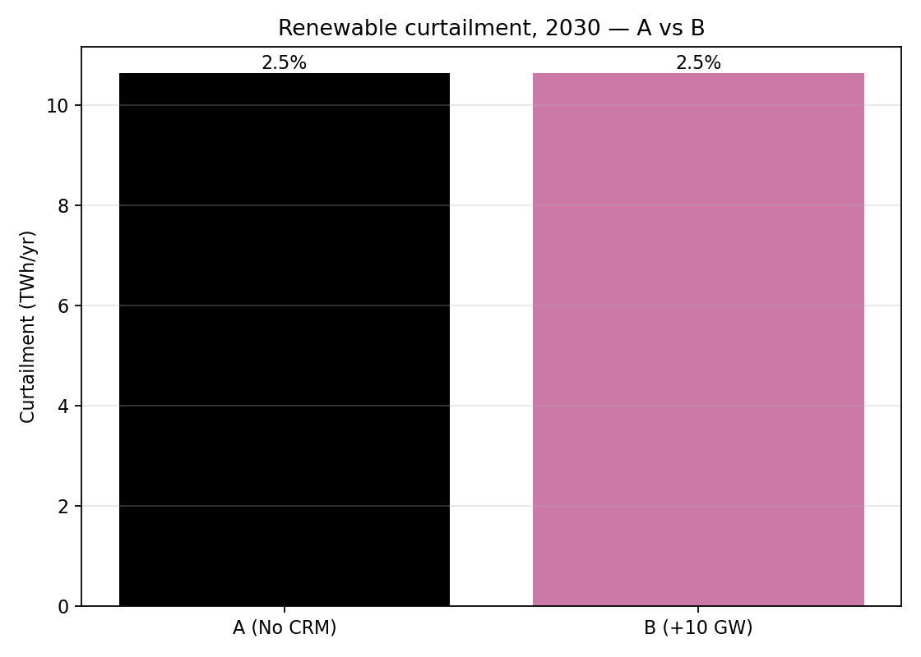
Renewable Curtailment — Without (A) vs With (B)
PART 2 · Model
Curtailment unchanged at 2.5% - firm capacity does not run in renewable-surplus hours.
Annual renewable curtailment, 2030 — Scenario A vs B.
Ruhr-Universität Bochum · Kraftwerksstrategie · June 2026
16
Notes:
All values from the uploaded model output; identical to the report. Curtailment is identical in both scenarios, again as predicted: firm gas only runs when there is a deficit, never in the surplus hours when renewables are spilled, so it cannot change curtailment.

Slide 17
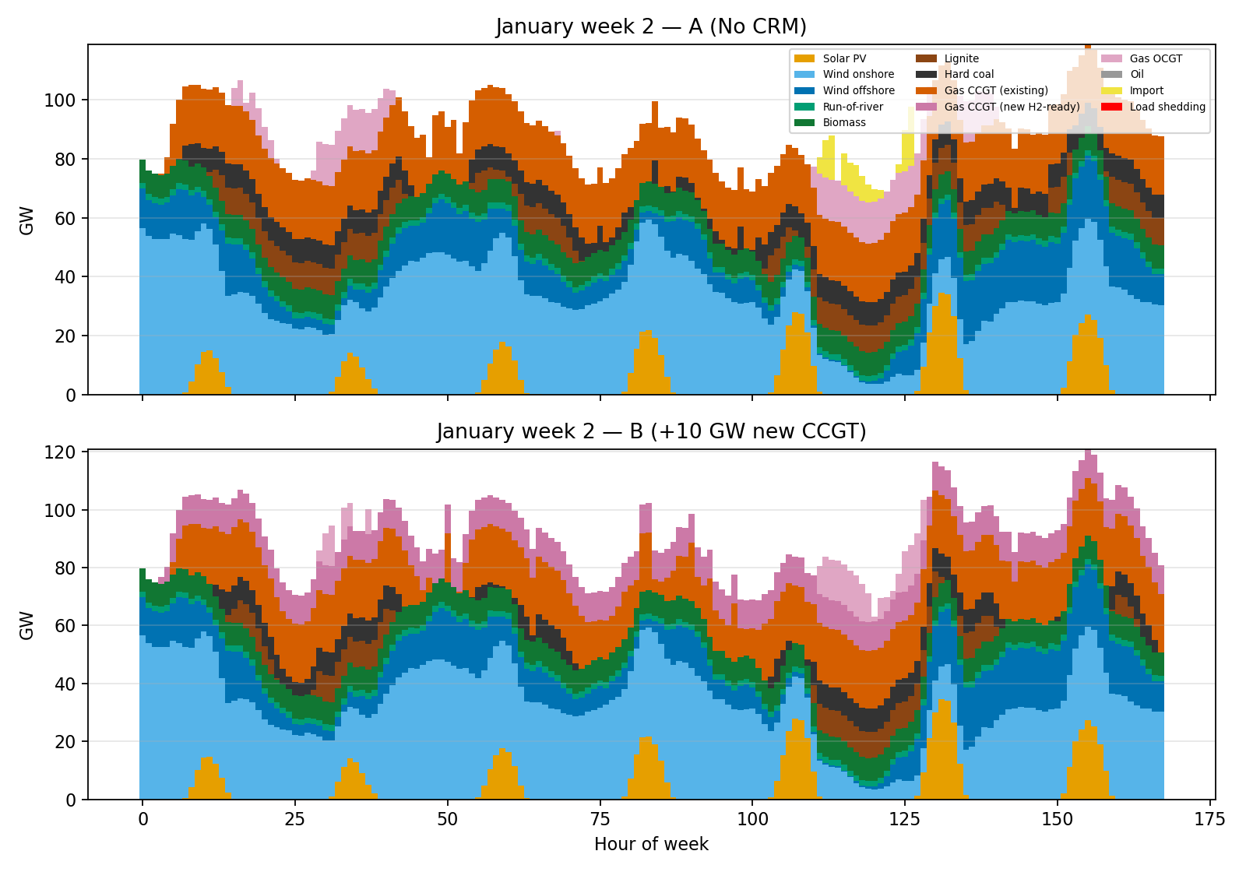
A Winter Week — Without (A) vs With (B)
PART 2 · Model
Scenario A reaches scarcity in the tightest winter hours; in B the new CCGT covers the same load comfortably.
Hourly dispatch, second week of January 2030 — Scenario A (top) vs B (bottom).
Ruhr-Universität Bochum · Kraftwerksstrategie · June 2026
17
Notes:
All values from the uploaded model output; identical to the report. This winter week makes the mechanism concrete. In A the system strains and hits scarcity prices; in B the new hydrogen-ready gas fills the gap, which is where almost all of the policy's value is concentrated.

Slide 18
Results Summary — Without (A) vs With (B)
PART 2 · Model
Metric | Without (A) | With (B) | Change
Mean wholesale price (EUR/MWh) | 113.0 | 92.6 | -18.1%
Price volatility, std (EUR/MWh) | 205.0 | 40.2 | -80.4%
Scarcity (loss-of-load) hours | 8 | 0 | -100%
Unserved energy (GWh/yr) | 32.2 | 0.0 | -100%
CCGT full-load hours (h/yr) | 5517 | 4926 | -10.7%
Renewable curtailment (%) | 2.5 | 2.5 | 0%
Renewable share of generation (%) | 72.4 | 71.8 | -0.9%
Net imports (TWh/yr) | 7.1 | 1.6 | -77.9%
CO₂ emissions (Mt/yr) | 101.3 | 88.7 | -12.4%
Total system cost (bn EUR/yr) | 26.75 | 25.80 | -3.5%
All values copied directly from comparison_table.csv (PyPSA + HiGHS model output).
Ruhr-Universität Bochum · Kraftwerksstrategie · June 2026
18
Notes:
All values from the uploaded PyPSA model output (comparison_table.csv); identical to the report. This is the headline table. With the new capacity, prices and volatility fall, scarcity and unserved energy go to zero, gas utilisation falls, emissions and imports drop, and — because the efficient plant displaces costlier generation — even total system cost is slightly lower.

Slide 19
Do the Model Results Match the Literature?
SYNTHESIS
Literature expectation | Model result (A → B) | Verdict
Adequacy improves (Bublitz 2019; Bhagwat 2017) | scarcity 8 → 0 h; unserved → 0 | Agree
Spikes & volatility fall (Bublitz 2019) | volatility -80%; spikes removed | Agree
Existing-plant dilution (merit order) | CCGT FLH -11%; OCGT -51% | Agree
Curtailment ~ unchanged | identical at 2.5% | Agree
Total cost RISES — textbook (Bhagwat 2017) | cost -3.5% (falls) | Diverge
“Missing money” (Cramton & Stoft 2005; Joskow 2008) | spikes that would fund the plant are removed | Illustrated
Interconnectors substitute (Newbery 2016) | imports -78%; benefit modest | Agree
The one divergence — explained
• Textbooks treat new capacity as idle “insurance”, so cost rises. Here the efficient new gas (MC ≈ €91) displaces costlier gas, peakers and imports, so it pays for its own build cost — cost falls slightly.
Ruhr-Universität Bochum · Kraftwerksstrategie · June 2026
19
Notes:
Almost every prediction holds: better adequacy, lower volatility, diluted gas use, unchanged curtailment, and the missing-money logic. The single divergence is cost: textbooks expect it to rise, but ours falls about three and a half per cent, because the new plant is efficient enough to displace costlier supply and pay for itself. We flag this honestly as our most interesting finding.

Slide 20
What This Means for German Prices
SYNTHESIS
€113 → €93
-80%
8 → 0 h
Mean wholesale price (−18%)
Price volatility (spikes removed)
Scarcity hours (supply secured)
The headline
• The Kraftwerksstrategie mainly removes the rare, extreme price spikes — the typical (median) hour barely changes.
• Result: a lower and far steadier wholesale price, plus firm security of supply, with lower CO₂ and imports.
• Caveat: these are WHOLESALE prices; consumer bills also include taxes, levies and grid fees, which we do not model.
Ruhr-Universität Bochum · Kraftwerksstrategie · June 2026
20
Notes:
All values from the uploaded model output; identical to the report. The takeaway is that the policy works mainly by removing the rare, violent price spikes — the average and the volatility drop sharply, while the typical hour barely moves. That means steadier wholesale prices and secured supply. One honesty note: these are wholesale prices, not the final consumer bill, which also includes taxes and grid fees.

Slide 21
Limitations of the Model
SYNTHESIS
Single node (copper-plate)
All of Germany is one bus, so internal grid congestion is ignored → curtailment is understated, gas use overstated.
Dispatch-only, no investment choice
The model is told to build 10 GW; it does not decide the optimal amount.
Perfect foresight
It plans the whole year knowing all weather in advance, so the system runs more smoothly than reality.
Single weather & data year (2025)
One year of weather/demand; a harsher year would change the scarcity result.
Simplified costs; no taxes/levies
Single fuel/CO₂ prices, no plant outages or start-up costs; wholesale only, no subsidy or consumer-bill layer.
Ruhr-Universität Bochum · Kraftwerksstrategie · June 2026
21
Notes:
We are honest about five limits. One node hides grid congestion, which is why curtailment looks low and gas hours high. The model only dispatches, it does not choose how much to build. Perfect foresight makes the system run too smoothly. We used one weather year, so the exact scarcity number is fragile. And costs are simplified, wholesale only — no taxes, subsidy or consumer bills. None of these change the direction of the findings.

Slide 22
Conclusion & Key Takeaways
SYNTHESIS
• The Kraftwerksstrategie's +10 GW removes the residual loss-of-load hours (8 → 0) and unserved energy → secured supply.
• It lowers the mean wholesale price (−18%) and collapses volatility (−80%) by removing scarcity spikes.
• It dilutes existing-gas use and cuts CO₂ (−12%) and imports (−78%); curtailment is unchanged.
• At 2030 prices the efficient plant pays for itself — yet the energy-only market may still under-deliver it (missing money), which is the rationale for the mechanism.
Outlook
• Open, transparent models like PyPSA are increasingly the standard for CRM and adequacy analysis — reproducible, extensible to multi-year, multi-region and capacity-expansion studies.
Ruhr-Universität Bochum · Kraftwerksstrategie · June 2026
22
Notes:
To conclude: the policy secures supply, lowers and steadies prices, and cuts emissions and imports, with curtailment unchanged. The efficient plant pays for itself at 2030 prices, yet the energy-only market may still fail to deliver it — the missing-money rationale for the mechanism. And looking forward, open models like PyPSA are becoming the standard tool for exactly this kind of adequacy and capacity-mechanism analysis.

Slide 23
References (APA 7th)
ACER & CEER. (2013). Capacity remuneration mechanisms and the internal market for electricity.
Bhagwat, P. C., Iychettira, K. K., Richstein, J. C., Chappin, E. J. L., & de Vries, L. J. (2017). The effectiveness of capacity markets in the presence of a high portfolio share of renewable energy sources. Utilities Policy, 48, 76–91.
Brown, T., Hörsch, J., & Schlachtberger, D. (2018). PyPSA: Python for Power System Analysis. Journal of Open Research Software, 6(1), 4.
Bublitz, A., Keles, D., Zimmermann, F., Fraunholz, C., & Fichtner, W. (2019). A survey on electricity market design: Insights on capacity remuneration mechanisms. Energy Economics, 80, 1059–1078.
Cramton, P., & Stoft, S. (2005). A capacity market that makes sense. The Electricity Journal, 18(7), 43–54.
Danish Energy Agency. (2024). Technology data for generation of electricity and district heating.
European Parliament. (2017). Capacity mechanisms for electricity (Briefing PE 603.949). EPRS.
European Union. (2019). Regulation (EU) 2019/943 on the internal market for electricity. OJ L 158, 54–124.
Huangfu, Q., & Hall, J. A. J. (2018). Parallelizing the dual revised simplex method (HiGHS). Mathematical Programming Computation, 10(1), 119–142.
Joskow, P. L. (2008). Capacity payments in imperfect electricity markets: Need and design. Utilities Policy, 16(3), 159–170.
Newbery, D. (2016). Missing money and missing markets: Reliability, capacity auctions and interconnectors. Energy Policy, 94, 401–410.
50Hertz, Amprion, TenneT, & TransnetBW. (2025). Szenariorahmen zum Netzentwicklungsplan Strom 2037/2045 (V. 2025).
Bundesministerium für Wirtschaft und Energie. (2026, Jan 15). Grundsatzeinigung über Eckpunkte der Kraftwerksstrategie [Press release].
Umweltbundesamt. (2022). CO₂ emission factors for fossil fuels (CC 29/2022).
Ruhr-Universität Bochum · Kraftwerksstrategie · June 2026
23
Notes:
These are the real sources behind the deck, in APA 7th style, identical to the report's reference list — the core CRM literature, the EU electricity regulation, the PyPSA and HiGHS tool papers, and the official German data and policy sources. Happy to point to any specific one.

Slide 24
Thank you — Questions?
Evaluating Germany's Kraftwerksstrategie · Literature review + PyPSA model of the 2030 power system
Ruhr-Universität Bochum · June 2026
Notes:
Thank you for listening. To summarise in one line: a literature review and our own PyPSA model both show the Kraftwerksstrategie secures supply and lowers and steadies 2030 prices — and the model quantifies it. I'm happy to take questions.

