Slide 1
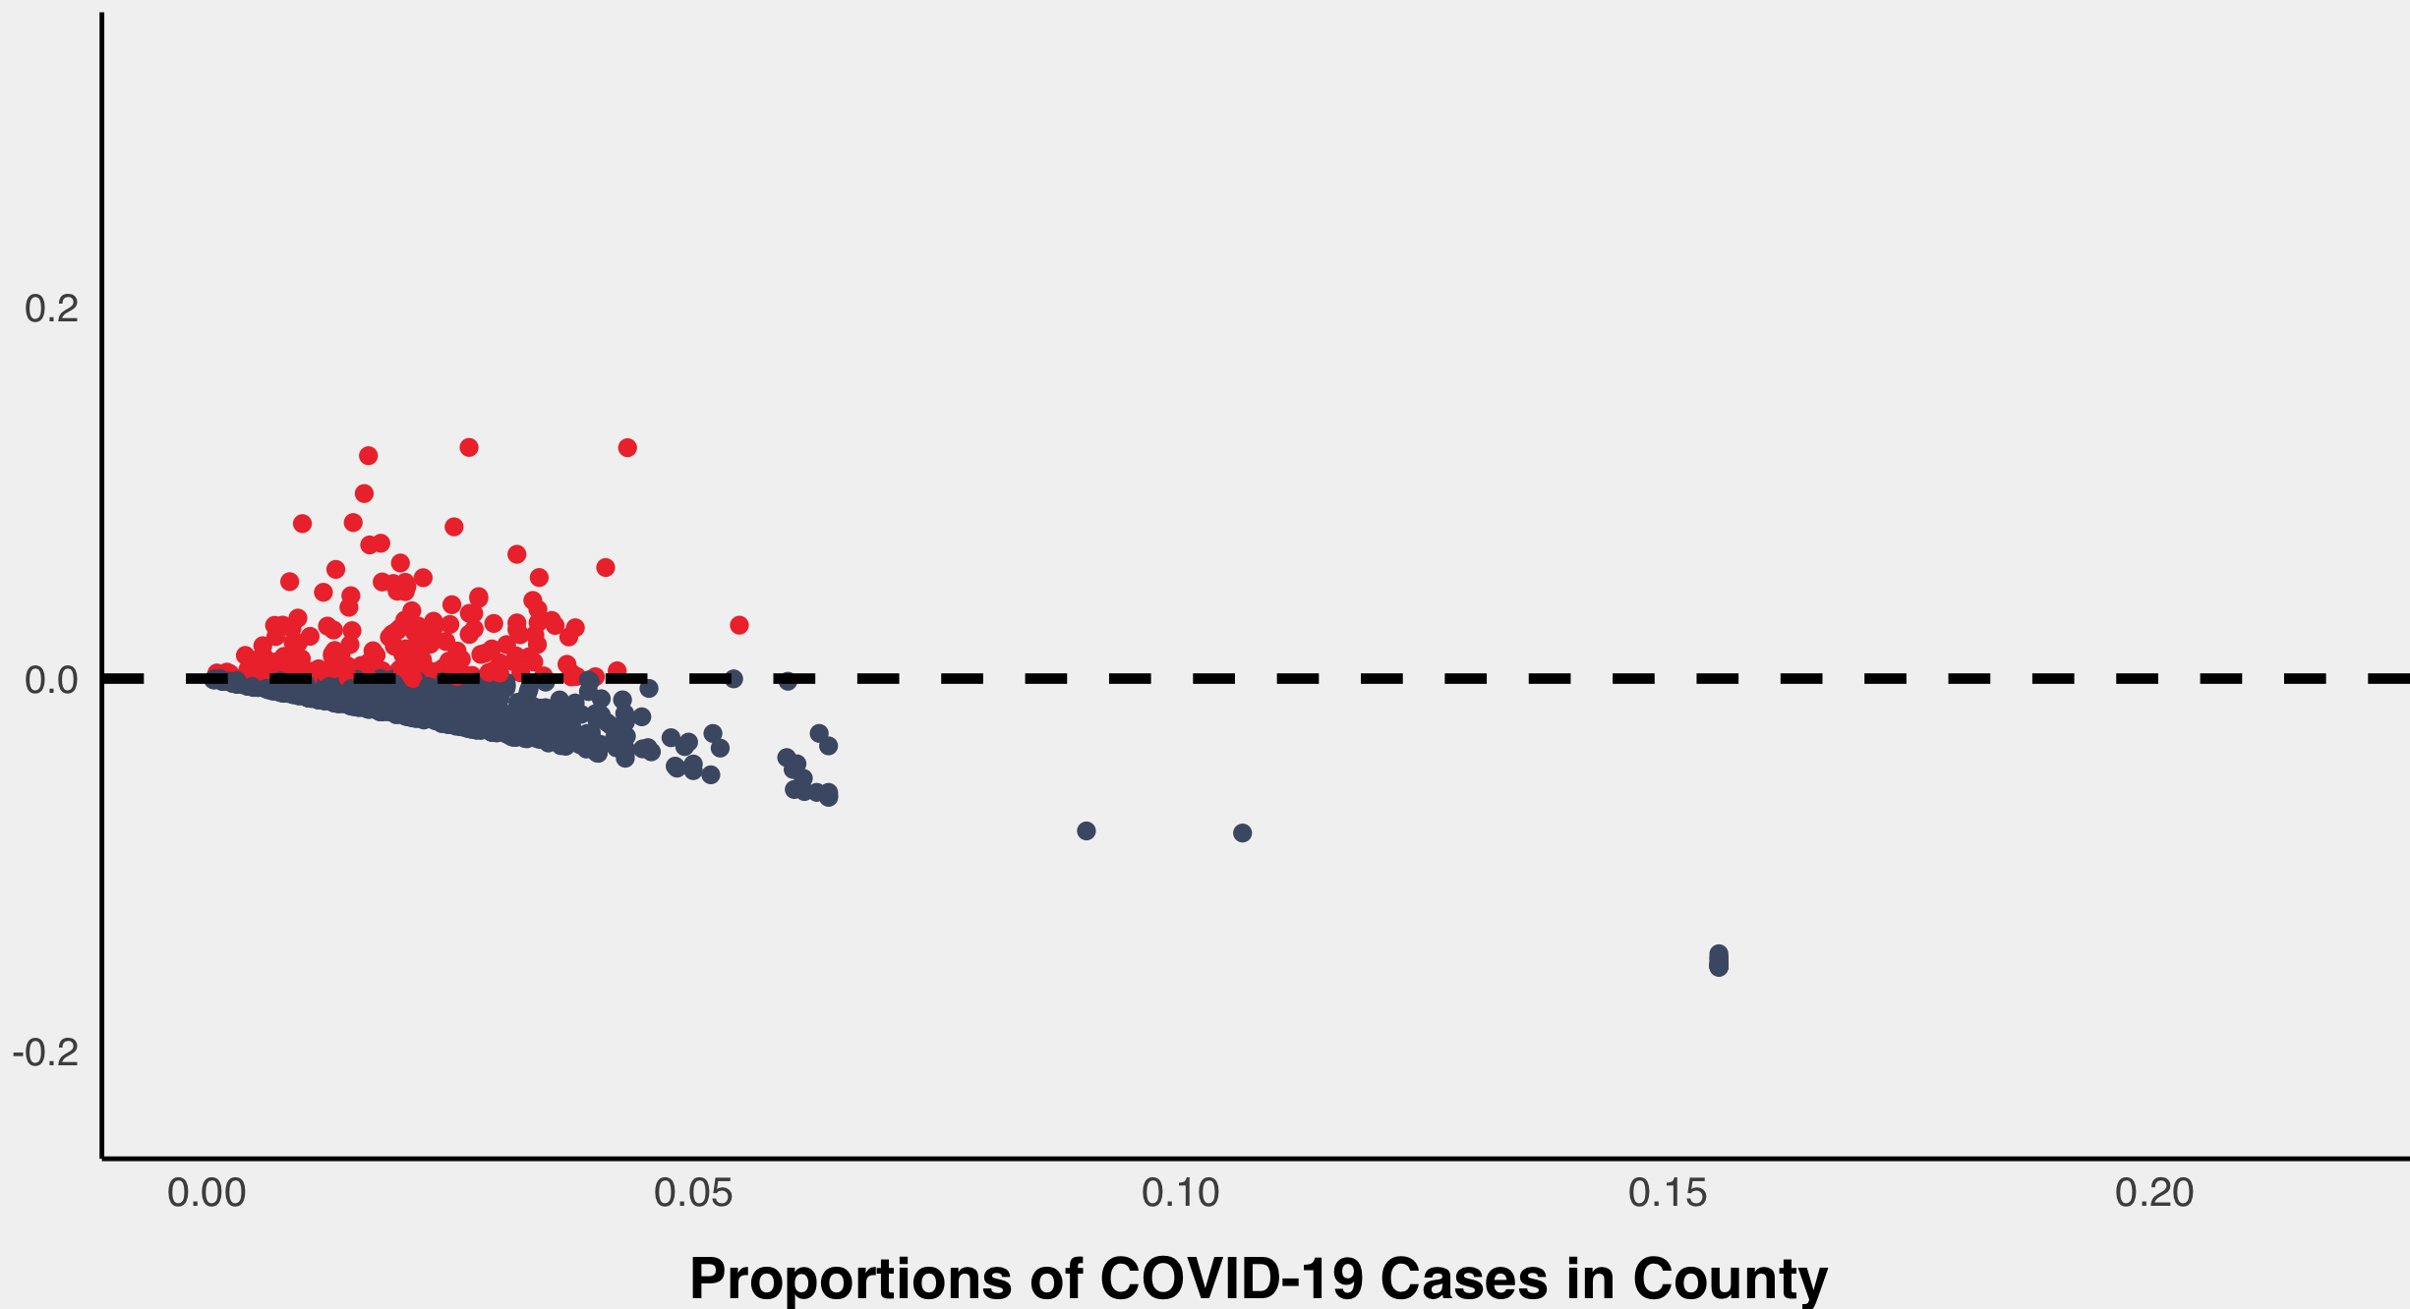
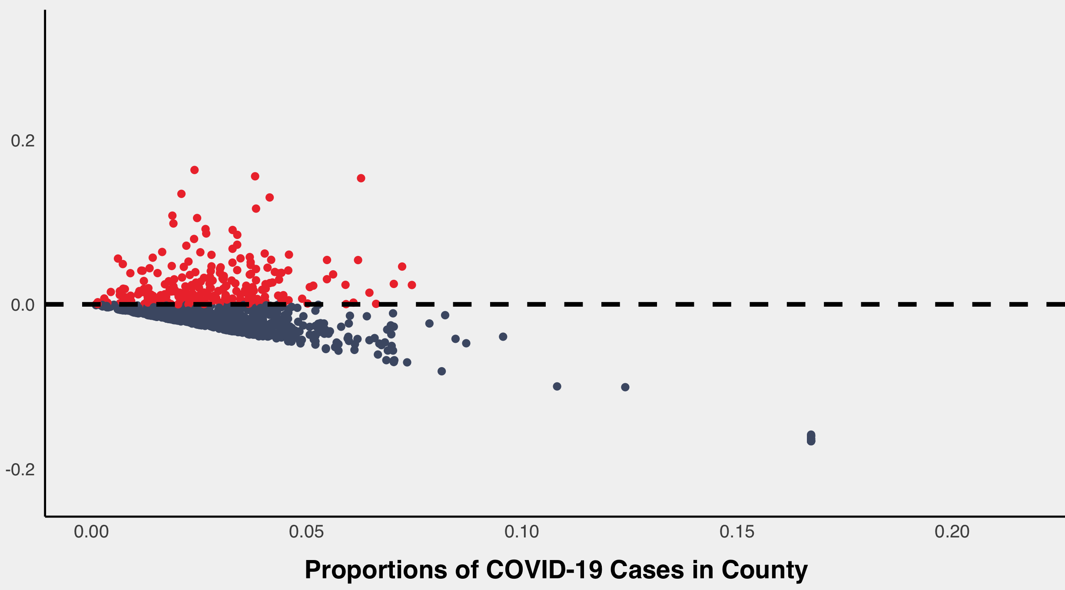
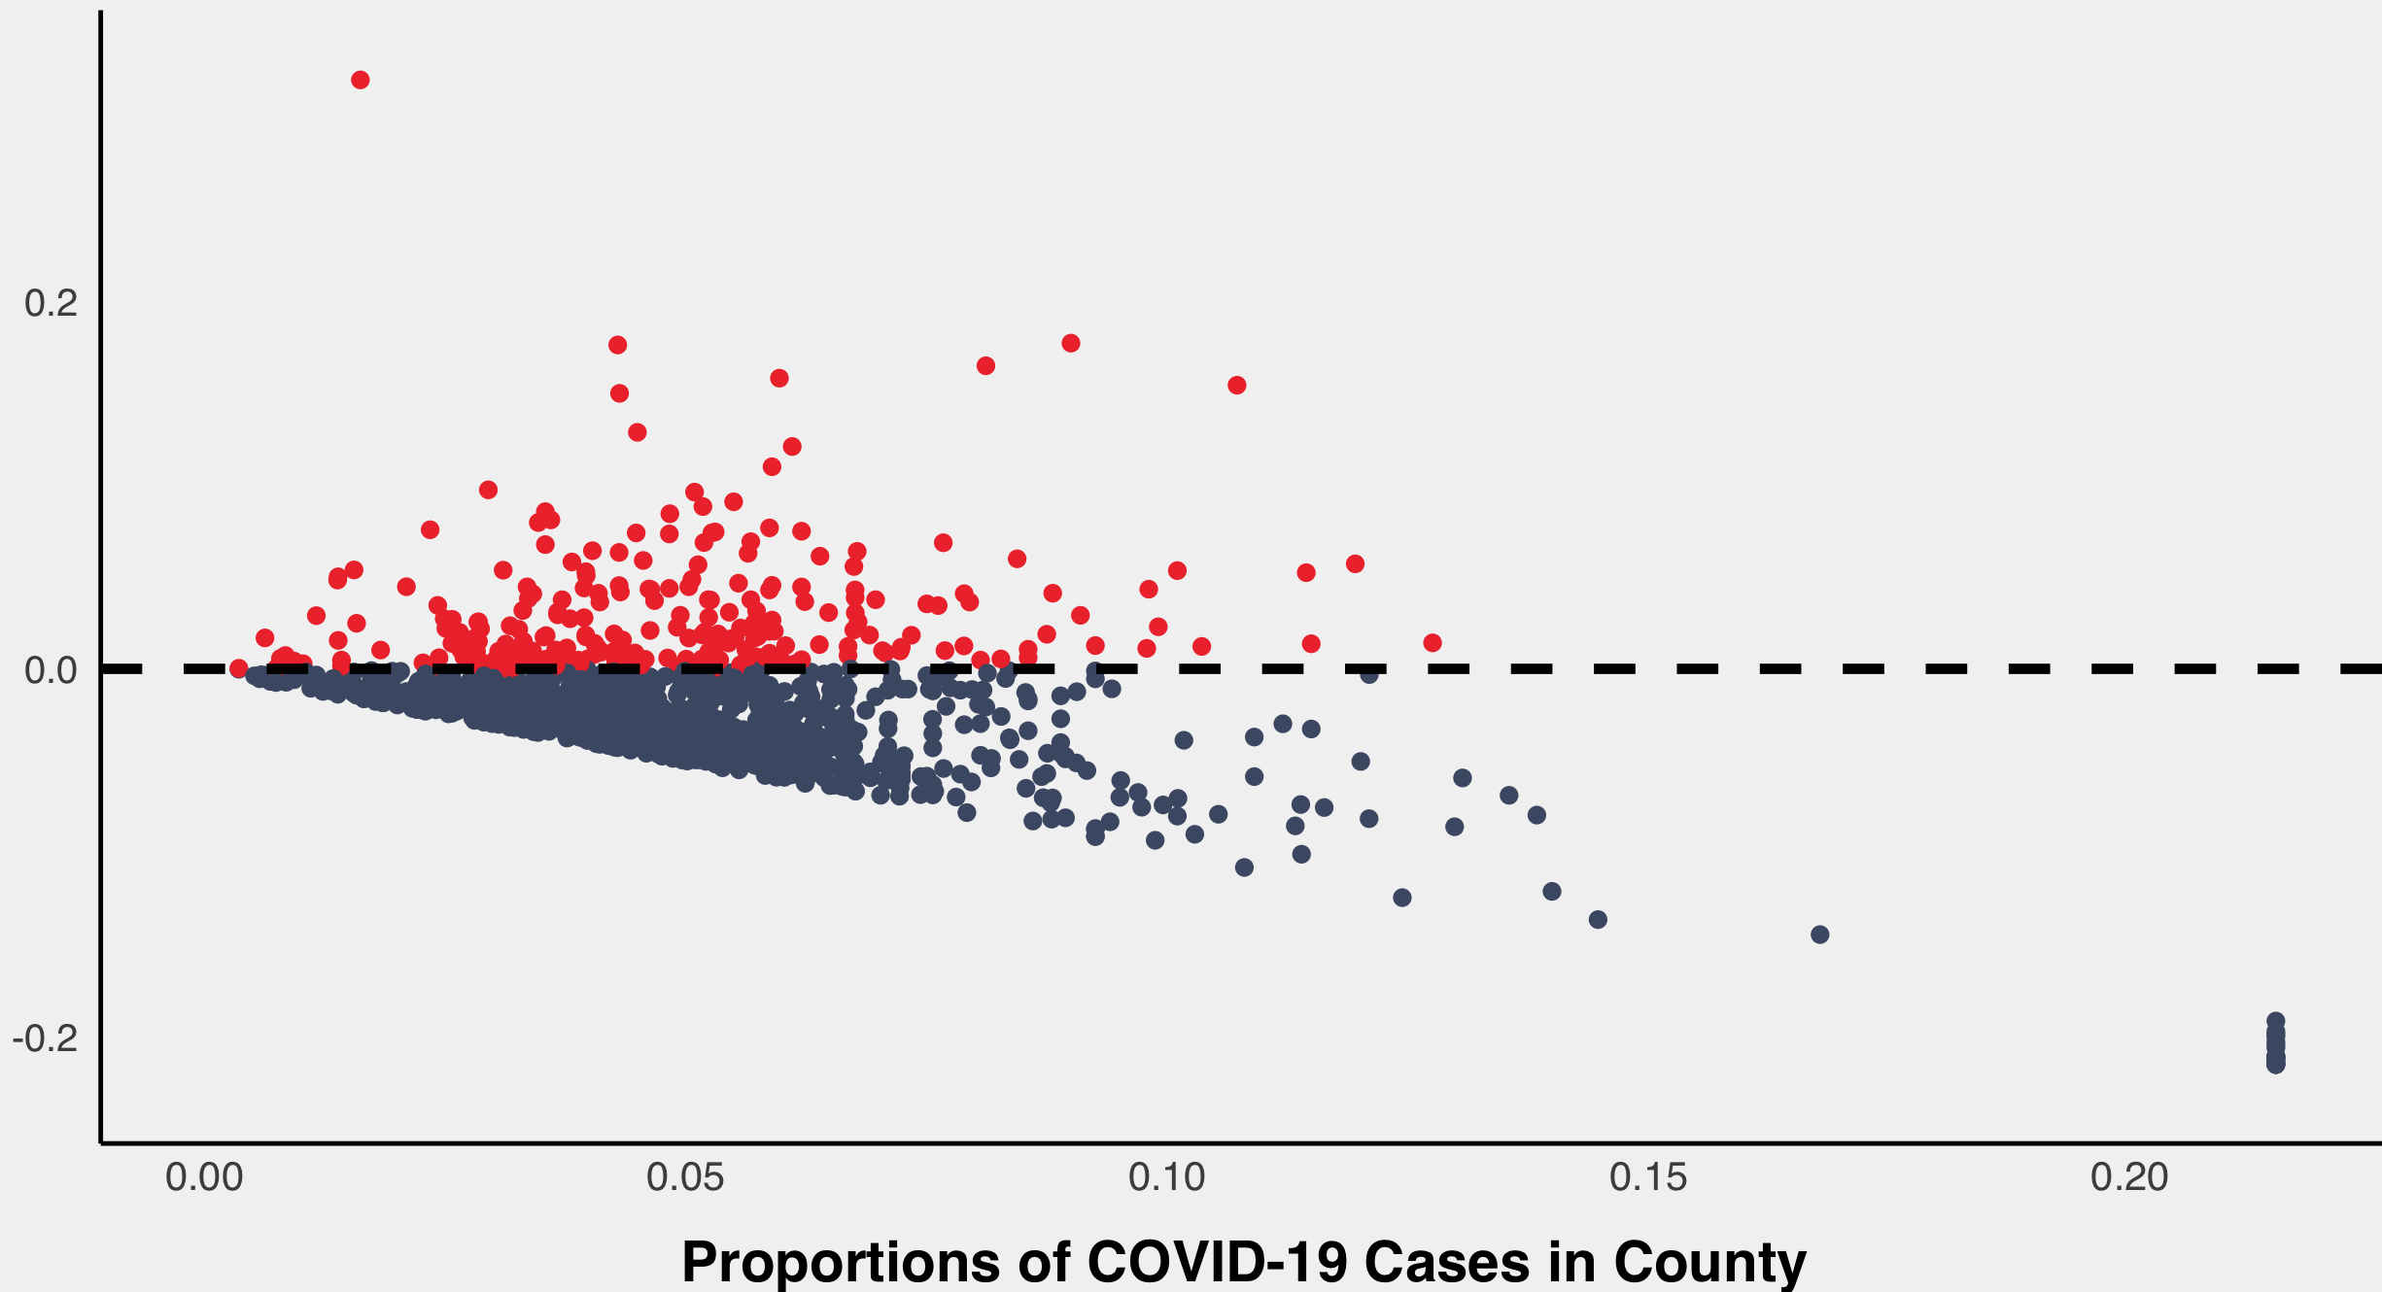
Difference in County and College COVID-19 Proportions Over Time
October 8, 2020
November 5, 2020
(College COVID-19 Proportions) — (County COVID-19 Proportions)
December 11, 2020

