Slide 1
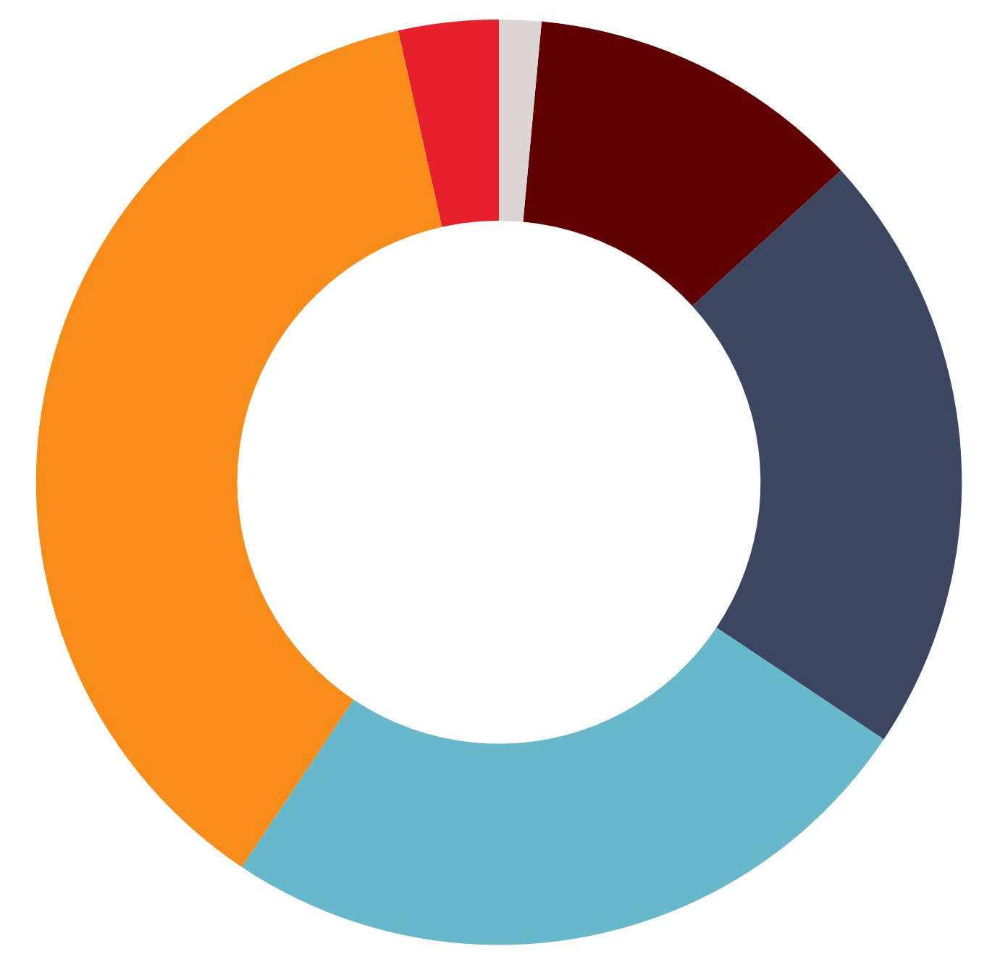
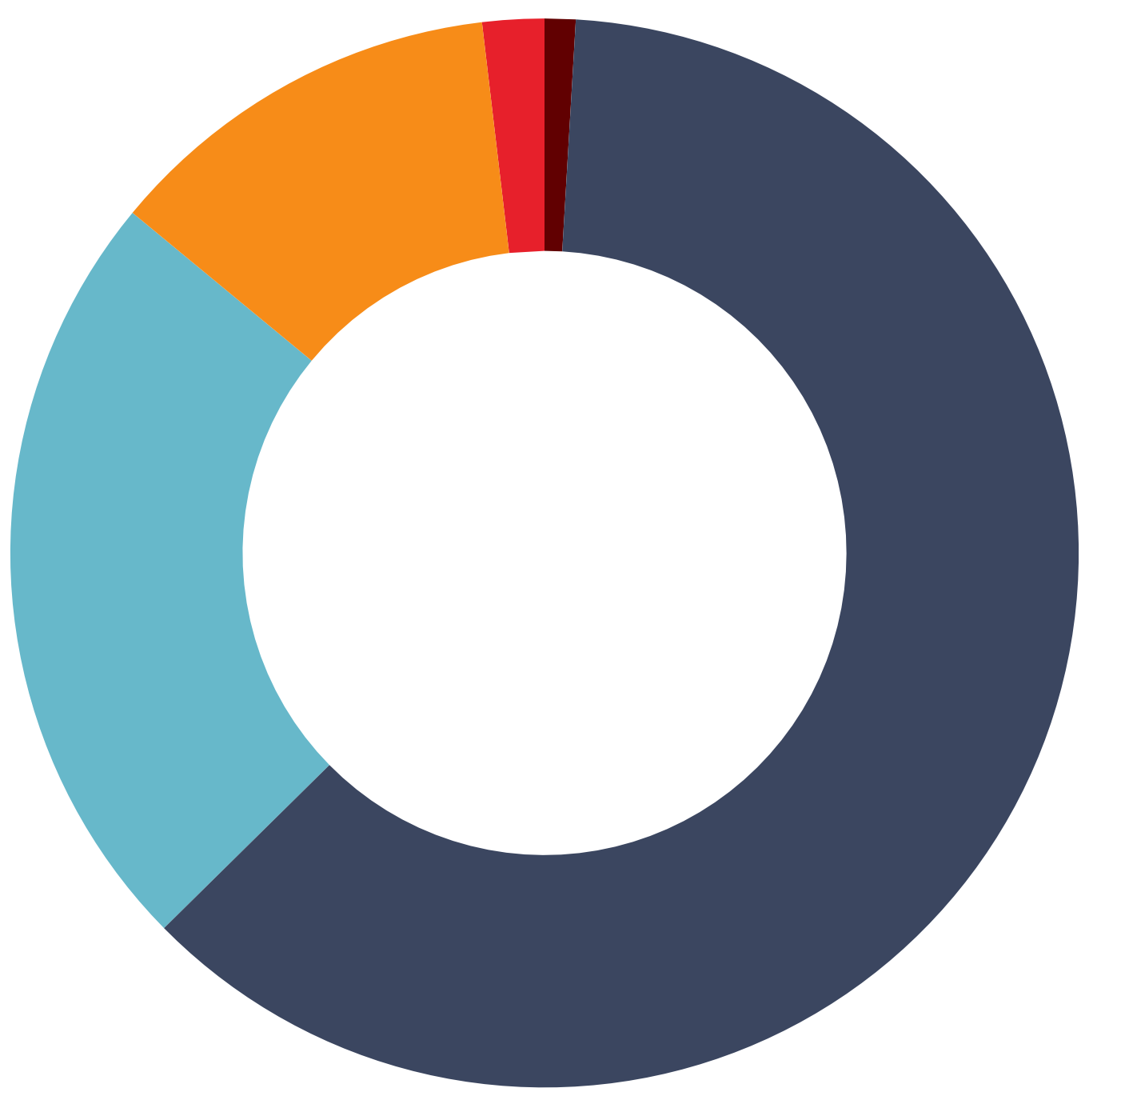
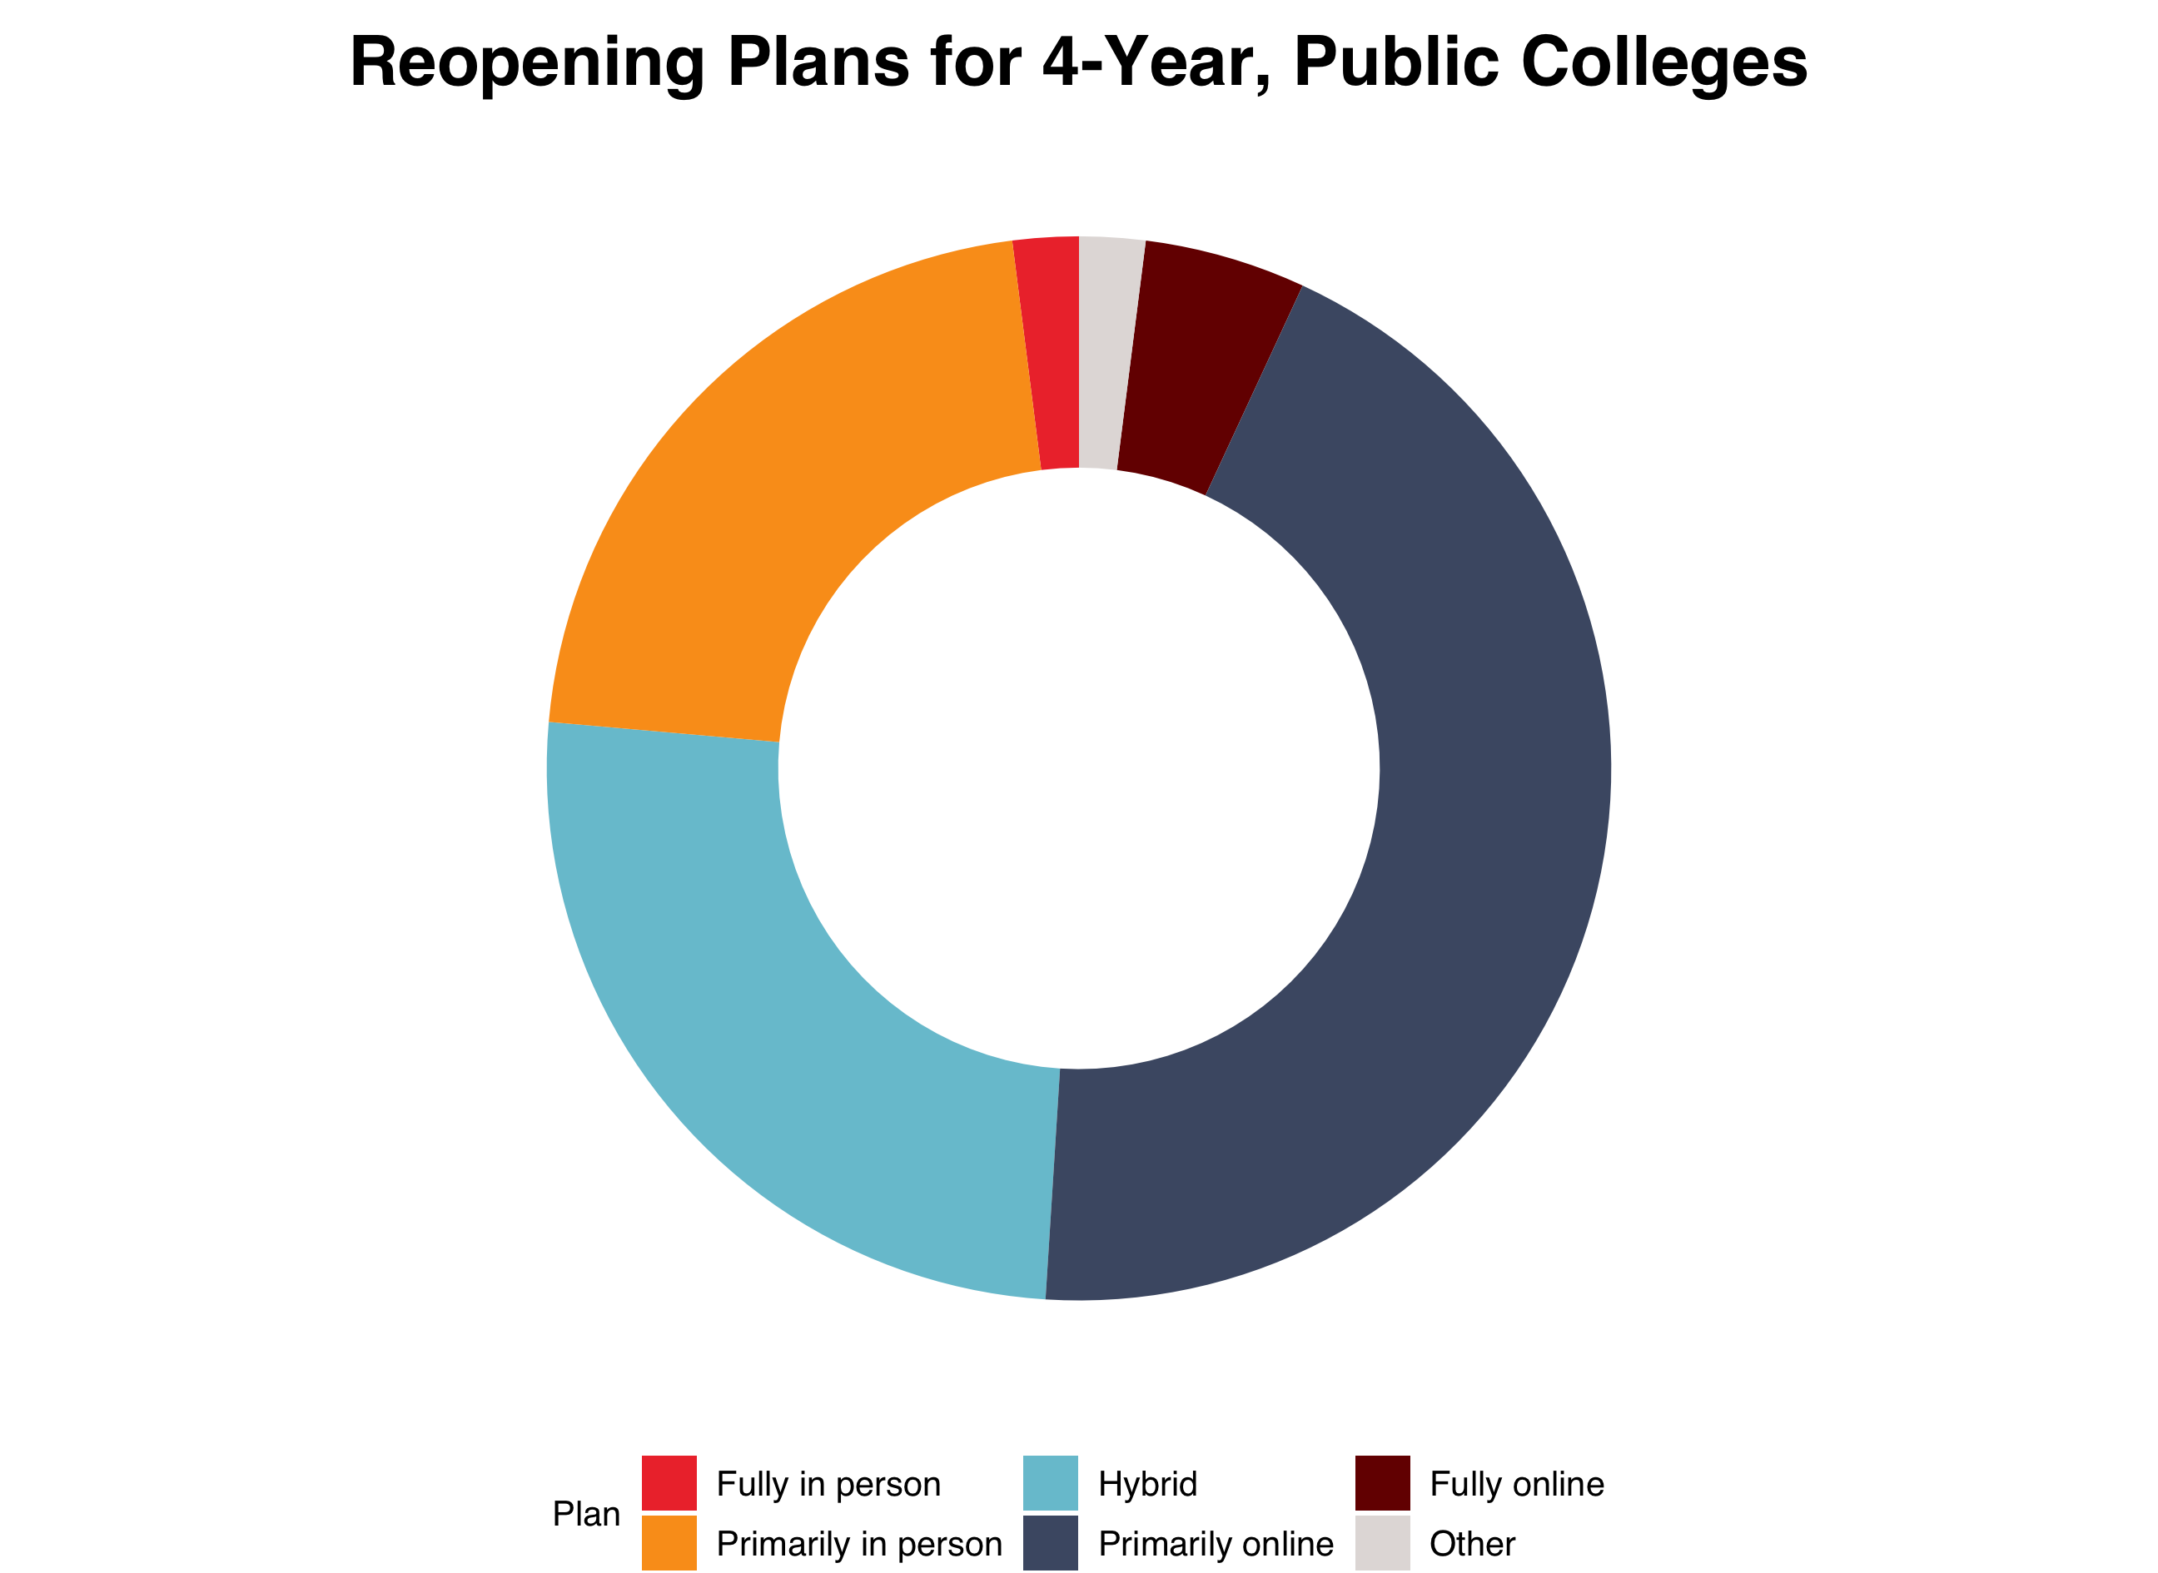
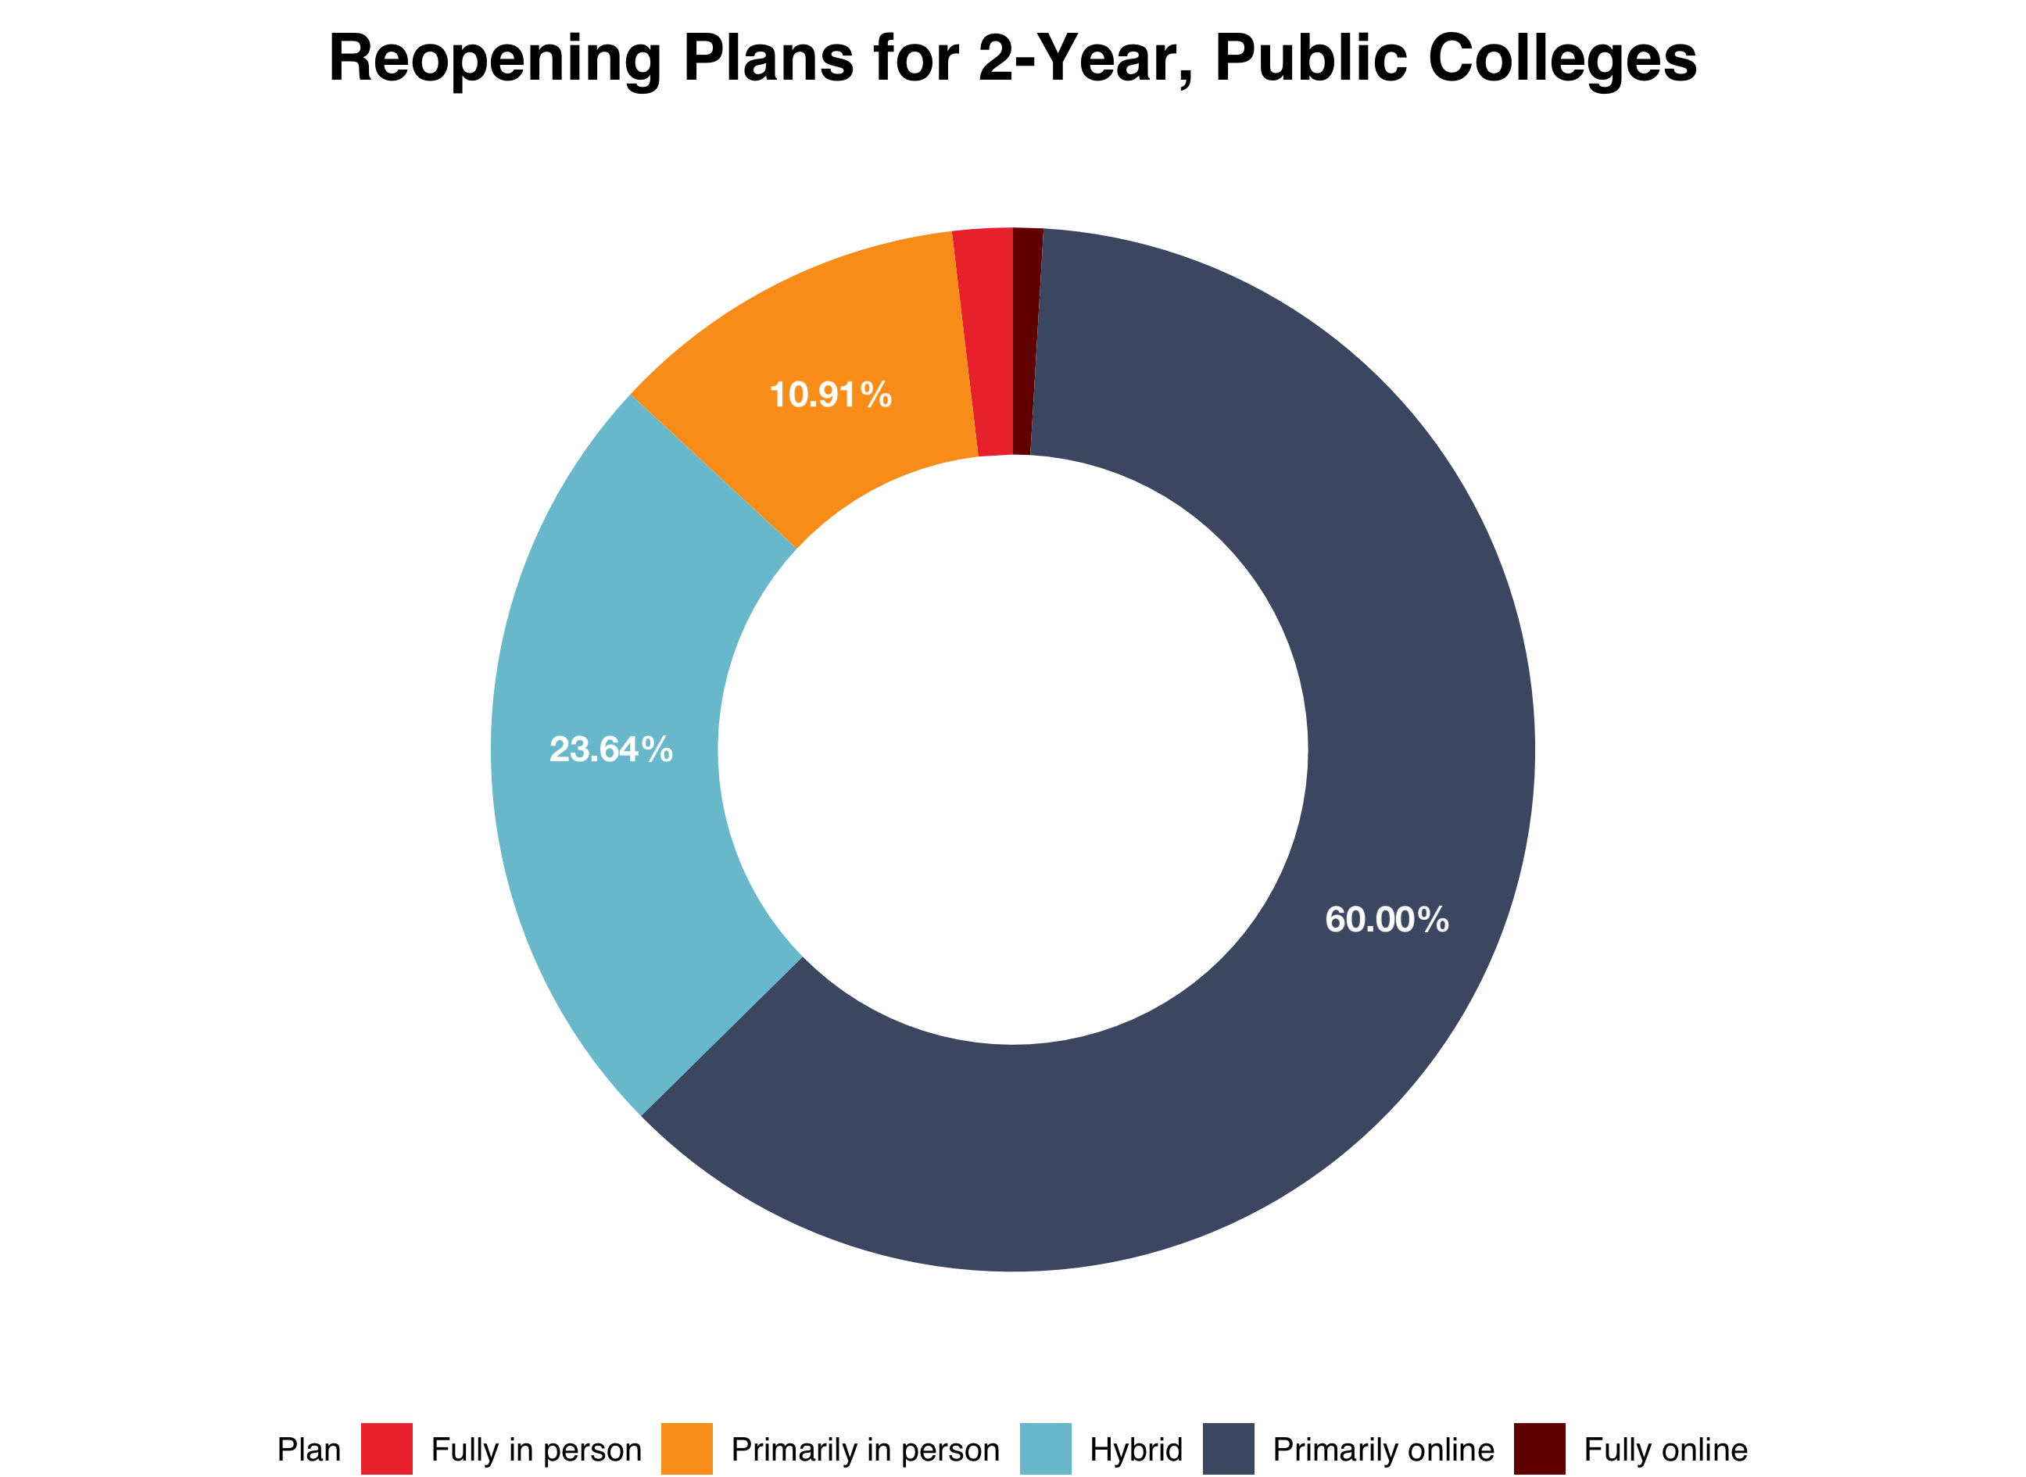
Reopening Plans by College Type
a) 4-Year, Private (n=544)
b) 2-Year, Public (n=110)
c) 4-Year, Public (n=449)
11.8%
12.1%
21.6%
37.1%
21.1%
23.4%
44.1%
61.7%
25.4%
25.0%

