Slide 1
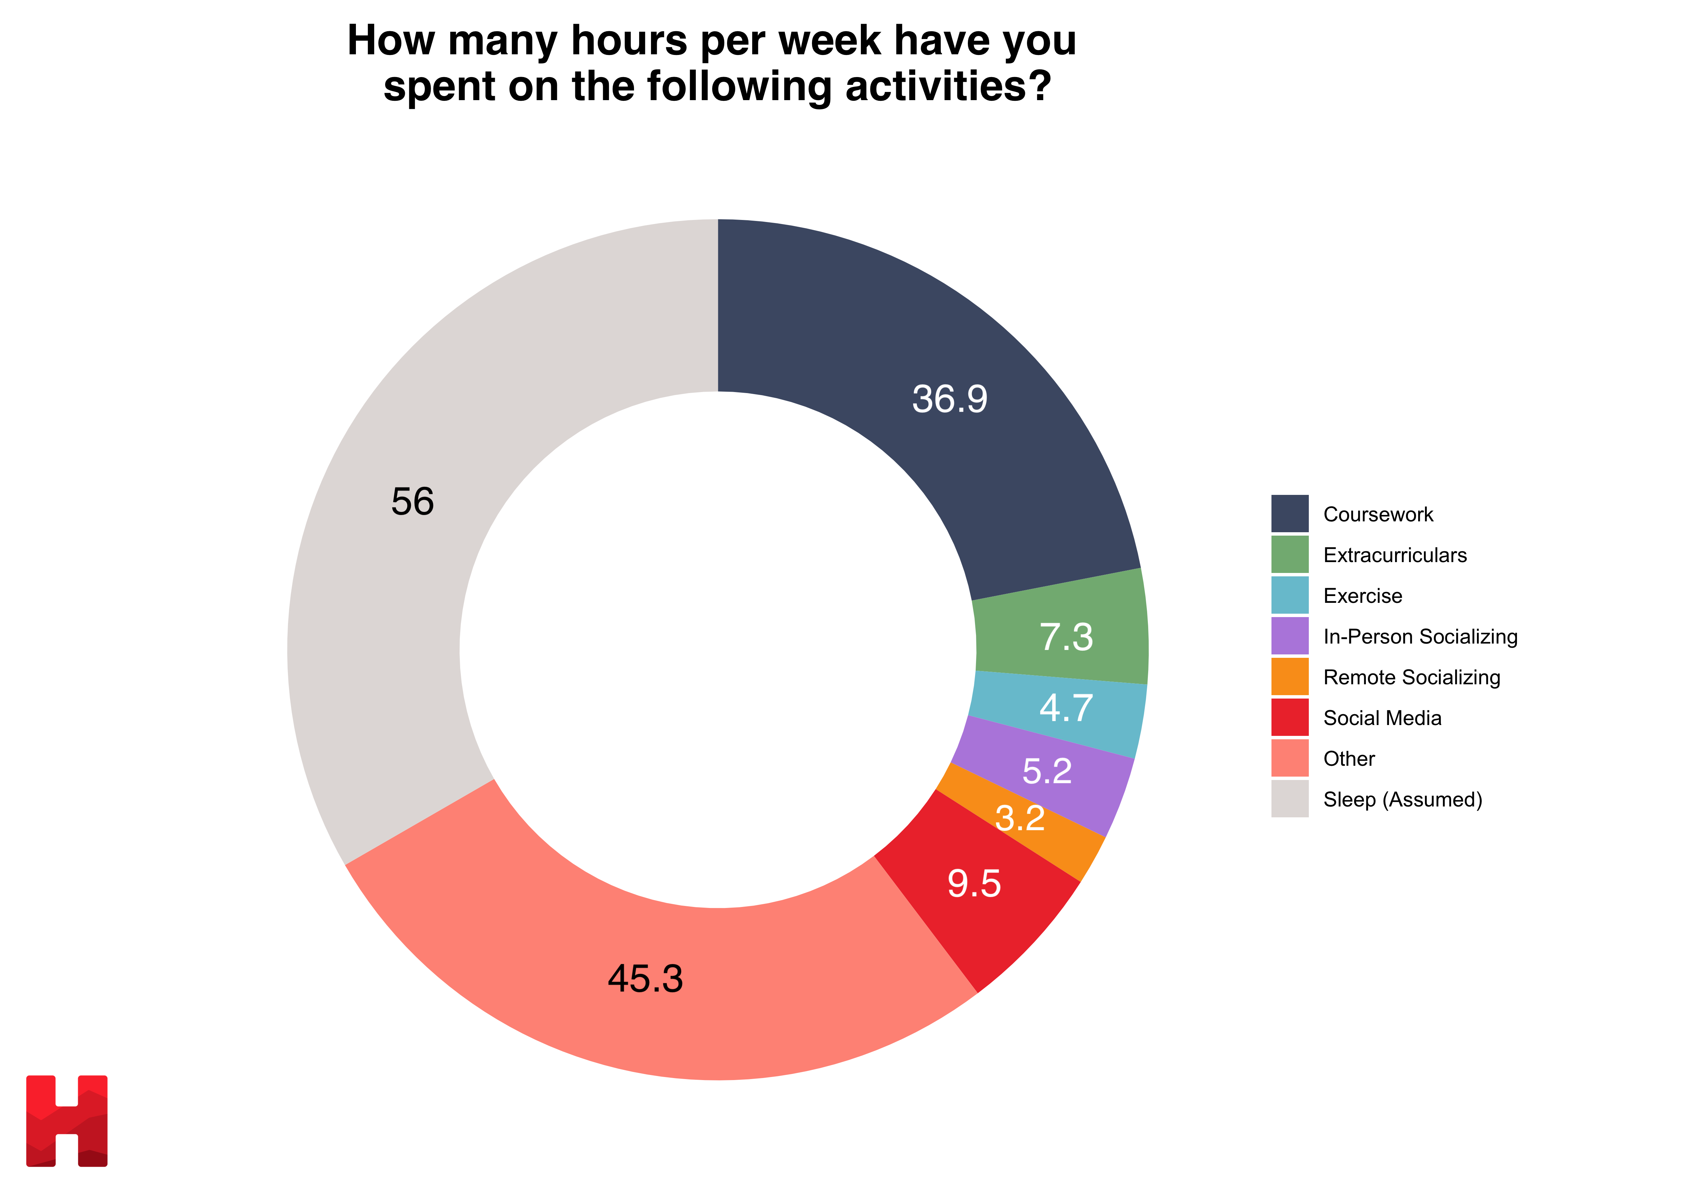
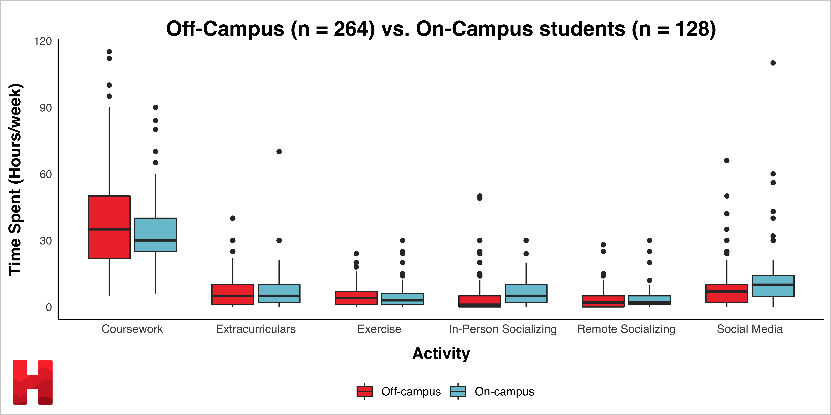
Off-Campus (n = 264) vs. On-Campus students (n = 128)

