Slide 1
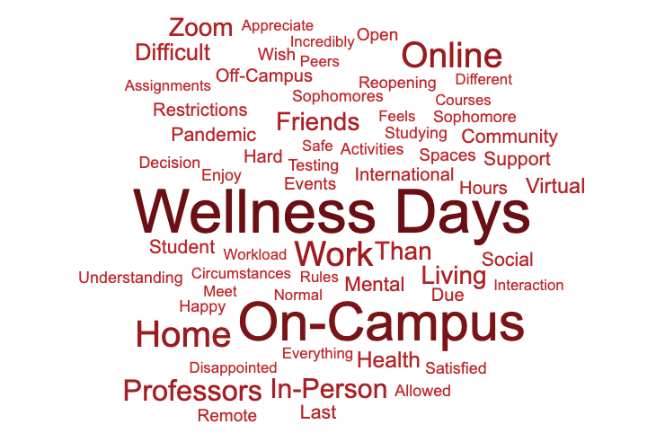
What specific factors have influenced your opinion of Harvard's Spring 2021 semester? (n = 389)

