Slide 1
Tutorial PCB Workhop HME
Ahmad Aziz
Email: a715210@gmail.com
ID Line: a715210
WA: 082285997821

Slide 2
Materi
Mencari dan install library
Bikin schematic
Layouting
Routing – 2 layer
Ground plane
Jumper
Label
Export
Bikin library (schematic, footprint, 3D body)
Export lanjutan

Slide 3
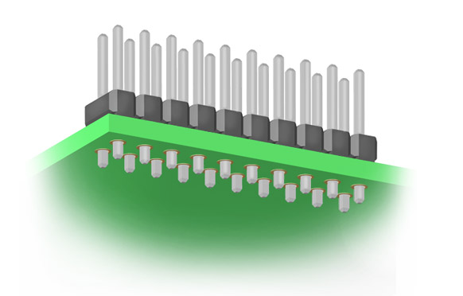
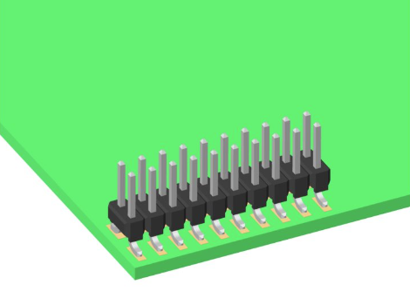
SMT vs THT
SMT (Surface Mounted Technology)
THT (Through Hole Technology)

