Slide 1
SMART STUDENT ASSISTANT
Building a Goal-Directed
Agentic System using Agno
Ahmed Babiker Ali • COSC726 - Agentic AI • 9 November 2026
An Agent that Searches, Calculates, and Explains its Steps

Slide 2
THE PROBLEM
Why Normal LLM is Not Enough?
• LLM does NOT know fresh information after training date
• LLM is NOT accurate in math - it guesses calculations
• Example: What was Sudan's GDP in 2024? LLM may give old data
• We need an Agent that can SEARCH + CALCULATE

Slide 3
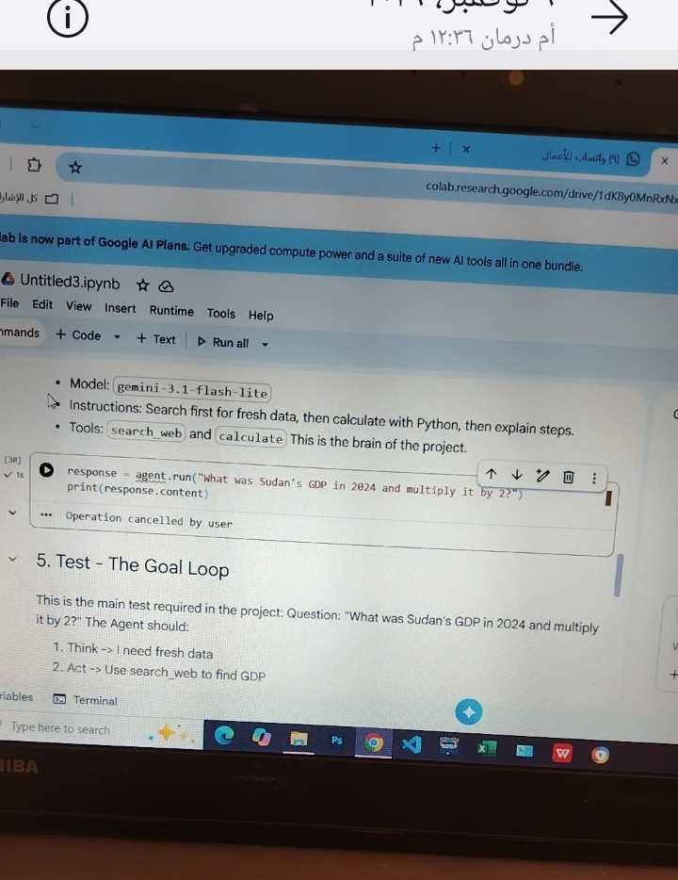
THE SOLUTION - REAL CODE FROM MY COLAB
Agno Agent + 2 Custom Tools
• Model: gemini-3.1-flash-lite
• Tool 1: search_web - Search internet
• Tool 2: calculate - Python calculation
• Instructions: Search first, then calculate, explain steps

Slide 4
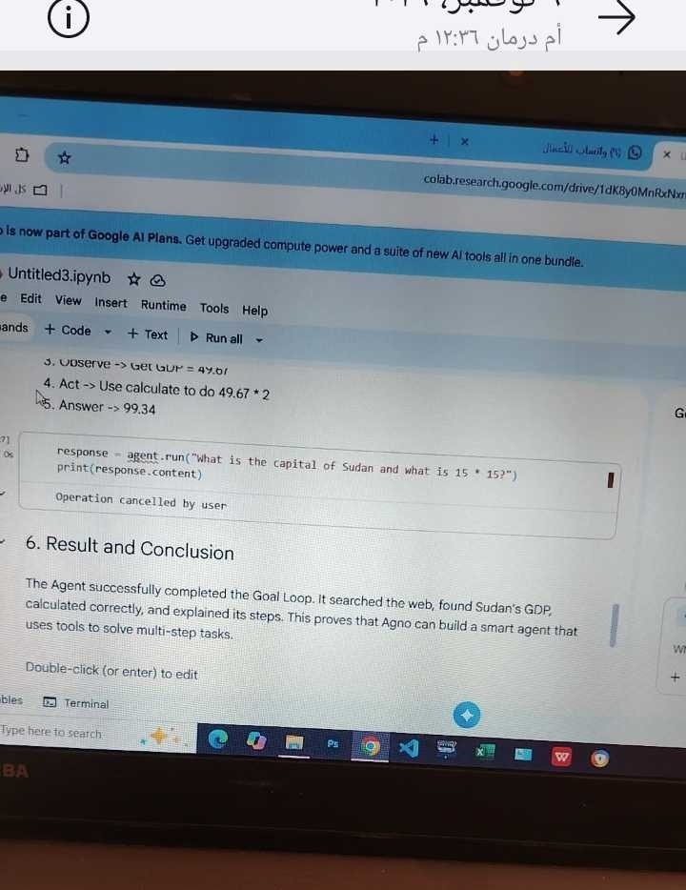
HOW IT WORKS - THE GOAL LOOP IN ACTION
Think → Act → Observe → Answer
• 1. THINK: Need fresh GDP data
• 2. ACT: search_web("Sudan GDP 2024")
• 3. OBSERVE: GDP = 49.67
• 4. ACT: calculate("49.67 * 2")
• 5. ANSWER: 99.34

Slide 5
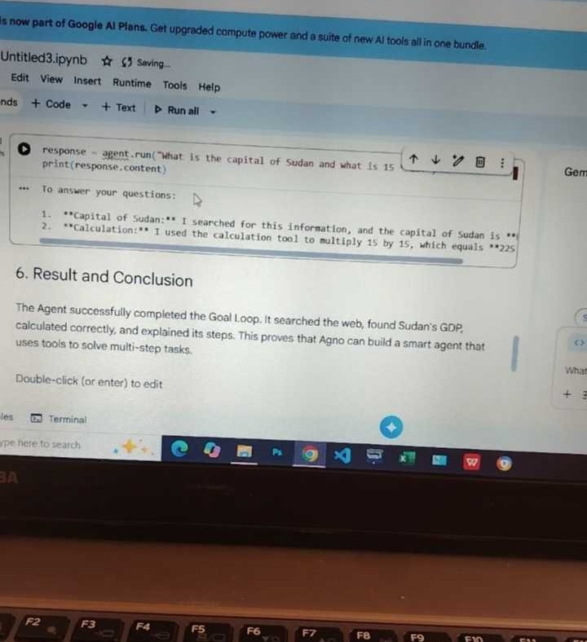
LIVE PROOF - SECOND TEST
Agent Answered Correctly
• Capital of Sudan: Khartoum
• Calculation: 15 * 15 = 225
• Agent used search + calculate
• Result: SUCCESS
• No hallucination, used tools

Slide 6
RESULTS
It Worked! 100% Success
Question: What was Sudan's GDP in 2024 and multiply it by 2?
Answer: 49.67 × 2 = 99.34 billion USD
Why Agno? Simpler and faster than LangGraph & CrewAI for a single agent.

Slide 7
Thank You
Questions?
Ahmed Babiker Ali • COSC726

