Slide 1



Predictive Maintenance
An intelligent system to predict machine failure and action required
Prepared By:
Ahmad Barakat
Pruthvi Ingole
Roshan Issac
Monika Slominski

Slide 2
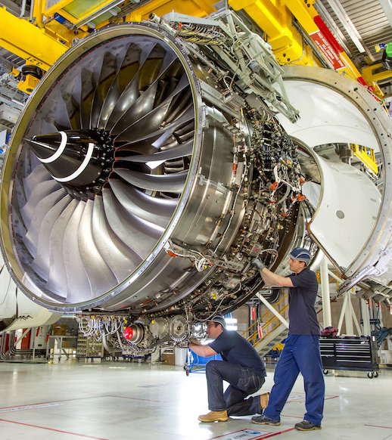
EXECUTIVE SUMMARY
Maintenance management is an important part of well-functioning production and becomes very crucial for companies that carry critical operations and require its assets (equipment) running at peak efficiency without any. Thus, preventive and predicative maintenance play huge role in preventing emergency shutdowns.
The purpose of this project is to design and develop an intelligent maintenance scheduling system power by AI to:
Estimate the remaining useful life of and equipment;
Predict the probability of an equipment fail within the next 30 days;
Mimic the decision-making of maintenance experts to enable the scheduling engine easily schedule repair requests, to reduce operation risks and system breakdowns.
1
2
3
Predictive Maintenance

Slide 3

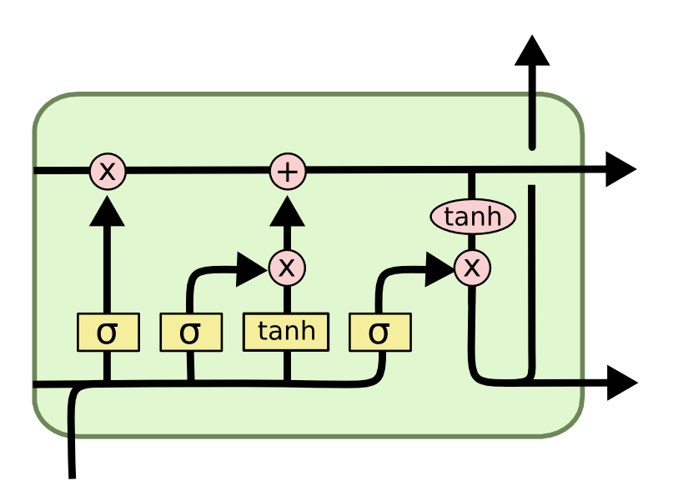
Model Architecture
High Level Model Design Architecture
Data Sources
Data Ingestion
Data Preparation
Model Development
Rule Based Layer
Remining Useful Time Prediction Using LSTM Recurrent Neural Network
Rules
If - Then
Facts
Data Pre-processing
Stream Analysis
Interface Engine
Simulated Data Source
Engine
Sensors & Detectors
Pressure, Temperature, Speed,
Vibration ..etc
Feature Engineering
Explanation Facilities
Time Series Dataset in a Tabular Format
Data Transformation
User Interface
Feature Selection
User
Predictive Maintenance

Slide 4
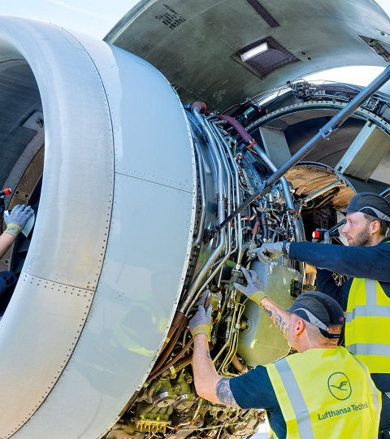


Data Source
The datasets were obtained from https://www.kaggle.com/datasets for an aircraft engine. The dataset consist of temporal and static data and contains the followings:
Machine metadata for 100 engines;
Data from 21 sensors;
Machine Sittings;
Machine Remaining Useful Life (RUL)
Data Preparation and Pre-processing
The data were preprocessed to divide the sensor data into time units (cycles) and determine the maximum number of cycles each machine works before fails. In addition, the time series sensor data were analyzed by looking at series rolling aggregates to determine any anomalies
After that data were transformed using minmaxscaler().
Model Development
The data was split into test and training and an LSTM RNN architecture was used to develop the model. The model was evaluated using accuracy and confusion matrix
Predictive Maintenance

Slide 5
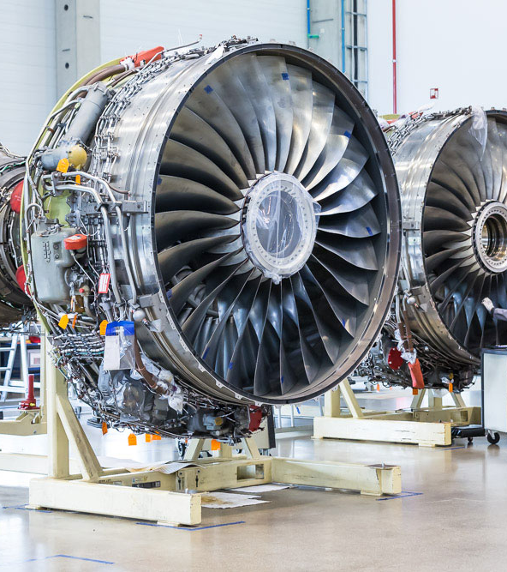
Rule Based Expert System
After that the rules were created for the scheduling system and stored in the database. The following list the main rules were used:
If the machine failure probabilities is between 0 and 40%, The action is “no action is required”;
If the machine failure probabilities is between 40% and 50%, The action is “Send a team to analyze machine and predict maintenance requirements”
If the machine failure probabilities is between 50% and 60%, The action is “Create work order and prepare for maintenance request”
If the machine failure probabilities is between 60% and 80%, The action is “Schedule and dispatch work and resources”
If the machine failure probabilities is between 80% and 100%, The action is “Execute maintenance”
1
2
3
4
5
Predictive Maintenance

