Slide 1
K

Slide 2


Slide 3
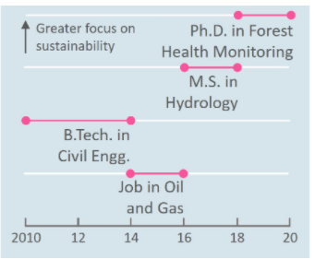
My next opportunity! Summer internship in 2021
Greater focus on sustainability
Ph.D. in Forest
Health Monitoring
M.S. in
Hydrology
B.Tech. in
Civil Engg.
Field Engg.
in oil & gas
2010
12
14
16
18
20
22

Slide 4
My next opportunity! Summer internship in 2021
Greater focus on sustainability
Ph.D. in Forest
Health Monitoring
M.S. in
Hydrology
B.Tech. in
Civil Engg.
Field Engg.
in oil & gas
2010
12
14
16
18
20
22

Slide 5
My next opportunity! Summer internship in 2021
Greater focus on sustainability
Ph.D. in Forest
Health Monitoring
M.S. in
Hydrology
B.Tech. in
Civil Engg.
Field Engg.
in oil & gas
2010
12
14
16
18
20
22

