Slide 1
Cloud-Based Customer Review
Sentiment Analysis Dashboard
A serverless, free-tier cloud pipeline for small-business review analytics
Ahmed Bin Jaffar · 26MS-DS037 · MSDS Semester 2 — Cloud Computing
Sir Ab Raheem Ansari · MUET · October 2026
1,214
4
105
$2.50/mo
real reviews evaluated
pluggable sentiment engines
automated tests, all passing
at 1M reviews, free tier
Cloud-Based Customer Review Sentiment Analysis Dashboard · 26MS-DS037
1 / 15
Notes:
Good morning. This project asked one practical question: can a small business get trustworthy review-sentiment analytics for effectively zero infrastructure cost? We built the full pipeline — ingestion to dashboard — and measured everything: accuracy, latency, throughput, and a source-checked monthly cost model. Every number in this deck comes from an executed run stored in results/.

Slide 2
The problem
who needs this, and why it does not exist yet
Reviews are free; the insight is not
DIY is out of reach
Commercial sentiment SaaS starts around $299/month (third-party estimate, unverified).
Usage-billed managed APIs cost roughly $300/month at one million reviews — linear in text volume.
Pipelines, databases and dashboards need engineers a shop owner does not have.
Black-box scores cannot be audited, exported or reproduced — trust is exactly what is missing.
Free tiers exist — but the boundary is unproven
Cloud free tiers are generous, yet nobody shows with measured numbers what volume they really cover, or what latency a free-tier design actually pays.
Our answer: an open, reproducible, free-tier serverless pipeline — and honest measurements of where it wins and where it bends.
Cloud-Based Customer Review Sentiment Analysis Dashboard · 26MS-DS037
2 / 15
Notes:
Three gaps: price, skill, and trust. A salon or restaurant paying $299 a month for sentiment analytics is paying for roughly one engineer-hour per week of value. DIY alternatives need engineering the owner does not have. And existing tools rarely show how a score was produced. Free tiers look like the answer, but their real capacity is folklore — so we measured it.

Slide 3
Objectives
as approved in the proposal — plus measurement rigor
1. A serverless ingestion-to-dashboard pipeline that runs inside free-tier limits, with zero servers to administer.
2. Pluggable three-class sentiment engines — VADER (default, fully offline), TextBlob, Hugging Face DistilBERT, Comprehend adapter.
3. Storage abstraction: SQLite locally, Firestore (proposal) and DynamoDB (infrastructure-as-code) in the cloud — same handlers.
4. An interactive dashboard: distribution, trends, keywords, filters, CSV/JSON upload, live single-review analysis.
5. Quantify accuracy, latency, throughput and monthly cost with reproducible experiments (seed 42).
6. Automated tests end-to-end, with every published number traceable to an executed run.
Cloud-Based Customer Review Sentiment Analysis Dashboard · 26MS-DS037
3 / 15
Notes:
Six objectives. Note that the proposal's stack — Firestore, Hugging Face, Streamlit — stays the design target; every layer is behind an interface so the identical code runs locally without any cloud credentials and deploys to the cloud unchanged. Objective five is what makes this a cloud-computing project and not just a demo: we measure the free tier rather than assume it.

Slide 4
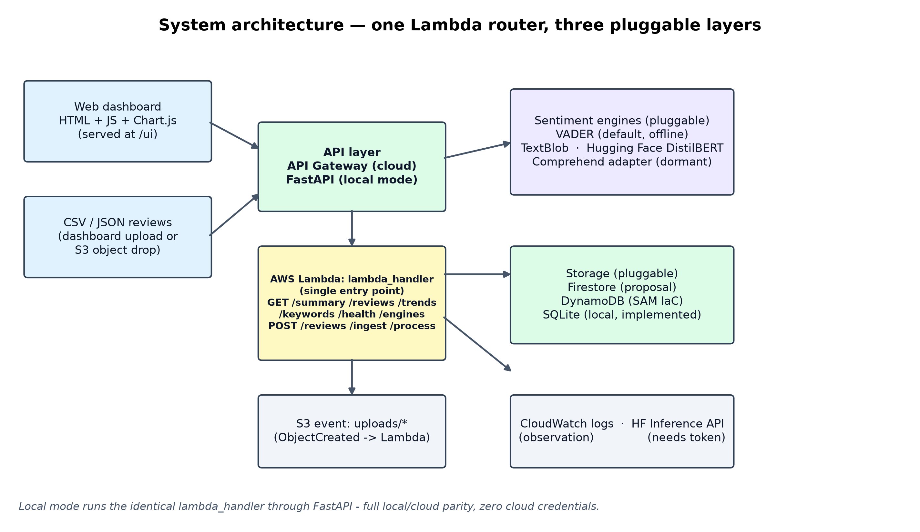
System architecture
one Lambda router · three pluggable layers
Cloud-Based Customer Review Sentiment Analysis Dashboard · 26MS-DS037
4 / 15
Notes:
One entry point — lambda_handler — routes API-Gateway v1/v2 requests and S3 object-created events to ingestion, processing and read handlers. Behind it sit three pluggable layers: four sentiment engines, three storage backends, and object ingestion. The local FastAPI server forwards every HTTP request to this same function, so local and cloud behaviour cannot drift apart — that is local/cloud parity, and it is why the whole system could be tested without credentials.

Slide 5
Why serverless — and why the free tier holds
economics measured, not assumed
FaaS economics
AWS free-tier allowances used
Billed per request and per millisecond — zero cost at zero traffic.
Event-driven: HTTP requests and S3 uploads both trigger the same function; auto-scaling is free.
No OS patching, no capacity planning — the scarce resource a small team actually has.
Lambda: 1M requests + 400k GB-seconds/month — always free.
API Gateway 1M calls, S3 5 GB, CloudWatch 5 GB logs (12-month).
DynamoDB: 25 GB storage + provisioned 25 WCU/RCU.
Measured cold-start reality
Free tier is not $0 — and that is fine
Engine init: VADER 0.05 s vs DistilBERT 18.6 s (model load dominates).
Warm: VADER 0.476 ms mean per review — DistilBERT 48 ms.
→ VADER stays the default engine; FaaS design follows the measurement.
At 1M reviews/month: free tier $2.50, no-free-tier $3.35 (DynamoDB on-demand bills per request).
Always-on t3.micro: $8.23/mo — ≈3,300× the serverless path at 1K reviews, plus a server to patch.
Cloud-Based Customer Review Sentiment Analysis Dashboard · 26MS-DS037
5 / 15
Notes:
Serverless changes the cost floor: at zero traffic the bill is zero, which no VM can match. The free tier covers a small business for a long time — but not literally everything: DynamoDB's on-demand mode bills per request even inside the free allowance, which is why our honest free-tier row at one million reviews is $2.50, not zero. The cold-start measurement decided the engine choice for us: 18.6 seconds to load DistilBERT is unusable behind an interactive API; 50 milliseconds for VADER is not.

Slide 6
Technology stack
proposal targets vs what runs today
Proposal stack (design target)
Implemented and measured here
Firebase Firestore (Spark plan) — cloud document database.
Hugging Face Inference API — managed sentiment AI.
Streamlit Community Cloud — free dashboard hosting.
Status: engine + storage adapters written behind interfaces; deployment gated on credentials — nothing is pretended live.
AWS roles stay optional: SAM infrastructure-as-code for Lambda, API Gateway, DynamoDB, S3, CloudWatch.
Python 3.13 · one lambda_handler · FastAPI local parity server.
Engines: VADER (default) · TextBlob · DistilBERT-SST2 · Comprehend adapter.
Storage: SQLite (live) · DynamoDB + S3 + SAM template (validated, not deployed).
Dashboard: HTML/JS + vendored Chart.js at /ui — works offline.
Tests: 105 pytest (unit + HTTP e2e) in 13.89 s + Playwright browser E2E 9/9.
Experiments: 5 runners, seed 42, raw outputs in results/.
Cloud-Based Customer Review Sentiment Analysis Dashboard · 26MS-DS037
6 / 15
Notes:
Two columns, one honest gap. The right column is what executes and is measured today; the left column is the proposal's hosted stack, which the remaining parts of the project will connect — Firestore and Streamlit Community Cloud. The interface abstraction means connecting them is configuration, not a rewrite: STORAGE_BACKEND=firestore and an HF token.

Slide 7
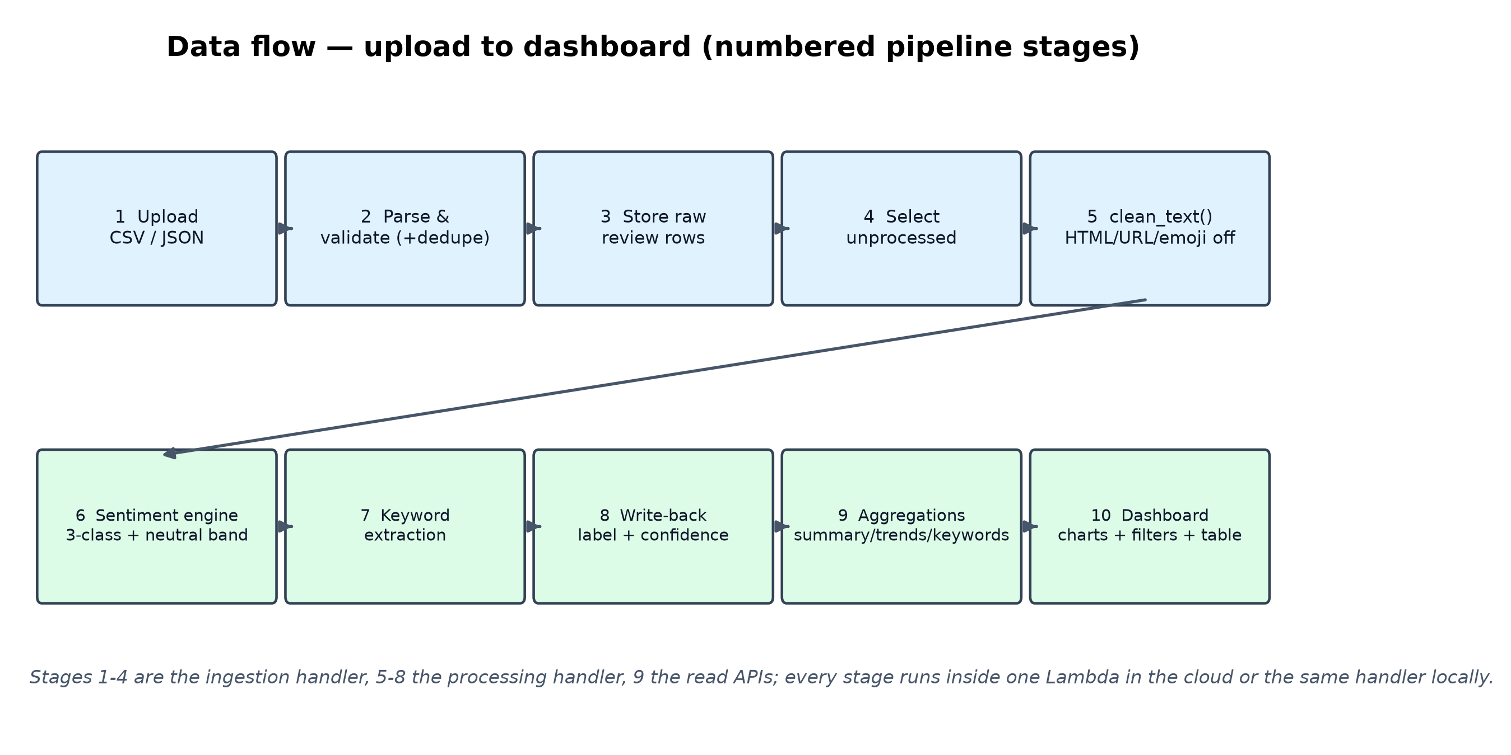
Pipeline walkthrough
upload → classify → dashboard, ten stages
Cloud-Based Customer Review Sentiment Analysis Dashboard · 26MS-DS037
7 / 15
Notes:
Ten numbered stages. Ingestion (1–4) accepts CSV or JSON from the dashboard, the API or an S3 drop; normalises column aliases, validates rows, de-duplicates and upserts idempotently by review id. Processing (5–8) cleans each text, runs the engine into the three-class scheme with the 0.15 neutral band, extracts keywords, and writes label, confidence, per-class scores and engine back to the same record. Reads (9–10) aggregate summary/trends/keywords for the dashboard and API consumers. Batches are capped at 200 reviews to stay inside free-tier quotas.

Slide 8
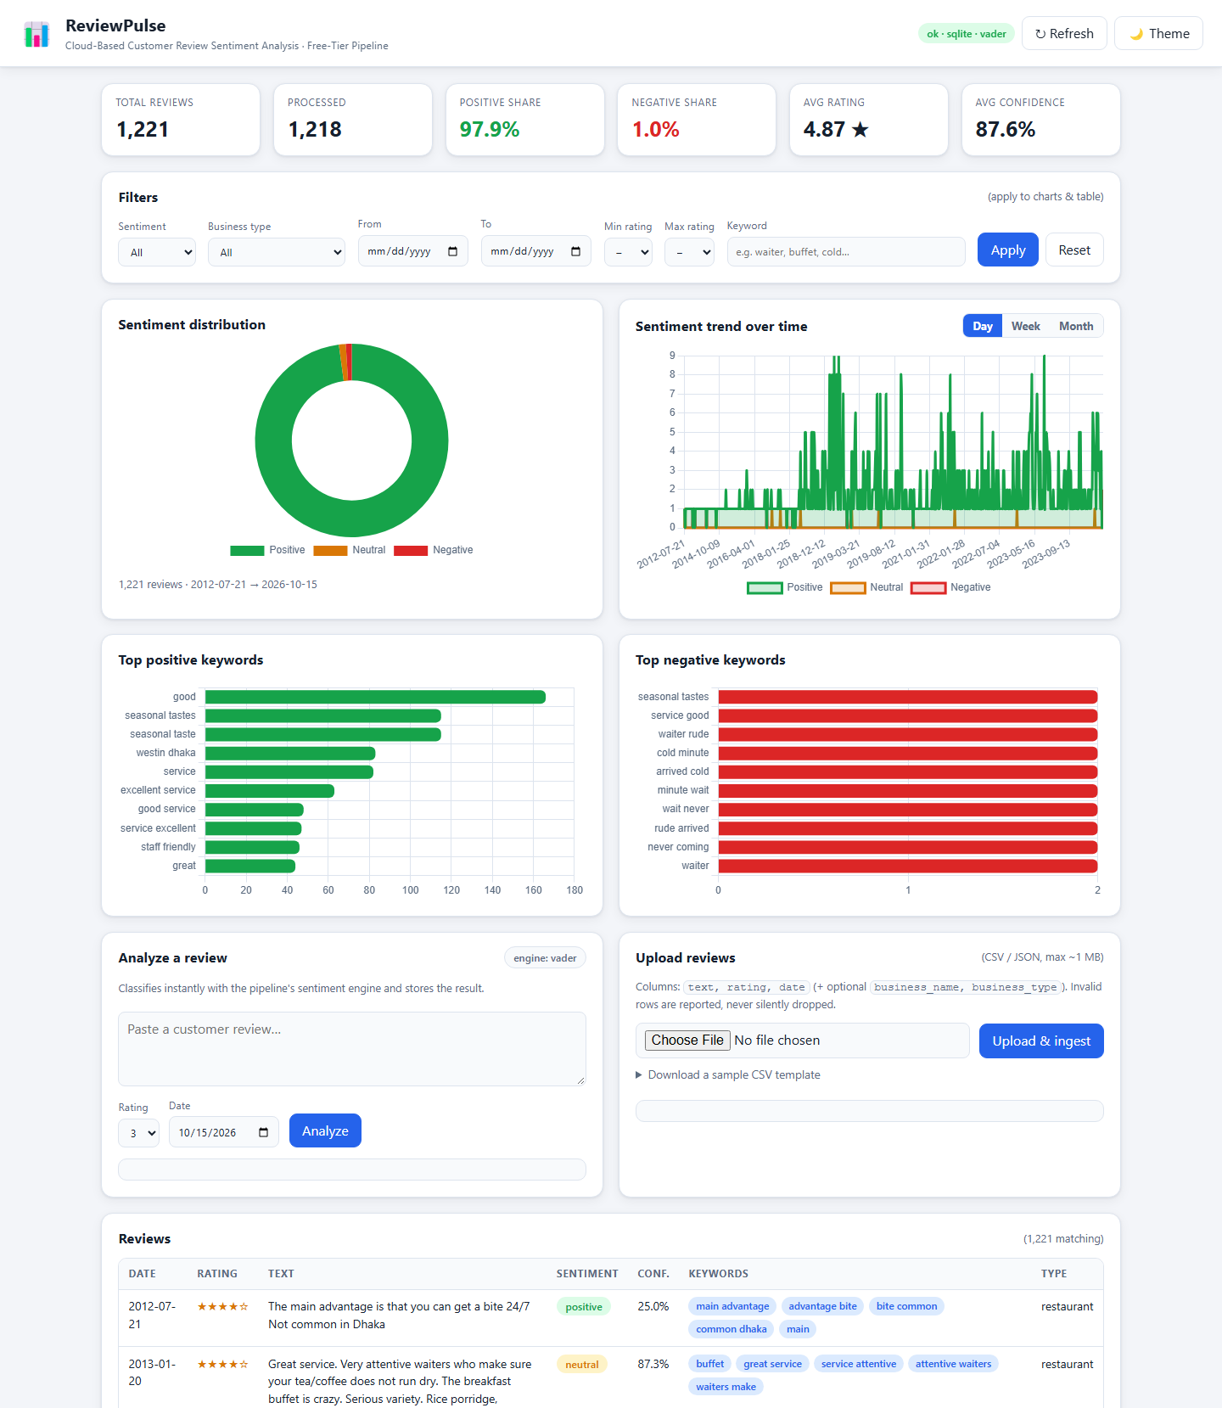
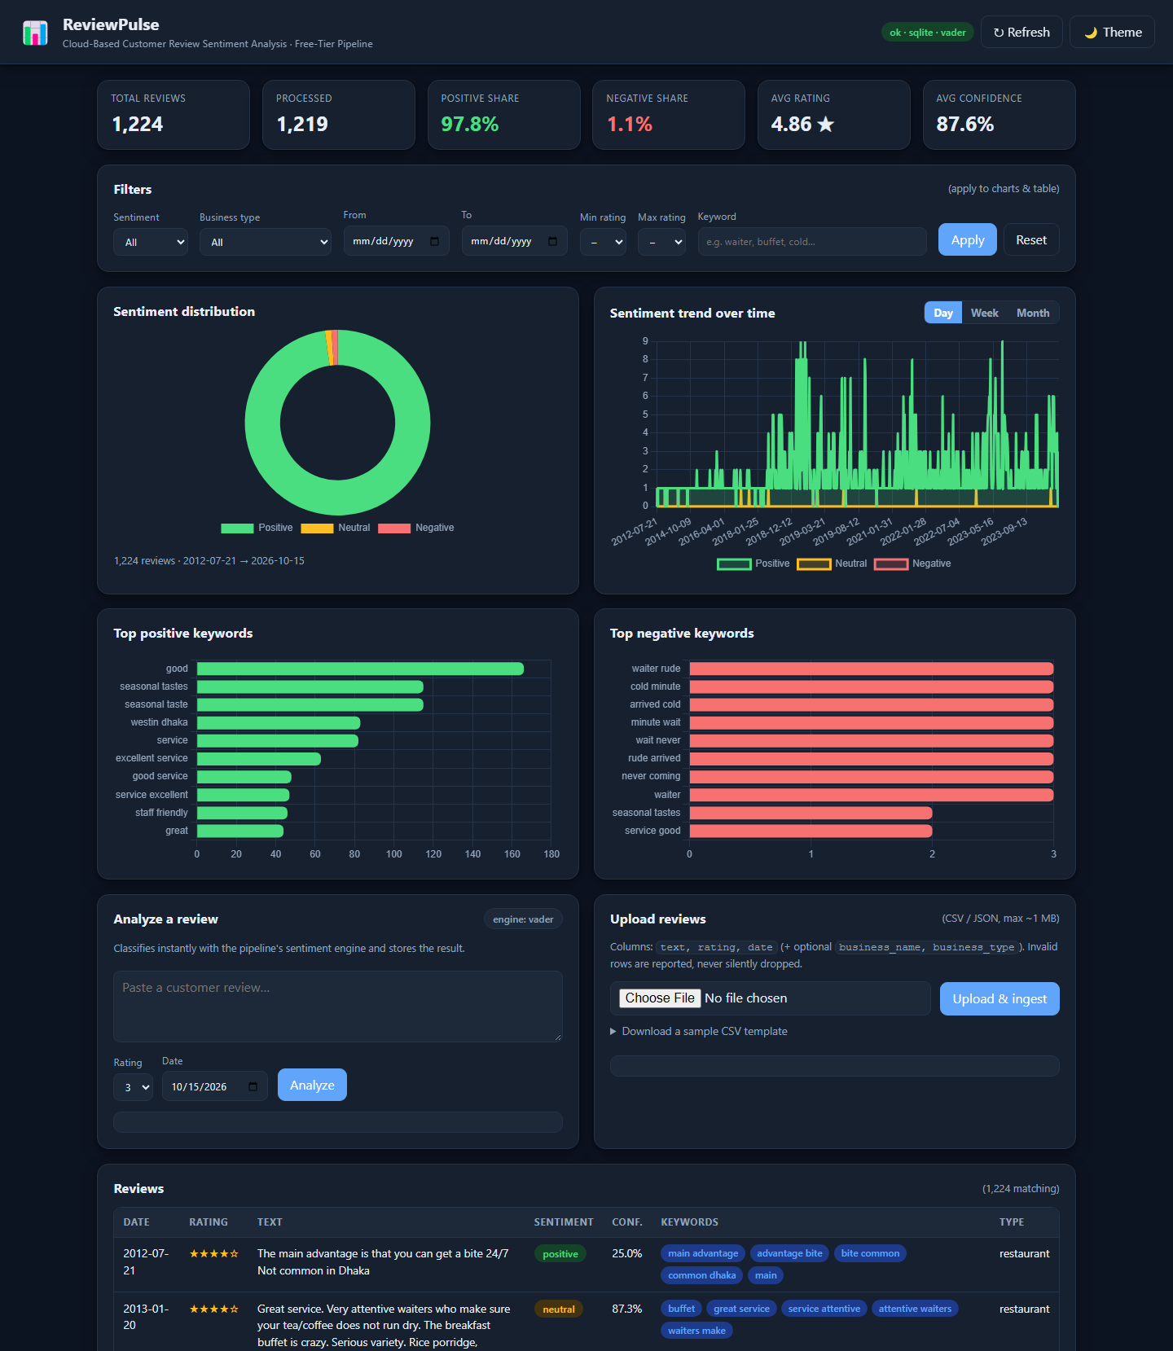
Dashboard — the product
real capture, 1,214-review corpus
KPI cards, sentiment doughnut, day/week/month trends and top keywords — all computed by the read APIs.
Light and dark themes, fully responsive; Chart.js is vendored, so the dashboard works offline.
Served at /ui — the same static bundle deploys unchanged to an S3 website bucket or Streamlit.
Light theme (left) · dark theme (right) — top of the page; full-page captures in docs/screenshots/
Cloud-Based Customer Review Sentiment Analysis Dashboard · 26MS-DS037
8 / 15
Notes:
This is the real dashboard, not a mock-up: headless-Chromium captures against the live local server with all 1,214 reviews loaded. KPIs, charts and keywords all come from the /summary, /trends and /keywords endpoints — the dashboard holds no data logic of its own. Both themes and the responsive layout were verified by the browser end-to-end test.

Slide 9
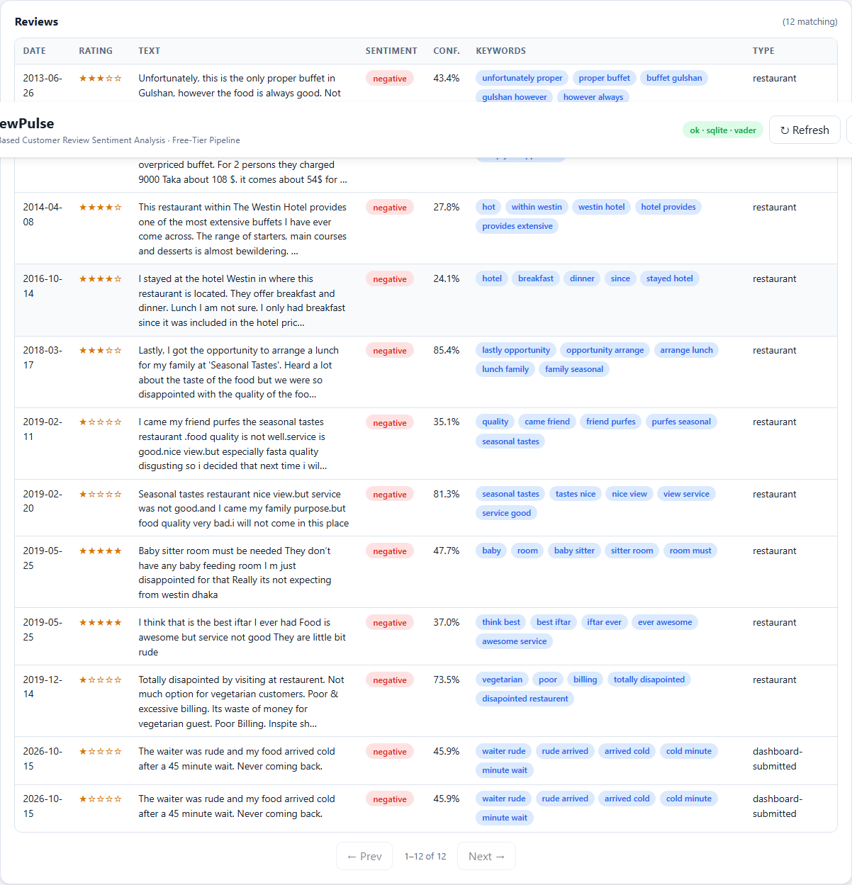
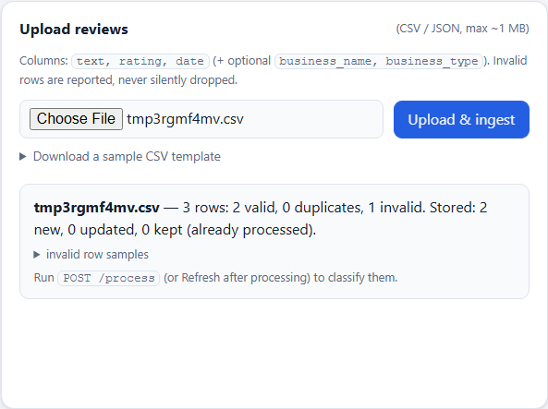
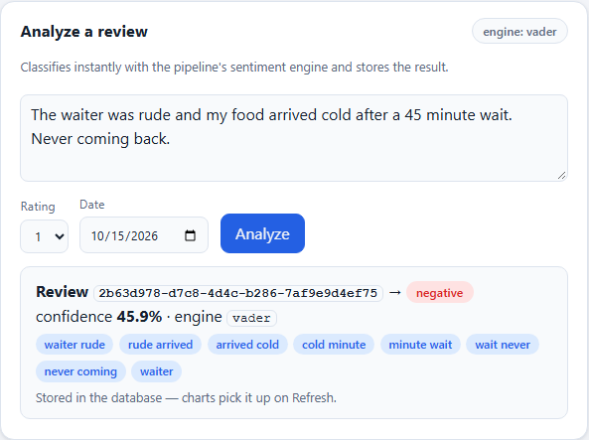
Dashboard — filters, upload, live analysis
every flow verified by browser E2E (9/9 checks)
Filters: sentiment, rating, date, keyword, business type — case-insensitive.
CSV/JSON upload with template download and a row-level ingestion report.
Live box: analyse one review instantly, per-class scores shown.
Mobile: zero horizontal overflow at 390 px (E2E-checked).
Sentiment filter → charts + table
CSV upload report · live analysis
Cloud-Based Customer Review Sentiment Analysis Dashboard · 26MS-DS037
9 / 15
Notes:
Beyond the charts, four interaction flows matter for a real user: filtering the corpus by sentiment (charts and table update together), bulk CSV upload with a per-row success/failure report, instant single-review analysis for 'what does this complaint say', and a usable phone layout. The Playwright suite clicks through all of them headlessly and captured these screenshots as evidence.

Slide 10
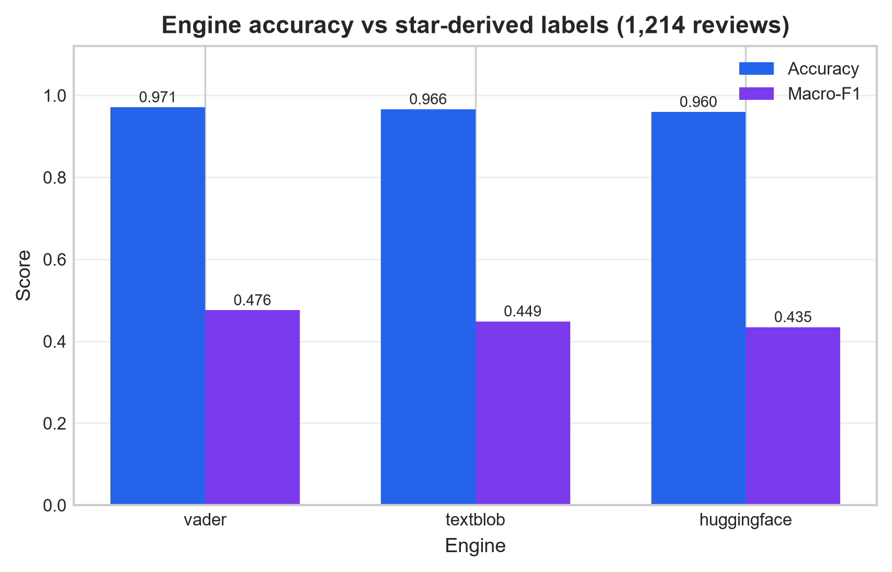
Results — accuracy against star labels
1,214 real reviews · ground truth: 1-2★ negative, 3★ neutral, 4-5★ positive
Engine | Accuracy | Macro-F1 | Neg. recall | ms/review
VADER (default) | 0.9712 | 0.4757 | 0.3333 | 0.219
TextBlob | 0.9662 | 0.4486 | 0.0833 | 0.639
HF DistilBERT | 0.9596 | 0.4346 | 0.8333 | 49.828
Corpus is 98% positive (1,190/12/12) — an 'always positive' baseline already scores 0.98 accuracy, so accuracy alone proves nothing.
VADER is the best all-rounder: highest accuracy and macro-F1, and 228× faster per review than DistilBERT.
DistilBERT catches the most negatives (10 of 12) but never predicts neutral — SST-2 is binary by construction.
105 automated tests lock the pipeline and the metric definitions; Comprehend honestly excluded (no AWS credentials).
Cloud-Based Customer Review Sentiment Analysis Dashboard · 26MS-DS037
10 / 15
Notes:
Evaluation is deliberately harsh. Because 98 percent of the corpus is positive, headline accuracy is nearly meaningless — we therefore lead with macro-F1 and per-class recall from the confusion matrices. VADER wins on the balanced measures while being three orders of magnitude cheaper to run per review. DistilBERT's negative recall of 10 out of 12 is the accuracy story, and its zero-neutral prediction is exactly the kind of finding the ablation and neutral-band design were built to surface.

Slide 11
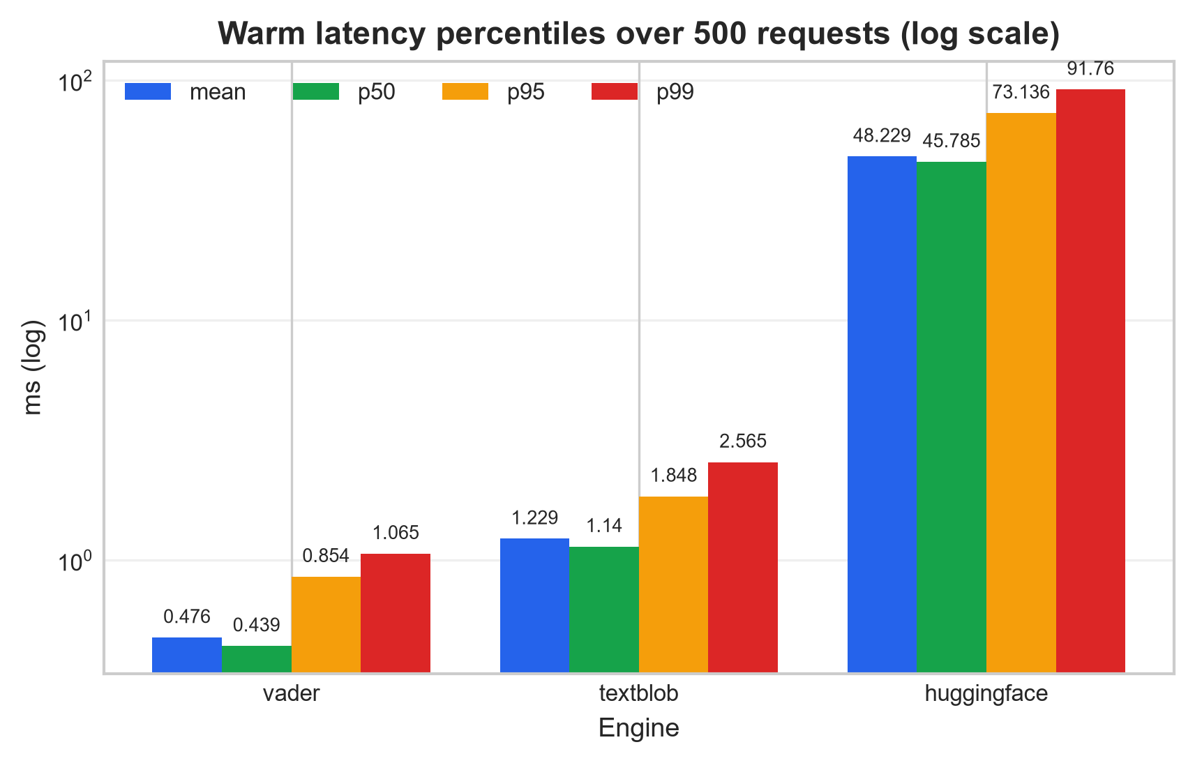
Performance — latency and throughput
500 timed requests per engine · ingestion batches 100 → 10,000
Warm latency (mean / p99)
VADER 0.476 / 1.065 ms — interactive-instant.
TextBlob 1.229 / 2.565 ms.
DistilBERT 48 / 92 ms (CPU, batch-of-1).
Throughput & memory (measured)
Ingestion: 17,242 reviews/s at 10k rows — linear scaling.
Peak RSS < 150 MB (148 MB worst); heap grows ≈2 MB per 10k rows.
Cold start (fresh process): VADER 3.4 s total vs DistilBERT 22.8 s — model loading dominates.
Cloud-Based Customer Review Sentiment Analysis Dashboard · 26MS-DS037
11 / 15
Notes:
Two slides' worth of numbers in one view. Warm latency: the lexicon engines answer in about a millisecond, DistilBERT in about fifty — fine for batches, marginal for an interactive API. Ingestion throughput is flat at roughly seventeen thousand reviews per second from one thousand to ten thousand rows, with memory under 150 megabytes — one order of magnitude above the largest modelled workload's steady-state rate. The cold-start column is the FaaS design input: total process time to first result is dominated by loading torch and the model weights.

Slide 12
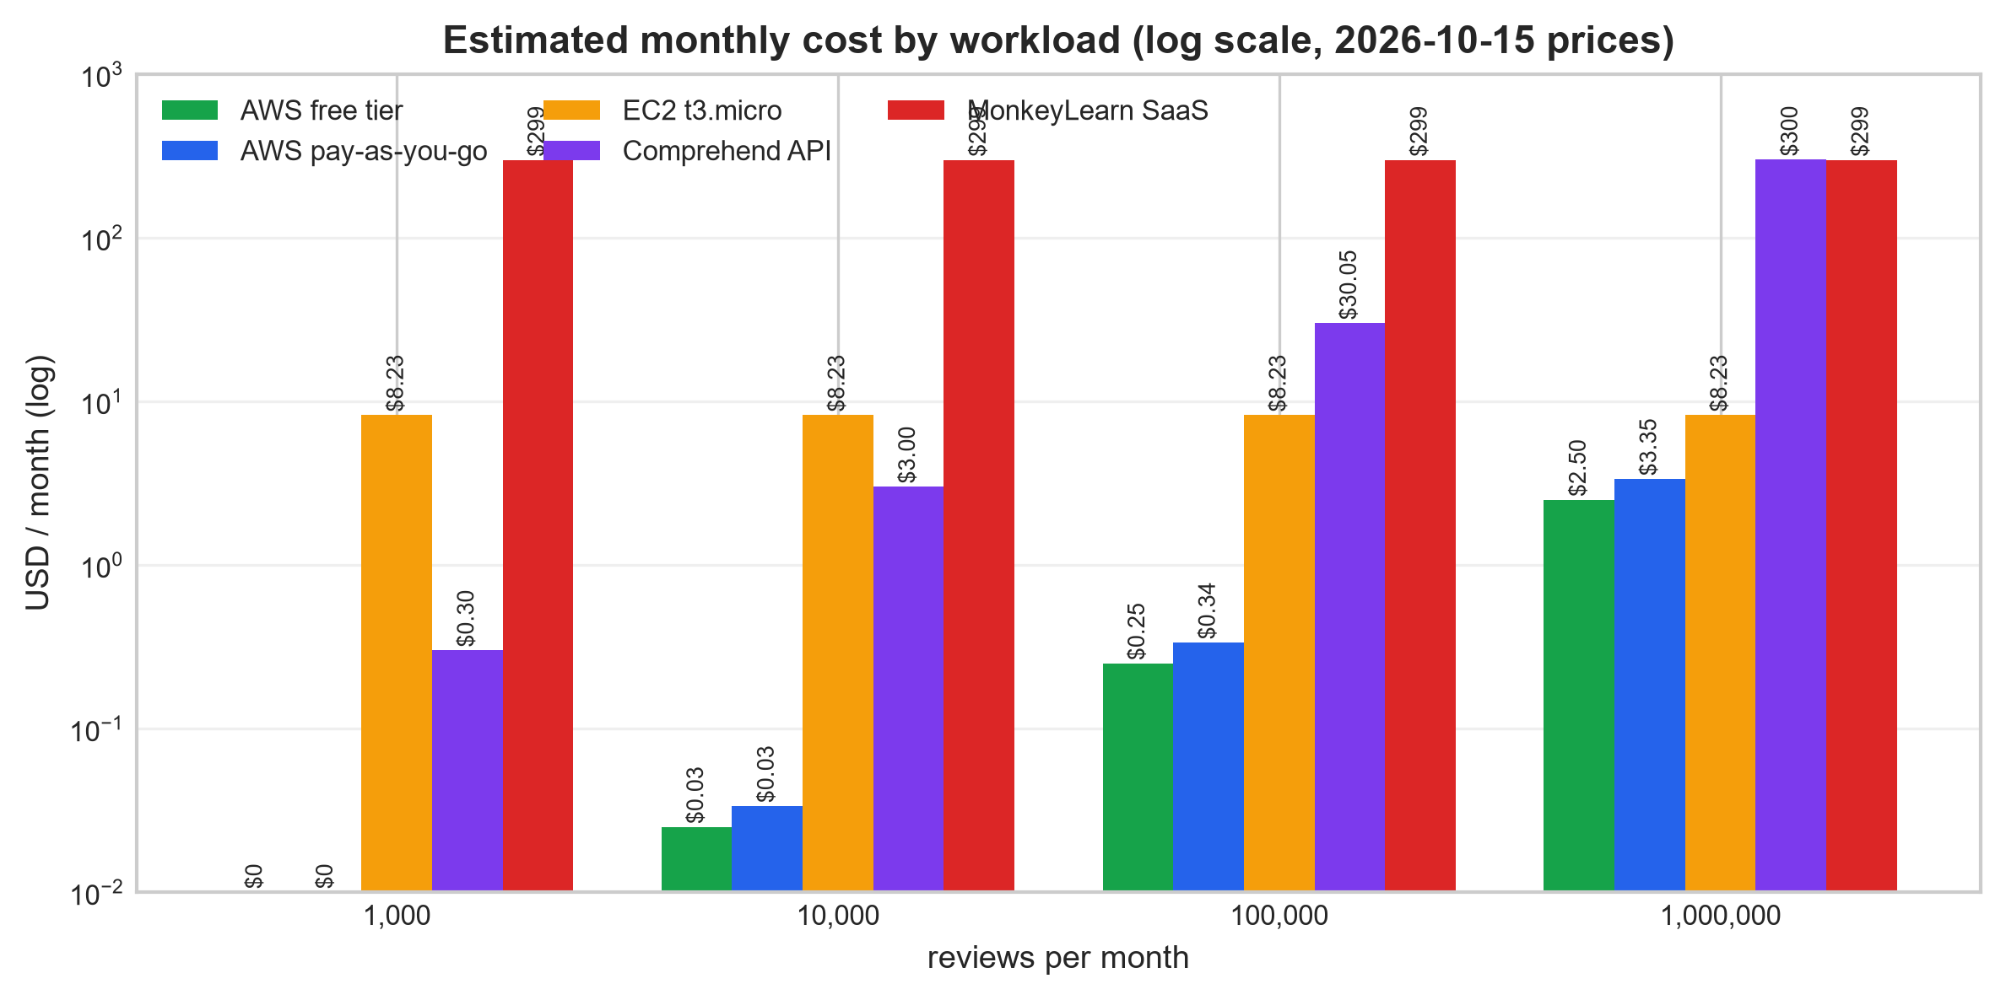
Free-tier cost analysis
measured inputs (7.47 ms/review, 732 B/review) · published prices, us-east-1, accessed 2026-10-15
Reviews/mo | AWS free tier | t3.micro | Comprehend
1,000 | $0.0025 | $8.23 | $0.30
100,000 | $0.2500 | $8.23 | $30.05
1,000,000 | $2.5000 | $8.23 | $300.49
Serverless wins at every modelled volume — pennies even with zero free-tier allowance ($3.35/mo at 1M reviews).
Free tier ≠ $0: DynamoDB on-demand is outside the provisioned-only allowance → $2.50/mo at 1M.
Managed sentiment APIs scale linearly with text: Comprehend $300.49/mo at 1M — 90× the pipeline.
Flat-rate SaaS ≈ $299/mo (third-party, UNVERIFIED) only makes sense above ~1M reviews.
Every price carries a source URL in results/cost_sources.json — nothing invented.
Cloud-Based Customer Review Sentiment Analysis Dashboard · 26MS-DS037
12 / 15
Notes:
The cost model combines two measured inputs — 7.47 milliseconds per processed review including write-back, and 732 bytes stored per review — with published, dated prices. The headline: two dollars fifty per month for a million reviews under the free tier, three thirty-five without any free tier, against three hundred for a managed sentiment API. The always-on VM is the trap: eight dollars and change sounds cheap until you compare it with a serverless path that costs fractions of a cent at small volume — and still needs no one to patch it.

Slide 13
Challenges & lessons learned
the honest part of the talk
No cloud credentials on the development machine → every cloud component (Firestore, DynamoDB, Comprehend, HF API) was written behind interfaces and verified through real local equivalents — nothing was ever pretended live.
Severe label skew (1,190/12/12) → accuracy alone is misleading; macro-F1, per-class recall and confusion matrices are the reported evidence.
Binary transformer vs the required 3-class output → neutral-band mapping; the ablation showed TextBlob collapses at band 0.5 (accuracy 0.6013), justifying the 0.15 default.
Windows quirks: PowerShell mangling inline JSON, SQLite temp-dir locks in one experiment, Hugging Face cache symlink fallback.
Writing 105 tests surfaced four real bugs — silent limit=0 default, case-sensitive sentiment filter, missing storage default, and a per-1M pricing bug that produced a $2,606/month nonsense estimate — all fixed and regression-locked.
Cloud-Based Customer Review Sentiment Analysis Dashboard · 26MS-DS037
13 / 15
Notes:
We include challenges because a cloud project is mostly constraints. With no credentials, the honest move was local parity, not screenshots of consoles. The skewed dataset forced better metrics. The binary-transformer mismatch became the neutral-band feature — and its ablation. And the test suite paid for itself immediately: the cost model's first version multiplied per-million prices by raw counts and claimed $2,606 per month; a sanity check caught it, and a regression test now pins the arithmetic.

Slide 14
Conclusion & future work
Delivered — and measured
Next steps
Free-tier review analytics is real: VADER 0.9712 accuracy at 0.476 ms per review.
≈17,416 reviews/s ingestion, <150 MB memory, linear scaling.
$2.50/month at one million reviews — ~120× cheaper than a managed sentiment API.
105 tests green + browser E2E 9/9; five experiment suites, seed 42, raw numbers in results/.
Nothing deployed, nothing billed, proposal untouched — the cloud parts activate with credentials, not rewrites.
Connect the proposal stack: Firestore adapter (STORAGE_BACKEND=firestore) + Streamlit dashboard on Community Cloud.
Live Hugging Face Inference-API token; fine-tune DistilBERT to recover neutral recall.
Multilingual and aspect-level sentiment (food, service, price) — actionable per-topic scores.
Streaming ingestion and per-tenant rate limiting for multi-business use.
CI/CD with drift checks on accuracy and cost; energy/carbon accounting per inference.
Cloud-Based Customer Review Sentiment Analysis Dashboard · 26MS-DS037
14 / 15
Notes:
In one sentence: the pipeline works, the numbers are real, and the cost is close to zero. What remains is connectivity, not construction — Firestore and Streamlit Community Cloud plug into the interfaces we already have. The measurement side continues too: fine-tuning for neutral recall, aspect-level sentiment for actionability, and extending the cost model from dollars to energy.

Slide 15
Thank you — questions?
Ahmed Bin Jaffar · 26MS-DS037 · MSDS Semester 2, MUET
Artifacts: docs/Project_Report.docx · presentation/ · results/ (raw numbers) · figures/ (300-dpi charts)
Dashboard live at /ui · tests: pytest (105) + Playwright E2E · re-run: scripts/generate_presentation.py
Cloud-Based Customer Review Sentiment Analysis Dashboard · 26MS-DS037
15 / 15
Notes:
Happy to take questions. If anyone wants to see the system running, it starts with one script — scripts/run_local.ps1 — and the whole study re-runs with scripts/run_experiments.ps1. The report and every raw result file are in the repository.

