Slide 1
Can I read your brain?
I am predicting the experienced feeling from the FC brain network with deep learning.
Fatemeh S., Claudeth H. & Ahmad D,​

Slide 2
Motivation:

Slide 3

Data:
Specific Task​
Emotion: Stimulus matching with fear/angry faces vs shapes
Human Connectome Project (HCP)​
fMRI: Rest & Task based​
360 ROIs (Glasser et al. 2016)​
100 Subjects
176 seconds

Slide 4
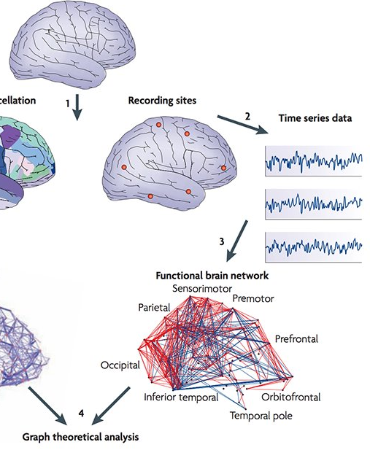
Motivation
We have two main motivations for this project
Emotional expressions in faces are known to activate a wide variety of brain regions (Blair et al. 1999).
Graph theory is one of the best approaches to study the brain! (Bullmore 2016 )

Slide 5
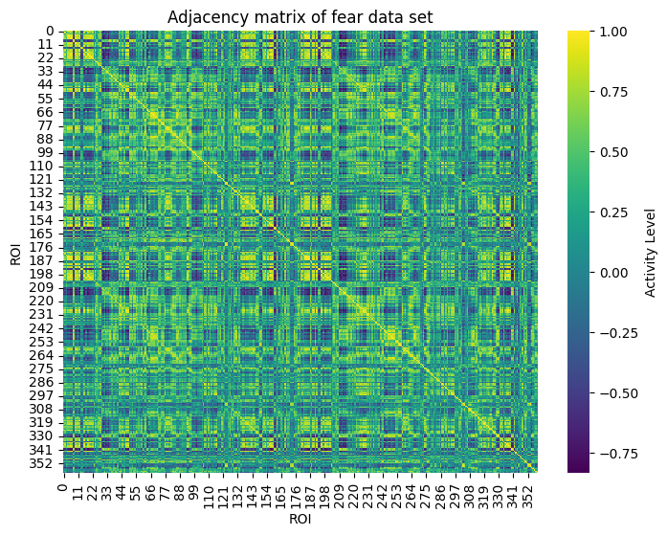
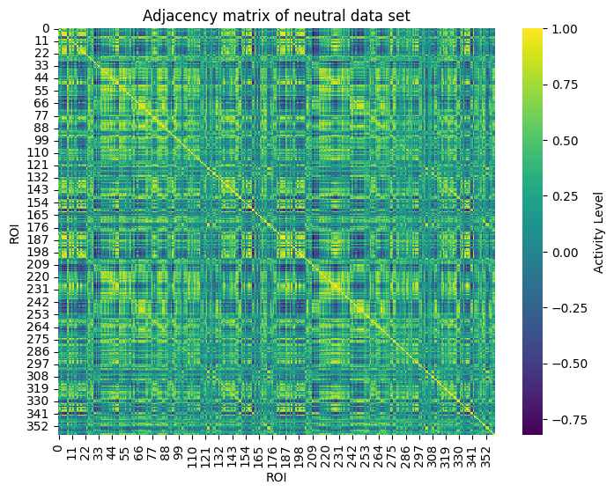

Slide 6
Hypothesis:
Is possible to predict emotion reaction to stimuli from the time series of ROIs with ML?

Slide 7
Approach:
01
Network feature of data —> network science (Louvain algorithm, …)
Predicting the feeling from the time series —> deep learning (CNN, RNN,...)
04

Slide 8
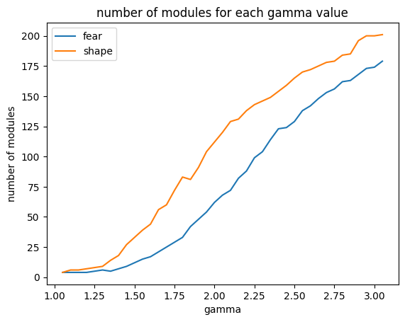
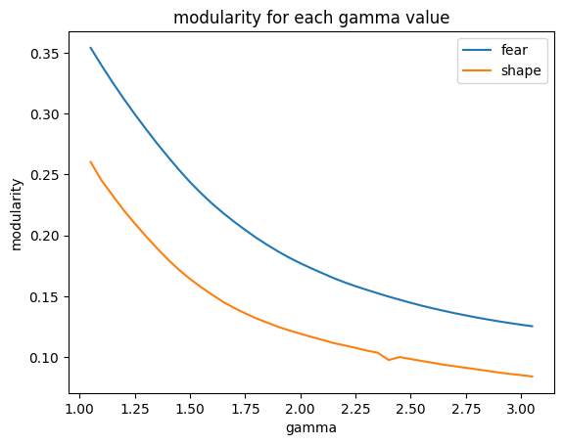
Results:

Slide 9
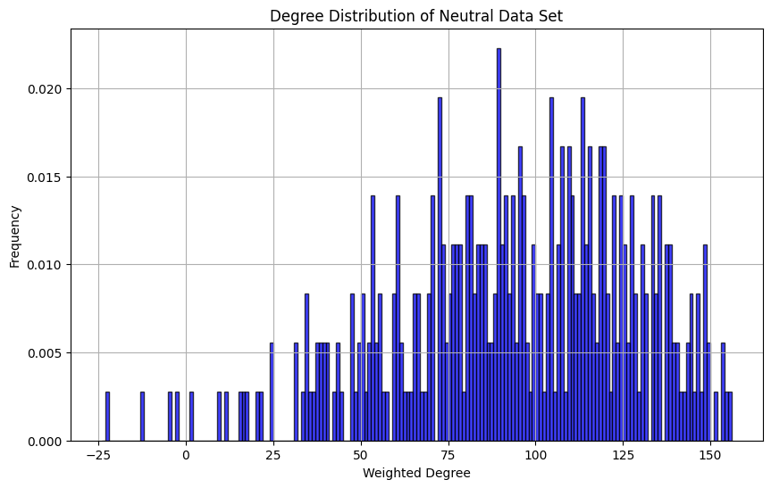
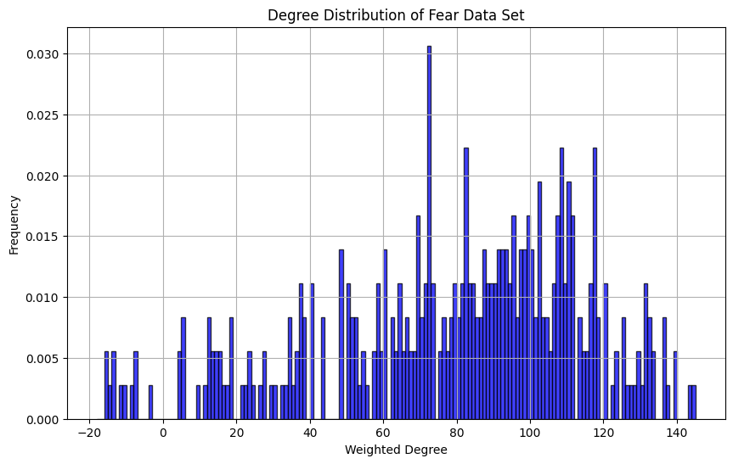

Slide 10
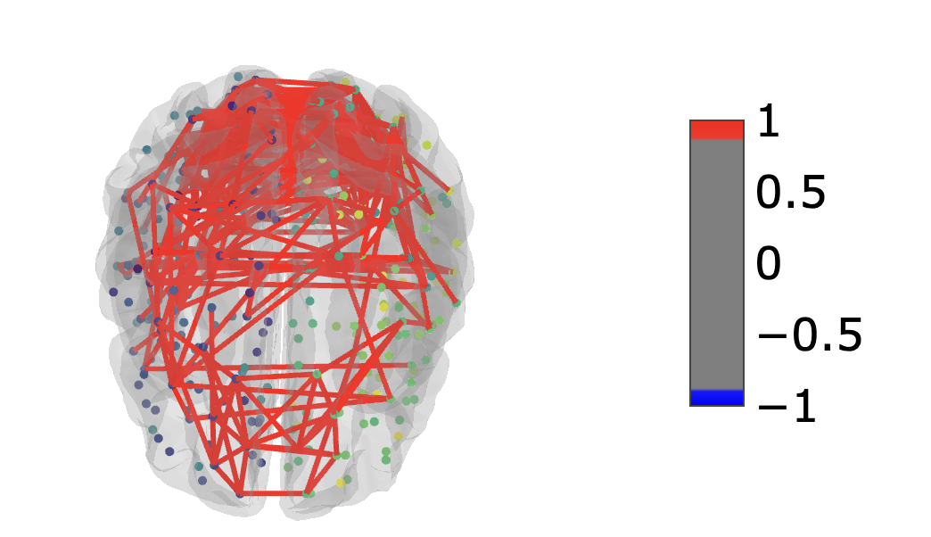
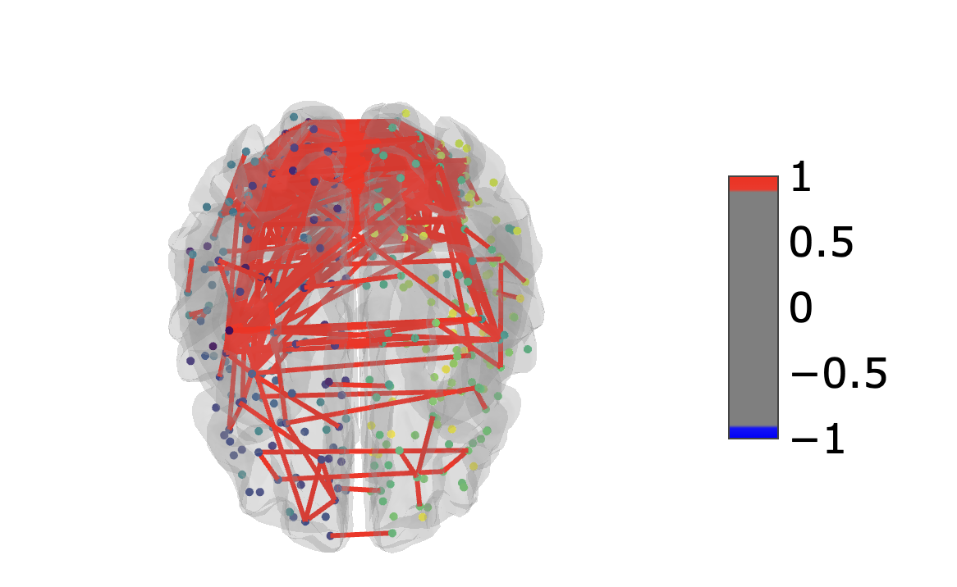
Neutral
Fear

Slide 11
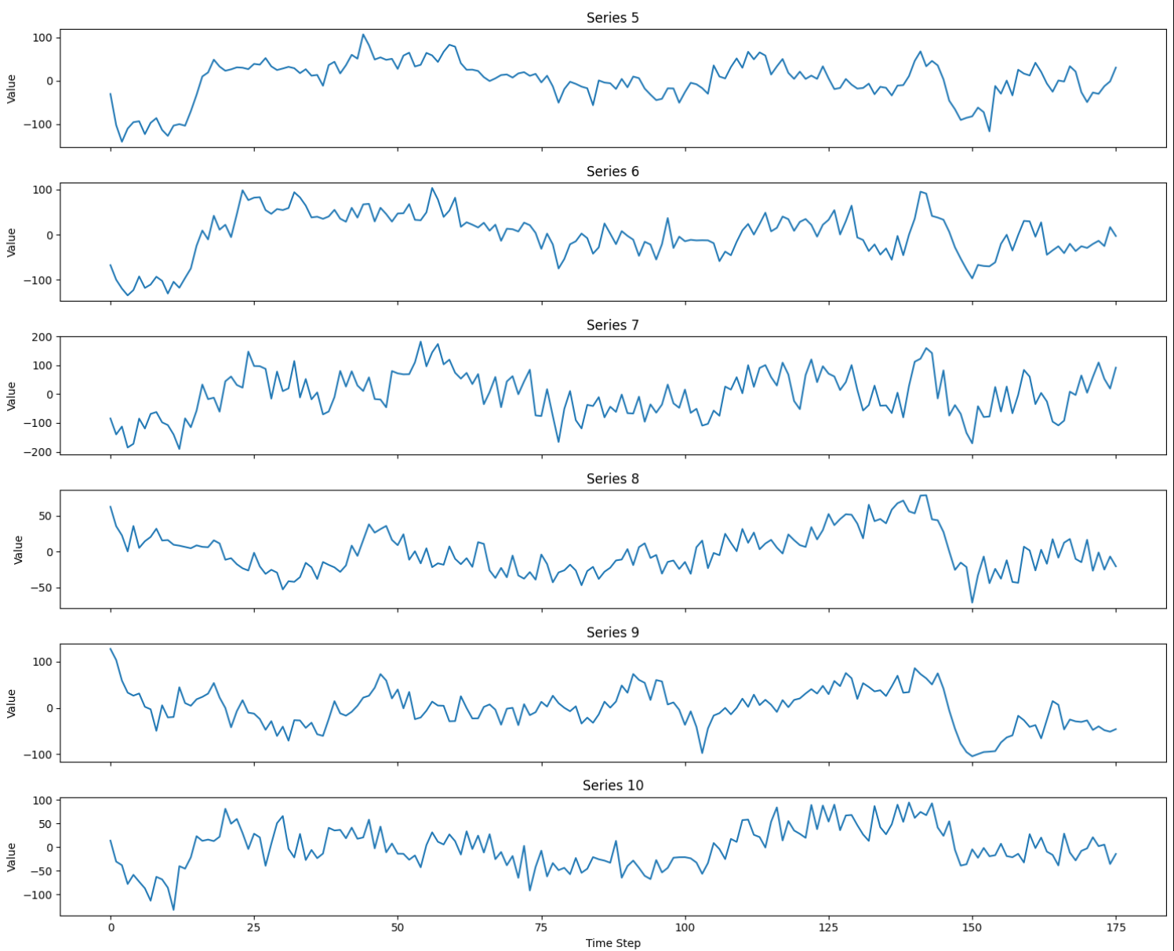
Visualize some time series

Slide 12
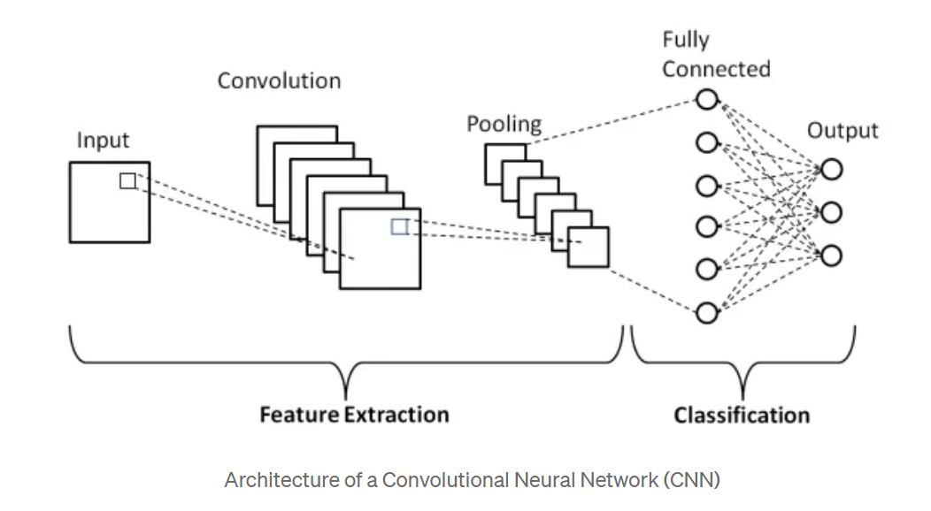
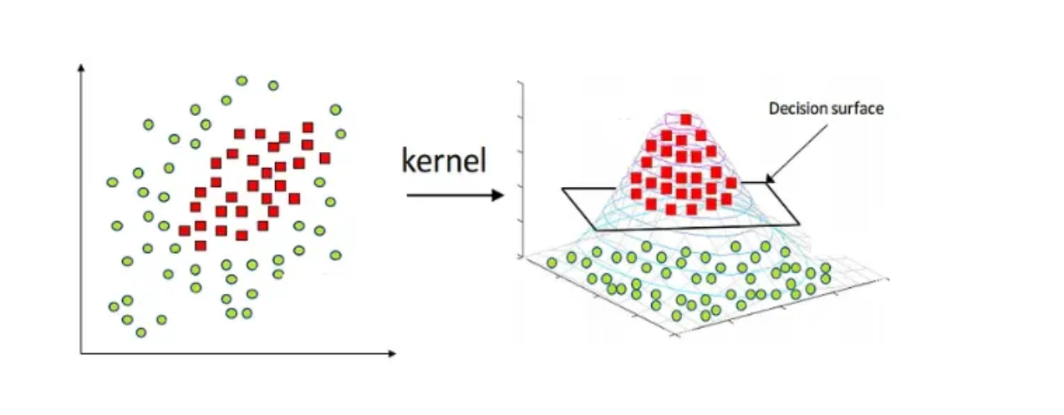
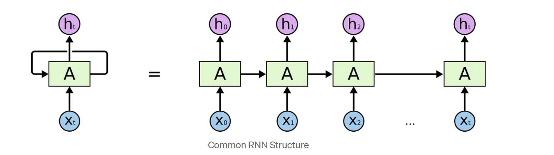
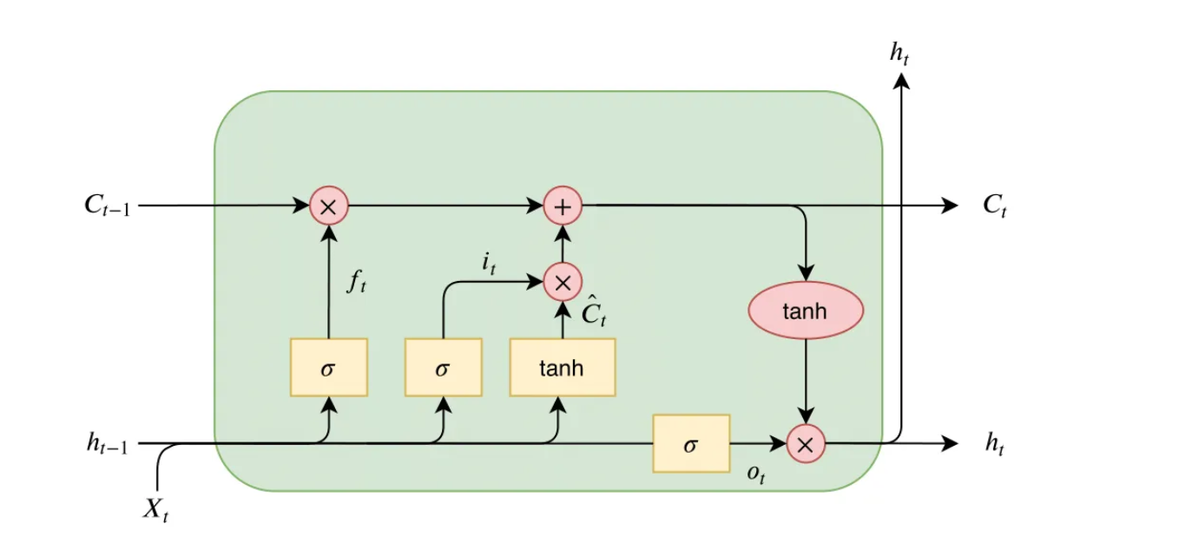
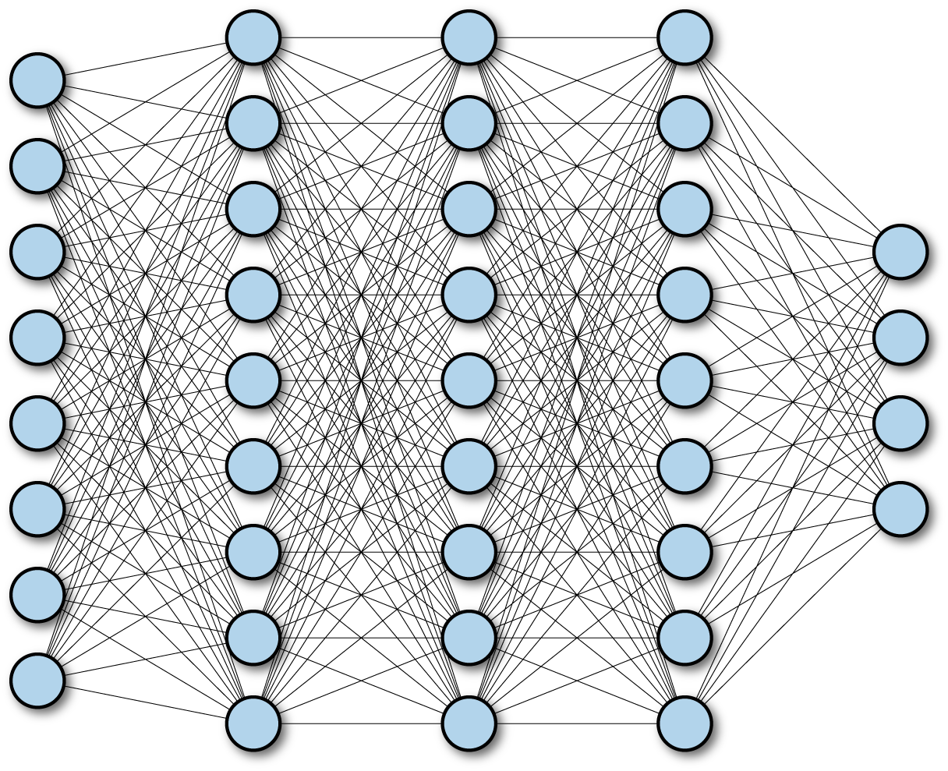
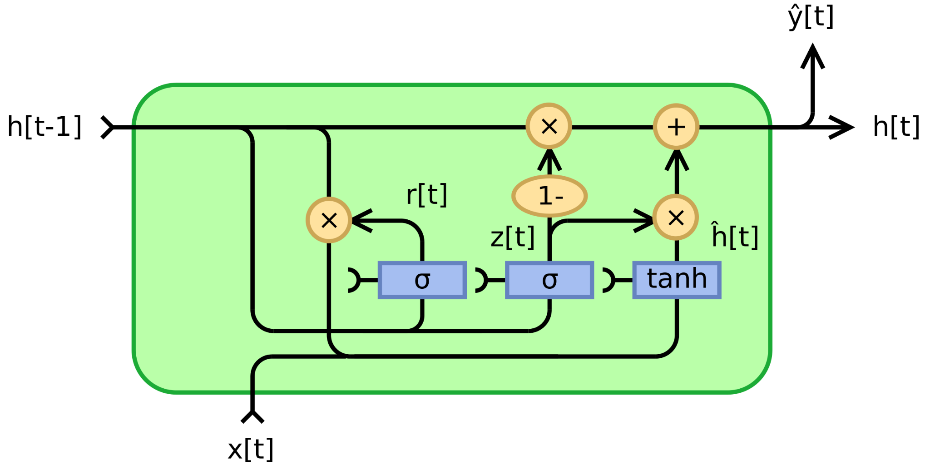
Deep Learning
RNNs
CNNs
LSTMs
DNN
GRU
SVM (ML not DL)

Slide 13
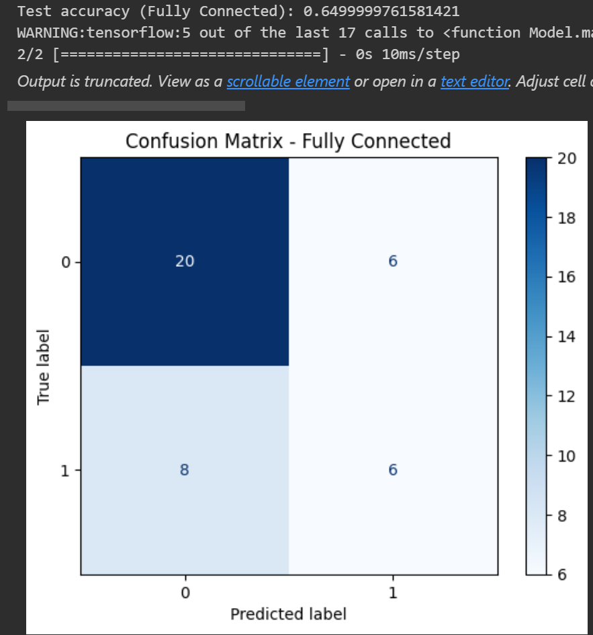
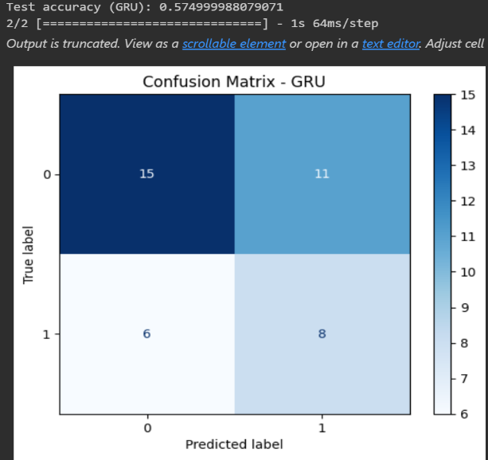
Deep Learning Results
Fully Connected (Dense) Neural Network
GRU

Slide 14
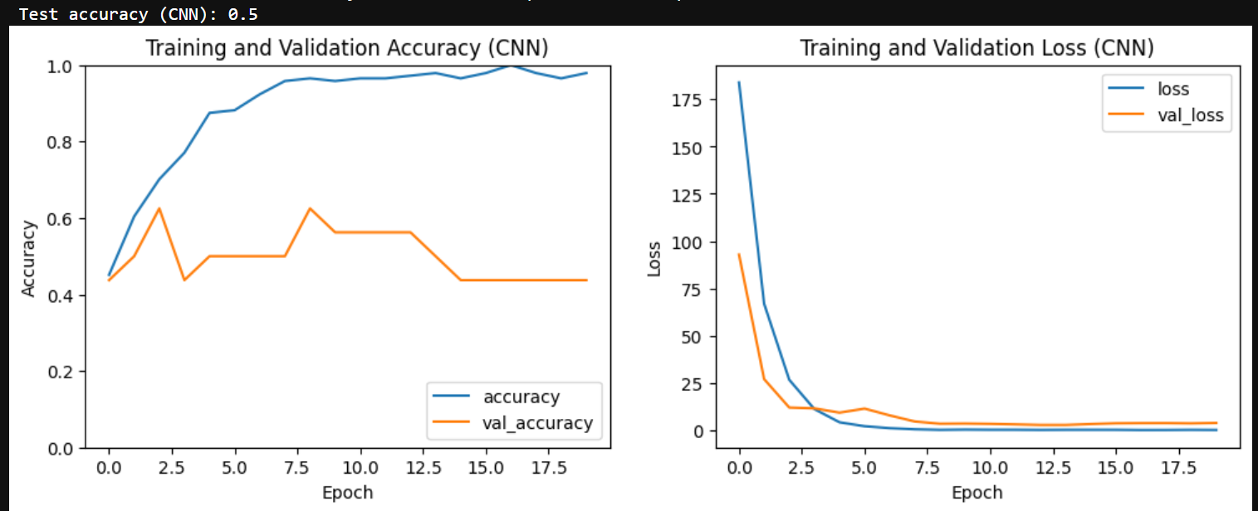
Convolutional Neural Network

Slide 15
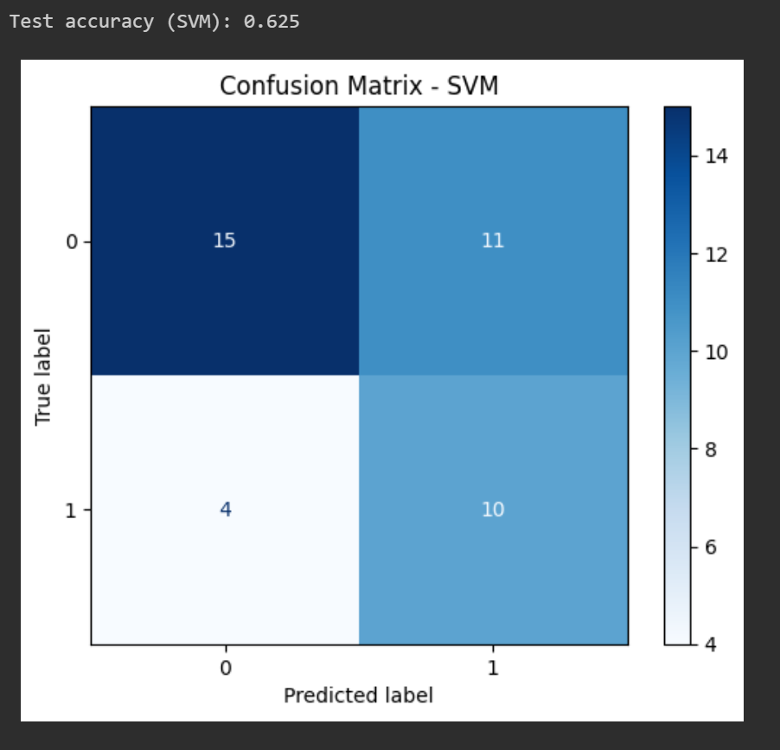
SVM (ML)

Slide 16
Conclusion
Our task was simple: predicting the emotion from the fMRI signal
We played with the dataset and did some feature engineering
We tested various Deep learning technics and the results was good
Finally, we can extend that reading the signals of brain is a way to understand the most mysterious object in the universe.

