Slide 1



Gym Exercises Recognition using deep learning
Name: ahmad sameh elhadad
ID: 181631
Supervisor: Dr. Ahmed Farouk

Slide 2
Table of contents
01
Introduction
02
Background
03
Problem statement
04
Objective
05
Related work
06
Proposed solution
07
Results and evaluation
08
Conclusion
09
Future work
10
Demo
11
References

Slide 3
Introduction
Exercises and Activities carried out inside, usually with the aid of equipment. A Gym is a big place with Equipment for training the body and gaining strength, or it’s a club where you can do exercises and improve health.

Slide 4
Background
Data Collection
Machine learning
Deep learning
Sensor-based
Video-based

Slide 5
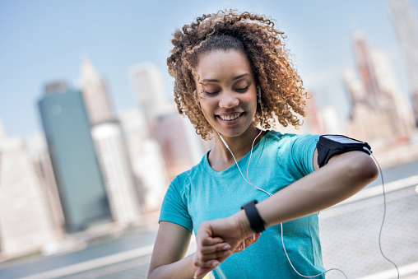
03
Problem statement
This project will help the Trainee to track their exercises.

Slide 6
Objective
04
This project will understand the records of the trainees and classify it based on the features

Slide 7
Related work
Research 1: Recognition and Repetition Counting for Complex Physical Exercises with Deep Learning
In this research the researcher used a program that ran on two smartwatches that were in contact with each other using Bluetooth low-energy, the sensor data was gathered and analyzed.
the researcher used a convolution layers to get the prediction accuracy with a combination of all sensors from both watches.

Slide 8
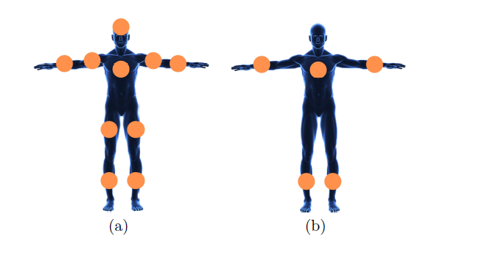
Related work
Research 2: Workout Type Recognition and Repetition Counting with CNNs from 3D Acceleration Sensed on the Chest
In ten distinct participants over the course of 2 to 3 workout sessions per subject, with each subject undertaking 1 of 4 different workout kinds, and with no-workout periods in between training sessions.
the researcher used 3 convolution layers to get the training type.

Slide 9
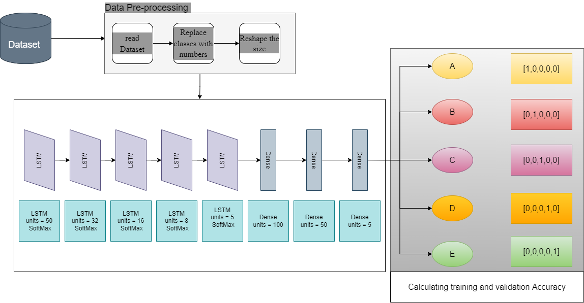
Proposed Solution

Slide 10
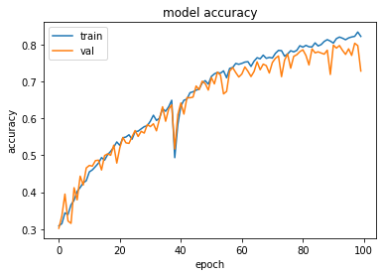
Results and evaluation
- Worst Case

Slide 11
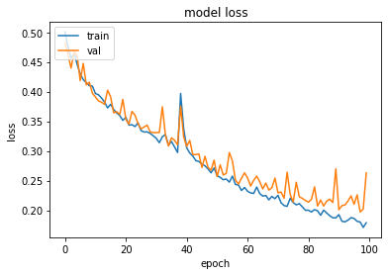
Results and evaluation
- Worst Case

Slide 12
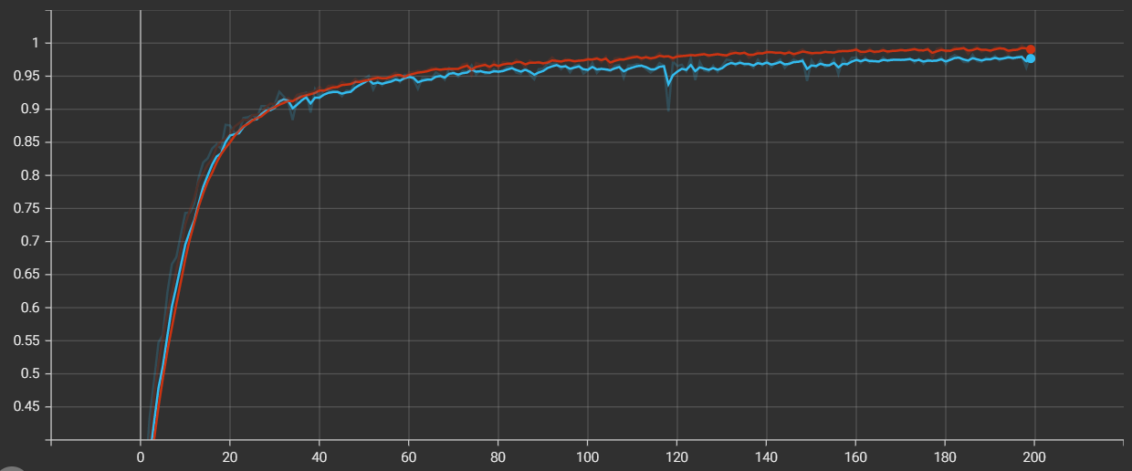

Results and evaluation
- Best Case epoch accuracy

Slide 13
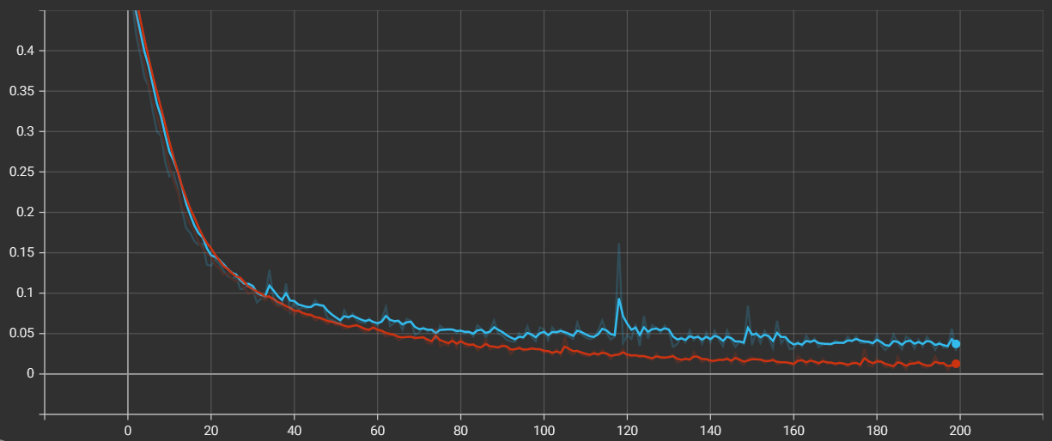
Results and evaluation
- Best Case epoch loss

Slide 14
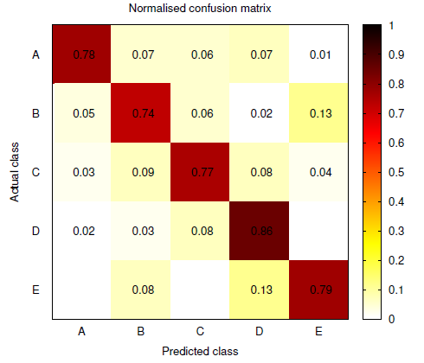
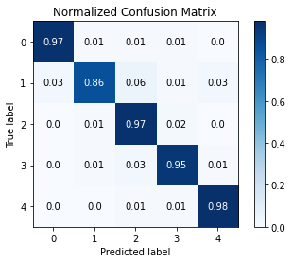
Results and evaluation

Slide 15
Conclusions
Finally, in our thesis, we developed a system that can read trainee records and, based on the features system can predict which exercise the trainee records belongs to.

Slide 16
Future work
Determine and evaluate the appropriateness of several sites on the human body to wear the sensor so I can get better accuracy to make it easier for the chip which will be used to determine the trainee exercise and help the trainee more accurately.

Slide 17
References
Bulling, A., Blanke, U. and Schiele, B., 2014. A tutorial on human activity recognition using body-worn inertial sensors. ACM Computing Surveys, 46(3), pp.1-33.
Fu, B., Kirchbuchner, F. and Kuijper, A., 2020. Performing Realistic Workout Activity Recognition on Consumer Smartphones. Technologies, 8(4), p.65.
Fu, B.; Kirchbuchner, F.; Kuijper, A. Unconstrained workout activity recognition on unmodified commercial off-the-shelf smartphones. In Proceedings of the 13th ACM International Conference on Pervasive.
Soro, A., Brunner, G., Tanner, S., & Wattenhofer, R. (2019). Recognition and repetition counting for complex physical exercises with deep learning. Sensors, 19(3), 714.
Skawinski, K., Roca, F. M., Findling, R. D., & Sigg, S. (2019, June). Workout type recognition and repetition counting with CNNs from 3D acceleration sensed on the chest. In International Work-Conference on Artificial Neural Networks (pp. 347-359). Springer, Cham
Wang, J., Chen, Y., Hao, S., Peng, X. and Hu, L., 2019. Deep learning for sensor-based activity recognition: A survey. Pattern Recognition Letters, 119, pp.3-11.
M. B•achlin, K. F•orster, and G. Tr•oster. Swimmaster: A wearable assistant for swimmer. In Ubicomp ’09: Proceedings of the 11th international conference on Ubiquitous computing, pages 215{224, New York, NY, USA, Sept. 2009. ACM. 4th Augmented Human International Conference (AH'13) 122

Slide 18
References
M. Gallagher. Ten most common causes of training injury. Muscle & Fitness, June 1996.
Soro, A., Brunner, G., Tanner, S., & Wattenhofer, R. (2019). Recognition and repetition counting for complex physical exercises with deep learning. Sensors, 19(3), 714.
S. N. Blair. Physical inactivity: the biggest public health problem of the 21st century. British Journal of Sports Medicine, 43(1):1 2, 2009.
Skawinski, K., Roca, F. M., Findling, R. D., & Sigg, S. (2019, June). Workout type recognition and repetition counting with CNNs from 3D acceleration sensed on the chest. In International Work-Conference on Artificial Neural Networks (pp. 347-359). Springer, Cham
Velloso, E., Bulling, A., Gellersen, H., Ugulino, W., & Fuks, H. (2013). Qualitative activity recognition of weight lifting exercises. Proceedings of the 4th Augmented Human International Conference on - AH '13. https://doi.org/10.1145/2459236.2459256
Wang, J., Chen, Y., Hao, S., Peng, X. and Hu, L., 2019. Deep learning for sensor-based activity recognition: A survey. Pattern Recognition Letters, 119, pp.3-11.
Z. Y. Kerr, C. L. Collins, and R. D. Comstock. Epidemiology of weight training-related injuries presenting to united states emergency departments, 1990 to 2007. The American Journal of Sports Medicine, 38(4):765{771, 2010.

Slide 19

Thanks!

