Slide 1
ESCAPE ROOM CHALLENGE
By Oxana, Bharat, Emma, Whitney and Ahmad
Working on this project:
Oxana Ribeiro
Bharat Singh
U'ta-liane Emmanuelle Matola-Boutali
Ahmad Marvi
Whitney

Slide 2
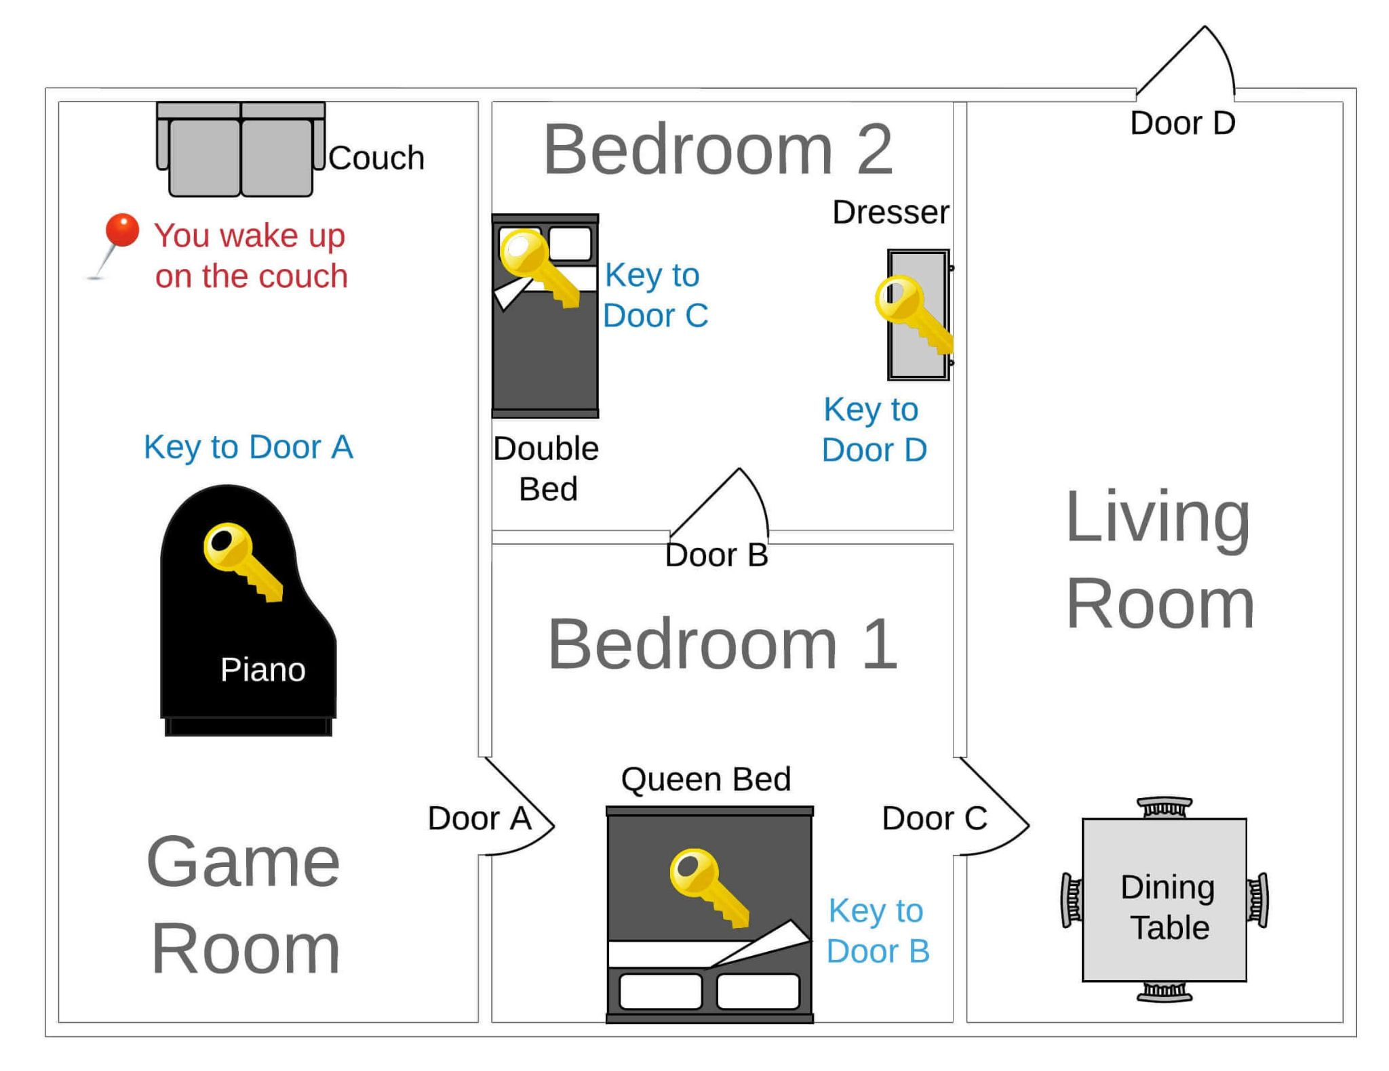
Game structure
It is a text-based escape room type of a game where the player will need to input the correct values in order to proceed.
The player finds himself in the Game room and needs to go through each room, inspecting every item in the room one by one, to collect all the keys and find the exit.

Slide 3
Functions and features
The list of functions used in the game:
start_game - a function called in the beginning of the game defining the room and item we start at
play_room - function comparing the current room with the target. When the target is reached, the game ends.
explore_room - function listing all items (furniture, doors) that belong to the current room
get_next_room_of_door - function that allows to go to the next room when the door is opened
examine_item - the function that allows to examine an item such as door or furniture. If the furniture has a key - we collect the key. If we already have a key corresponding with the door - we are able to open the door.

Slide 4
Technical challenge
1. Understanding the technical aspect of the game w.r.t the flow.
2. Defining missing aspects of the rooms.
3. Identify the missing object relation and completing them as per sequence of rooms.

Slide 5

Our biggest mistake
Not adhering to the game sequence.

Slide 6
Let’s take a look into a demo of our game:
CLICK HERE

Slide 7
THANK YOU FOR WATCHING

