Slide 1
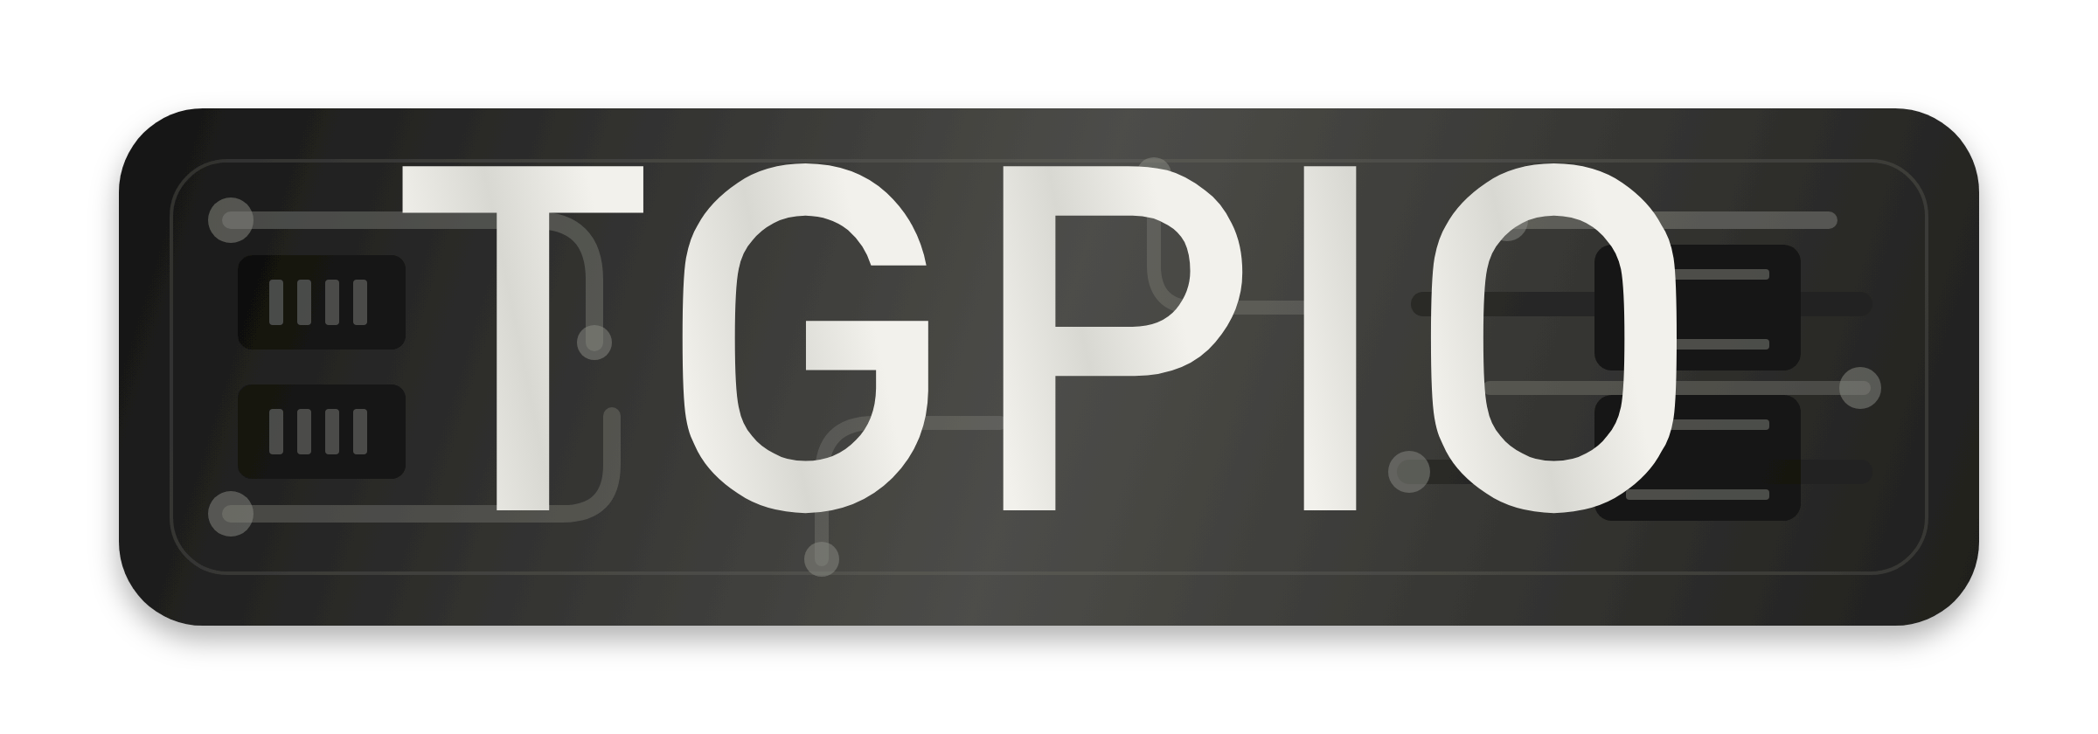
Time-Aware GPIO on Linux
Exposing firmware-undeclared Intel timed I/O through the PTP hardware clock interface
Ahmad Byagowi
ISPCS 2026 — International Symposium on Precision Clock Synchronization
github.com/ahmadexp/TGPIO

Slide 2
Why timed I/O?
• PTP / PTM make clocks comparable — but measurement and control need time attached to physical signals
• TGPIO is the missing boundary: capture external edges, generate scheduled transitions, in platform time
• Motivating case: GPS receiver PPS wired straight into a TGPIO input
– GPS time reaches host timekeeping with no dedicated timing card
– The OS becomes a time-aware participant in a TSN domain
• The catch: on this platform the TGPIO blocks exist in silicon but are not declared by firmware
– No ACPI device, no upstream driver binds — the hardware is invisible to Linux

Slide 3
The hidden hardware
• Two Intel TGPIO blocks at fixed MMIO (0xFE001210 / 0xFE001310, 0x38 span each)
• Timebase: Always Running Timer (ART), 38.4 MHz nominal — one LSB ≈ 26 ns
– Real oscillator rate calibrated at load; TSC/ART ratio 170/2 from CPUID leaf 0x15
• Each block: external timestamp capture (input) or compare-driven periodic output
• Registers speak raw ART cycles — capture values and compare/interval values alike
• Driver maps the known addresses and presents each block as a standard PTP pin
Load only on platforms where the addresses are confirmed — the driver is intentionally platform-specific.

Slide 4
Driver architecture
• A software PHC layered on ART: anchor-plus-rate model (anchor_art, anchor_ns, base_art_hz, scaled_ppm)
• Standard ptp_clock_info: gettime / settime / adjtime / adjfine / extts / perout / crosststamp
• Existing tooling just works: ts2phc, phc2sys, chrony, testptp
• Polling capture path with stall watchdog; debugfs status + activity log via journalctl
• Both blocks independent: any mix of input/output — set with TGPIO0=… TGPIO1=…

Slide 5
Three clock modes
• phc (default) — adjustable ART-backed PHC; discipline it with ts2phc / phc2sys
• art — free-running hardware timebase anchored to CLOCK_MONOTONIC_RAW; every adjustment rejected
• realtime — the PTP clock IS CLOCK_REALTIME; adjustments steer the system clock itself
– settime → do_settimeofday64; freq/offset → do_adjtimex (kprobe-resolved, not exported)
– Hardware timestamps discipline the OS clock directly — validated with a chrony PHC refclock
• All modes drive the same ART-domain registers underneath

Slide 6
What the silicon actually does
• Established by register-level experiments (devmem + logic analyzer), not the datasheet:
• Single-shot output compares never fire — periodic mode is the only way to move the pin
• The output level flop is write-only toggle history
– Survives disable; EN=0 forces the line low but keeps the flop; unreadable from software
• In-flight rewrites of the period (PIV) and compare (COMPV) registers are glitch-free
– …but COMPV rewrites can register phantom events — pause event mode around the write
• COMPV reads back live (COMPV = TCV + PIV); enabling with a past COMPV fires immediately
Several of these invalidated our earlier working theories — the paper documents the negative results too.

Slide 7
Deterministic output polarity
• One bit of truth the hardware will not give back: is the pin currently high or low?
• Driver keeps a software mirror of the flop, folded on every stop/re-arm
– Drain-low across disables and module reloads; parity-aware slot selection on arm
• Result: rising edges on the requested grid, every time
– 5/5 reloads, deliberate 300 ms PHC steps, phc2sys restarts — all correct
• External correction path: a one-poke debugfs flip snapped a deliberately inverted waveform onto the grid without a glitch
• Bonus (negative result): polarity is fundamentally unobservable from an external reference at 50% duty

Slide 8
Disciplining a free-running output — no restarts
• Naive approach re-arms the waveform on every servo update → phase lottery + 40 µs/s rate error
• Instead the output free-runs in hardware and the driver steers it in flight:
– Calibrated base ART rate (not the 38.4 MHz nominal) anchors the clock model
– Grid-aligned arms: first edge at start + k·period, never 'now'
– Hot PIV refresh on every adjfine — the period tracks servo frequency continuously
– Phase nudges via paused COMPV rewrite only beyond a 200 ns tolerance
• Zero waveform restarts over multi-minute disciplined captures

Slide 9
Two discipline paths
• phc2sys (PHC-to-PHC over PCIe)
– Asymmetric read cost → constant ~2.4 µs systematic; needs one-shot calibration
– Needs platform pinning: performance governor + /dev/cpu_dma_latency held at 0
• ts2phc (ART-domain loop) — reference PPS wired into a TGPIO input
– Capture and generation share the ART timebase — PCIe drops out of the loop
– Uncalibrated systematic collapses to ~50 ns (≈ two ART cycles); no pinning needed
• The input-capture path wins operationally — and it IS the GPS use case, with the atomic PPS standing in for a receiver

Slide 10
Evaluation setup
• Reference: OCP TimeCard, atomic-clock (MAC) referenced 1 PPS
• Instrument: Saleae Logic Pro 16, headless scripted captures, edge statistics vs the reference channel
• DUT: Intel platform with the two hidden TGPIO blocks; block 0 input, block 1 output
• Every number is wire-to-wire on the same instrument — including the TimeCard's own PPS as a fairness check
Instrument crystal runs ~-7.4 ppm vs the atomic PPS; all measurements are differenced against the reference channel.

Slide 11
Results: within 100 ns of an atomic reference
Signal (1 PPS vs atomic reference)
Mean offset
Std dev
TGPIO output — phc2sys path, calibrated
+9 ns
64 ns
OCP TimeCard's own PPS output (same instrument)
−10 ns
54 ns
TGPIO output — ts2phc ART-domain loop, uncalibrated
−52 ns
122 ns
System clock via chrony PHC refclock
−218 ns
11 ns
The disciplined TGPIO output is statistically comparable to the dedicated timing card's own PPS
Reference-wire noise floor on the instrument is 60–80 ns; residual spread is consistent with the 26 ns ART quantization step plus servo wander

Slide 12
Beyond PPS: the full feature set
• TDC mode — the two blocks become start/stop (selectable) for interval measurement, ~26 ns LSB
• Output shaping — hardware asymmetric duty cycle, one-shot pulses (99.9990 ms measured for a 100 ms request)
• Observability — input phase/interval statistics, per-edge verbose rounding reports, activity log in journalctl
• Integration — kernel PPS sources, precise cross-timestamps (PTP_SYS_OFFSET_PRECISE), auto-polarity via loopback
• Operations — stall watchdog, save-config persistence, comprehensive make help, GitHub wiki

Slide 13
Limitations and future work
• Platform-specific by design: hard-coded MMIO, confirmed addresses only → needs discovery/quirk mechanism
• Polling capture path — an interrupt-backed path would suit high-rate event streams
• The PHC is a software clock model on ART; the oscillator itself is not steered
• Polarity rests on one bit of external truth: cold states the driver never saw need one external observation
• Future: more platforms, interrupt support, evaluate a subset for upstream Linux review

Slide 14
Availability
• github.com/ahmadexp/TGPIO — driver, build tooling, measurement scripts, wiki documentation
• TGPIO Non-Commercial License
– Free for personal, academic, research, teaching, and evaluation use
– Commercial use requires the prior written permission of the author
– MODULE_LICENSE stays GPL-compatible solely for kernel symbol gating
• Reproducibility: scripted headless logic-analyzer captures and analysis included in the repo

Slide 15
Hidden silicon → usable physical time
A firmware-undeclared timed I/O block, driven through the standard PTP interface,
holds an atomic PPS reference within 100 ns — comparable to a dedicated timing card.
Thank you — questions?
Ahmad Byagowi · ahmadexp@gmail.com · github.com/ahmadexp/TGPIO

