Slide 1

The React Framework For Production
Eng/Ryhab Farouq

Slide 2
React
react is a library for building user interfaces
Not quite possible to build a full feature rich application ready to deployed for production
You have to make decisions on other features of the application like routing , styling , authentication etc.

Slide 3
Next
A package that uses react for building user interfaces loaded with a lot more features that enable you to build full fledged production ready applications features exactly like routing , styling , authentication , bundle optimization etc.
There is no need to install additional packages , next.js provide everything for you
Opinions and conventions need to be followed to implement the above said features

Slide 4
Why learn Next.js?
Next.js simplifies the process of building a React application for production
File based routing
Support for css modules
Pre-rendering
Next.js create html page for all at once that affect the performance
API routes
Dev and Prod build system
Authentication

Slide 5

History
Version | Year | Key Innovation
1 | 2016 | File-based routing + SSR
9 | 2019 | API Routes + Dynamic Routing
10 | 2020 | Image Optimization
12 | 2022 | SWC Compiler “Speedy Web Compiler” + Middleware
13 | 2022 | App Router + RSC + Turbopack
14 | 2023 | Partial Prerendering + Server Actions
16 | 2025 | Turbopack default + Edge-first design

Slide 6
Installation
npx create-next-app <project-name>
npm run dev
It runs the _app.js at first then index.js

Slide 7
Routing in Next.js application
Route with pages
Nested routes
Dynamic routes
Catch-all routes
Navigate from the UI
Programmatically navigation between pages

Slide 8
Routing Section
React :
Install a third party package
Routes.js file to configure the routes
For each route , create a component file , export the component import it in routes.js and configure the new router with a new property

Slide 9
Next :
File-system based routing mechanism
When a file is added to the pages folder in a project , it automatically becomes available as a route
By mixing and matching file names with a nested folder structure , it’s possible to pretty much define the most common routing patterns

Slide 10
Nested routes
Routing with pages
As soon as you make html pages inside pages folder you can route between them immediately
Localhost:3000/blog/first

Slide 11
Dynamic routers
Localhost:3000/product/1
Nested dynamic routers
Localhost:3000/product/1/review/5
Catch All Routes
I have sidebar that contains main links and submain links

Slide 12
Routing Summary
Page based routing mechanism , pages are associated with a route based on their file name
Nested routes , Nested folder structure , files will be automatically routed in the same way in the URL
Dynamic routes can be created by adding square brackets to a page name
Catch all routes , add three dots inside square brackets to create a catch all route

Slide 13
Pre-rendering
Next.js generates html for each page in advance instead of having it all done by client-side javascript
No pre-rendering “plain react.js app”
In initial loading :
app is not rendered js loads react comp are initialized and app become interactive
Pre-rendering “using next.js”
In initial loading :
Pre-rendered html is displayed js loads react comp are initialized and app become interactive

Slide 14
Pre-rendering improves performance
In react application , you need to wait for the javascript to be executed
Perhaps fetch data from an external API and then render the UI.
There is a wait time for the user
With a pre-rendered page , the html is already generated and loads faster

Slide 15
Pre-rendering helps with SEO
With a react application , if the search engine hits your page , it only sees a div tag with id equal to root
If search engine hits a pre-rendered page through all the content is present in the source code

Slide 16
Static Site Generation ‘SSG’
A method of pre-rendering where the html pages are generated at build time
Prod server : an optimized build is created once you deploy that build , you don’t make code changes on the go once it’s deployed
Dev server : we should be able to make changes on our code and we want that code to immediately reflect in the browser

Slide 17
getStaticProps function
Used only for pre-rendering
Runs only on the server-side , the function will never run client-side
It should return an object and object should contain a props key which is an object
getStaticPaths function
To fetch dynamic data

Slide 18
Server Side Rendering ‘SSR’
Next.js allows you to pre-render a page not at build time but at request time , the html is generated for every incoming request
SSR is required when you need to fetch data per request and also when you need to fetch personalized data keeping in mind SEO
We use getServerSideProps function to fetch data

Slide 19
Client Side Data Fetching
Sometimes you might not always need to pre-render the data
Like : user dashboard page .
As it’s private , that’s behind a login page screen , highly user specific and SEO is not relevant , so no need to pre-render the data you can rely on client side data fetching .

Slide 20
SWR for client side data fetching
The name ‘SWR’ is derived from ‘Stale-While-Revalidate’
Is a strategy to first return the data from cache (stale), then send the fetch request (revalidate) and finally come with the up-to-date data
Npm add swr

Slide 21
Revision
CSR: Rendering happens on the browser, so users may see a loading spinner while the application is being rendered. The performance (initial load) depends on the size of the application and how much JS is shipped to the browser
SSR: Rendering happens on the server before the result is sent to the browser. There may be latency (depending on the server's location) because the request has to go to the server and back
SSG: Rendering happens at a built time on the server, the result is cached in CDNs closer to users. This helps improve performance because rendering happens once and the result is stored closer to users (solving latency issues)
ISR: Rendering happens at time intervals and is cached, so it's still performant but using ISR ensures data doesn't become stale

Slide 22
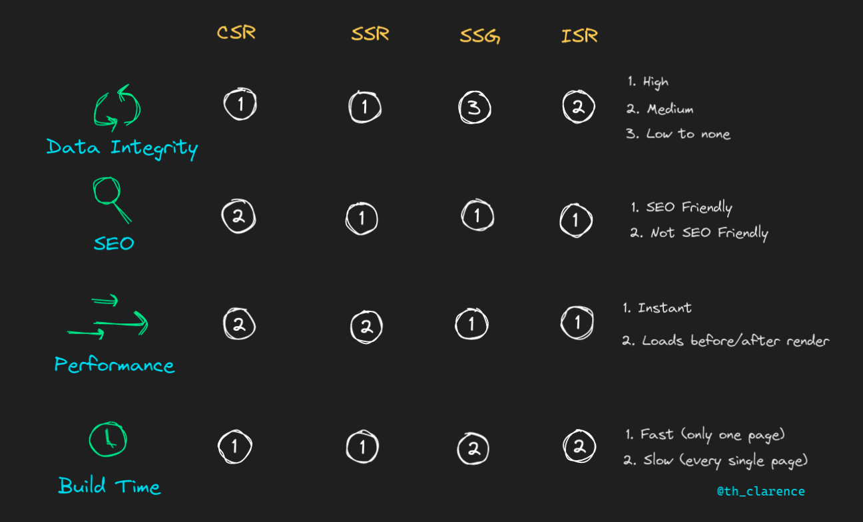

Slide 23
Agenda
Authentication and Authorization
Client Side Authentication
Securing Pages Client Side
Server Side Authentication
Securing Pages Server Side
Securing API Routes

Slide 24
Intro
API routes allow you to create restful endpoints as part of your next.js application folder structure
Within the page folder , you need to create a folder called ‘api’
Within ‘api’ folder you can define all the APIs for your application
You can add business logic without needing to write any additional custom server code and without having to configure any API routes
Next.js gives everything you need to write full-stack react + node application

Slide 25
API routing mechanism is similar to page based routing mechanism , APIs are associated with a route based on their file name
Every API routes exports a default function typically named as handler function
We shouldn’t call our own API routes for pre-rendering content “cause delay”

Slide 26
Adding bootstrap
npm I bootstrap .
In _app.js
import 'bootstrap/dist/css/bootstrap.min.css'
import {useEffect} from 'react’
useEffect (()=>{
import('bootstrap/dist/js/bootstrap.min.js')
},[])

