Slide 1


Slide 2



Slide 3

Table or entity: a collection of records
Attribute or Column or field: a Characteristic of an entity
Row or Record or tuble: the specific characteristics of one entity
Database: a collection of tables
Server: a collection of DBs

Slide 4

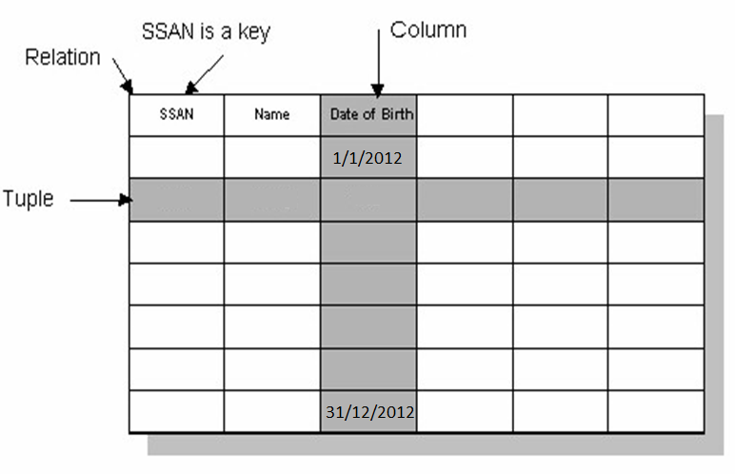

Slide 5

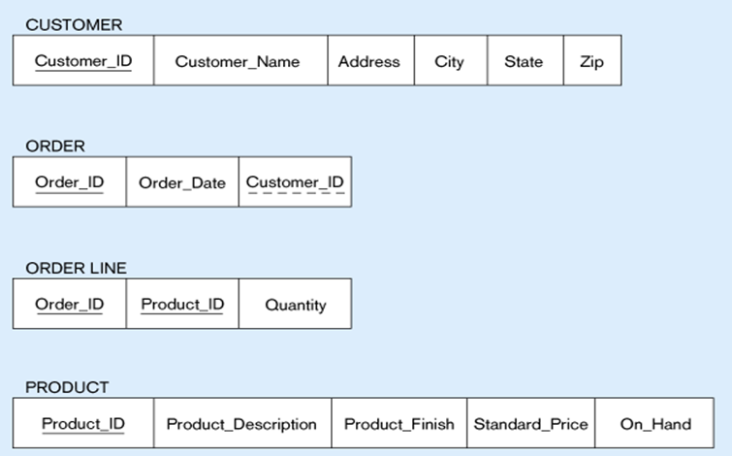
Primary Key
Foreign Key
composite primary key

Slide 6

Step 1: Mapping of Regular Entity Types if there is 1 to 1 relationship mandatory
Step 2: Mapping of Weak Entity Types
Step 3: Mapping of Binary 1:1 Relation Types
Step 4: Mapping of Binary 1:N Relationship Types.
Step 5: Mapping of Binary M:N Relationship Types.
Step 6: Mapping of N-ary Relationship Types.
Step 7: Mapping of Unary Relationship.

Slide 7

Create table for each entity type -> if there is no 1-1 relationship mandatory from 2 sides
Choose one of key attributes to be the primary key

Slide 8



(a) CUSTOMER entity type with simple attributes
(b) CUSTOMER relation

Slide 9


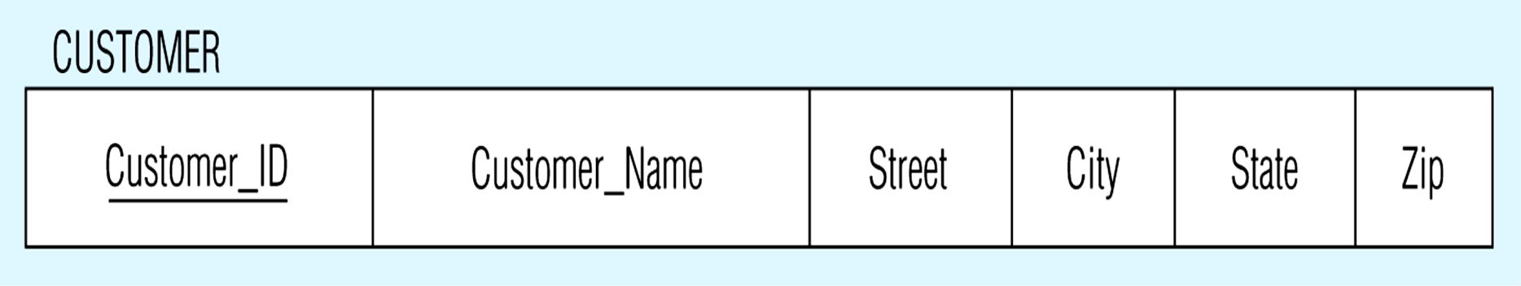
CUSTOMER entity type with composite attribute
CUSTOMER relation with address detail

Slide 10



Multivalued attribute becomes a separate relation with foreign key
------------
1 – to – many relationship between original entity and new relation

Slide 11

In the most cases Derived attribute not be stored in DB
Mapping Complex Like Mapping Multivalued attribute then including parts of the multivalued attributes as columns in DB

Slide 12

Eid
number
name
has
Emp
account
Salary
overtime
Net Salary
balance
Employee(Eid, Name, salary, overtime)
Note
Netsal= salary+overtime
ERD Concepts

Slide 13


number
name
Eid
address
has
customer
account
phones
zip
num
balance
Customer(Eid, Name, address)
Emp_phones(Eid, Zip, Num)
-----
ERD Concepts

Slide 14

Create table for each weak entity.
Add foreign key that correspond to the owner entity type.
Primary key composed of:
    Partial identifier of weak entity
    Primary key of identifying relation (strong entity)

Slide 15

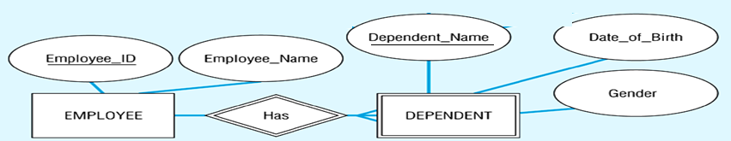
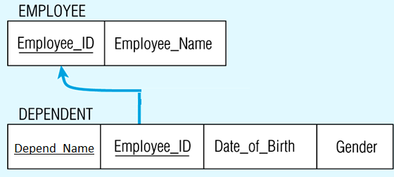
---------------------
Composite primary key

Slide 16

Merged two tables if both sides are Mandatory.
Add FK into table with the total participation relationship to represent optional side.
Create third table if both sides are optional.

Slide 17



One-to-One
2 Mandatory
EID
EName
CID
CName
1
Has
1
Employee
Computer
1 table
tbl_xy (PK,….,…,….)
PK = PKx or PKy
Emp(EID, Ename, Cname, CID)

Slide 18

One-to-One
X optional – Y mandatory
EID
EName
CID
CName
1
Has
1
Employee
Computer
2 tables
tbl_x (PKx,….,…….)
tbl_y (PKy,….,….,PKx….)
Employee(EID, Ename)
Computer(CID, Cname, EID_FK)
------------

Slide 19

One-to-One
2 Optional
EID
EName
CID
CType
1
own
1
Employee
Car
3 tables
tbl_x (PKx,….,…….)
tbl_y (PKy,….,…….)
tbl_xy (PKxy,….,…,FKxy,….)
PKxy = PKx or PKy
Employee(EID, Ename)
Car(CID, CType)
Emp_Car(EID, CID_FK)
----- -------

Slide 20

Add FK to N-side table if N side mandatory
else you can create anther table to represent relation

Slide 21

One-to-Many
X whatever– Y mandatory
EID
EName
DID
DName
M
work
1
Employee
Department
2 tables
tbl_x (PKx,….,…….)
tbl_y (PKy,….,….,FKy….)
FKy= PKx
Department(DID, Dname)
Employee(EID, Ename,DID)
------

Slide 22


One-to-Many
X whatever– Y Optional
EID
EName
PID
PName
M
1
Employee
Works_on
Project
3 tables
tbl_x (PKx,….,…….)
tbl_y (PKy,….,…….)
tbl_xy (PKxy,….,…….)
PKxy = PKy
Project(PID, Pname)
Employee(EID, Ename)
Proj_Emp(EID,PID_FK)
----- --------

Slide 23

Create a new third table
Add FKs to the new table for both parent tables
Add simple attributes of relationship to the new table if any .

Slide 24

Many-to-Many
X whatever– Y whatever
SID
SName
CID
CName
M
take
M
Student
Course
3 tables
tbl_x (PKx,….,…….)
tbl_y (PKy,….,…….)
tbl_xy (PKx ,PKy, ….,…….)
PKxy= PKx+PKy
Student(SID, Sname)
Course(CID, Cname)
Stud_Course(SID, CID)
----- -----

Slide 25



The Supplies relationship will need to become a separate relation
Foreign key
Composite primary key
------------ -------------
Foreign key

Slide 26

If n > 2 then :
Create a new table
Add FKs to the new table for all parent tables
Add simple attributes of relationship to the new table if any .

Slide 27
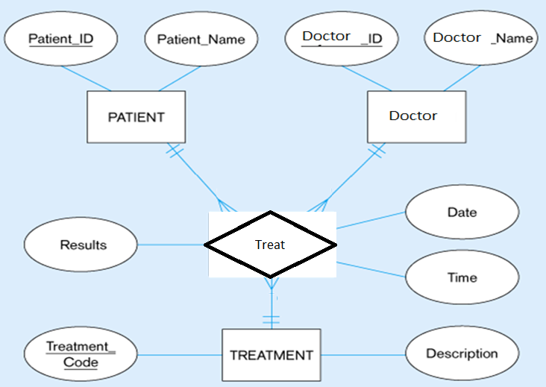

Slide 28
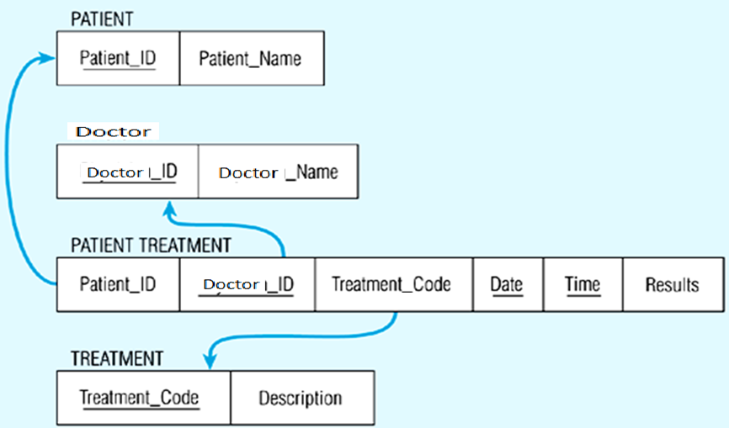
------------ ------------ ------------

Slide 29

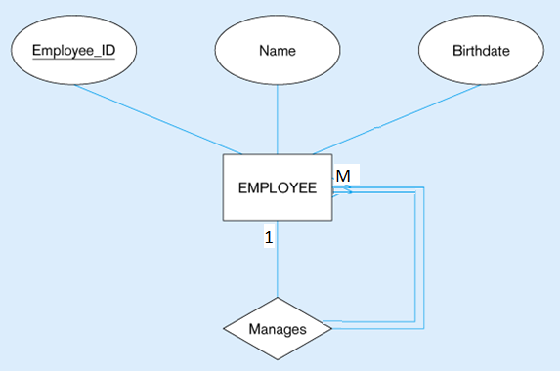

(a) EMPLOYEE entity with Manages relationship
(b) EMPLOYEE relation with recursive foreign key

Slide 30


(a) Bill-of-materials relationships (M:N)
(b) ITEM and COMPONENT relations
--------- --------------

Slide 31

ERD Concepts

Slide 32
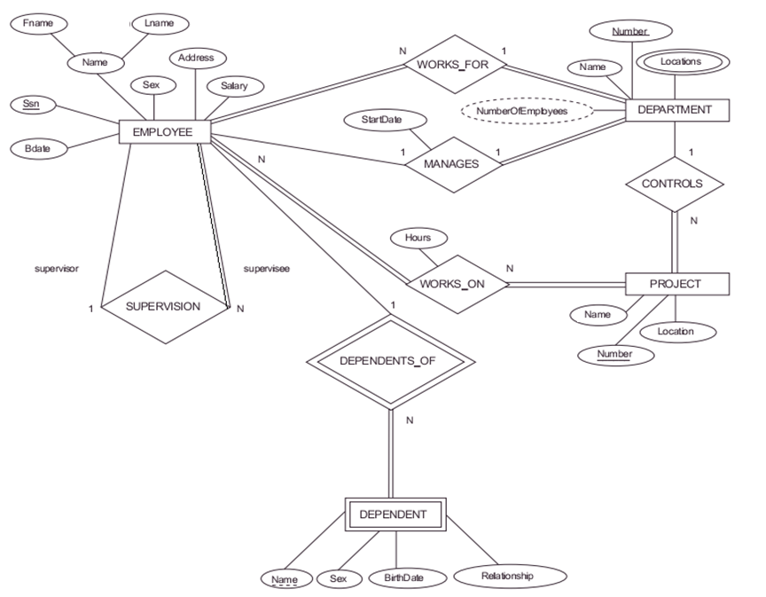

Slide 33




Slide 34

ERD Concepts

Slide 35
Student(St_id,st_fname,st_Lname,st_age,st_super,Dept_ID)
Course(Crs_id.Crs_Name,Crs_Duration,Top_id)
Topic(Top_ID,Top_Name)
Stud_Course(St_ID,Crs_ID,grade)
Instructor(Ins_ID,ins_Name,Address,Salary,Dept_ID)
Ins_Course(Ins_ID,Crs_ID,Evalution)
Department(Dept_ID,Dept_Name,Manager_ID,HireDate)
ERD Concepts

Slide 36
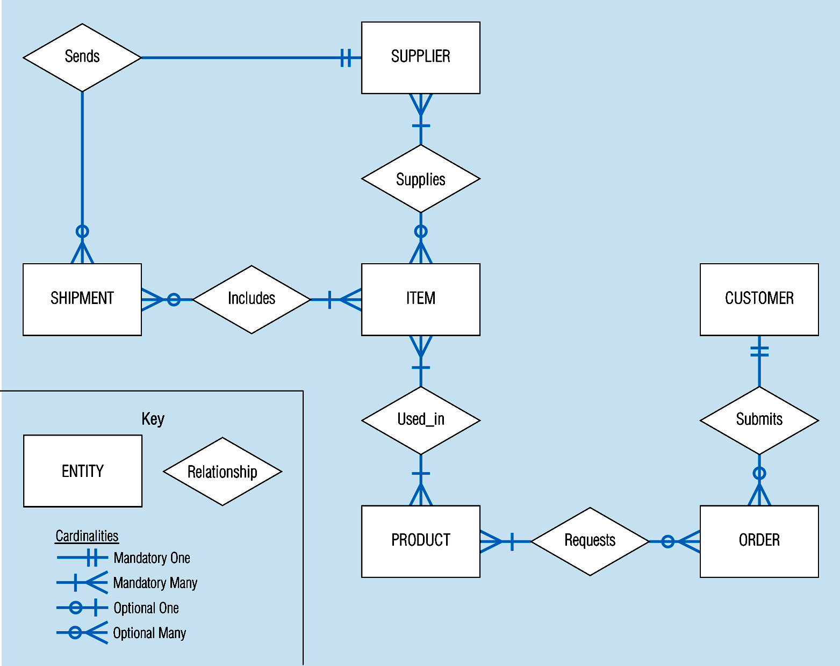
Sample E-R Diagram (figure 3-1)
© Prentice Hall, 2002
Notes:
3

Slide 37

ERD Concepts

