Slide 1

COURSE OBJECTIVE
To demonstrate the importance of Human Factors in aviation management.
To understand and manage human factors as an important element on your organization.
Explaining the scope, applications and methods on contemporary human factors applied to Aviation.

Slide 2

COURSE OBJECTIVE
To provide excellent customer service and ways to deal with type of passengers and any difficult situations.
To provide a hassle-free travel to our customers
To apply safety and security requirements
To acquire comprehensive knowledge on passenger processing at check-in counter and departure gate
Notes:
In this course, you’ll learn how to deliver excellent customer service, including how to handle different types of passengers, even in difficult or unexpected situations.
You’ll discover how to create a hassle-free travel experience, making every journey smoother and more enjoyable for our customers.
We’ll also guide you through the essential safety and security procedures that keep our passengers, our colleagues and our operations safe.
And finally, you’ll gain in-depth knowledge of passenger handling processes from the check-in counter to the departure gate, ensuring a seamless experience every step of the way.
Let’s begin your journey to becoming a confident, capable and world-class passenger service professional.

Slide 3
COURSE OBJECTIVE
To demonstrate the importance of Human Factors in aviation management.
Explaining the scope, applications and methods on contemporary human factors applied to Aviation.
To understand and manage human factors as an important element on your organization.
Explaining the scope, applications and methods on contemporary human factors applied to Aviation.

Slide 4
Pressure Point (Indirect Pressure)
If direct pressure and elevation fails to control the bleeding, indirect pressure points can be used
Pressure is applied with the fingers, thumb or heel of hand
DO NOT apply pressure for longer than 10 minutes
01

Slide 5
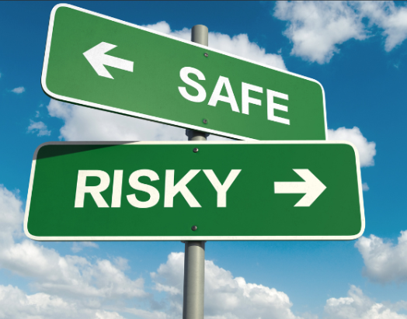
Research has shown that up to 80% of work-related accidents are caused by employees' behaviour. ... Safe behaviour is regarded as a critical work-related skill so unsafe behaviours can act as an early warning system for accidents and incidents.
80%

Slide 6

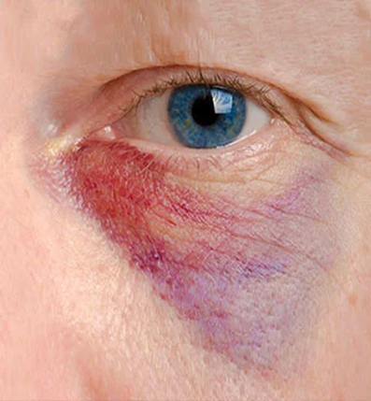
Signs are something that you can see on the victim eg: victim is drowsy, pale face, sweating, rapid breathing, skin rashes or signs of injury such as deformities, swelling and bleeding.

Slide 7
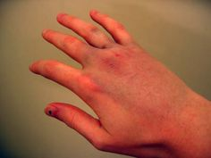
CLOSED
Deformity
Swollen
Pain
Bruises
Tenderness

Slide 8


An enabler rather than a provider

Slide 9
Produces clear, logical writing.
An essential part of conveying your message clearly.

Slide 10
Colour of ink and paper
Dark ink on light paper
Avoid colour combinations with low contrast

Slide 11
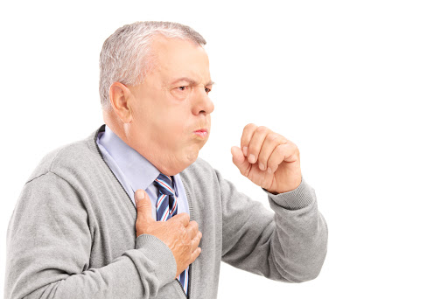
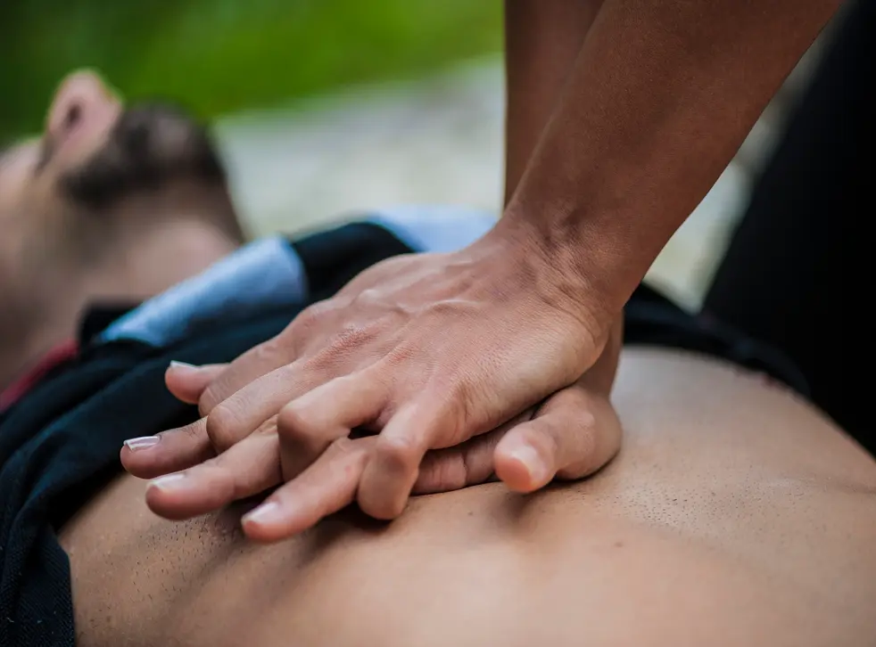
Partial
Complete
Conscious
Signs:
Having forceful cough
Able to speak
Management:
Do not interfere with cough – encourage to cough
Signs:
Clutching the throat
Unable to speak or cough
Management:
Adult & Child: Heimlich Maneuver/Abdominal Thrust
Obese & Pregnant Lady: Chest Thrust
Infant: 5 back blows, 5 chest thrusts + check mouth
CHOKING
Unconscious
Management:
CPR

Slide 12
External Bleeding
External Bleeding is visible. It is usually associated with wounds that are caused by a cut, laceration and deep incision.
01
Methods of Controlling External Bleeding
Direct Pressure
Elevation
Indirect Pressure (Indirect Pressure)
Tourniquet (only by Doctor)
02

Slide 13
New Learning
Equilibration
Change of belief
Schemata
Mental representation of an associated set of perceptions

Slide 14
Formative
Summative

Slide 15
Improves:
Comprehension, Retention, Reading Speed and Reading Persistence
Features Affecting Readability:
Content, Style, Design, Structure
01
02

Slide 16

PAX 05.05.07 PASSENGER ACCEPTANCE
Revenue And Non-revenue Processing
Revenue Processing
  This refers to handling passengers or cargo for which the airline is earning revenue — i.e., paying customers.
Non-Revenue (Non-Rev) Processing
This refers to handling passengers or cargo that does not directly generate revenue, often internally within the airline. Most common case: non-rev travel by employees, retirees, or their eligible family members on “standby” passes.
Notes:
Revenue Processing is all about paying passengers — those who buy their tickets through normal sales channels. The process includes things like ticket validation, payment confirmation, check-in and boarding. Basically, it’s how airlines handle customers who generate income for the company.
Non-Revenue Processing, on the other hand, refers to staff or eligible travelers who fly on discounted or complimentary tickets. These passengers are usually on standby and only get a seat if there’s space left after all revenue passengers have been checked in.
In short, Revenue means paid travel and Non-Revenue means staff or benefit travel. Both are processed carefully to make sure flights run smoothly and records stay accurate.

Slide 17
Anticipate questions an informed reader is likely to ask
01
Organize writing to answer questions in the order the reader will ask them
02

Slide 18
01
02
Obscure and often pretentious language marked by circumlocutions and long words
Example: Hereby, Wherefore, ab initio
Necessary technical terms
Example: Habeas corpus, plaintiff

Slide 19
We don’t just do our job—we want to help
How can I make this easier for the passenger?
Service-Oriented Mindset
Example
Not just about following SOPs. It’s about serving with heart
How can I leave a good feeling behind?

Slide 20
Purpose
Observation
Urgency
Instill
Skills
Processing
Competition
Probing

Slide 21
Busy airport
“I can handle this calmly.”
Scenario
With A Positive Mindset
Delays
“They’re upset at the situation - not at me.”
Frustrated Travellers
That’s what makes a frontliner not just good—but great.
Stressed
“I’m here to help solve it.”

Slide 22
Any use of any Psychoactive substance or drugs is incompatible with Safety.
Even the so-called soft drugs can affect your performance, mood and health.
Psychoactive Substances or Drugs

Slide 23
Research suggests that seven items are the maximum that work well in a list.
Longer lists are hard to navigate.

Slide 24
Scientists have recently discovered
that alcohol is absorbed into the
fluid of the inner ear and stays
there after it has gone from the
blood and brain.
Since the inner ear monitors;
balance, alcohol there can be
responsible for incorrect balance
information and possibly spatial
disorientation.

Slide 25
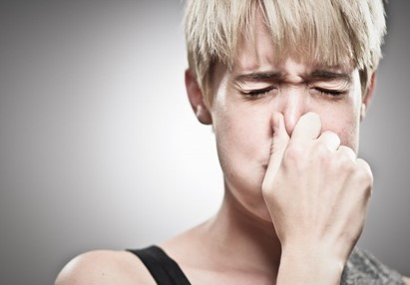
Signs and Symptoms
Treatment
Noisy intake of air
Ask the victim to sit quietly and hold the breath
Uncomfortable feeling in the abdomen
Drink water slowly from a glass
Breathe in and out through an airsickness bag covering nose and mouth
Stomach pain if prolonged

Slide 26
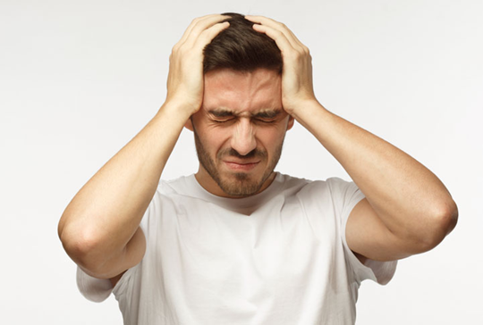
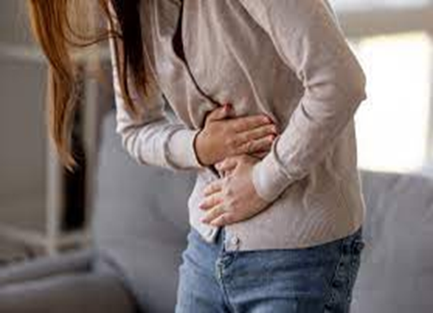
Symptoms - something that the victim experiences / unpleasant sensation or any complaints that the victim is having
What the victim tells you about his / her condition eg: chest pain, headache, nausea, thirst, cold, fever, etc

Slide 27
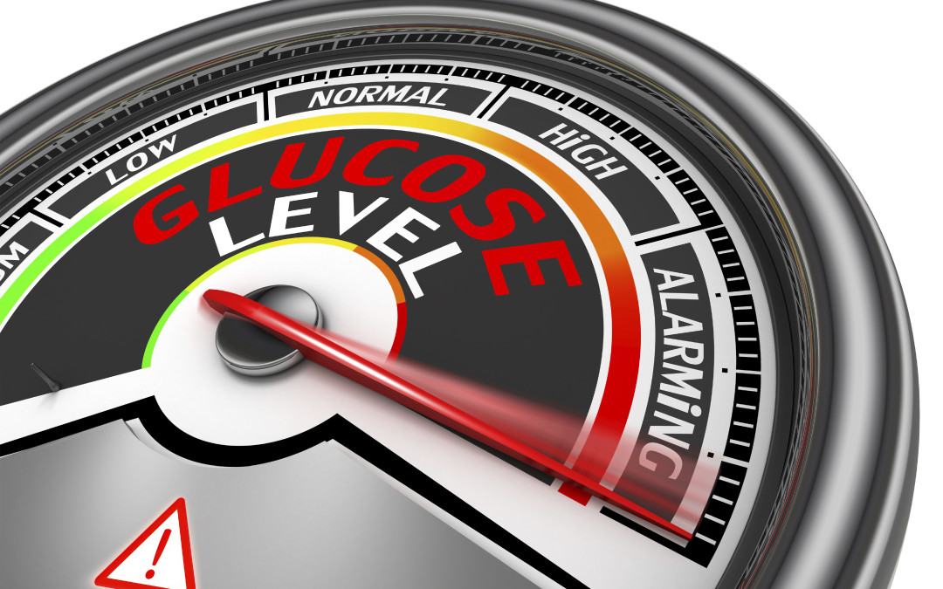
In principle, all patients with diabetes should undergo:
Lifestyle modification, which consists of
dietary therapy and
increased physical activity

Slide 28
Know basic cultural gestures & avoid taboos
Respect personal space and customs
Adapt your greeting and body language
Examples:
Bowing slightly to Japanese passengers
Open hand gestures instead of finger pointing
Understanding Muslim passengers’ modesty preferences

Slide 29
It also increases the rate of productivity in several ways. Workers are healthier and happier, resulting in less time off work.
It can lower the rate of accidents that occur by positively impacting the rate of human error and reducing it.

Slide 30
There are basically 2 types of STRESS :
Acute
Chronic
Short term example due to Emergencies. Normally last for limited time only.
Long term example due to Deaths, medical problems. May be permanent and may require life adjustment to cope.

