Slide 1
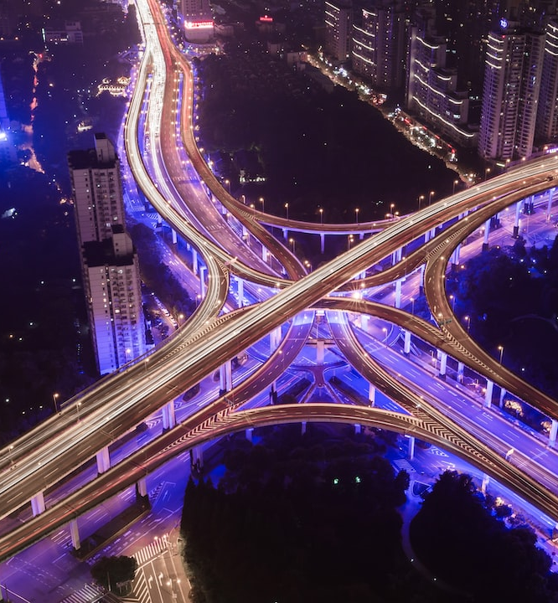

JANUARY 2024
HACKFEST
Transforming
Urban Living: Integrated Utilities
for the
Capital City
A Groundbreaking Solution for Delhi and Beyond
by GladiatorsRealm

Slide 2
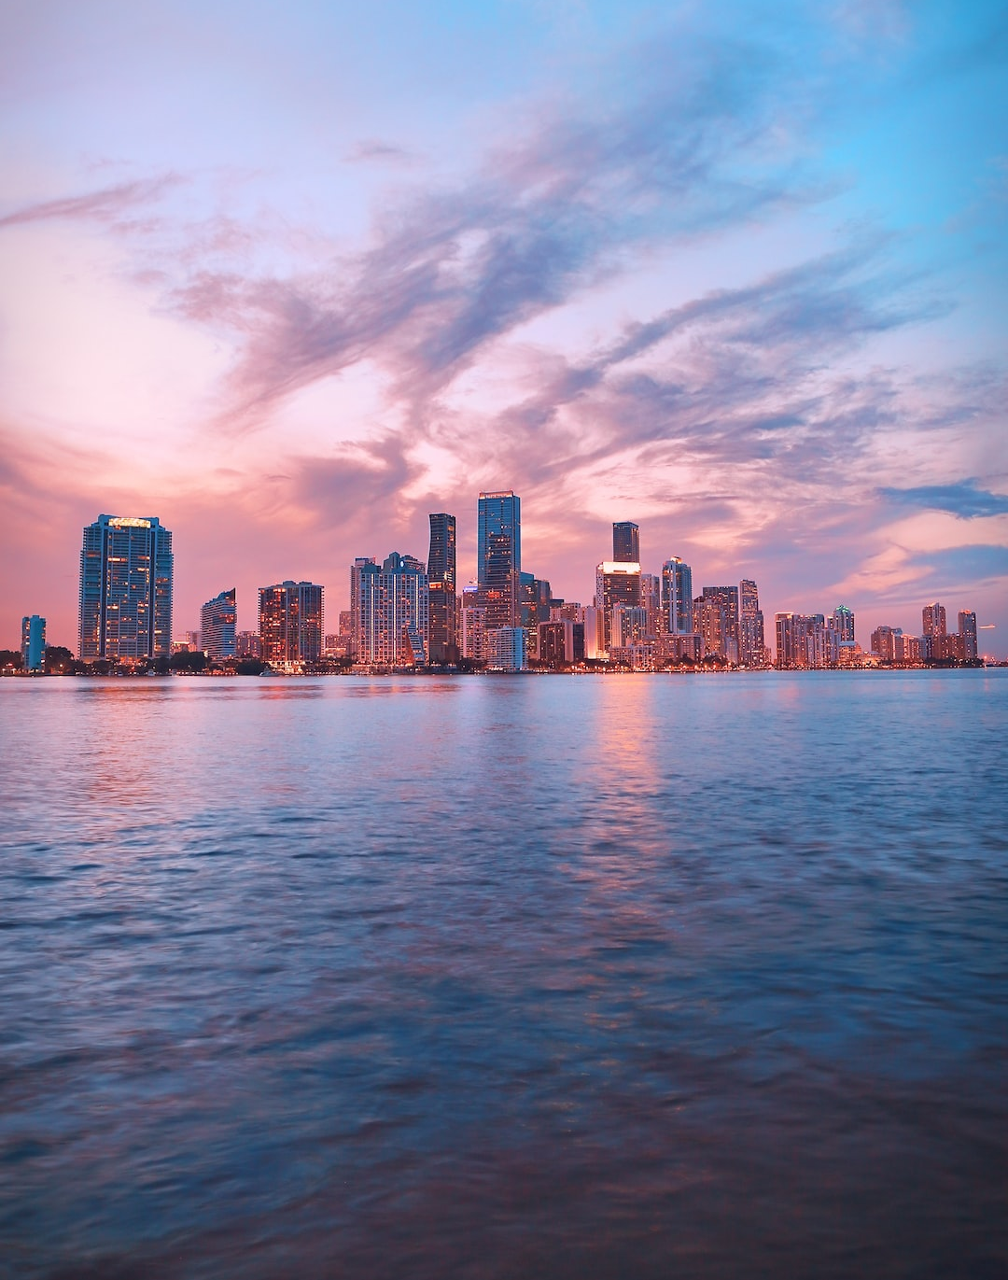
Introduction
& Overview
Revolutionizing urban living with the Integrated Utilities Project for a Smarter, Sustainable Future
A comprehensive approach integrating traffic, government services, transportation, utilities, safety, and more.

Slide 3
INTEGRATED UTILITIES
Urban Efficiency Unleashed
01
02
03
Traffic Management
Government Initiatives Access
Transportation & EV Integration
Real-time updates, live cameras, and smart parking solutions for seamless traffic flow.
Effortless access to a myriad of government services, schemes, and event notifications.
Real-time tracking of public transport, EV charging station maps for a holistic urban mobility experience.

Slide 4
SMARTER CITY
Elevated Utility Services
01
02
03
Electricity and Water Services
Wi-Fi Hotspots
Tourist Guide
Effortless bill payments, consumption tracking, and outage notifications for enhanced utility experiences.
Mapping of free Wi-Fi hotspots for uninterrupted connectivity throughout the city.
Providing detailed information on local attractions and cultural events, enhancing the tourist experience.

Slide 5
SAFETY AND SECURITY
Ensuring Safety and Facilitating Civic Engagement
01
02
03
Emergency Response System
Data Privacy Assurance
Personal Safety Features
Seamless integration with emergency services for swift response in critical situations.
Robust measures in place to safeguard user data and ensure privacy
Tools and features prioritizing user safety, ensuring a secure and reliable experience.

Slide 6
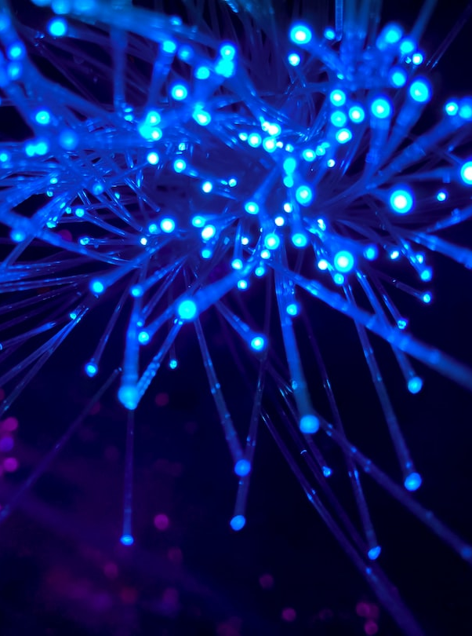
Future Expansion and Technological Edge
Nationwide Adoption: "Positioning Delhi as a model for smart city initiatives nationwide."
Emerging Technologies: "Innovative Foundations - Harnessing AI, MERN, IoT for Unmatched Development."
Inclusive Urban Development: "From Metropolis to Hamlet - Bridging Gaps, Ensuring Inclusivity in Every Service."

Slide 7
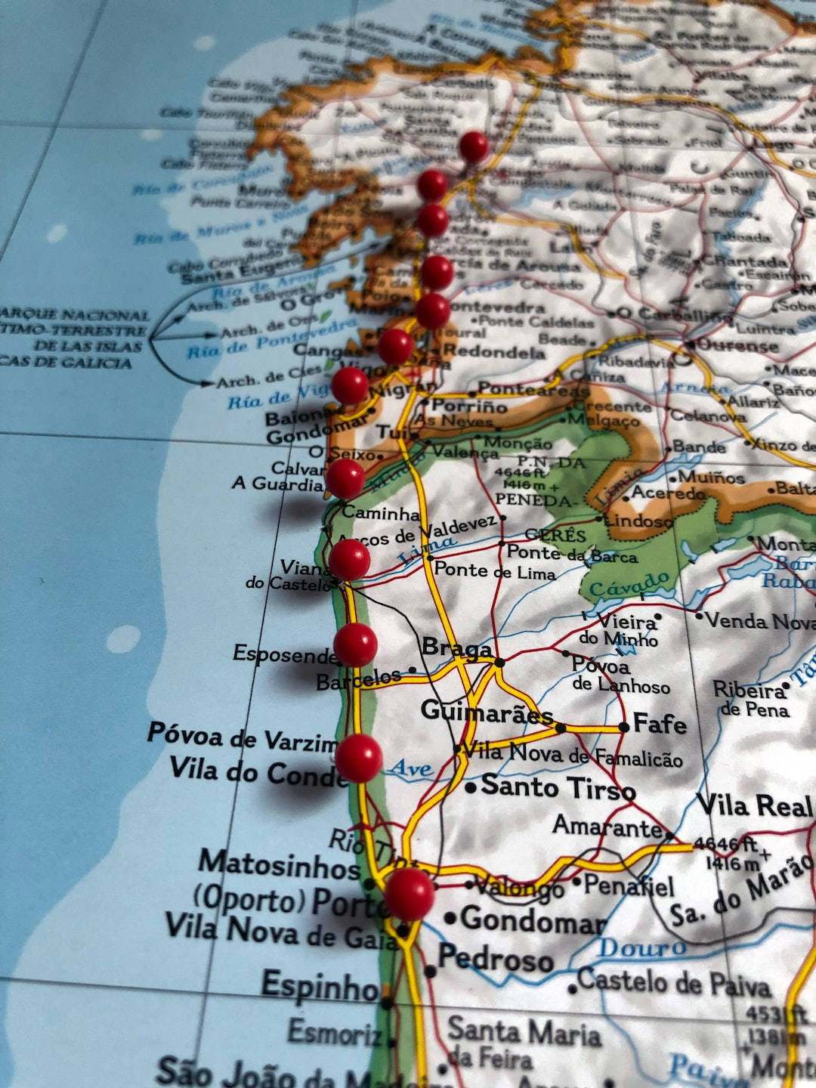
THE POTENTIAL FOR WIDESPREAD IMPLEMENTATION IN INDIA
Collaborative Powerhouse
"Creating a collaborative powerhouse with strong ties between government bodies, private entities, and tech providers."
The success of this initiative in Delhi will pave the way for nationwide adoption. With the potential for widespread implementation in India, the project aims to revolutionize urban living through an Integrated Utilities System and Smart City Initiatives. Leveraging cutting-edge technologies, it streamlines traffic, enhances government services, promotes sustainable transportation, ensures safety, facilitates civic engagement, and optimizes essential utilities like electricity and water. By replicating this model across the country, India can embrace a new era of smart cities and transform the lives of its citizens.

Slide 8

Measuring Impact
01
02
Improved Quality
Enhanced Services
Delhi citizens will experience a significant improvement in their quality of life.
The integrated system will provide easier access to government services, ensuring a seamless experience for the residents.

Slide 9

Powerful Innovation Showcase
&
Promoting Sustainability
01
02
Technological Advancements and Innovations.
Environmental and Social Impact.
Revolutionizing Urban Living - Unveiling Delhi's Powerful Innovation Showcase
Green Horizons - Delhi's Commitment to Promoting Sustainability in Every Initiative.

Slide 10
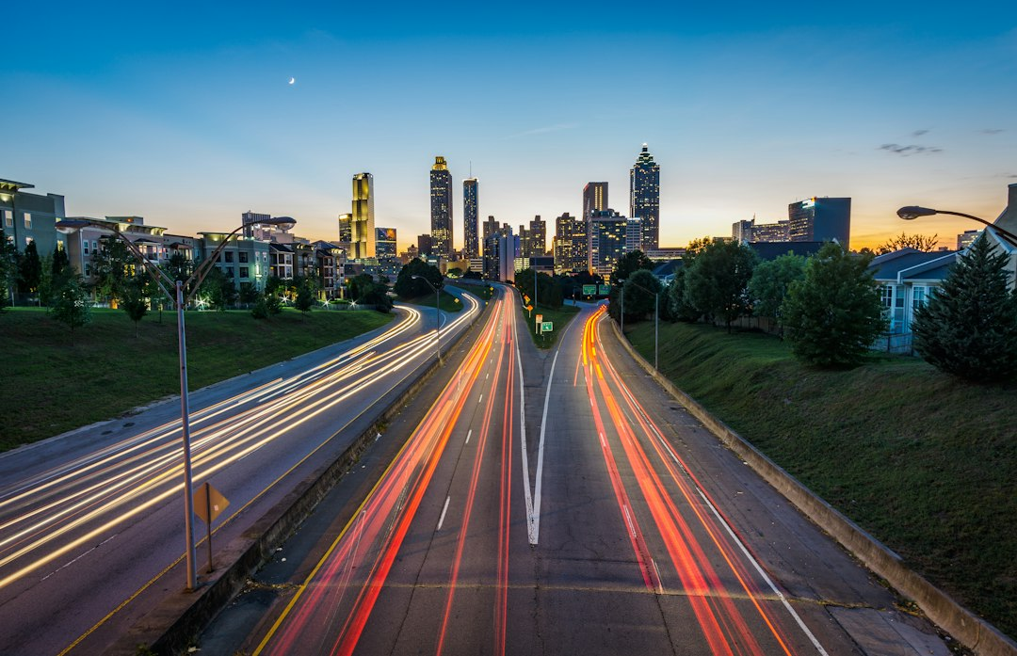
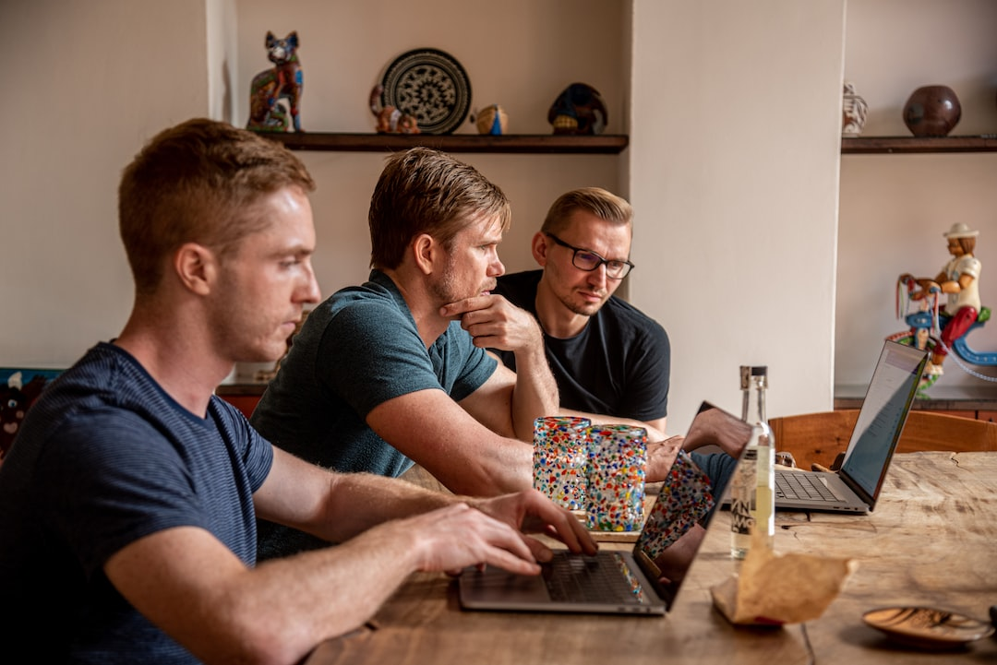

CHALLENGES AND SOLUTIONS
Addressing obstacles and overcoming implementation challenges
Traffic Management
Smart Government Services
Sustainable Transportation
Implement advanced traffic control systems to ease congestion.
Streamline government services through digital transformation.
Promote eco-friendly modes of transportation for a greener city.

Slide 11
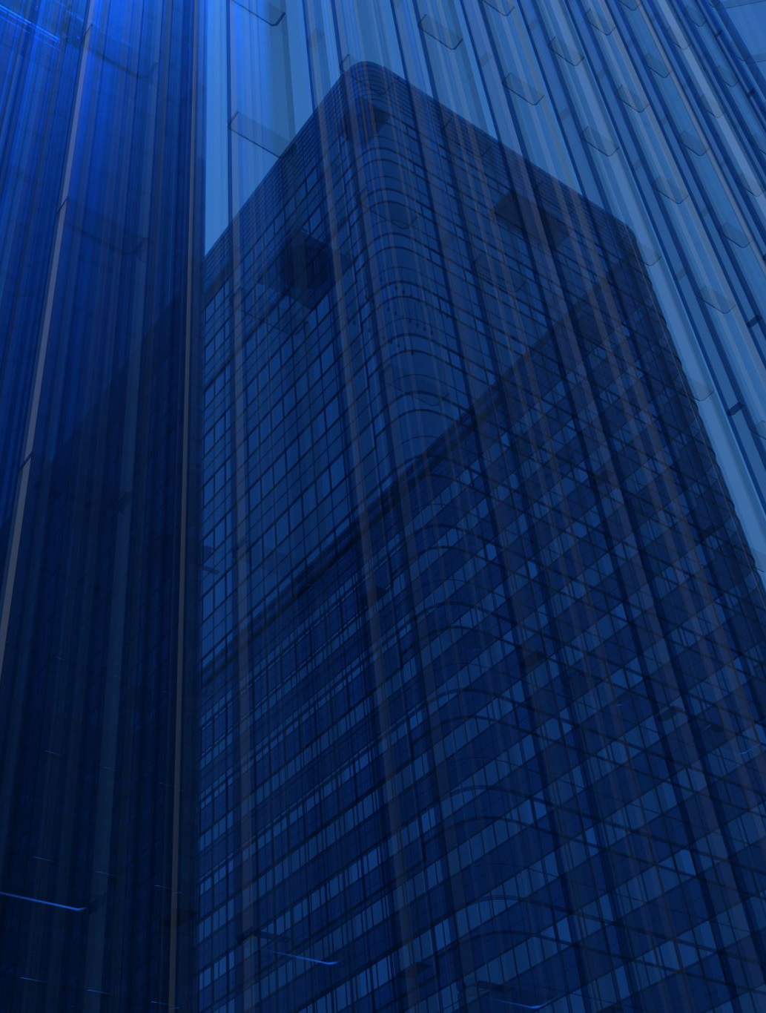
Culmination
Vision: "Setting the stage for a connected, sustainable, and efficient future in Smarter India"
As the Integrated Utilities Project positions Delhi as a pioneer in smart city initiatives nationwide. By embracing cutting-edge technologies, promoting sustainability, and ensuring inclusive urban development, we're creating a blueprint for connected, efficient, and sustainable cities across India. Thank you for being part of this transformative vision.​

Slide 12

SmartVista
THANK YOU !
Much obliged for your time, attention,
and interest towards the project.
Expressing gratitude, as the curtains fall on this presentation, let's carry forward the spirit of innovation and sustainability,
knowing that the best is yet to come. .
Faran Ahmad Siddiqui
Ahzam Akhtar
Shifat Ali
Zohaib Hasan Siddiqui
GLADIATORSREALM@GMAIL.COM

