Slide 1
Final Project Stock Price Prediction
By: Loic
Ahmad
Hamid
Hazim Hamadneh

Slide 2
The Purpose of this project is to forecast stocks using Python Code. Using the historical and latest stocks prices assisted in using Time series forecast. Facebook prophet is used for this forecast.
Factors considered are limited to: Date, Open, Close, High and Low prices . This project provides the user with static visualizations created as part of the analysis which are deployed via Flask, js and Python.

Slide 3
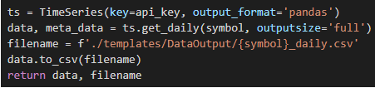
prediction consider
The High price
The low price
The open close price
The volume
The source used to get the stock prices is the Alpha-vantage
For faster results, the data collected using API and saved to csv file.

Slide 4
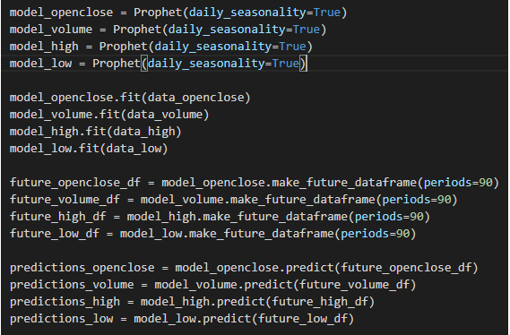
Via Fbprophet, we created different models and created 90 days data frame.

