Slide 1

Final Project Stock Price Prediction
Contributors:
Loic
Ahmad
Hamid
Hazim

Slide 2

Purpose:
The Purpose of this project is to forecast stocks using Python Code. Using the historical and latest stocks prices assisted in using Time series forecast. Facebook prophet and Linear regression are used for this forecast and for comparing the results.
Factors considered are limited to: Date, Open, Close, High and Low prices . This project provides the user with static visualizations created as part of the analysis which are deployed via Flask, js and Python.

Slide 3

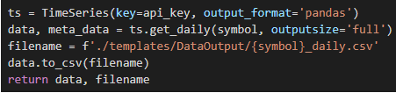
Approach:
FP Prophet prediction consider
The High price
The low price
The open close price
The volume
Linear regression prediction consider Closing price only.
The source used to get the stock prices is Alpha-vantage
For faster results, the data collected using API and saved to csv file.

Slide 4
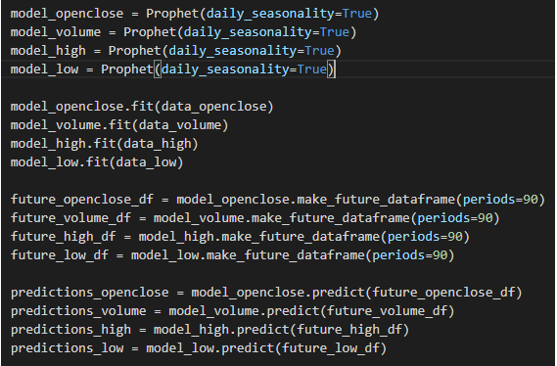
Approach:
Via FBprophet, we created different models and created 90 days data frame.

Slide 5

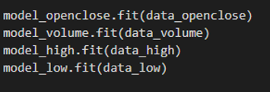

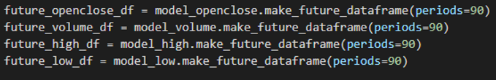
Prediction:
FB prediction is achieved by fitting the model to the training data
LR prediction is achieved by fitting the date and the closing price to LR model
The data frame for future dates are made for forecasting via make_future_dataframe function

Slide 6
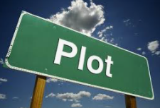
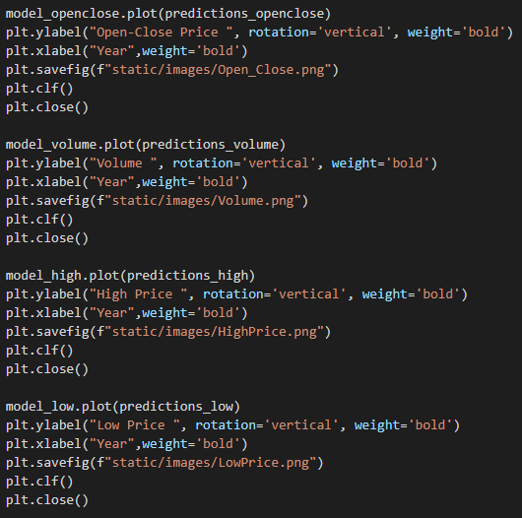
Plot:
Matplotlib is used for drawing the predicted plots

Slide 7

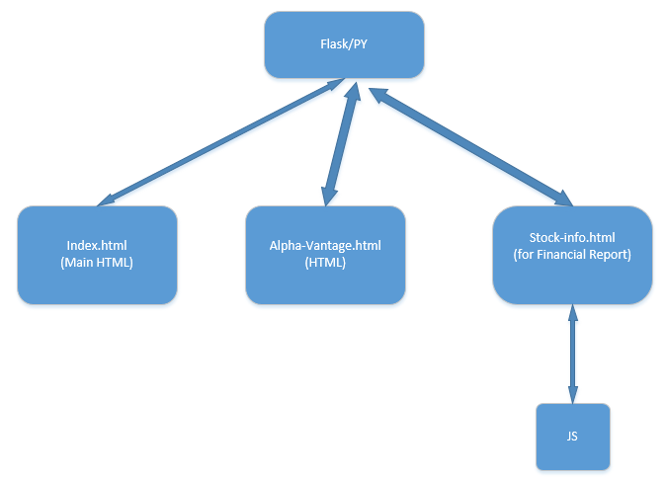
html communication:
In this project we use three html file, one Flask/py and one js file
Index.html is for the main page of the project, and stock-info.html is the file for presenting the Financial report of the stock. Alpha-Vantage is for displaying the downloaded raw data.

Slide 8

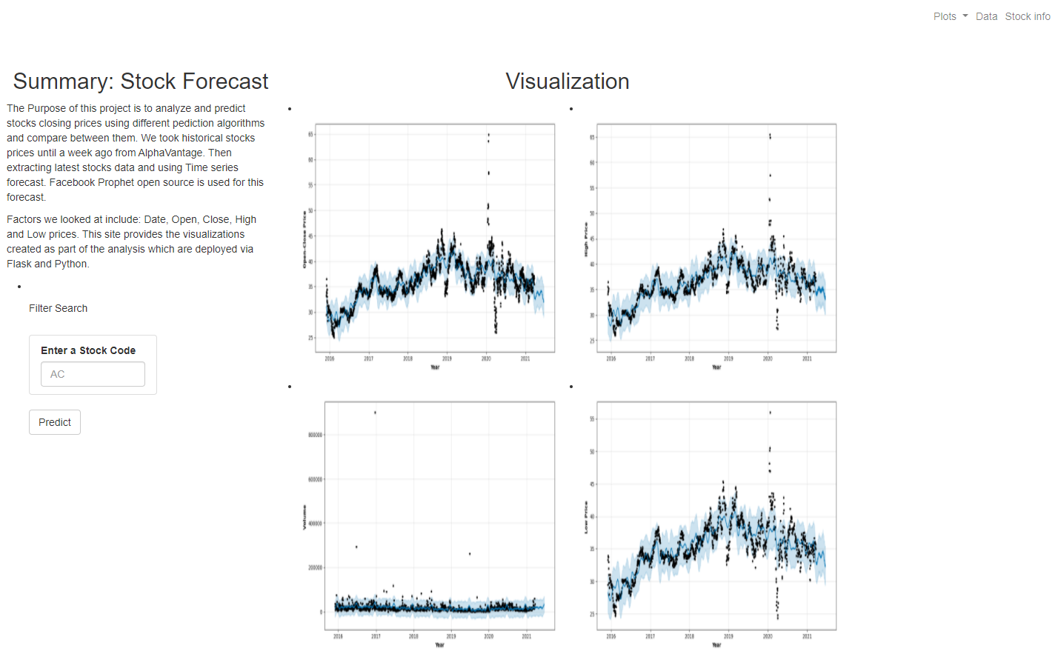
Front Page:
The interactive main page provides the user to enter the stock for perdition.

Slide 9

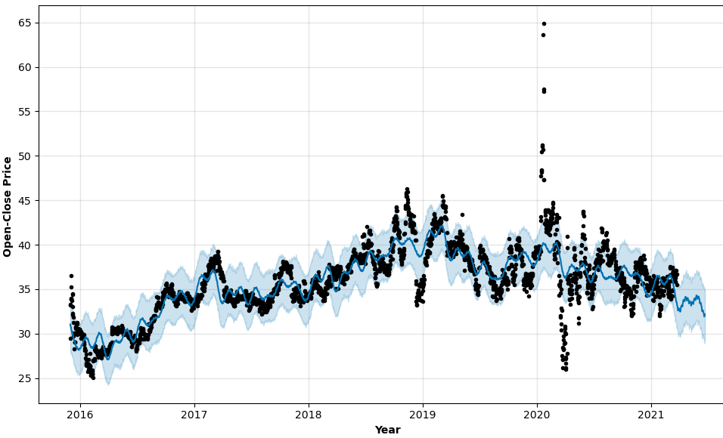
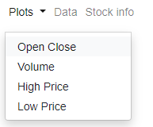
Closer look:
By selecting the plots user can see the prediction in a better view

Slide 10


