Slide 1


GovSec Product Roadmap
Q3 2026 – Q2 2027
Roadmap proposal and project cards based on GovSec 3.0 MVP Specification and version changelog

Slide 2
Executive Summary
The roadmap moves GovSec from MVP productisation into enterprise-grade operation, integration, intelligence expansion, and high-assurance resilience.
Q3 2026
Q4 2026
Q1 2027
Q2 2027
Productise and pilot
Integrate and govern
Scale analysis
Broaden assurance
Harden the v3.0 platform, refine executive visualisation, and prepare feed-quality controls for controlled production use.
Add identity assurance, SIEM/ticketing readiness, and repeatable alert-to-case playbooks.
Expand AI Analyst, threat hunting, and response orchestration foundations.
Introduce exposure monitoring, BYOK/HA planning, and maturity analytics for roadmap refresh.

Slide 3
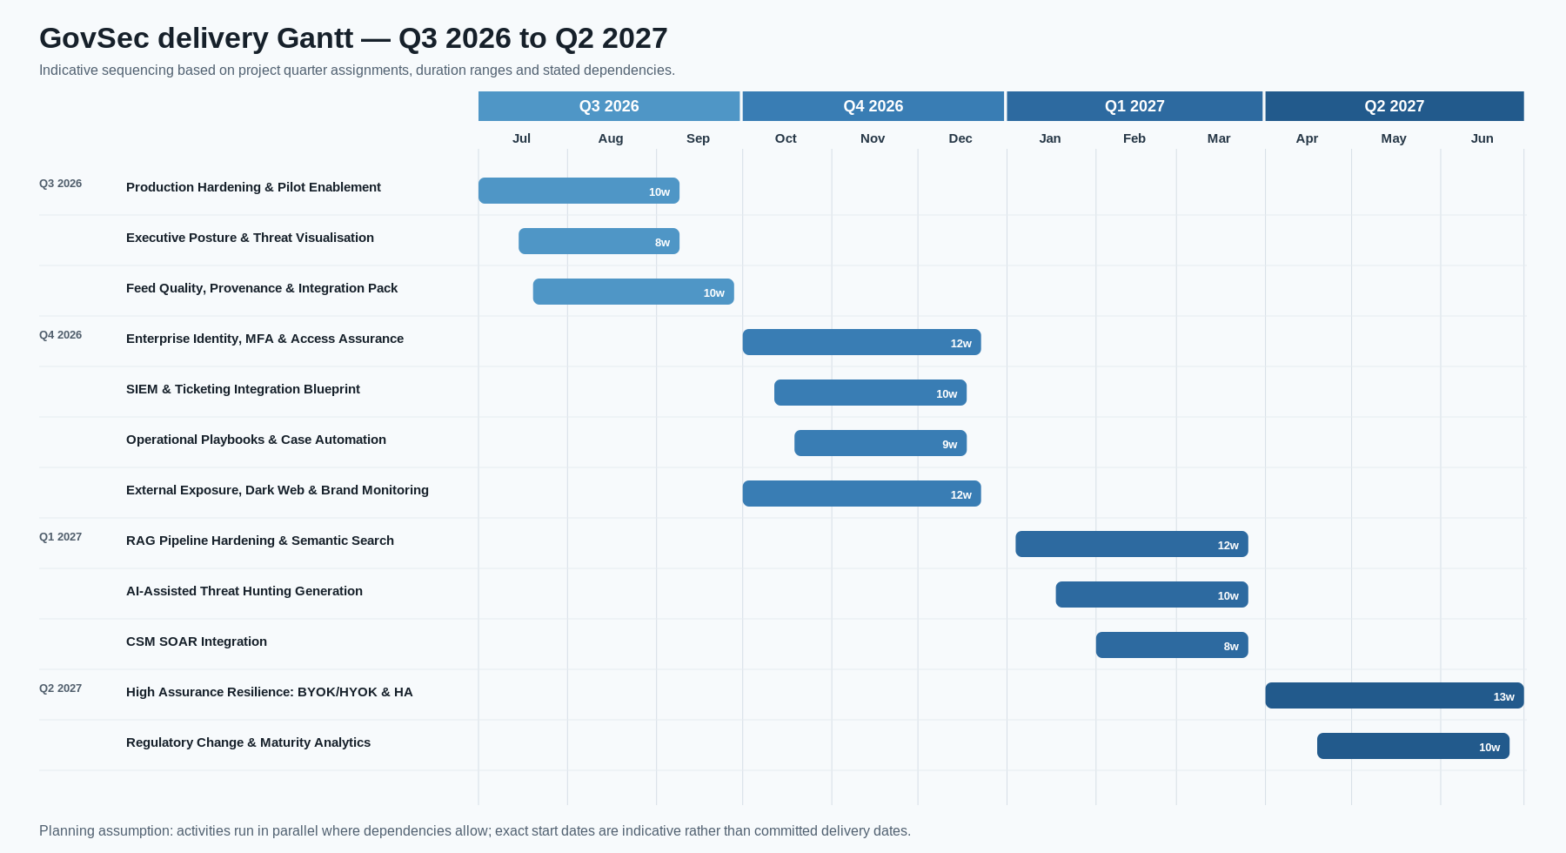

Slide 4
GovSec Product Roadmap
Q3 2026
Q4 2026
Q1 2027
Q2 2027
Productise and pilot
Integrate and govern
Scale analysis
Broaden assurance
Production Hardening & Pilot
Identity/MFA & Access Assurance
RAG Pipeline & Semantic Search
BYOK/HYOK & High Availability
Executive Posture & Visualisation
SIEM & Ticketing Blueprint
AI-Assisted Threat Hunting
Regulatory Change & Maturity Analytics
Playbooks & Case Automation / Exposure
Roadmap Refresh & Next-Phase Planning
Feed Quality & Integration Pack
CSM SOAR Integration
Roadmap sequencing
• Q3 establishes production confidence around the v3.0 MVP release and executive visualisation baseline.
• Q4 prepares enterprise operations through identity assurance, SOC integration, repeatable playbooks, and external exposure visibility.
• Q1 expands AI-assisted analysis, threat hunting, and safe response orchestration foundations.
• Q2 broadens high-assurance resilience and maturity analytics for the next roadmap cycle.

Slide 5
Project cards
Ownership
CTI
1. Production Hardening & Pilot Enablement
Q3 2026
Description
• Stabilise GovSec 3.0 for controlled production pilot usage, closing security findings, validating deployment tooling, and preparing operations teams for live threat-intelligence workflows.
◷ Estimated duration
8–10 weeks
⚙ Estimate effort
3 FTEs
🔗 Project dependencies
GovSec v3.0 baseline; security audit remediation plan
▣ Key Deliverables
Security remediation baseline
• Close remaining OWASP Web and LLM findings
• Add security headers, password complexity, and delete audit logging
• Set NODE_ENV=production and validate deployment rollback
Pilot operating model
• Pilot environment with seeded feeds and users
• Runbook for feed ingestion, scheduler monitoring, and incident triage
• Operational acceptance checklist and go/no-go report

Slide 6
Project cards
Ownership
CTI
2. Executive Posture & Threat Visualisation Release
Q3 2026
Description
• Productise the leadership dashboard and threat visualisation workspace into a coherent executive review experience for posture, sector risk, threat maps, and correlation graph exploration.
◷ Estimated duration
6–8 weeks
⚙ Estimate effort
2 FTEs
🔗 Project dependencies
v3.0 dashboard widgets, threat map, threat graph
▣ Key Deliverables
Executive review cockpit
• Posture score narrative and metric grid rationalisation
• 30-day ingest and score movement highlights
• Org/sector breakdown prepared for monthly posture review
Visual intelligence workspace
• Unified map/graph filters for severity, type, country, and sector
• Campaign-level drill-down from markers and graph nodes
• Export-ready screenshots and briefing notes

Slide 7
Project cards
Ownership
CTI
3. Feed Quality, Provenance & Integration Pack
Q3 2026
Description
• Improve reliability and transparency of feed onboarding by formalising feed health, provenance, STIX/TAXII handling, Logstash bridge mapping, and external push-ingestion governance.
◷ Estimated duration
8–10 weeks
⚙ Estimate effort
2 FTEs
🔗 Project dependencies
MVP feed registry; push ingestion API; scheduler ledger
▣ Key Deliverables
Feed onboarding standards
• Configuration template for STIX/TAXII, REST JSON, CSV, Logstash, and push API feeds
• Per-feed health scoring and failure triage workflow
• Provenance checks for every indicator
Data quality controls
• Deduplication and validation dashboard
• Backfill process for geo-enrichment and CVE recognition
• Integration guide for external feed operators

Slide 8
Project cards
Ownership
CTI
4. Enterprise Identity, MFA & Access Assurance
Q4 2026
Description
• Extend MVP role-based access with enterprise identity controls, SSO/MFA readiness, access reviews, and classification-compartment governance suited to Malaysian government deployment.
◷ Estimated duration
10–12 weeks
⚙ Estimate effort
2 FTEs
🔗 Project dependencies
RBAC hierarchy; classification and compartment model
▣ Key Deliverables
Identity integration foundation
• SAML/OIDC SSO design and connector prototype
• MFA policy and privileged-access enforcement model
• Password and session policy alignment
Access assurance
• Quarterly role and compartment review workflow
• Sensitive-operation audit dashboards
• Exception and break-glass access process

Slide 9
Project cards
Ownership
CTI
5. SIEM & Ticketing Integration Blueprint
Q4 2026
Description
• Design the integration architecture for SOC tooling through bidirectional SIEM interfaces and remediation-ticket workflows, producing a blueprint and connector prototypes, not full integration.
◷ Estimated duration
8–10 weeks
⚙ Estimate effort
1 FTE
🔗 Project dependencies
API reference; Logstash ECS bridge; alert/case lifecycle
▣ Key Deliverables
SIEM integration blueprint
• Connector design for Splunk and Microsoft Sentinel
• Alert/evidence mapping to GovSec indicators, correlations, and cases
• Event ingestion and outbound enrichment patterns
Ticketing workflow design
• Jira/ServiceNow case and remediation ticket mapping
• State synchronisation rules and audit requirements

Slide 10
Project cards
Ownership
CTI
6. Operational Playbooks & Case Automation
Q4 2026
Description
• Standardise alert-to-case handling by packaging escalation logic, triage SOPs, deterministic case AI, reporting templates, and playbook-based response guidance.
◷ Estimated duration
8–10 weeks
⚙ Estimate effort
1.5 FTEs
🔗 Project dependencies
Alert lifecycle, escalation log, case AI reports
▣ Key Deliverables
Response playbooks
• Critical/high alert triage SOPs and escalation thresholds
• Case priority matrix and closure quality checklist
• Hunt-to-case promotion workflow
Automated reporting
• Case AI report template library
• Executive summary and technical appendix outputs
• Quality review and sign-off workflow

Slide 11
Project cards
Ownership
CTI
10. External Exposure, Dark Web & Brand Monitoring
Q4 2026
Description
• Expand beyond internal feeds into credential exposure, leaked-data signals, brand impersonation, typosquatting, and executive exposure monitoring mapped into GovSec indicators and cases.
◷ Estimated duration
10–12 weeks
⚙ Estimate effort
3 FTEs
🔗 Project dependencies
Feed quality pack; actor/indicator/organisation linkage
▣ Key Deliverables
Monitoring expansion
• Dark web credential and leaked-data detection design
• Brand, executive, and typosquatting monitoring sources
• Exposure severity rules and false-positive handling
Operationalisation
• Exposure-to-indicator normalisation
• Executive/organisation linkage and notification workflow
• Monthly exposure trend report

Slide 12
Project cards
Ownership
CTI
7. RAG Pipeline Hardening & Semantic Search
Q1 2027
Description
• Harden GovSec Command’s RAG pipeline by scoping data access per user role, adding semantic retrieval for relevance, and refining model prompts to close security gaps and improve analysis quality.
◷ Estimated duration
10–12 weeks
⚙ Estimate effort
3 FTEs
🔗 Project dependencies
AI Analyst RAG; conversation history; audit controls; security audit findings #43, #51, #55
▣ Key Deliverables
RAG security & scoping
• Role-aware context assembly; no full-table dumps to LLM
• Classification-aware retrieval filters
• Conversation history re-sanitization
Semantic retrieval & model refinement
• Vector index for indicators, cases, reports, and MITRE context
• Retrieval evaluation set and precision/recall baseline
• Domain prompt tuning, structured outputs, usage dashboard

Slide 13
Project cards
Ownership
CTI
8. AI-Assisted Threat Hunting Generation
Q1 2027
Description
• Enable senior analysts to convert natural-language hypotheses into validated hunt queries, scheduled hunts, and MITRE-informed investigation workflows.
◷ Estimated duration
8–10 weeks
⚙ Estimate effort
2 FTEs
🔗 Project dependencies
Threat hunting JSON DSL; MITRE coverage heatmap
▣ Key Deliverables
Hunt generation assistant
• Natural-language hypothesis capture
• DSL query generation with safety checks and explanations
• MITRE technique suggestions and coverage-gap context
Hunt operations
• Saved/scheduled hunts with approval controls
• Result promotion to alerts and cases
• Hunt library with reusable playbooks

Slide 14
Project cards
Ownership
CTI
9. CSM SOAR Integration
Q1 2027
Description
• Integrate GovSec with CyberSecurity Malaysia's existing SOAR platform, enabling bi-directional alert/case synchronisation, playbook execution, and response action routing back into GovSec.
◷ Estimated duration
6–8 weeks
⚙ Estimate effort
2 FTEs
🔗 Project dependencies
Operational playbooks; CSM SOAR API documentation; SIEM/ticketing blueprint
▣ Key Deliverables
Integration layer
• CSM SOAR API connector for alert and case synchronisation
• Playbook trigger mapping from GovSec alerts to SOAR playbooks
• Response action routing back to GovSec case timeline
Operational alignment
• Alert severity and status mapping between platforms
• Audit trail for cross-platform actions
• Integration test harness with sample payloads

Slide 15
Project cards
Ownership
CTI
11. High Assurance Resilience: BYOK/HYOK & HA
Q2 2027
Description
• Prepare GovSec for high-assurance government hosting by introducing customer-managed key options, resilience design, backup validation, and active-active HA planning.
◷ Estimated duration
12–14 weeks
⚙ Estimate effort
4 FTEs
🔗 Project dependencies
Production hardening; deployment baseline; data residency requirements
▣ Key Deliverables
Key management design
• BYOK/HYOK architecture and operating model
• Secret rotation, database encryption, and audit requirements
• Key custody, break-glass, and recovery procedures
Resilience roadmap
• Backup/restore validation and RTO/RPO targets
• Multi-region HA reference architecture
• Failover test plan and operational readiness report

Slide 16
Project cards
Ownership
CTI
12. Regulatory Change & Maturity Analytics
Q2 2027
Description
• Close the first roadmap year with automated compliance monitoring, maturity metrics, and leadership analytics that show risk reduction and product value over time.
◷ Estimated duration
8–10 weeks
⚙ Estimate effort
2 FTEs
🔗 Project dependencies
PDPA engine; audit log; executive dashboard
▣ Key Deliverables
Regulatory monitoring
• PDPA and related Malaysian regulatory change tracker
• MyCERT/CsIRT feed integration and sharing readiness
• Impact assessment workflow; retention and PII exception reporting
Maturity analytics
• Quarterly control effectiveness scorecard
• KPI dashboard for ingestion health, detection coverage, response time, and AI usage
• Roadmap refresh pack for Q3 2027 planning

