Slide 1

Host Behavior Analysis (Property Rental Company)

Slide 2
Action Plan
Phase 1
Phase 2
Phase 3
Phase 4
Analyze problem statement
Coaching
Acceptance
Start-up
Label
Brain Storming
SQL Query
Output
Analyze the given problem statement
Brain storming on the given problem & check the multiple table for possible solution
Figuring out the right SQL query
Get the output based on the respective query

Slide 3
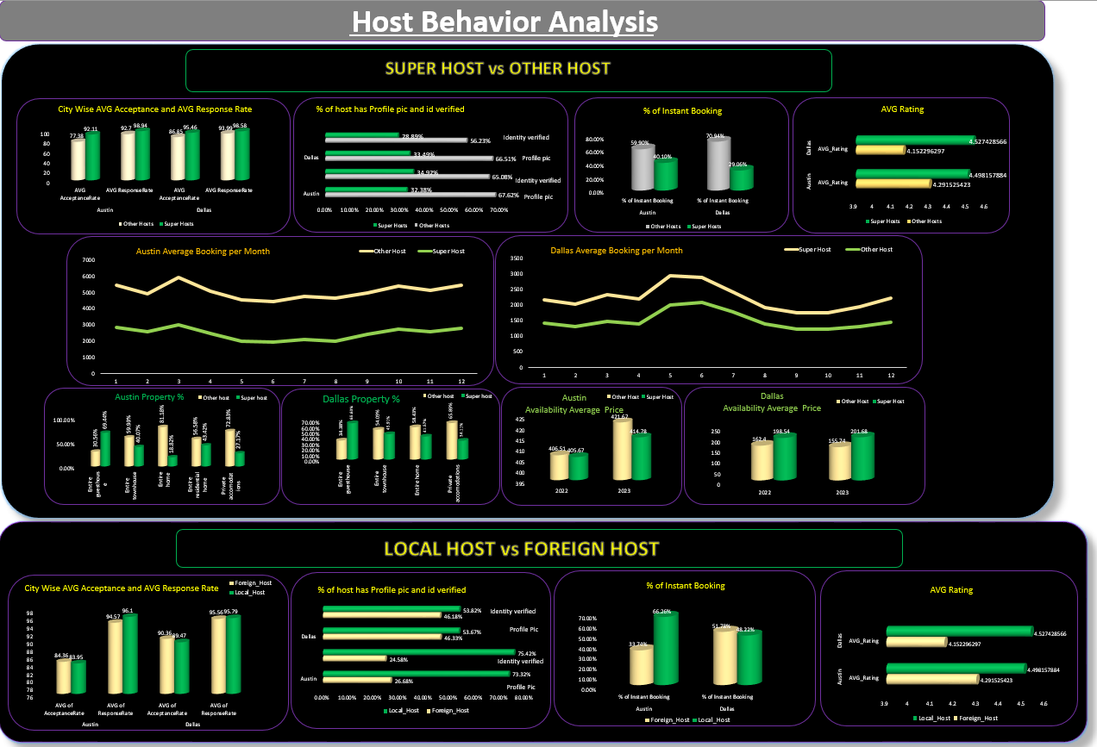

Slide 4
Identity verified
Profile pic
Identity verified
Profile pic
The avg. acceptance rate of super-host is greater then other host in both the cities which means customer has greater chances of getting booking confirmed in the case of super-host as compared to other-host.
The percentage of profile pic and identity verified is more in case of other host as compared to super host in both the cities which mean
The avg. response rate of other-host is less as compared to other-host which mean customer have to wait for a response for a longer time in case of super-host

Slide 5
The percentage of instant booking is greater in case of other host as compared to super host for both the cities which mean the customer with no prior booking, on arrival prefer other host than super host
The average rating of super host is greater than other host in both the cities which mean the level of service , cleanliness upon arrival is extremely good

Slide 6
The average booking per month is always low in case of super host as compared to other host in Austin
The average booking per month is always high in case of super host as compared to other host in city Dallas

Slide 7
Three Criteria For Hosts to become Super Hosts.
--To become Super Host AVG acceptance rate should be > 91%
--To become Super Host AVG response rate should be > 98%
--To become Super Host AVG rating should be > 4.491

Slide 8
The percentage of complimentary comments is more for super host as compared to other host in both the cities which means that customers is more satisfied with the super host
The percentage of bad comments is more for other host as compared to super host which means that customers are not satisfied with the other host.

Slide 9
In Austin & Dallas among the various rental properties , the percentage of ‘’Entire guest-house’’ acquired by super-host is more as compared to other host
In Austin among the various rental properties , the percentage of ‘’Entire home’’ acquired by super-host is least as compared to other property. Whereas in Dallas among various property, the percentage of “Private accommodations “ acquired by super-host is least as compared to other rental property.

Slide 10
In Austin , the average availability price is all time high for the other-host for the year 2022 & 2023
In Dallas , the average availability price is all time high for the super-host for the year 2022 & 2023

Slide 11
The avg response rate of local host is more in Austin as compared to Dallas which mean customer are expected to get delay in response rate in case of foreign host
The percentage of profile pic & identity verified is greater in case of local host for both Austin & Dallas which mean most of the local host are authentic as compared to foreign host

Slide 12
In Austin , the percentage of instant booking is greater in case of local host where as in Dallas the percentage of instant booking is greater in case of foreign host.
The average rating is greater in case of local host for Austin & Dallas Compared to foreign host.

