Slide 1
Cloud Computing with AWS

Slide 2
Cloud Computing Basics
IaaS – Infrastructure as a Service
SaaS - Software as a Service
PaaS – Platform as a Service

Slide 3
Few Components of AWS Cloud
EC2 – Elastic Cloud Compute
AMI – Amazon Machine Image
ELB – Elastic Load Balancing for EC2
Auto Scaling

Slide 4
AWS Cloud Security

Slide 5
Securing Cloud
Use http over SSL i.e https
Storage Encryption
IAM – Identity and Access Management ( User, Group, Role, Permission)
Patching

Slide 6
Storage Options
EBS – Elastic Block Storage
S3 – Object Storage
Glacier – Archiving Data

Slide 7
Cloud Watch

Slide 8
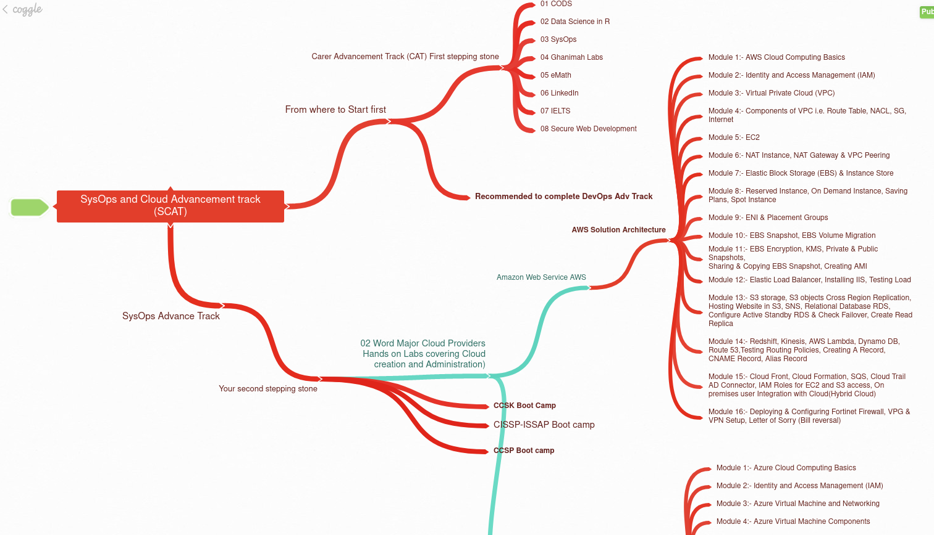
Why you should take SCAT

Slide 9

Cloud Blocks

Slide 10
Cloud Computing with AWS
AWS Global Infrastructure: Keeps increasing
https://aws.amazon.com/about-aws/global-infrastructure/?p=ngi&loc=1&refid=~ha_awssm-evergreen_aware_prospect
AWS fundamentals – VPC & AZ

Slide 11
Virtual Private Cloud (VPC)
Its secure & logically isolated from other VPCs on AWS
VPC cannot span across region i.e VPC is region specific

Slide 12
Virtual Private Cloud (VPC)
VPC is a virtual Infrastructure or a data center
AWS client has full control over resources & servers hosted inside that VPC
Its similar to having your own Data Center inside AWS

Slide 13
Virtual Private Cloud (VPC)
VPC Components

Slide 14
CIDR and IP Address range
Private Ipv4 addresses
RFC1918name IP add-range no of add
24-bit block/8 10.0.0.0-10.255.255.255 16777216
20-bit block/12 172.16.0.0-172.31.255.255 1048576
16-bit block/16 192.168.0.0-192.168.255.255 65536
https://www.site24x7.com/tools/ipv4-subnetcalculator.html

Slide 15
Virtual Private Cloud (VPC)
One VPC can have multiple AZ ( Min 2 or more)
Subnet cannot extend beyond AZ
Multiple IP subnets inside each AZ

Slide 16
CIDR & IP Address range
One VPC is created you cannot change its CIDR block range ( Create new VPC)
Size of CIDR block Min/28 or Max/16
Different CIDR’s in VPC cannot overlap
Expand your VPC by adding new CIDR IP address ranges ( secondary – u can delete)

Slide 17
CIDR & IP Address range
AWS reserves 1st four IP & last one IP in each subnet
Say 10.0.0.0/24
10.0.0.0 Network ID
10.0.0.1 VPC Router
10.0.0.2 DNS Related
10.0.0.3 Future Use
10.0.0.255 Broadcast

Slide 18
Implied Router
No request has to be made, automatic facility
Implied router automatically does communication between subnets & outside internet world

Slide 19
Route Tables
These are tables that have entries which says what is the destination and target for the packet
Just like reception of hotel has info about the rooms!!

Slide 20
Internet Gateways
VPC without Internet gateway communicate with the internet – NO
Horizontally Scaled, Redundant, Highly available VPC component
Only ONE Internet Gateway per VPC !!!!!!!!!!!
It support both Ipv4 & Ipv6
If we detach the gateway from VPC then router cannot access the internet (blackhole will be created)
To correct this we have to ways:
1. To again connect vpc with default gateway
2. To reassign default gateway to customized gateway!!

Slide 21
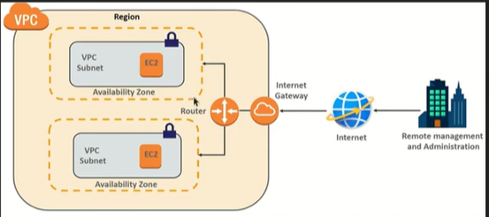

Slide 22
Security Groups
Security Groups are basically virtual firewalls that protects your virtual servers or EC2 Instances
It protects VM machine through NIC (Network interface card) card. (Last line of defense)

Slide 23
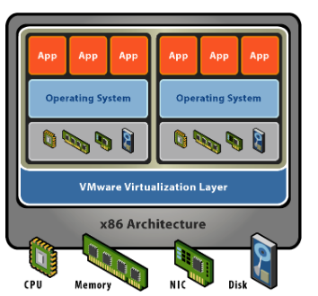

Slide 24
Network Access Control list
First line of defense
Security group functions at virtual NIC level where as the Network ACL they work at the subnet level
First attack – NACL (firewall for subnet)
Backup attack – Security group (firewall for VM

Slide 25
Virtual Private Gateway
The Virtual private gateway will take you to your own premises or headquarters or branches through VPN or Direct connect
A Virtual Private Gateway (VGW) allows secure connections between your AWS Virtual Private Cloud (VPC) and your on-premises data center or branch offices via VPN or AWS Direct Connect. For example, a retail company can use a VGW to connect its AWS-hosted inventory system to its main office servers over a VPN.
In contrast, an Internet Gateway (IGW) enables communication between resources in your VPC and the public internet. So while a VGW is for private, secure site-to-site connections, an IGW is used for public-facing access, such as hosting a website or allowing EC2 instances to reach the internet.

Slide 26
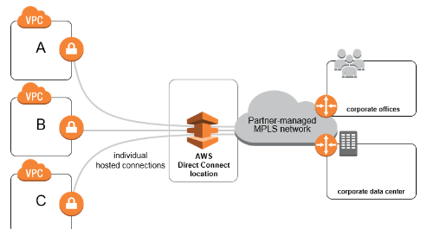

Slide 27
Direct Connect
AWS direct connect is a cloud service solution that makes it easy to establish a dedicated network connection from your premises to AWS

Slide 28
Direct Connect
In many cases can reduce your network costs, increase your bandwidth throughput, and provide a more consistent network experience than internet based connections ( VPN)
AWS direct connect provides 1Gbps and 10 Gbps connections, you can easily provision multiple connections if you need more capacity
Pay as you use and also stable connection!!!!

Slide 29
Types of VPC

Slide 30
Default VPC
When AWS account is created, its by default created in all AWS region
It has default CIDR, SG, NACL & Route tables
Default subnets in each AZ
IGW is also by default

Slide 31
Custom VPC
This VPC is created by Account owner
At the time of creation decide CIDR
It also has default security groups, NACL & route tables
No default subnet in each AZ
Does not have Internet Gateway, attach one if you require

Slide 32
Route Tables & Security Group
Route Tables & Security Group

Slide 33
Route Tables
These are tables that have entries which says what is the destination & target for that packet
Each subnet MUST have ONLY ONE Route Table
One ROUTE Table can be associated with multiple subnets

Slide 34
Route Tables
If you dont specify a subnet-to-route-table association, the subnet will be associated with the Main (default) VPC route table
Default route table that gets created automatically when you create VPC is set as Main Route table

Slide 35
Route Tables
Subnet association can be changed to another Route Table ( Custom)
Custom Route Table can become Main Route Table
Main Route Table cannot be deleted
Every Route table has default rule for all VPC subnets to communicate ( you cannot modify or delete )
One alternative is by using NACL we can limit the communication between subnets that are associated in 1 RT

Slide 36
Security Groups
Security group is a virtual firewall
It controls traffic at the virtual server or EC2 instance ( Specifically associated with virtual network interface also known as ENI – Elastic Network Interface)

Slide 37
Security Groups
Its the defense in depth, basically the last defense component in the VPC
An EC2 Instance must have a security Group at lauch

Slide 38
Security Groups
Security group are stateful & Directional
If Inbound traffic is allowed, return traffic(Outbound) is allowed ( no rules required)
If Outbound trafic is allowed, return traffic(Inbound) is allowed (no rules required)

Slide 39
Security Groups
Can have only PERMIT rule (allow rule)
Deny rule not possible
All rules are checked to find Permit rule
Implicit deny rule at end (by default)

Slide 40
Security Groups
Default Security group in default or custom VPC
Inbound rules allow Multiple EC2 instance assigned to same security group talk to each other
All outbound traffic is allowed by default

Slide 41
Security Groups
Custom Security group in default or custom VPC
No Inbound rules- all inbound traffic denied by default
(even servers cannot communicate with each other)
All outbound traffic is allowed by default

Slide 42
Security Groups
Security groups all rules can be changed Inbound and Outbound ( Not like Route Table)
Default Security Group cannot be deleted
Changes to security group effect immediately

Slide 43
Network Access Control List

Slide 44
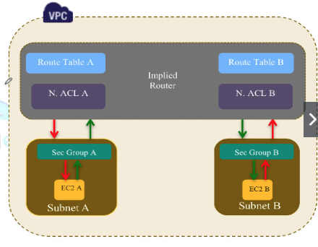
Network Access Control List

Slide 45
N-ACLs
This function is performed on Implied Router
The Implied VPC Router hosts the N-ACL
It works at Subnet Level
N-ACLs are stateless
We can have PERMIT & DENY both rules in a N-ACLs

Slide 46
N-ACLs
NACL is set of rule, each has number
Lowest No rule is permitted
You can insert rules, so reasonable spacing of no’s is recommended

Slide 47
N-ACLs
NACL ends with explicit deny which cannot be deleted
Subnet must be associated with NACL, else default NACL associated automatically

Slide 48
N-ACLs
Default NACL allows all inbound & outbound traffic by default
Custom NACL denies all inbound & outbound traffic by default
Changes to NACL effect is immediate like SG
When NACL is preferred over SG?

Slide 49
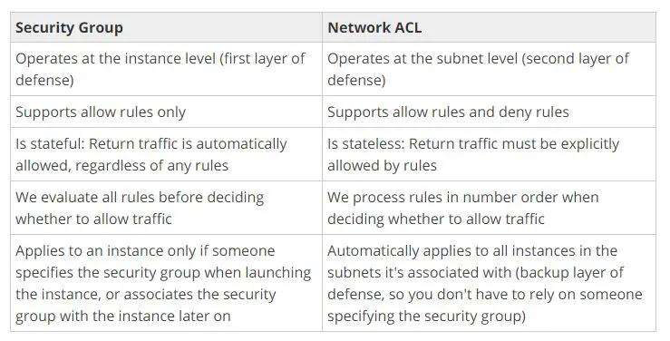
SG vs. NACL

