Slide 1
VPC Peering

Slide 2
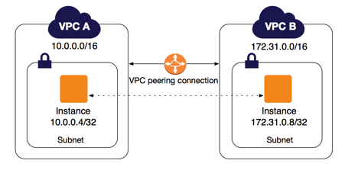

Slide 3
VPC Peering
VPC Peering is a network connection done between two VPC that enables to route traffic between them (IPV4 or IPV6)
AWS uses the existing infrastructure of a VPC to create VPC peering connection

Slide 4
VPC Peering
There is no single point of failure for communication or a bandwidth bottleneck
It is simple and cost-effective way to share resources between regions or replicate data for geographic redundancy across regions

