Slide 1
Elastic Block Storage & Instance store

Slide 2
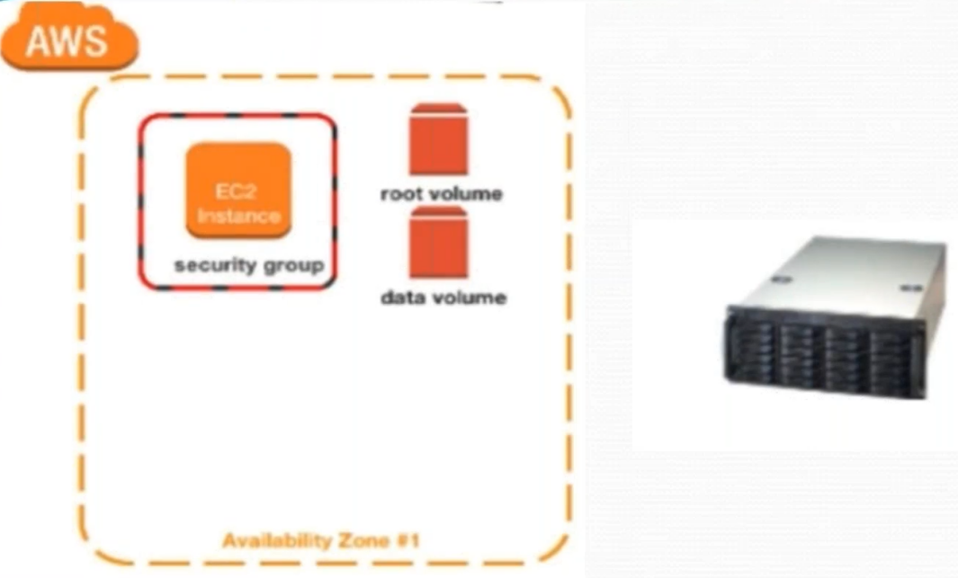

Slide 3
EBS
EBS optimized Instance
EBS optimized Ec2 instances enable the full use of an EBS Volume’s provisioned IOPS
They deliver dedicated performance between Ec2 instances & their attached EBS volumes

Slide 4
EBS- Elastic Block Storage
Amazon EBS volumes types fall into two categories
SSD-backed volumes
Optimized for transactional workloads involving frequent read/write operations, High IOPS and low latency
Can be used as boot volumes

Slide 5
EBS- Elastic Block Storage
Amazon EBS volumes types fall into two categories
HDD-backed volumes
Optimized for large streaming workloads, big data, log processing
Cannot be used as boot volumes

Slide 6
EC2- Elastic Compute Cloud
Two types of Block store devices are supported
Elastic Block Storage
Its persistent
Instance Store
Non-Persistent
(Virtual disk allocated to EC2 instance, root instance store can be max 10GB)

Slide 7
EC2- Elastic Compute Cloud
EBS backed EC2 Instance means root volume type is EBS
Instance Store backed EC2 means root volume type is Instance store

Slide 8
EBS- Elastic Block Storage
You can add volume, modify volume size & volume type
You cannot decrease EBS volume size
For Running EC2 Instance you cannot detach/re-attach EBS root volume
EBS has 99.999 availability

Slide 9
EBS volume should be present in the same availability zone as ec2 instance

