Slide 1
EC2 Purchasing Options

Slide 2
EC2 Purchasing Option
Reserved Instances:
We do not actually buy instances, rather we reserve long term capacity and pay for it for instance family/configuration ( in that AZ or region)
On-demand instance that matches the reserved one, reserve pricing will apply to the on-demand instance.

Slide 3
EC2 Purchasing Option
Reserved Instances:
You can purchase it at a significant discount
Purchased reserve instance are always available
Term options are 1 year or 3 years

Slide 4
EC2 Purchasing Option
Reserved Instances:
By selecting an AZ, the RI you purchase will provide a capacity reservation and a discount for the use of instances in the selected AZ ( Capacity is also guaranted in that AZ)
When an availability zone isnt specified, the RI discount will apply to a running instance of any size (within the same family) in the region in any AZ

Slide 5
EC2 Purchasing Option
Reserved Instances:
Once purchased, it CANNOT be refunded or cancelled
You can however, sell them on AWS reserved instance marketplace (standard only, convertibale cannot be sold)
You are billed for RI, whether it is running or stopped ( as you have reserved capacity)

Slide 6
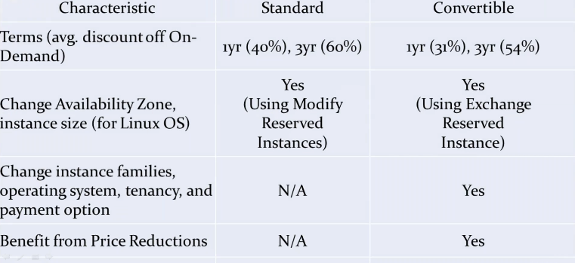
Modifying Reserved Instances

Slide 7
Modifying Reserved Instances
Example:
You have 14RIs with scope of AZ1, and you have submitted a request to AWS to do some modifications, where you want 6 RIs to be moved AZ2, and 8 to remain in AZ1
What will AWS do?
AWS will split the request in 2 new reservations as follows:
- One of 8 RIs in AZ1
- Another for 6 RIs in AZ2

Slide 8
Ec2 Instance State
If you reboot an Ec2 instance, it is considered as running & does not add additional hour for your bill
Stopping & starting add an hour to your billing
When you stop an Instance, AWS shuts it down
When we stop instance and start gain then ip will be changed but remain same after reboot!

Slide 9
Ec2 Instance State
Instance store backed instance CANNOT be Stopped, they can only be Rebooted and Terminated
EBS backed Instance CAN be stopped, No charges for stopped EC2 Instance (but EBS incur charges)

Slide 10
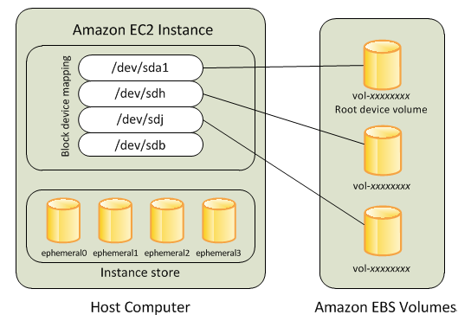

Slide 11
Ec2 Instance State
When you stop EBS backed Instance any data in Instance store volume is lost
When EC2 is restarted (means started) it will go on another physical host (likely)

Slide 12
When you stop EBS backed Instance
EC2 Instance retains its private Ipv4 Add and Ipv6 Add
EC2 Instance releases its Ipv4 Public Ip back to AWS pool
EC2 Instance retains its Elastic IP Add (It Incur charges if its not used like EBS)

Slide 13
EC2 - Reboot
Best Practice
Use EC2 reboot and not the Instance OS reboot
AWS when initiates a reboot,wait for 4 minutes, if instance did not reboot, will force hard boot
AWS reboot creates an AWS CloudTrail Log which is useful for troubleshooting & Audit purpose

Slide 14
EC2 Instance Termination
EC2 instance terminate will delete boot/root volumes by default, any additional volume remains
EC2 Termination-Proctection protects against accidental termination

Slide 15
EC2 Termination- Protection
If you want to terminate an instance that has terminate protection ON
Configure AWS to treat OS shutdown as instance termination &
Perform OS shutdown

