Slide 1
Placement Group

Slide 2
• EC2 placement group determines how instance is placed on underlying hardware
• There is no charge of creating a placement group (EC2 charges apply)

Slide 3
Types of placement groups:
Cluster Instances are in low-latency group in a single AZ
Spread- Spreads instances across underlying hardware in same or different AZ's
Partition- Spreads your instances across logical partitions in same or different AZS

Slide 4
• A Cluster placement group keeps all instance of the group in single AZ
• It is recomended when your applications majority of the network traffic is between the instances in the group

Slide 5
• A Spread placement group is a group of instances that are each placed on distinct underlying hardware in different racks
• Spread placement groups are recommended for critical applications that should be kept separate from each other (max 7 in one AZ)

Slide 6
Partition placement group is used to keep one group of server separated from another group of server
Every Partition is launched in a separate rack to minimize the impact of a failure
Maximum of 7 partitions per AZ

Slide 7
A spread placement group spreads your EC2 instances across different hardware racks, so if one rack fails, only one instance is affected — it’s like putting your eggs in different baskets for high availability. A partition placement group, on the other hand, splits your instances into logical partitions, and each partition sits on separate racks — great when you have many instances and want to isolate them by group (e.g., database servers in one partition, app servers in another) so that a failure in one group doesn’t affect the others. So: spread = maximum separation per instance, partition = separation per group of instances.

Slide 8
EBS Snapshots

Slide 9
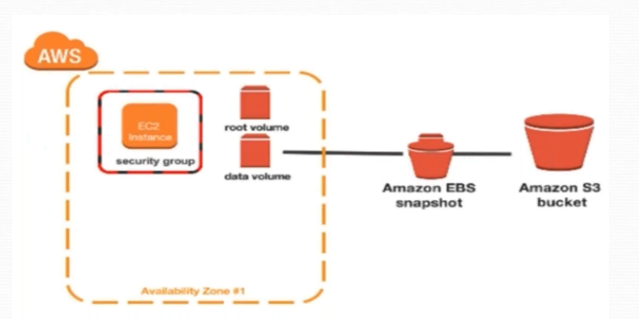

Slide 10
EBS- Snapshots
EBS Snapshots are point-in-time Images/Copies of your EBS volume
Any data written to the volume after the snapshot process is initiated will NOT be included in the resulting snapshot
Snapshot of EBS volume can be done manually or Automated through Life cycle management

Slide 11
EBS- Snapshots
EBS Snapshots are stored incrementally (means only additional changes will be considered e.g., from snapshot1 to snapshot2)
EBS volumes are AZ specific
Snapshot are Region specific
(That’s the reason we used snapshot for Disaster recovery)

Slide 12
When you take multiple snapshots of a disk (like snap1 then snap2), each new snapshot usually only saves the changes since the previous one, kind of like a child inheriting most of what the parent already has — this is why it’s loosely compared to inheritance. Over time, having too many linked snapshots can slow things down, so disk consolidation comes in to merge the data from earlier snapshots into a more efficient, unified state, reducing dependency on the old ones and improving performance.

Slide 13
EBS- Snapshots
The Snapshot is created immidiately ( it may stay in pending status until its complete)
This may take few minutes or hours to complete ( for large volumes) especially for the first time snapshots of a volume
When the snapshot status is pending, you can still access the volume but the I/O might be slower because of the snapshot activity

Slide 14
EBS- Snapshots
From a Snapshot you can restore to an EBS volume of the same or larger size than the original EBS volume size (not small size)
You can take the snapshot of a EBS volume while the volume is in use on a running EC2 instance

Slide 15
EBS- Snapshots
To Restore an EBS from one AZ to another
Create a snapshot (region specific)
Create an EBS volume from the snapshot in the intended AZ (other AZ)

Slide 16
EBS- Snapshots
To Restore an EBS from one Region to another
Create a snapshot of the volume
Copy the snapshot and specify the new region
In the new region create a volume out of the copied snapshot

Slide 17
EBS- Snapshots
Low cost storage on s3 and a gurantee to restore full data from the snapshot
You are charged for s3 storage & data xfer to s3 from your EBS volume you are taking snapshot

