Slide 1
Auto Scaling

Slide 2
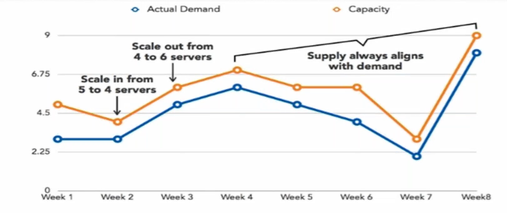
Auto Scaling

Slide 3
Auto Scaling
It is as AWS feature that allows your AWS compute needs (EC2 instances fleet) to grow or shrink depending on your workload requirements
Auto scaling helps you save costs by cutting down the number of EC2 instances when not needed, and scaling out to add more instances only when it is required

Slide 4
Auto Scaling Components
1) Launch Configuration:
Its the configuration template used to create new EC2 instances for the ASG
It defines parameters like Instance family, instance type, AMI, Key pair, Block devices, and Sec groups
It cannot be edited after creation

Slide 5
Auto Scaling Components
2) ASG Group:
Its the logical grouping of EC2 instances managed by AS Policy
An ASG can have a minimum, maximum, and desired capacity of EC2 instances
It can be edited after creation

Slide 6
Auto Scaling Components
3) Scaling Policy (Plan):
Determines when and how the ASG scales or shrinks (On-demand/Dynamic Scaling)

Slide 7
Auto Scaling
Auto Scaling can span Multi-Azs within the same AWS region (Not Regions), so it can be used to create Fault Tolerant designs on AWS
There is no additional cost for lauching ASG, you can pay only for EC2 instances
It works well with AWS ELB, Cloud Watch

Slide 8
Auto Scaling
Auto Scaling service always tries to distribute EC2 instances evenly across Azs where it ti enabled
Incase of uneven distribution it will Auto rebalance

Slide 9
Cloud Watch
Amazon CloudWatch monitors your Amazon AWS resources like EC2 in real time
For example – CPU utilization of your EC2 instance
Cloud Watch Alarm can be used as Triggers in your AWS
For example- to scale ASG

Slide 10
Auto Scaling
You can Detach running EC2 instance from an AS group
You can then manage the detached instances independently or attach it to another AS Group

Slide 11
Auto Scaling
You can manually move an instance from an ASG & put it in standby state
Instances in standby are still managed by Auto Scaling
But they do not count towards available EC2 instance for workload/application use

Slide 12
Auto Scaling
When you delete an ASG its parameters
Minimum
Maximun
and desired capacity are all set to Zero
(It shows under AWS console as well) hence it would terminates all its EC2 instances

