Slide 1
S3 – Simple Storage Service

Slide 2
S3
S3 is the storage for the internet
It has simple web services interface for simple storing and retrieval of any amount of data from anywhere on the internet
S3 is object-based storage & NOT a block storage (Audio, Vide, Snapshots, etc)
S3 has a distributed data-store architecture (redundantly stored in multiple locations)

Slide 3
S3
S3 has 99.99% availability
Amazon Guarantees 99.999999999% Durability
Tiered Storage available (Standard type is default used)

Slide 4
S3
An object size stored in an S3 bucket can be upto 5TB
There is unlimited storage
A bucket can be viewed as a containers for objects (Default its private)
You can use name for folders in a bucket when using the AWS console

Slide 5
S3
An s3 bucket is region specific
Cross Region Replication can be done
S3 Bucket names are globally unique across all AWS regions

Slide 6
We created replica rule in 1 bucket for creating replicas in another bucket.
We also hosted static websites in s3 bucket as well by enabling static website hosting!

Slide 7
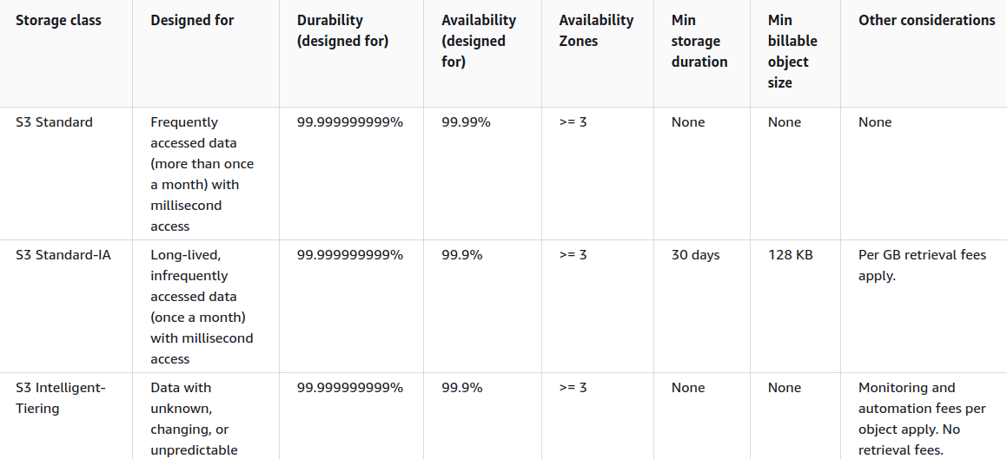
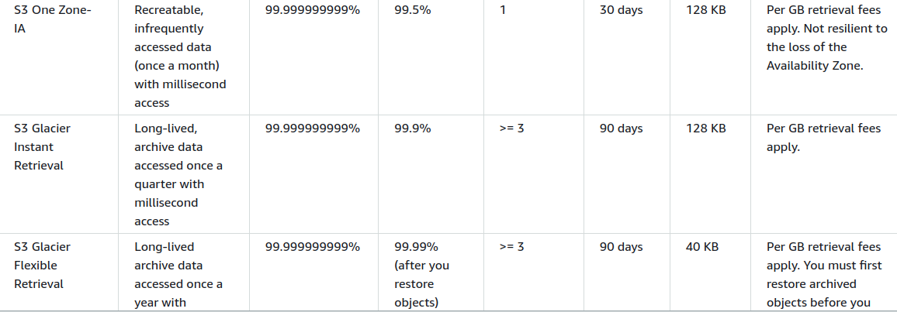
S3

