Slide 1
Relational Database Service (RDS)

Slide 2
Relational Database Service (RDS)

Slide 3
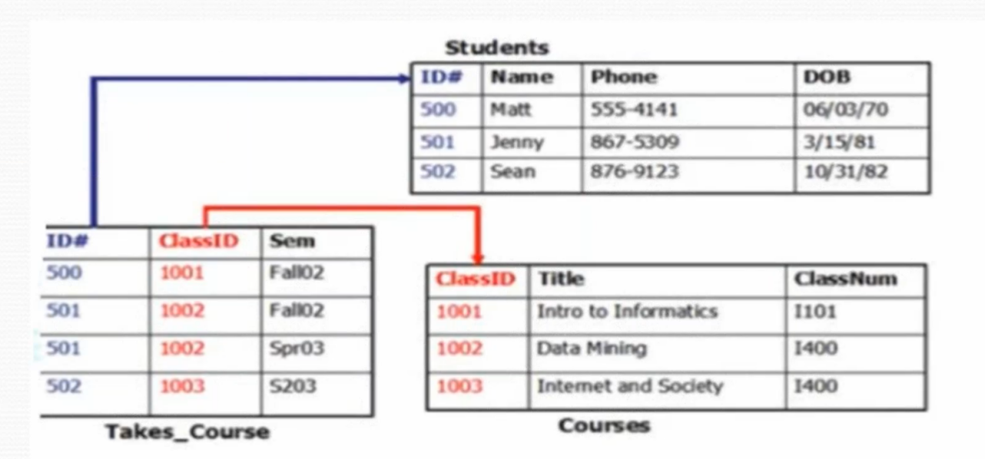

Slide 4
Relational Database
A Relational Database is a data structure that allows you to link information from tables or different types of tables
It normalizes data into structures
It means it requires schema which strictly defines tables, columns,indexes and relation between tables
Virtually all Relational Dbs uses Structured Query Language (SQL)

Slide 5
Relational Database Service RDS
AWS is responsible for:
Security and patching of the database instances
Automated backup for your DB instances (default setting)
Software updates for the database DB engine (07 days)
If Multi-AZ is selected then Synchronous replication between the active and standby DB instances in same region

Slide 6
Relational Database Service RDS
AWS is NOT responsible for:
Managing DB settings
Building a relational DB Schema
DB Performance tunning

Slide 7
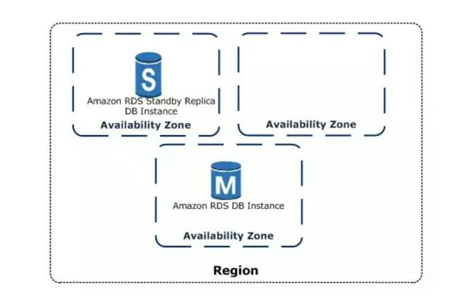
Multi AZ RDS

Slide 8
Relational Database Service (RDS)
You CANNOT read/write to the standby RDS DB instance
Depending on the instance class it may take 1 to few minutes to failover to the standby instance
Recommended to implement DB connection retries into your applications, so failover doesnt create an issue

Slide 9
Relational Database Service (RDS)
Read Replicas
It allow you to have a read-only copy of your production database
This is achieved by using Asynchronous replication from the primary RDS instance to the read replica
You use read replicas primary for very read heavy database workloads not for DR !!
AZ will be reversed!!!
On replica we will not be able to write (e.g. truncate table)
https://razorpay.com/blog/day-of-rds-multi-az-failover/

