Slide 1
Kinesis

Slide 2
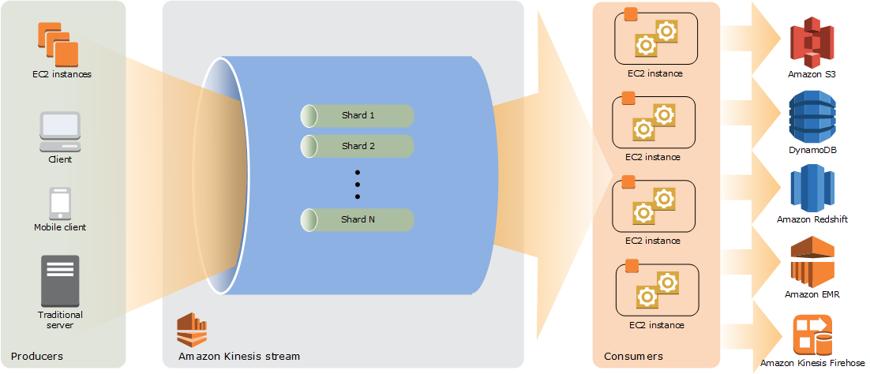

Slide 3
Kinesis
Kinesis Streams data that is sent continuously from a large number of sources (usually in Kbytes or MBytes)
Kinesis is a platform for streaming data on AWS (used for IoT & Bigdata Analytics)
It offers powerful services to make it easy to load and analyze streaming data

Slide 4
Kinesis
Kinesis is continuously capture & store Terabytes of data per hour from 100s of thousands of sources like
- IoT sensors data
- Log files from customers of mobile applications and web apps
- In-game player activities
- Financial trading floors and stock markets

Slide 5
Kinesis
Retension Period:
The time for which data records will be kept and made accesible to kinesis streams applications
- Default is 24 hours (1day)
- Can be extended for additional charges

