Slide 1
AWS Lambda

Slide 2
AWS Lambda
AWS Lambda is a highly available compute service that lets you run code without provisioning or managing servers
AWS Lambda executes your code only when needed and scales automatically, from a few requests per day to thousands per second

Slide 3
AWS Lambda
Just supply your code, in one of the languages that AWS Lambda support like Node.js, Java, C# and Python
Use case example:
You can use AWS Lambda to run your code in response to:
Events such as changes to data in an Amazon s3 bucket

Slide 4
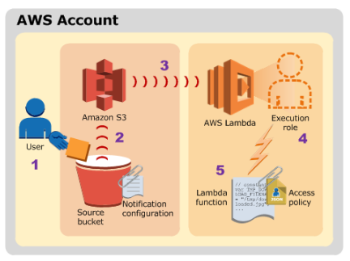
AWS Lambda

