Slide 1
Cloud Formation

Slide 2
Cloud Formation
CloudFormation allows you to code your infra from scratch with CloudFormation template language, in either YAML or JSON format, or start from many available sample templates
No additional Cost( Only U pay for resources)\
When we delete CloudFormation Stacks then the resource you created using CF will also be deleted e.g., S3 bucket
https://docs.aws.amazon.com/AWSCloudFormation/latest/UserGuide/aws-properties-amplify-app-autobranchcreationconfig.html

Slide 3
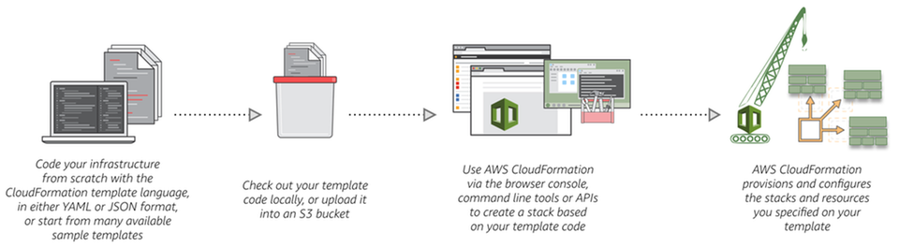
Cloud Formation

