Slide 1
Cloud Front

Slide 2
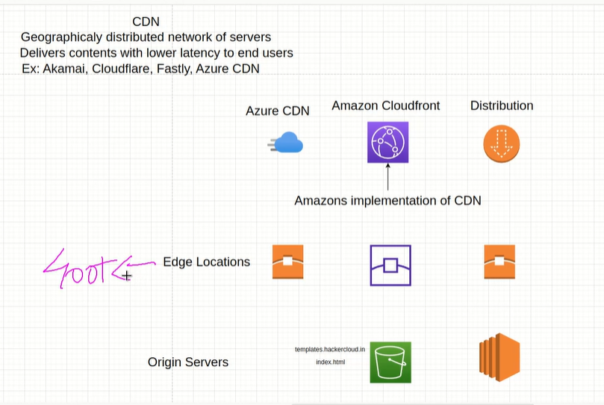

Slide 3
Cloud Front
Amazon CloudFront is a content delivery network offered by Amazon Web Services
CloudFront delivers your content through a worldwide networks of data centers called edge locations
So that content (Images/Videos/Doc) is delivered with the best possible performance(Low Latency)

Slide 4
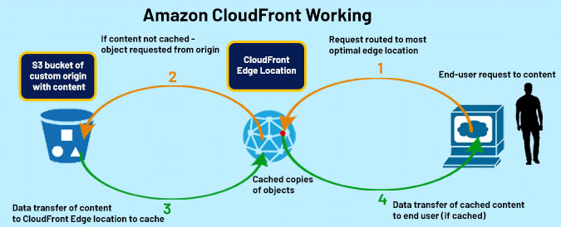
Cloud Front

Slide 5
Cloud Front
When a user requests content that youre serving with CloudFront
If the content is already in the edge location with the lowest latency, CloudFront delivers it immidiately
If the content is not in that edge location, CloudFront retrieves it from an origin that you’re defined

Slide 6
When setting up a custom domain name for your AWS CloudFront distribution, it's important to ensure secure and proper routing. To do this, you need to provide the following two key components:
SSL/TLS Certificate: This certificate enables HTTPS for your domain, ensuring that all data transmitted between the client and CloudFront is encrypted and secure.
Matching Domain Name in the Certificate: The certificate you use must include the exact domain name (e.g., www.example.com) that you want to associate with your CloudFront distribution. If there's a mismatch, CloudFront won't be able to serve traffic correctly under that domain.

