Slide 1


Hope to Skills
Lecture# 26
Irfan Malik, Dr. Sheraz Naseer

Slide 2
Agenda
Applications of CNN
Auto Encoders
Introduction
Architecture
Encoder
Feature space
Decoder
Types of Decoders
Applications of Decoders
Quiz

Slide 3
Previously
Artificial Neural Networks (ANN)
Convolutional Neural Networks (CNN)

Slide 4
Application of CNN
Image Classification
Image Segmentation
Facial Recognition
Gesture Recognition

Slide 5
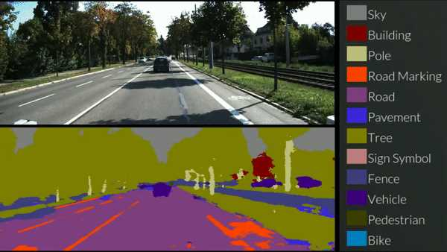
Image Segmentation

Slide 6
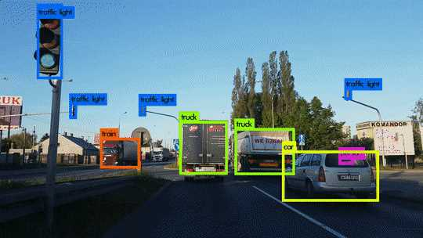
Object Detection

Slide 7
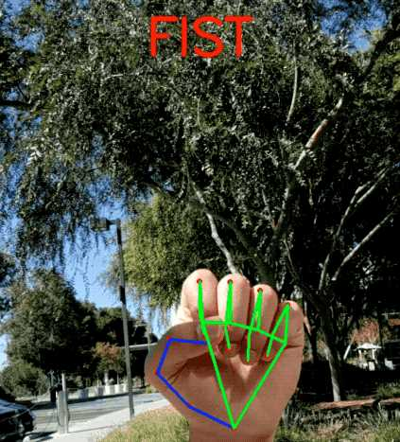
Gesture Recognition

Slide 8
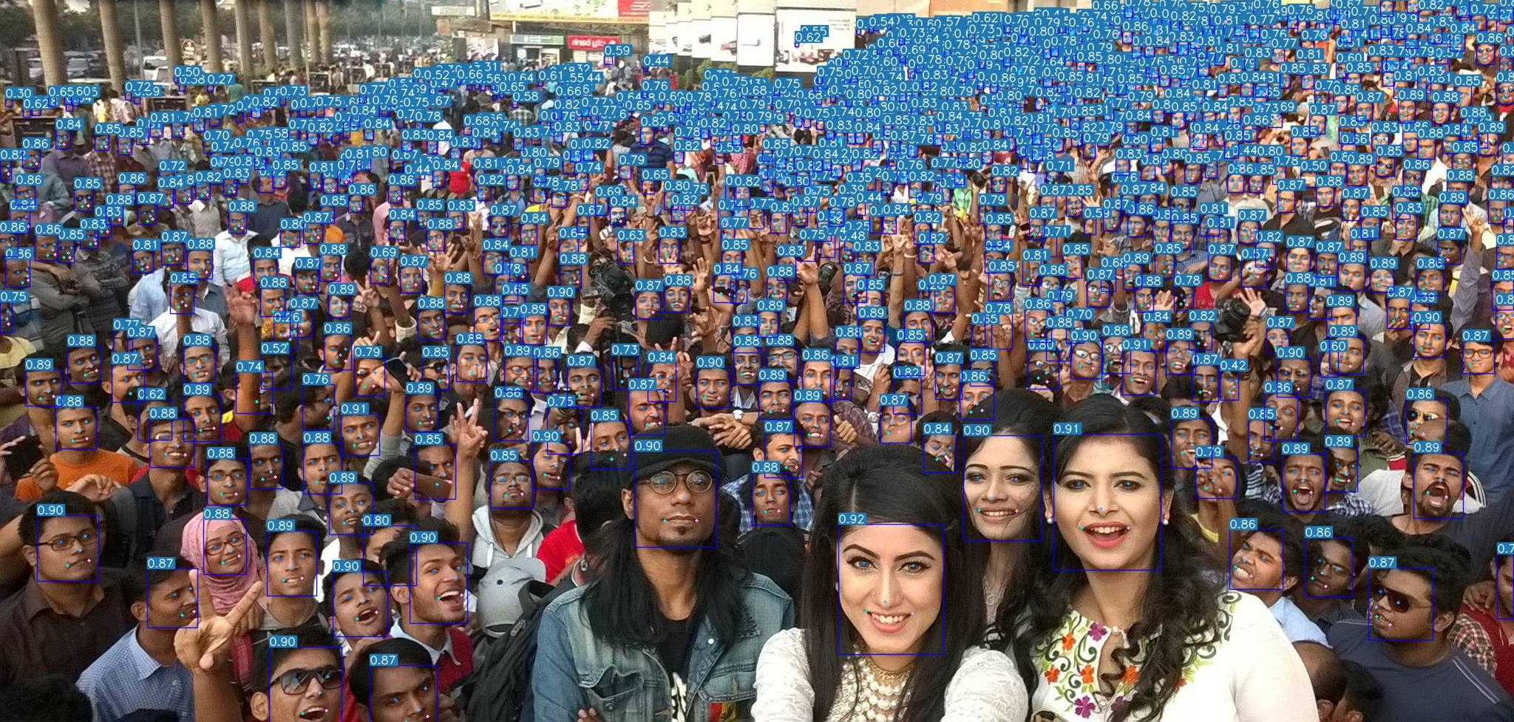
Face Detection

Slide 9
Encoders & Decoders in Deep Learning
Encoder
Converts original data into a secret code.
Uses rules or transformations to hide the message.
Decoder
Reverts the secret code back to the original data.
Understands the rules to reverse the encoding.
Enables understanding of the hidden message.

Slide 10
What Are Autoencoders?
A type of neural network designed for dimensionality reduction and feature learning.
Primary goal: To encode data into a compact representation and then decode it for reconstruction.

Slide 11
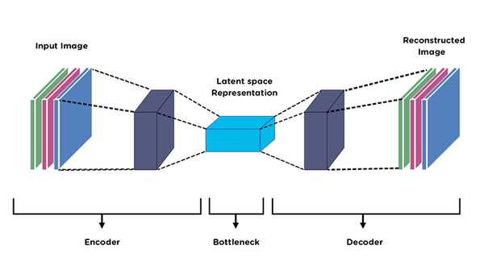
Anatomy of an Autoencoder
Components: Encoder, Bottleneck/Hidden Layer, Decoder.

Slide 12
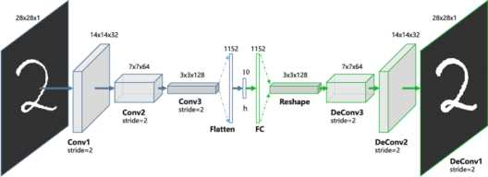
Anatomy of an Autoencoder
Components: Encoder, Bottleneck/Hidden Layer, Decoder.

Slide 13
Encoder
The encoder is like a detective that learns to capture the most important features of an image or data.
It's the first part of the autoencoder and responsible for compressing the input data.

Slide 14
How Does the Encoder Work?
Imagine an encoder as a funnel that squeezes a big picture into a smaller representation.
It transforms the input data (e.g., an image) into a compact form called the latent space or encoding.

Slide 15
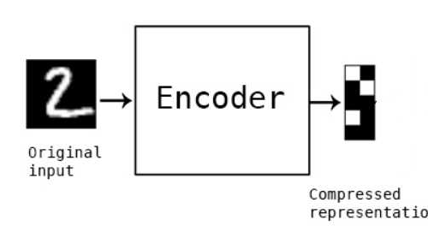
Encoding Process
Step 1: The input data, such as an image, is fed into the encoder.
Step 2: The encoder consists of layers of neurons that learn patterns and features in the data.
Step 3: These patterns are combined and transformed into a compact representation in the latent space.

Slide 16
Why is it Important?
Data Compression: The encoding is much smaller than the original data, making it efficient to store and transmit.
Feature Extraction: The encoder learns to extract valuable information, which can be used for various tasks.

Slide 17
What is a Decoder?
The decoder is like an artist that takes the compact representation (encoding) from the encoder and recreates the original data.
It's the second part of the autoencoder and responsible for generating output from the encoding.

Slide 18
How Does the Decoder Work?
Imagine a decoder as a reverse funnel that expands the compact representation back into a full image or data.
It transforms the encoding from the latent space back into a reconstructed output.

Slide 19
Decoding Process
Step 1: The encoded data (latent space representation) is fed into the decoder.
Step 2: The decoder consists of layers that learn to reverse the compression process by generating features and patterns.
Step 3: These generated features are combined to reconstruct the original data.

Slide 20
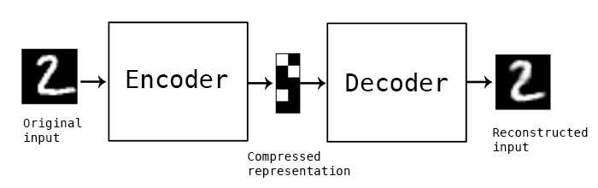
Recreating Original Data
The decoder's goal is to recreate data as close to the original input as possible.
It uses the knowledge it gained from the encoder to generate meaningful features.

Slide 21
Why is it Important?
Data Reconstruction: The decoder's job is to bring back the data's original form from the compressed encoding.
Completing the Loop: Autoencoders aim to minimize the difference between the input and the reconstructed output.

Slide 22
Simple/Vanilla Auto-encoder

Slide 23
Types of Auto-Encoders
Vanilla Autoencoder
Denoising Autoencoder
Variational Autoencoder (VAE):

Slide 24
Denoising Autoencoder

Slide 25
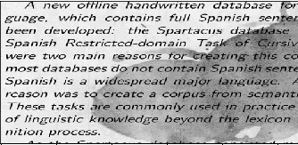
Input Image

Slide 26
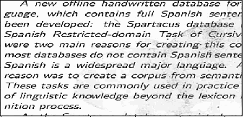
Output Image

Slide 27
Denoising Autoencoder
Denoising Autoencoders are a type of neural network.
Designed to clean noisy or corrupted data and extract essential features.

Slide 28
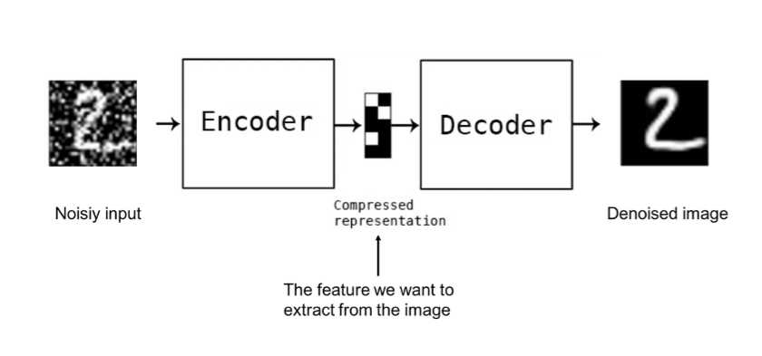
Denoising Autoencoder

Slide 29
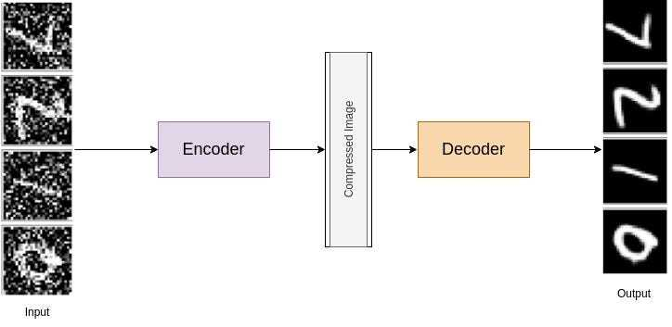
Denoising Autoencoder

Slide 30
Quiz

