Slide 1


PROJECT AVATAR
Facial Landmarks Detection and Lip Reading On a Distributed System Based on an Android Device and Remote Server
Presented by :
Ahmad Hassan Mirza (7104716)
ahmad.mirza001@stud.fh-dortmund.de
Supervisor:
Prof. Dr.-Ing. Jörg Thiem

Slide 2
AGENDA
Section-1 : Introduction
Section-2 : Application Development
Section-3 : MachineLearning Module
Section-4 : Results
==Demo==
Notes:
Introduction:
UseCase
Requirements Design and Modelling
System Design
Tools Used
Application Development
Application Architecture – Component Diagram
Execution Sequence – UML Sequence Diagram
Class Diagram
Machine Learning Module
Theory
Architecture of CNN
Data Preperation
PreProcessing and Training
Results
Performance Metrics
Training Statistics

Slide 3
INTRODUCTION
Section-1

Slide 4

USE-CASE
Almost 8% of children aged 3-17 had a communication disorder.[1,2]
Out of these only 55% have received any medical help.
To address this demographic, a smart phone based solution is proposed:
Wide availability of smart phones
Huge processing power of these devices can be exploited.
Proposal – Smartphone application that can recognise and evaluate irregularities in speech.
Software, die glücklich macht!
[1] https://www.nidcd.nih.gov/health/statistics/quick-statistics-voice-speech-language
[2] https://www.cdc.gov/nchs/products/databriefs/db205.htm
Notes:
[1,2]National Health Interview Survey :
https://www.nidcd.nih.gov/health/statistics/quick-statistics-voice-speech-language
https://www.cdc.gov/nchs/products/databriefs/db205.htm
Reason for less medical intervention: Social stigma, Cost of medical help, access to medical professionals in the field.
Reason for proposing a smart phone for the solution:
The Apollo Guidance Computer (AGC) had 32,768 bits of RAM memory and 72kb of ROM.
0.043MHz Processor.
A typical smart phone (iPhone) usually has up to 4GB of RAM and 512GB ROM, processor 2490MHz.

Slide 5

REQUIREMENTS DESIGN
Phase -1
Analysis and comparison of facial and landmarks detection techniques
Phase -2
Real-Time Facial Landmarks Detection on Live Camera Stream
Phase -3
Implementation of wireless data transfer to a remote computer
Phase -4
Implementation of Machine Learning Component

Slide 6
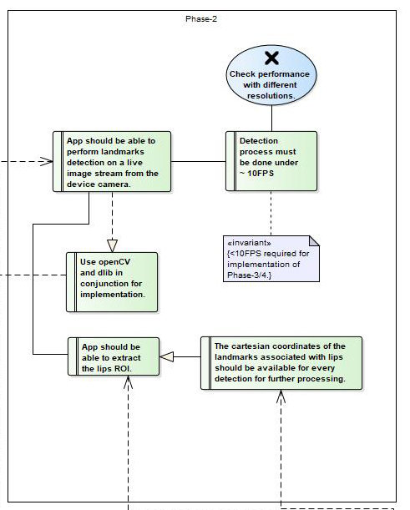
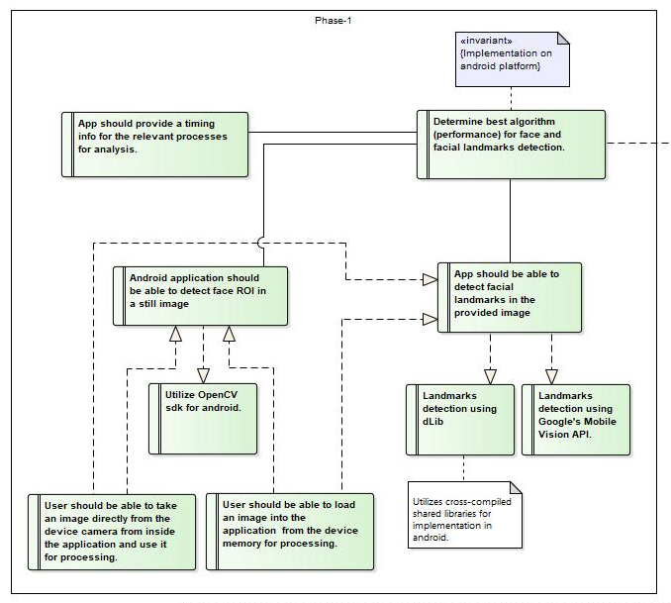
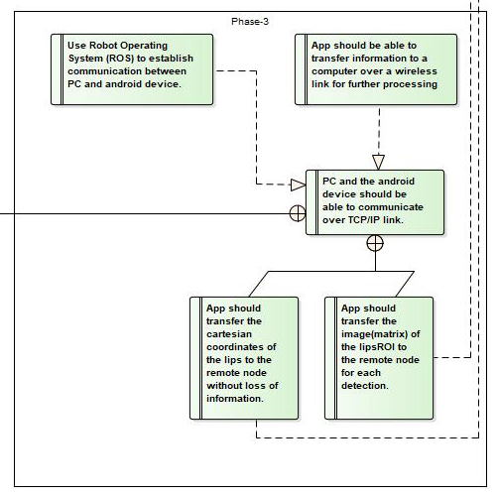
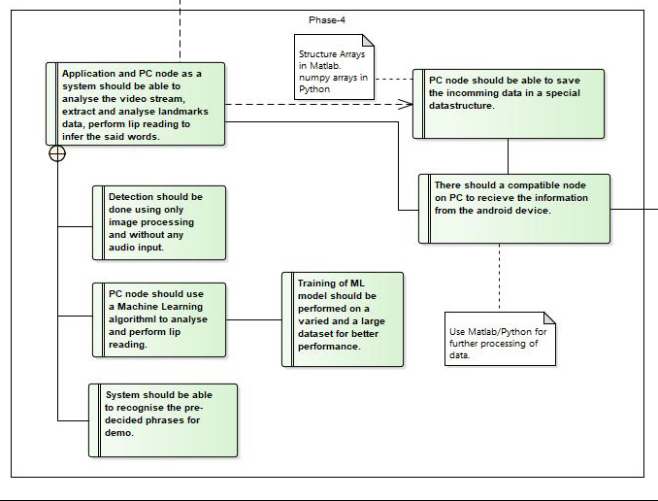
UML MODEL

Slide 7
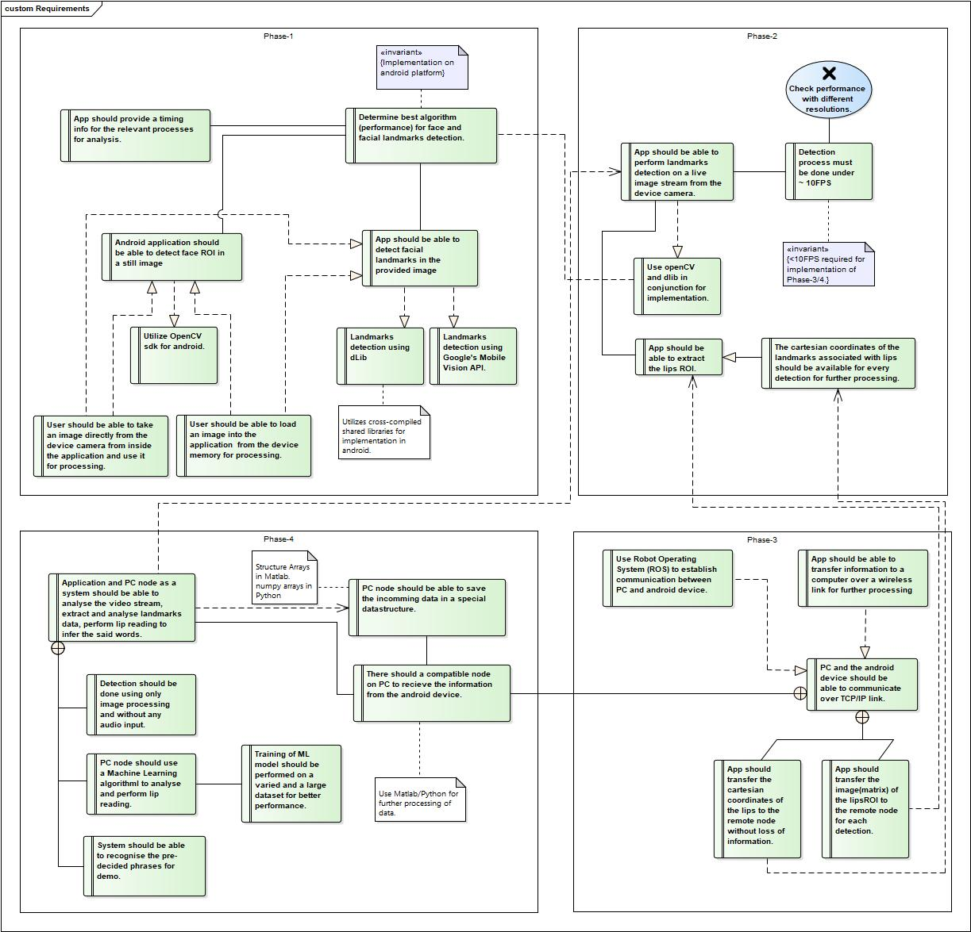
BIGGER PICTURE

Slide 8
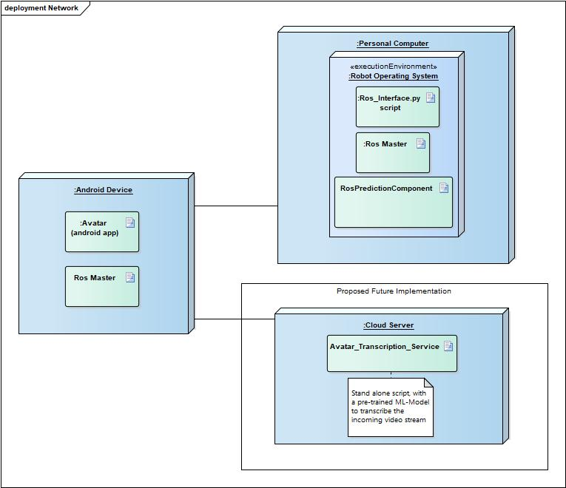
SYSTEM DESIGN
Distributed Architecture
Better Performance.
Segregation of components.
Each system can be updated without effecting the other.
Easy to expand depending on user base.
Notes:
Image processing done on Android device.
Predicitons done on the remote server.
Removes the load of running MachineLearning Component on the Android device.
Can be moved to any high end server based on the needs
The machine learning model can be updated independently of the Android application.
Retrain the model and deploy on the server.

Slide 9





TOOLS USED
Android Studio
Python
Tensor Flow
Keras
OpenCV
dLib
Notes:
[1]By Source (WP:NFCC#4), Fair use, https://en.wikipedia.org/w/index.php?curid=38682289
[2]By Adi Shavit - http://opencv.willowgarage.com/wiki/OpenCVLogo, Public Domain, https://commons.wikimedia.org/w/index.php?curid=26547749
[3]By Google - https://blog.google/products/android/evolving-android-brand/, Public Domain, https://commons.wikimedia.org/w/index.php?curid=81564513
[4]By www.python.org - http://www.python.org/community/logos/, GPL, https://commons.wikimedia.org/w/index.php?curid=34991637
[5]By TensorFlow - vectors combined, edited - Begoon - https://github.com/tensorflow/tensorflowhttps://github.com/valohai/ml-logos/blob/master/tensorflow-text.svghttps://github.com/valohai/ml-logos/blob/master/tensorflow-tf.svg, Apache License 2.0, https://commons.wikimedia.org/w/index.php?curid=65268375
[6] By Francois Chollet - Keras Logo, Public Domain, https://commons.wikimedia.org/w/index.php?curid=51518645

Slide 10
APPLICATION DEVELOPMENT
Section-2
Git-Repo

Slide 11
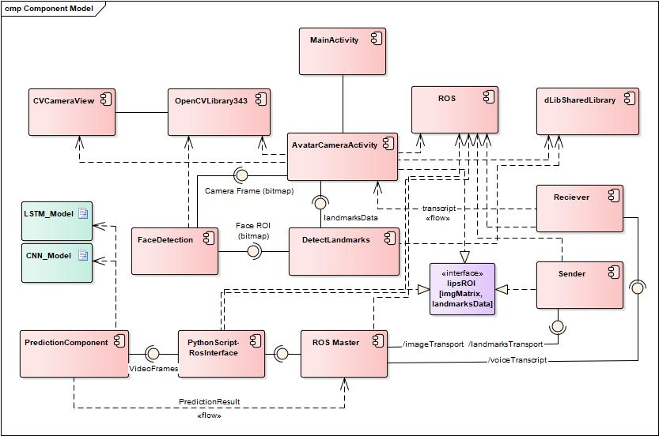
APPLICATION ARCHITECTURE

Slide 12
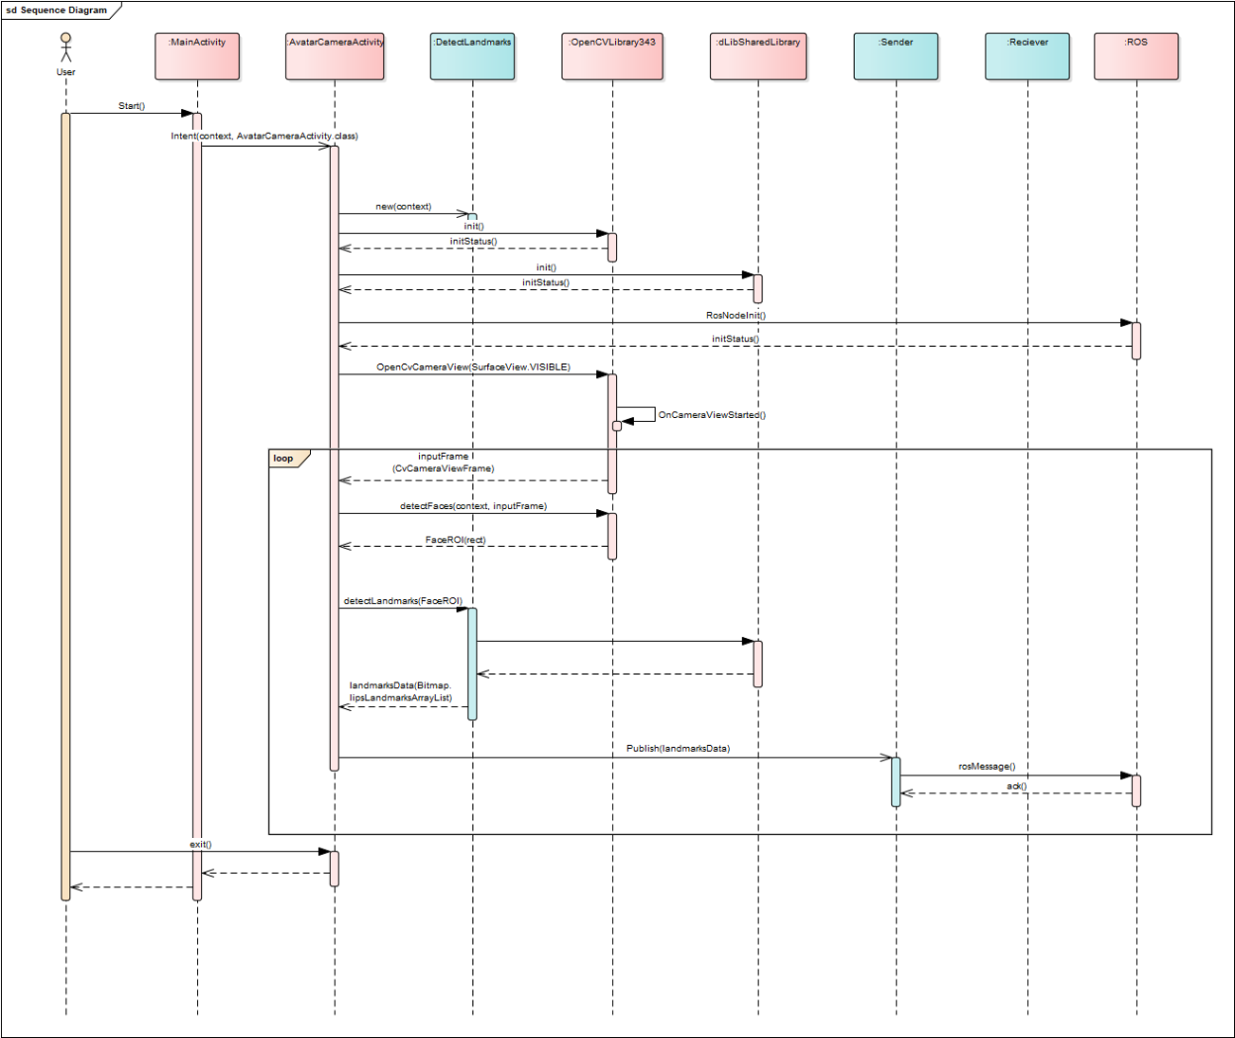
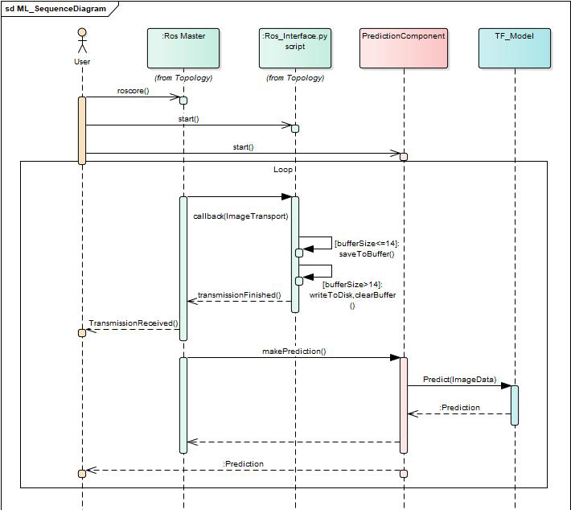
SEQUENCE MODEL

Slide 13
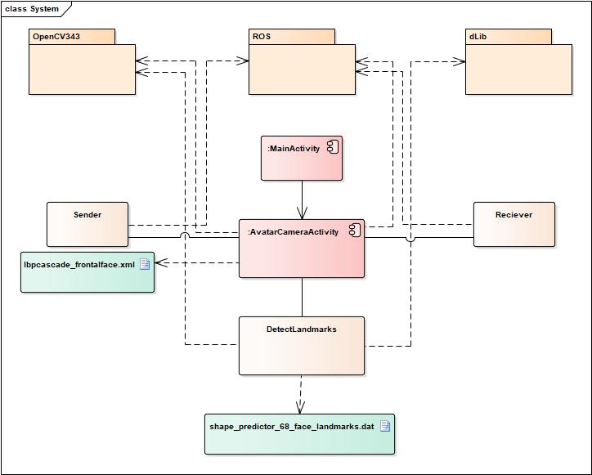
CLASS DIAGRAM
Libraries:
OpenCV ver 3.4.3
ROS Kinetic Kane
Dlib
Artefacts/Dependancies:
Lbpcascade_frontalface.xml – OpenCV face detection pre-trained template
Shape_predictor_68_face_landmarks.dat – Dlib template for 68 facial landmarks detection

Slide 14

MACHINE LEARNING MODULE
Section-3

Slide 15
THEORY
Artificial Intelligence - Broad concept
Idea - Machines should be able to perform tasks in a way that could be classified as smart without human intervention
Machine Learning
To enable the machines to learn for themselves by iterating over large amount of data.
Types of Machine Learning architectures used:
Convolutional Neural Networks
VGG16 + Custom Layers
Recurrent Neural Networks
Vanilla LSTM
Stacked LSTM
Notes:
Transfer learning : A machine learning method where a model developed for a task is reused as the starting point for a model on a second task.
Oxford VGG Model
Google Inception Model
Microsoft ResNet Model
In CNNs - features are more generic in early layers and more original-dataset-specific in later layers.

Slide 16
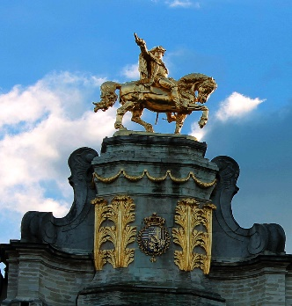
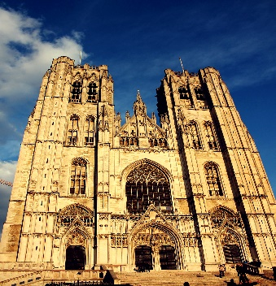
ARCHITECTURE OF A CNN
MaxPoolLayer
MaxPoolLayer
OutputLayer
Input Images
Convolution Layer
Convolution Layer
FullyConnectedLayer
Notes:
Convolution Layer: Contains a set of filters- parameters are learnt.
The height and weight of the filters are smaller than those of the input volume.
Each filter is convolved with the input volume to compute an activation map made of neurons.
Max-Pooling Layer: A pooling operation that calculates the maximum value in each patch of each feature map.
The results are down sampled that highlight the most present feature in the patch.
FullyConnected Layer: Takes the output of the previous layers, “flattens” them and turns them into a single vector that can be an input for the next stage.

Slide 17
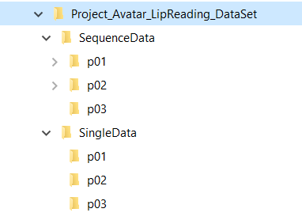
DATA-SET PREPERATION
Three phrases.
Spoken by six people.
5-8 samples for each phrase.
Frame Extraction ->Face Extraction -> Lip ROI extraction.
Phrase | Key | Class | Samples
How are you? | p01 | 1 | 50
Nice to meet you! | p02 | 2 | 40
Thank you. | p03 | 3 | 40

Slide 18
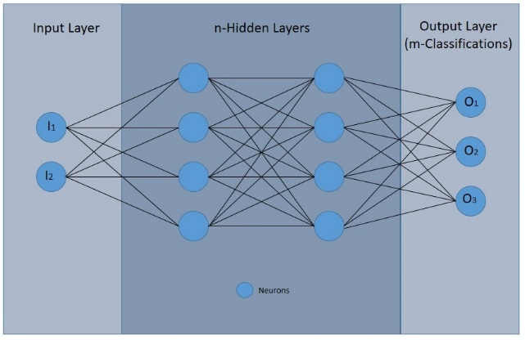
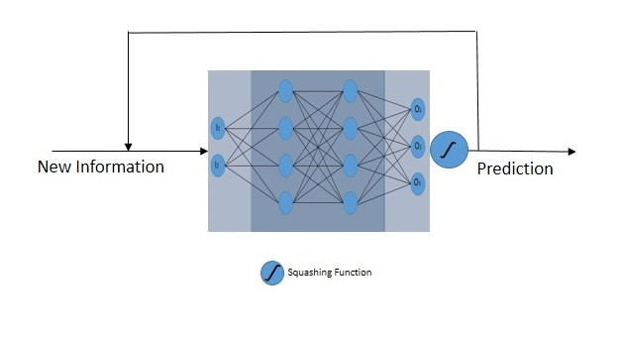
DATA PRE-PROCESSING
CNN – Architecture:
Resized to 244*244*3
Concatenate image to a single large image.
Flatten the image.
LSTM – Architecture:
Resized to 244*244-GRAY_SCALE
Read all images in np.Array data struct
Reshape to 3d Samples,TimeSteps,Features

Slide 19
RESULTS
Section-4

Slide 20
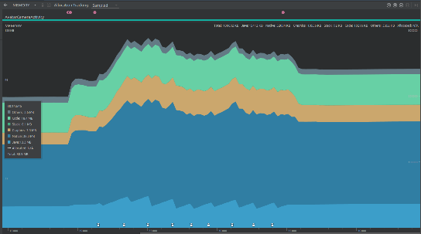
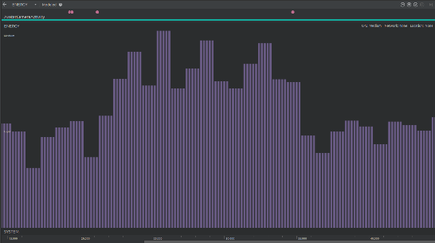
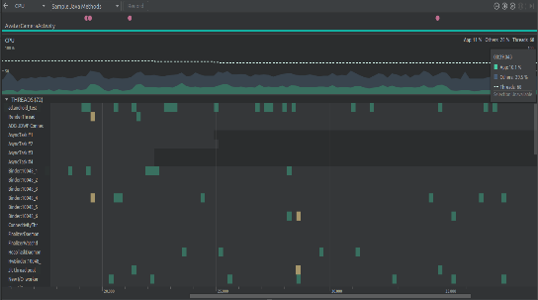
PERFORMANCE METRICS
Frame Rate
Without Image Processing Tasks = 23-26 FPS
With Image Processing Tasks = 9-11 FPS
Memory Consumption : 80.9MB to 100.6MB
Energy Consumption : Light to Medium (No quantitative results available)
CPU Usage : ~ 10%

Slide 21
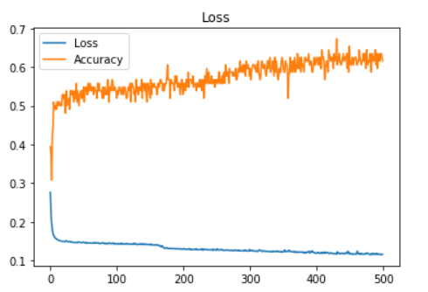
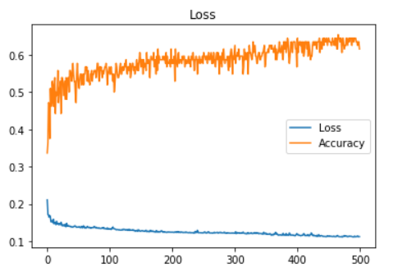
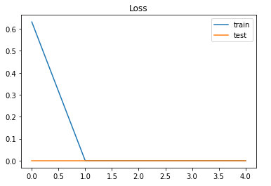
TRAINING STATISTICS
Model | Neurons | Epochs | Batch Size | Loss (%) | Accuracy (%)
vLSTM | 30 | 150 | 10 | 14.7 | 50
 | 50 | 100 | 10 | 13.2 | 53.8
 | 50 | 500 | 10 | 12.7 | 65.4
 | 200 | 500 | 10 | 13.7 | 65.4
sLSTM | 50 | 500 | 10 | 13.5 | 53.8
 | 200 | 500 | 10 | 12 | 65.4
vLSTM – Configuration 3
OverFit!
CNN Network
sLSTM – Configuration 2

Slide 22
DEMO
Thanks For your time and attention.

Slide 23
References
http://www.robots.ox.ac.uk/~vgg/research/very_deep/
https://machinelearningmastery.com/
https://www.sciencedirect.com/topics/engineering/convolutional-layer
https://missinglink.ai/guides/convolutional-neural-networks/fully-connected-layers-convolutional-neural-networks-complete-guide/

Slide 24
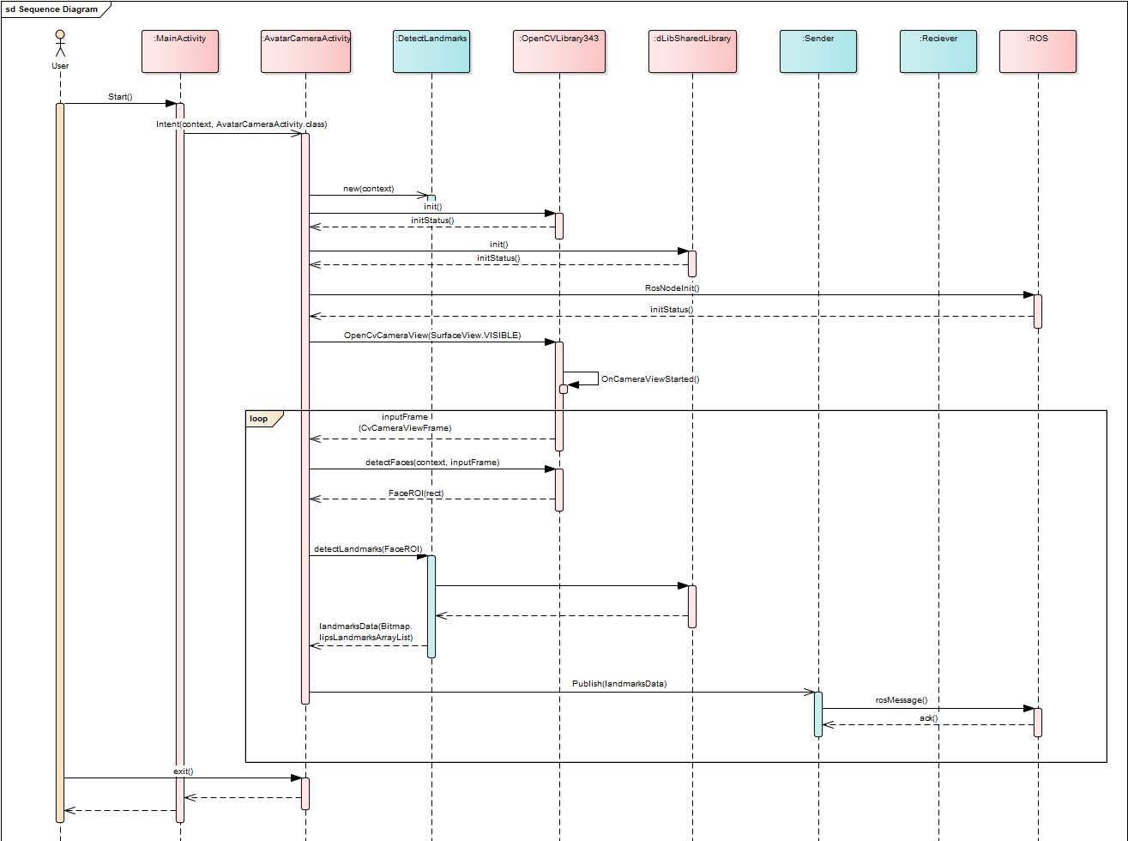

Slide 25
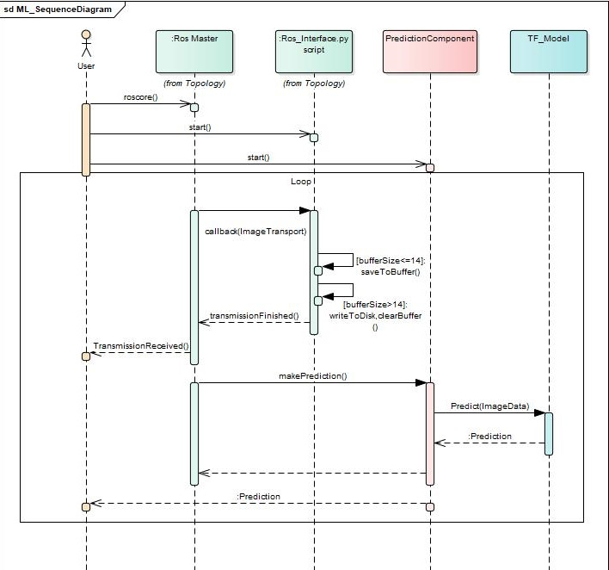

Slide 26
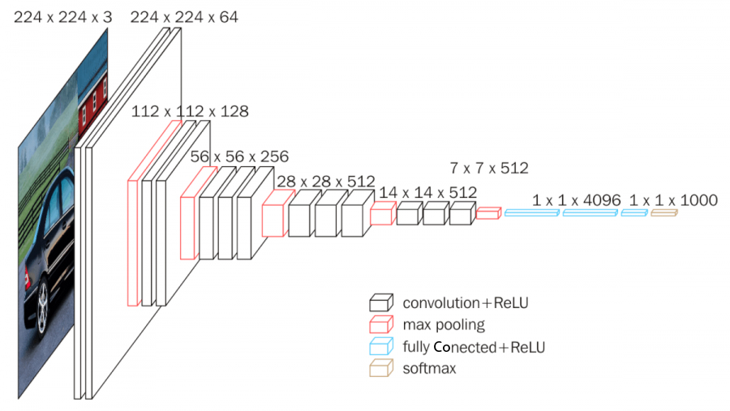
VGG16 – Model Architecture
Notes:
https://neurohive.io/en/popular-networks/vgg16/

Slide 27
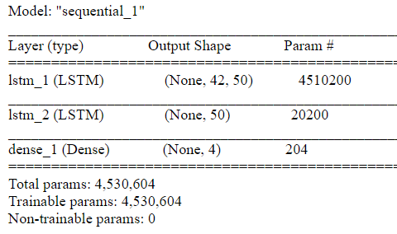
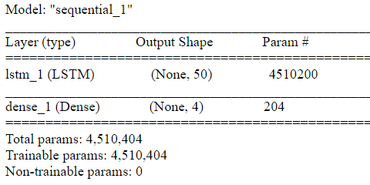
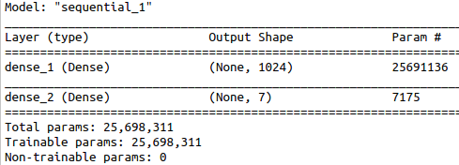
Custom Model Architectures
Fig. vLSTM
Fig. sLSTM
Fig. CNN

Slide 28
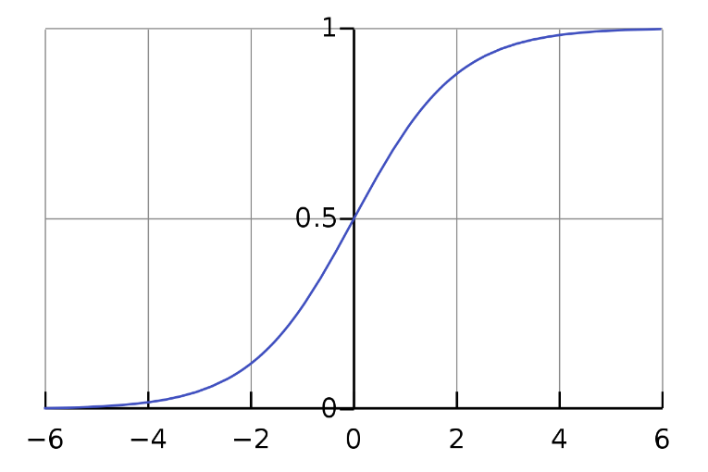
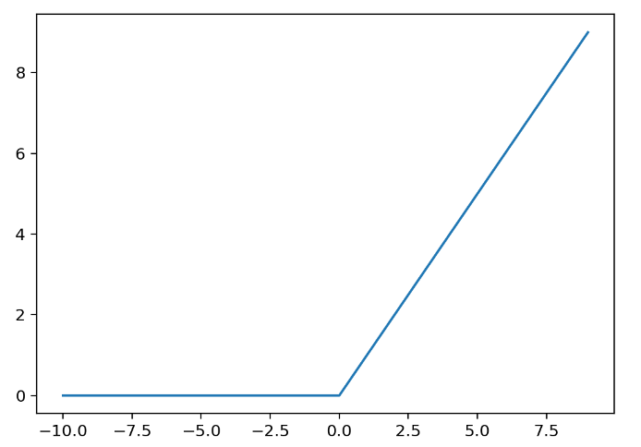

Activation/Squashing Functions
Softmax function:
Squashes the final layer's activations/logits into the range [0, 1].
Allows final outputs to be directly interpreted as probabilities.
Sigmoid
$σ\left(x\right)= \frac{1}{1+e^{−x}}$
ReLU
$ReLU\left(a\right)=\max\left(0,a\right)$
Notes:
[1] Sigmoid Function Plot : By Qef (talk) - Created from scratch with gnuplot, Public Domain, https://commons.wikimedia.org/w/index.php?curid=4310325
[2] ReLU Function Plot : https://machinelearningmastery.com/rectified-linear-activation-function-for-deep-learning-neural-networks/

Slide 29

Memory Consumption

Slide 30
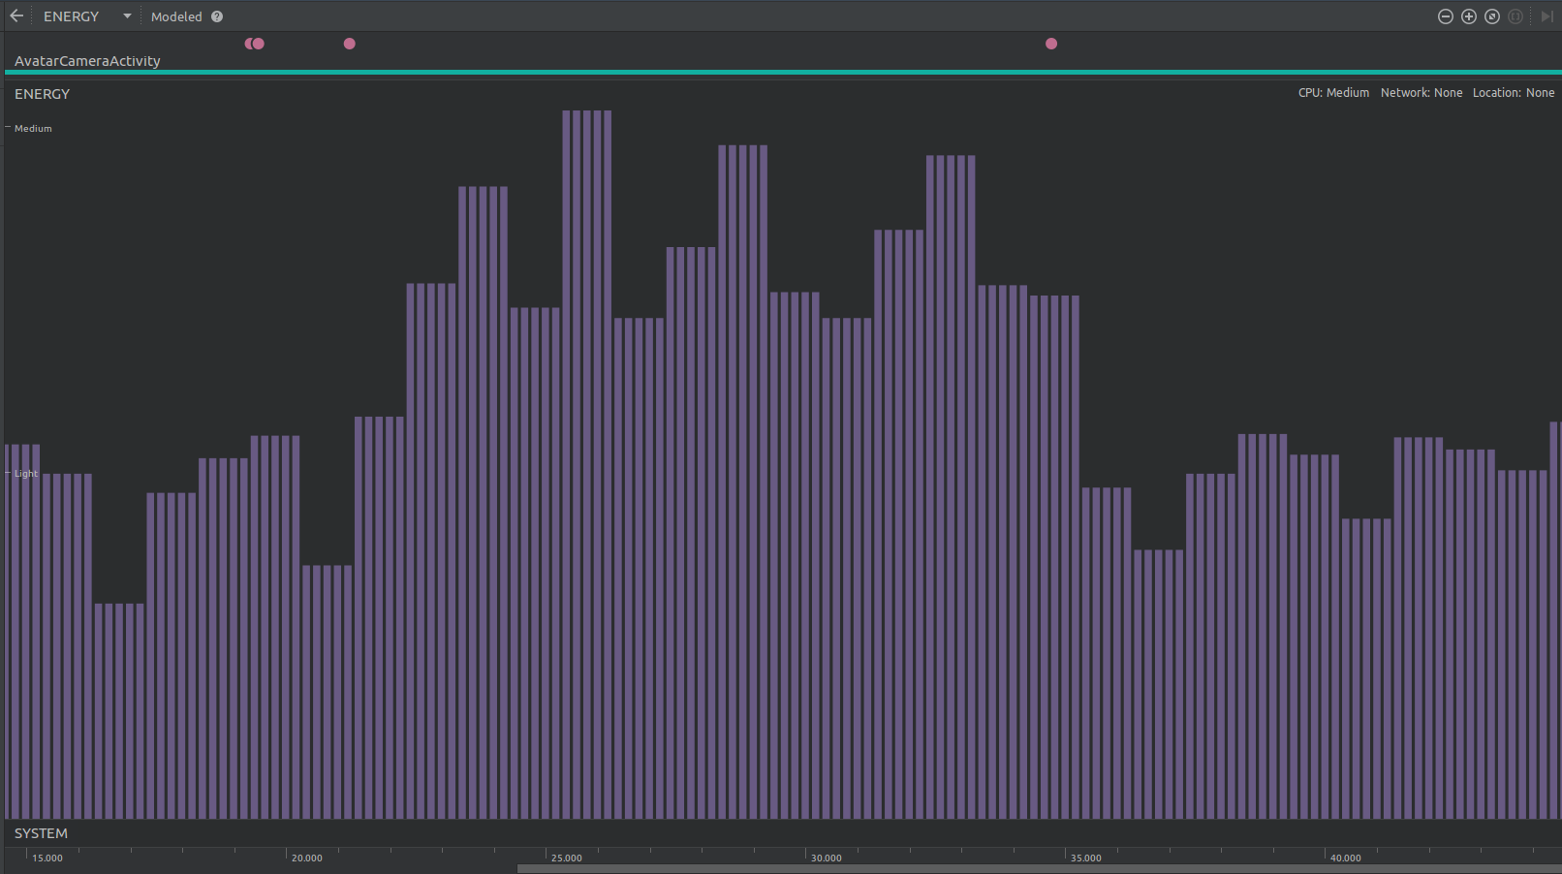
Energy Consumption

Slide 31
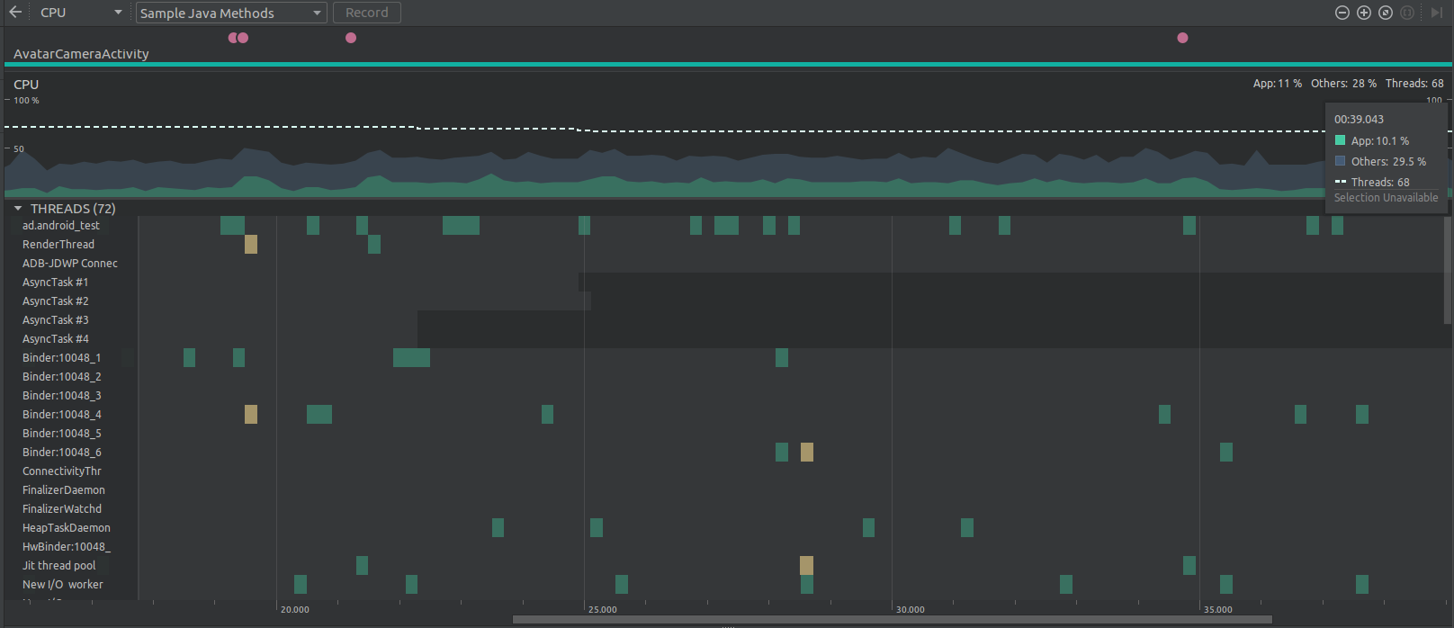
CPU Usage

