Slide 1


Design & Development of an Inter-Company Software Collaboration Platform Using S.O.A and RestAPIs
FROM MONOLITHIC ARCHITECTURE TO FLEXIBLE MICRO-SERVICES
By: Ahmad Hassan Mirza
First Supervisor: Prof. Dr.-Ing. Jörg Thiem
Second Supervisor: Dipl.-Ing. Martin Kisser

Slide 2




Agenda
Research Question
Introduction
Application Requirements & Research Questions
Application Design
Application Overview and Results
Conclusion
Future improvements
Notes:
Car image from : https://cliparting.com/free-car-clipart-1120/
https://www.vecteezy.com/vector-art/658885-radio-wifi-signal
https://www.vectorportal.com/StockVectors/Icons/Office-building-vector/14505.aspx
https://depositphotos.com/vector-images/house.html

Slide 3
Research Question
How existing software cooperation workflows can be simplified in terms of:
Inter-company collaboration.
Between OEMs and Bosch – software sharing.
Automation ready solution (based on CLI instead of a GUI).
Intra-company collaboration.
Within different departments of Bosch.
Multi party software integration.
Remote Testing.
Providing remote access to testing software (SaaS).
Providing access to software running on special hardware on-campus. (IaaS).
Remote AI & ML services.
Fast and simple setup on client side for using such services.
Support for low-end devices such as raspberry-pi, mobile phones/tablets or ECUs.
Notes:
How software components comming from different teams for one software project can be easily integrated and delivered as a final product.

Slide 4
Introduction
software sharing.
Saas & soa
Why SOA and a Cloud-Based Solution?
Application Programming Interface.
API Architectures.

Slide 5
Software Sharing
OEMs and Bosch work together to generate code for ECUs.
OEMs add their proprietary code in the dummy adapters without having to share the proprietary code with T-1 supplier removing the need for making new contracts and legal documents.
Development Timeline:
Manual process .
Automated process with a monolithic architecture.
Automated process with service-oriented architecture (SOA).
OEM
Bosch
Base-software
Create Configuration Files (usually excel and xml files)
Verify the input files
Generate new code adapters and integrate into the software
Add OEM specific code to the new adapters
Test and perform partial build
Perform full build and flash to ECU
End
Notes:
OEM: Original Equipment Manufacturer.
Bosch GmbH: Tier-1 supplier.

Slide 6
SaaS & SOA
Software as a Service
Service oriented architecture
SaaS: Delivery model for software centrally hosted on a cloud server.
Other Models:
IaaS: Infrastructure as a service
PaaS: Platform as a service
SOA: Architecture/pattern for building cloud applications offering SaaS, IaaS, PaaS.
The app is structured as a set of loosely coupled services.
Each service addresses a single use case.
Promotes granularity/modularity.
Services communicate with each other and clients via message passing using a lightweight protocol such as HTTP.
Monolithic software package
Modular S.O.A
Notes:
Software-as-a-Service : SaaS
Service-Oriented-Architecture: SOA
JSON/XML for returning responses

Slide 7
Why S.O.A. and a Cloud-Based Solution?
Simplifies software sharing process between OEMs and Tier-1 companies.
Makes intercompany software co-operation workflows more efficient.
HOW?
Choice: Clients can choose which service they need for their workflows.
Cost effective: No software distribution medium needed* . Pay to use/subscription based model.
Efficient Processes: No need to communicate with the T-1 engineers to setup requirements and configuration.
Independence: Each team works on developing, deploying and maintaining a seperate service.
Simplicity: No need to integrate each component into a single package.
Faster: Improves time to market for new features and updates.
Notes:
Cloud based services are accessible via simple API calls.
A distributed architecture allows offering high-end infrastructure available on-campus as a service to low-end devices. Further reducing costs.
*The cloud model has no physical need for indirect distribution because it is not distributed physically and is deployed almost instantaneously, thereby negating the need for traditional partners and middlemen.
Less disk space on server deployment, as only the required components can be deployed for the client instead of the whole package.
Pay-to-use solution. SaaS is usually subscirption based payments, or pay to use model.

Slide 8
Application Programming Interface
APIs define the interface of each service that is exposed to the outside world.
Web-APIs provide a practical, network-based access to cloud-based infrastructure e.g:
remote devices.
software services.
collection of data via sensors etc.
Table-1: Common API- Design Styles
API Design | Charachteristics | Communication Protocols
URI | Static URIs | HTTP
Hyper Media | Dynamic URIs, self descriptive messages. | HTTP,COAP etc. (REST)
Tunneling | Transport agnostic | R.P.Cs in XML format messages
Event Driven | Async messages e.g. WebSockets | HTTP, TCP/IP etc.

Slide 9
API Architectures
Table-2: API Architectures
Parameter | REST | GraphQL | gRPC | WebHooks | SOAP
Summary | Data transfer between nodes, stateless | API Query language, user defined data in the response | Lightweight system built using remote procedure calls. | Automated serving of data and state updates. | Resource sharing in a systematic & standardized way.
Transport Protocol | HTTP | *HTTP | HTTP/2 | HTTP | *HTTP & SMTP
Payload Format | * JSON, XML etc. | GraphQL query (JSON) | Protobufs | HTTP POST | XML
Notes:
A poorly designed or poorly documented API could have an adverse effect on the quality of the software.
A good API can lead to long term customers and a bad one can have a very adverse effect on an organization’s image ,
as a basic guiding principle an API should be very easy to use and hard to misuse, and thorough documentation should be available for complex APIs.

Slide 10
Why REST?
Table-3: Rest vs. gRPC
Domain | REST | gRPC
Payload format | JSON (most commonly used) | Protocol Buffers
Transfer protocol | HTTP (typically 1.1) | HTTP/2
Interface definitions | Uses HTTP verbs | Structured messages/ interfaces
Communication | Request-Response model | Allows bi-directional data streaming
Easier to use.
Uses standard payload formats – no strict requirements.
Uses standard HTTP.
Can be adapted to virtually every usecase.
Well documented and has a huge userbase and support community.
Notes:
A poorly designed or poorly documented API could have an adverse effect on the quality of the software.
A good API can lead to long term customers and a bad one can have a very adverse effect on an organization’s image ,
as a basic guiding principle an API should be very easy to use and hard to misuse, and thorough documentation should be available for complex APIs.

Slide 11
Application Requirements
P.o.c. cloud native application == HyAPI

Slide 12
Application Requirements
Platform for offering software and infrastructure as a service (Saas and IaaS) – HyAPI.
Migration of existing software from monolithic to service oriented architecture.
Services should be cross-platform compatible.
Services should be ready for integration into automation workflows – CLI based.
The application should be secure against attacks and malicious use.
Usecases:
File transfer (upload and download).
UML diagram generation.
FDK (software-sharing) services.
Machine Learning toolkit (model training and object detection).

Slide 13

Application Design
HyAPI

Slide 14
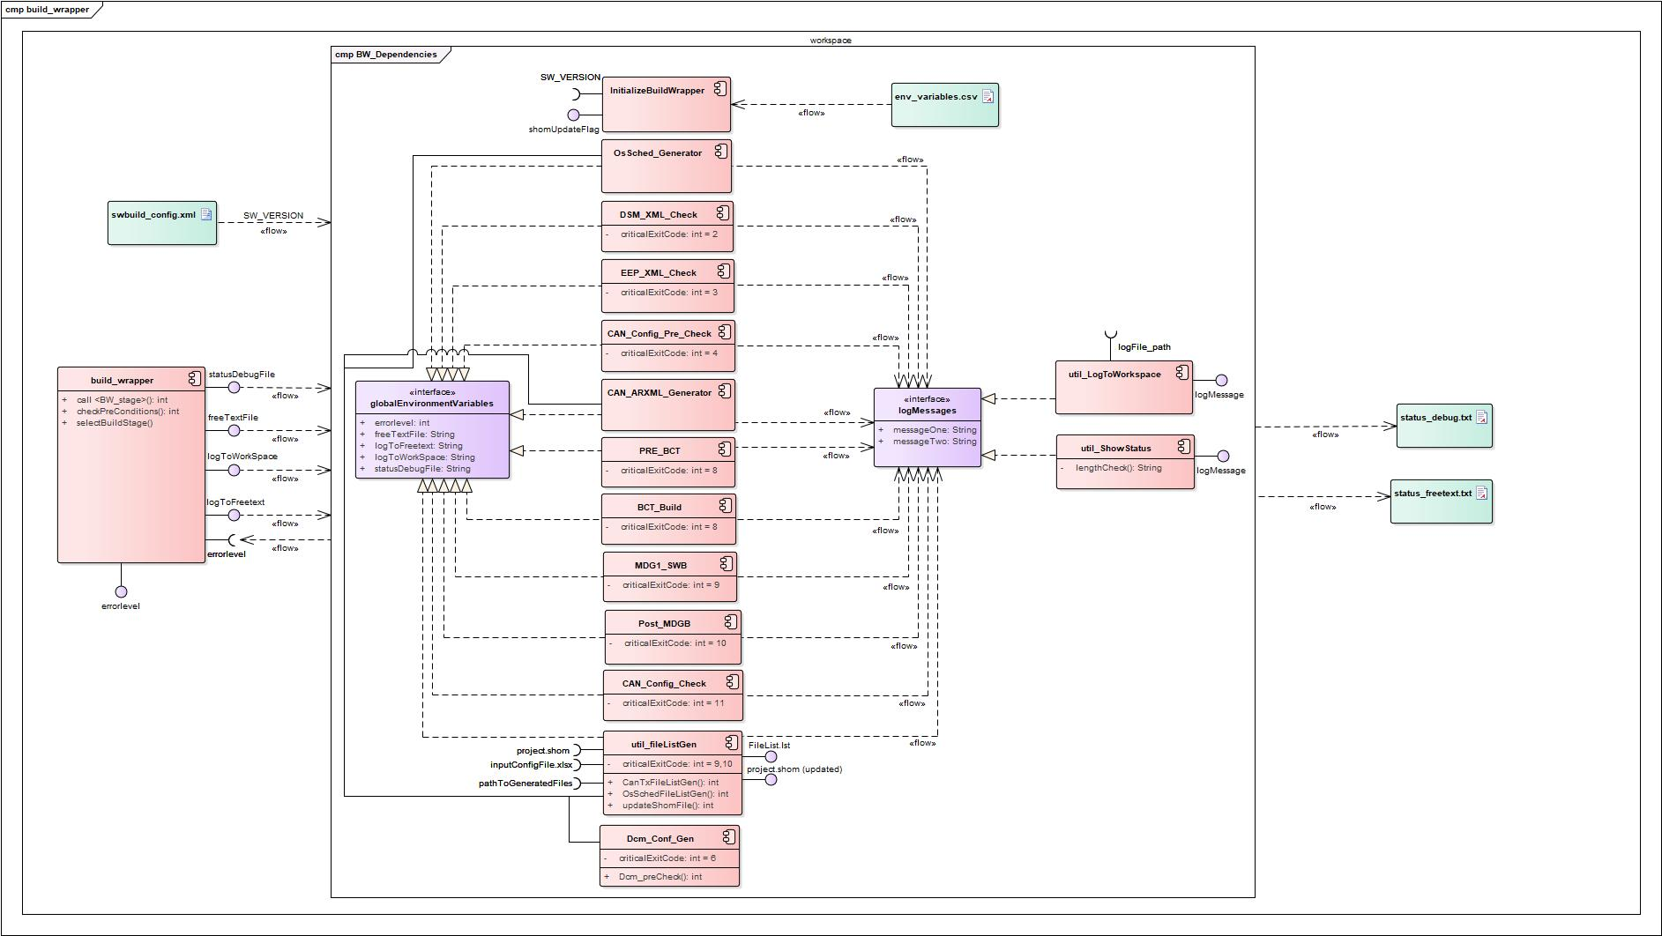
Monolithic Architecture - Legacy

Slide 15
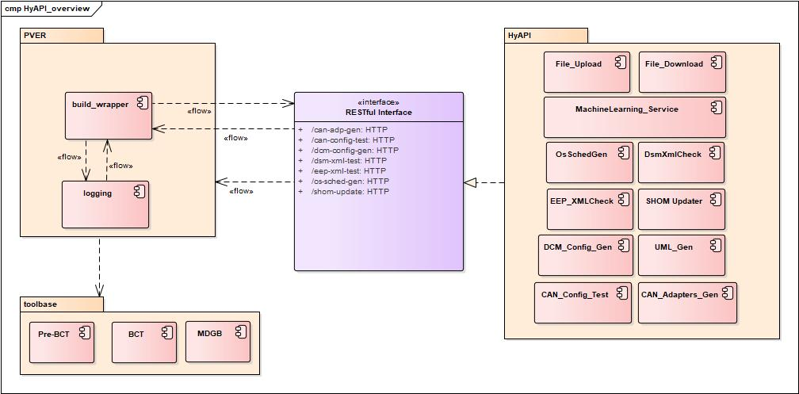
Service Oriented Architecture - Proposed

Slide 16
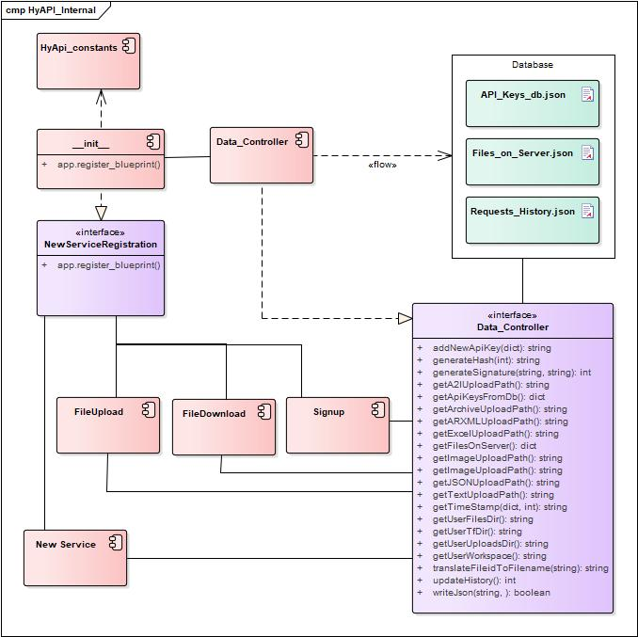
HyAPI Platform Architecture

Slide 17
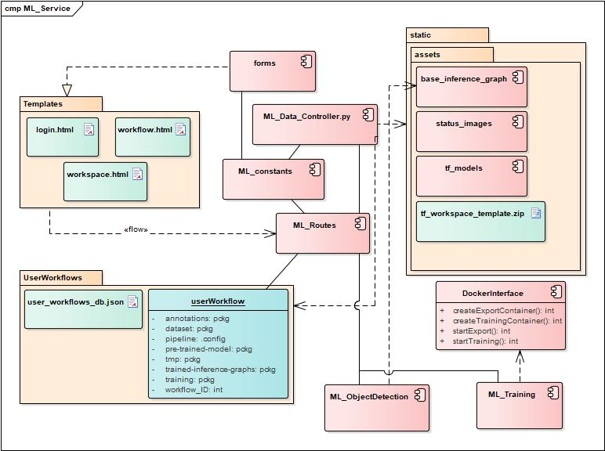
Machine Learning Toolkit

Slide 18
Securing a Cloud Native Application
Table-4: Security vulnerabilities and suggested mitigation techniques.
Security Vulnerability | Mitigation Techniques
Injection Attacks | Input sanitization.
Broken Authentication | Multi-factor authentication, using randomly generated strings for session management etc.
Improper protection of sensitive data | Using strong hashes, encryption protocols (HTTPs/TLS).
Processing of external entity references | Use JSON instead of XML, avoid serialization of sensitive data.
Insufficient logging and monitoring | Implementing detailed logging across the software.
Distributed Denial of Service | Web application firewall, API gateway , Rate limiting.
Cross Site Scripting

Slide 19
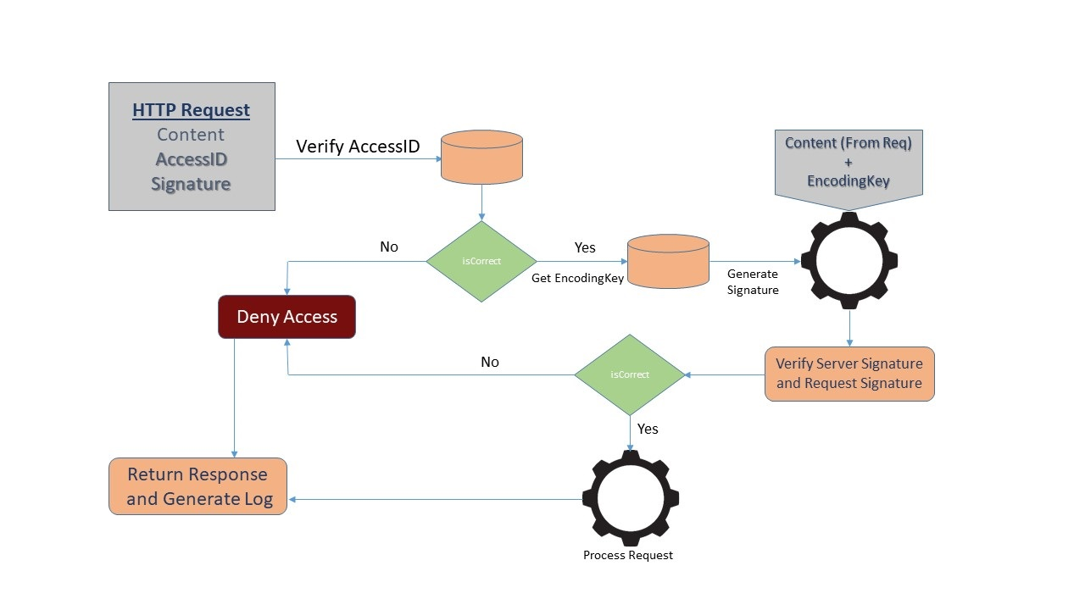
2-Tier Authentication
API-Key Verification.
Request Content‘s Signature Verification.

Slide 20
2-T Authentication
For every new customer a unique AccessID and EncodingKey is generated.
Util_AccessID_Generator.py
Only Authorized personel shall have access to this script.
New Customer receives following as on-boarding:
AccessID
EncodingKey
Script (util_Generate_Signature.py) or instructions on how to generate signature.
Moving forward each request (API-call) must contain the following elements.
AccessID (API-Key)
http request e.g excel file, json, image, string etc.
Unique signature specific to the request based on HMAC encoding.

Slide 21

Application Overview and Results
HyAPI

Slide 22
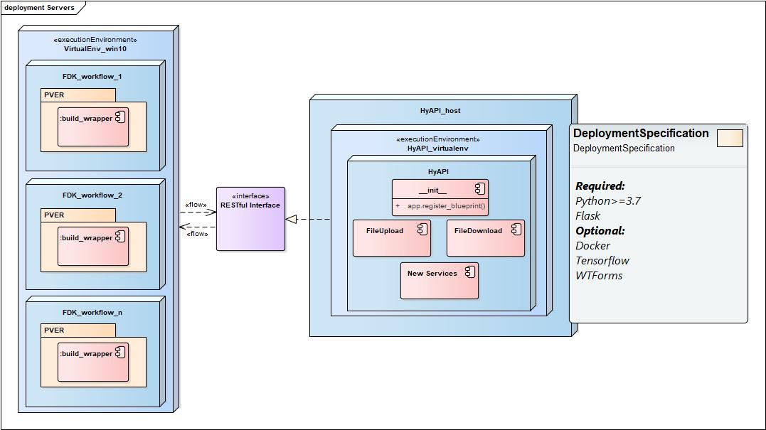
HyApi Deployment

Slide 23
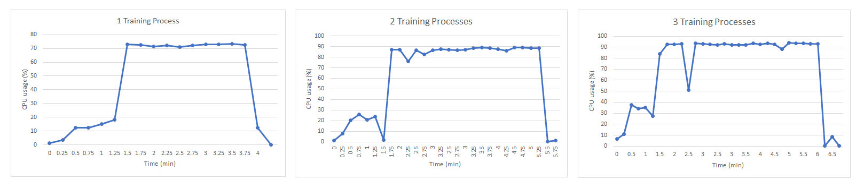
Scalability and Performance Metrics
Server Machine: Lenovo Legion Y520
OS: Linux
GPU: Nvidia GeForce GTX1010i GPU
CPU: Intel core i7 with 2.8GHz and 8 CPUs

Slide 24
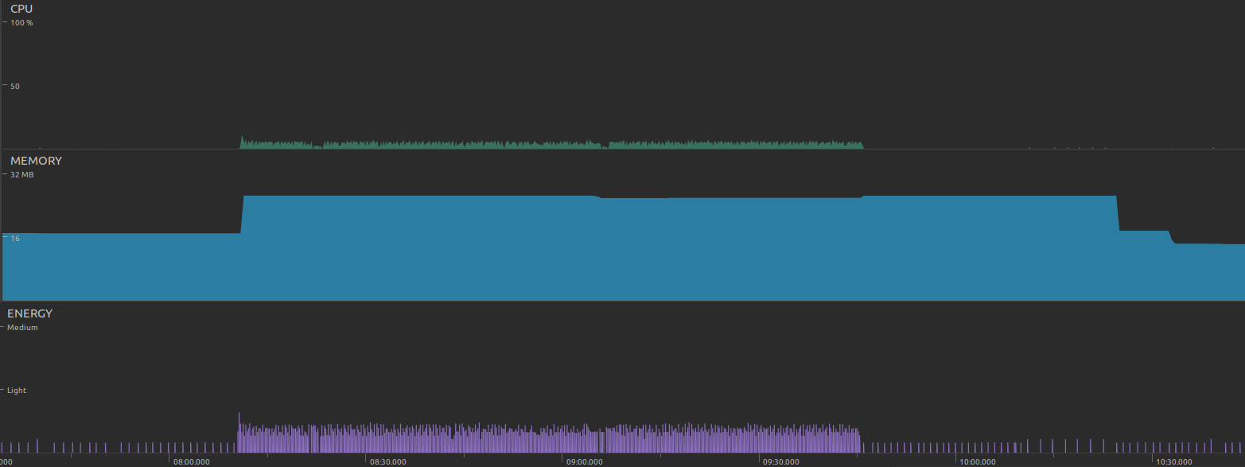
Scalability and Performance Metrics
CPU: 10%
Memory: 32MB
Energy: Light
Client machine: Samsung Galaxy Tab A
OS: Android 8.1
CPU: 1.6 GHz Cortex-A53, Octa-core.
GPU: Mali-T830 MP1

Slide 25
Conclusion
HyAPI

Slide 26
Conclusion
Service Oriented Architecture adds a layer of abstraction.
Each service operates in its own eco-system.
Enables easier cooperate for developing software, as well as collaboration across company boundaries.
Wide ensemble of design patterns available for SOA.
Promotes highly scalable system designs.
Interface design using RESTful APIs.
Simplicity (for use and development).
Lightweight HTTP for faster data transfer.
Wide range of platform compatibility.
Proposed architecture allows for a faster time to market, shorter time for rolling out updates.

Slide 27
Future Work
Making the system more scalable for industry use.
Operation with an API Gateway.
Using edge computing along with cloud computing to make the application usable for real time applications.
APIs for Continuous Integration and Continuous Deployment

Slide 28

Thank you
HyAPI – The Future is in the clouds
Demo and Questions.

