Slide 1
Sock Shop on AWS
Infrastructure as Code & Automated Deployment
Ahmad Ibhais
Sr. DevOps Engineer Assessment — Avertra · July 8, 2026
Notes:
Frame in one line: a 13-microservice demo app deployed entirely as code on ECS Fargate, time-boxed. Everything in this deck is in the repo and the docs folder.

Slide 2
Approach
Thirteen pre-built microservices, deployed as-is on ECS Fargate — every resource in Terraform, every deployment through a gated GitLab pipeline, every claim below measured rather than estimated.
13
~60
2
microservices deployed
Terraform resources
availability zones
~⟨15⟩ min
0
3 / 4
rebuild from nothing
stored cloud credentials
advanced features built
Notes:
The numbers strip: point at rebuild time — that number is the repeatability proof. Zero stored credentials sets up the OIDC slide.

Slide 3
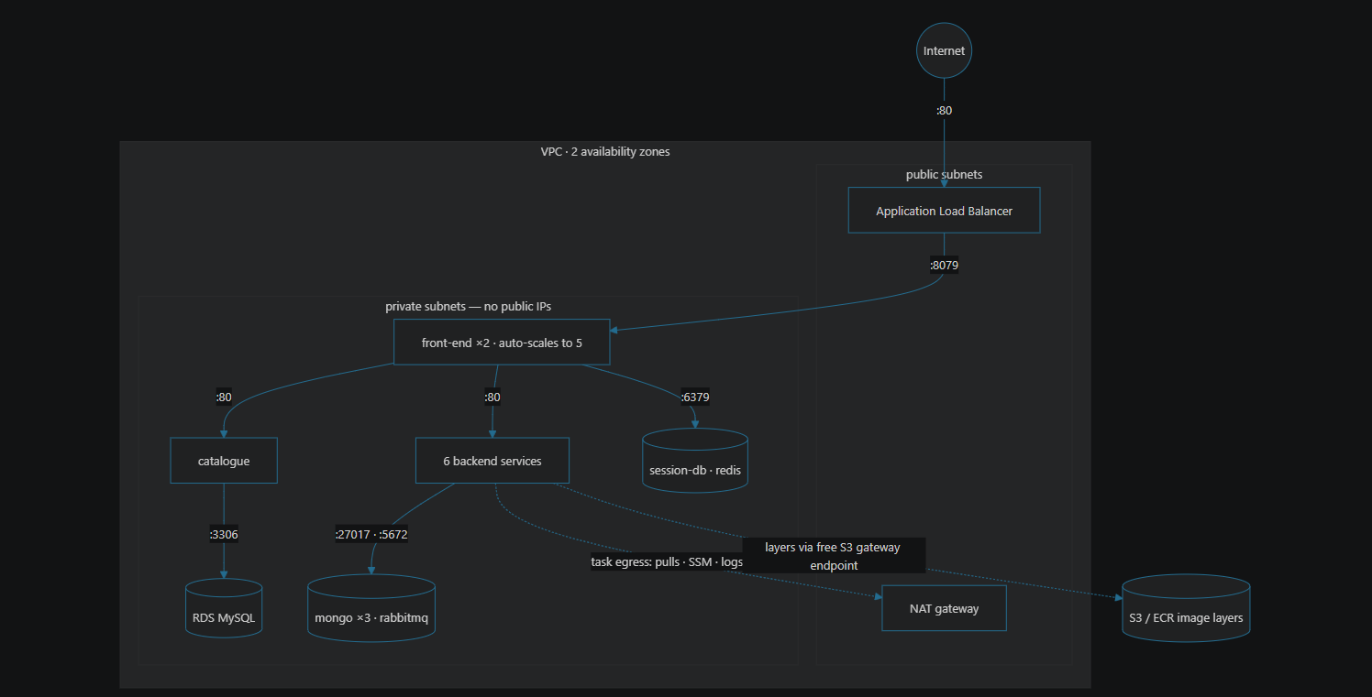
Architecture
The ALB is the only public entry. Every task and the database live in private subnets with no inbound internet path
Notes:
Walk the diagram top-down: internet, ALB, front-end, backends, data tier. One sentence on the route-table fork: image layers ride the free S3 endpoint, everything else pays the NAT.

Slide 4
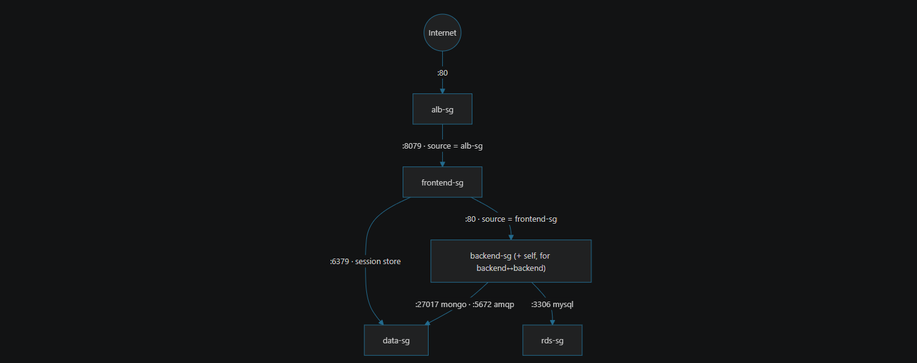
Security & identity
SG
One chain, two layers
Subnets decide reachability; security groups decide permission. each tier admits only the tier above it, enforced at every task’s own network interface.
ID
Zero stored credentials
Every pipeline job federates a GitLab-signed identity into a one-hour AWS role — trust pinned to the immutable project ID. Nothing to store, nothing to leak, nothing to rotate.
Notes:
Two strongest sentences of the defense live here. If probed: subnets = routing layer, SGs = identity-based permission at the ENI; OIDC = AssumeRoleWithWebIdentity, project-ID-pinned trust, day-one key exposure is the lived argument.

Slide 5
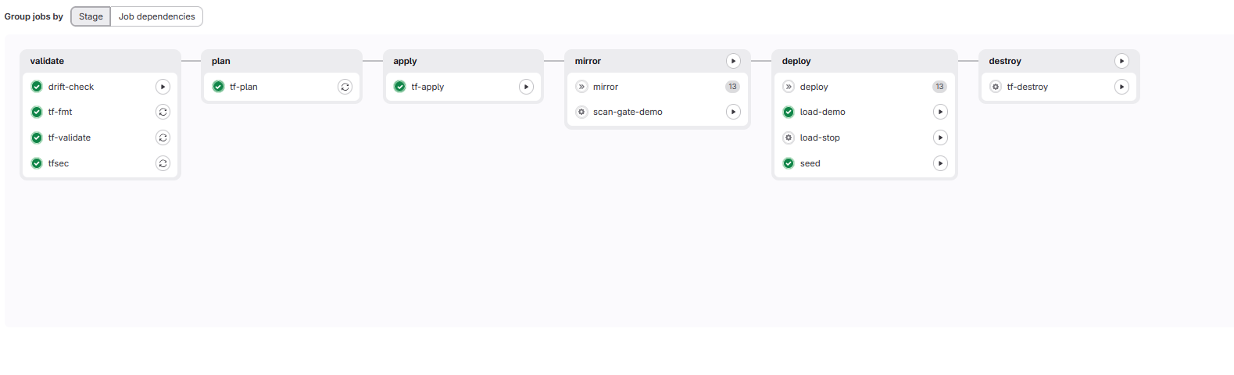
CI/CD pipeline
validate
›
plan
›
apply ▸ manual
›
mirror + scan
›
deploy
›
destroy
Every automated job is read-only — every mutation waits behind a manual gate
Apply executes the exact reviewed plan artifact — never a fresh plan
Scanning at three layers: blueprint (tfsec, blocking) · border (Trivy) · warehouse (ECR)
Operational buttons: seed · load-demo / load-stop · drift-check · double-locked destroy
Notes:
Point at the dark chip: Continuous Delivery, not Deployment — the pipeline makes the release possible, a human makes it happen. Drift-check runs on schedule; destroy needs a typed confirmation on top of the click.

Slide 6
Requirements → evidence
Requirement | How it is met | ✓
Provisioning | Two Terraform roots, ~60 resources, zero console-created — drift-checked on a schedule | ✓
High availability | 2 AZs end-to-end · ALB · minimum 2 front-end tasks · RDS Multi-AZ | ✓
Scalability | Target tracking on CPU + requests-per-target — measured 2→5 in one decision, p99 flat | ✓
Fault tolerance | Self-healing desired count · connection draining · circuit-breaker auto-rollback | ✓
Automated deployment | Pipeline mirrors, scans, plans, applies and seeds | ✓
Monitoring & logging | Golden-signals dashboard (p50 + p99 on one chart) · 5 alarms with recovery · per-service logs | ✓
Advanced features: 3 of 4 built — auto-scaling on application metrics, three-layer security scanning, drift detection. The fourth’s objective (safe rollback) is covered by the deployment circuit breaker; full blue-green is specified in the roadmap.
Notes:
The grader's slide. If asked for proof of any row, docs/03-requirements-mapping.md maps each to files and screenshots.

Slide 7
Challenges, lessons & what’s next
“A fresh task is not a fresh deployment”
Thirteen green services, one unresolvable name. Service Connect snapshots endpoints per deployment — fixed by adding deploy order and forced redeploys.
MySQL 8’s handshake vs a 2017 driver
The server-level fix is immutable on RDS — so the seeding task’s modern client re-keys the account before catalogue sends any requests.
HTTPS + WAF
NAT per AZ
Managed data tier
Everything else I’d change is a row in 04-tradeoffs.md
Notes:
Close on the invitation line — it steers the Q&A toward the trade-off table, which is home turf. Roadmap chips are the 'big three'; the rest is docs/05.

