Slide 1


Slide 2
AGENDA
ANGULAR 5
Introduction to Angular 5
Architecture diagram
Angular 2+ is For everyone
Internal working of Angular 5 application and Web Worker
Introducing Angular-cli

Slide 3
Introduction to angular 5
Angular 2+ is a framework for building client applications in HTML using either JavaScript or a language like TypeScript that compiles to JavaScript.
You write Angular applications by composing HTML templates with Angularized markup, writing component classes to manage those templates, adding application logic in services, and boxing components and services in modules.
Then you launch the app by bootstrapping the root module.

Slide 4
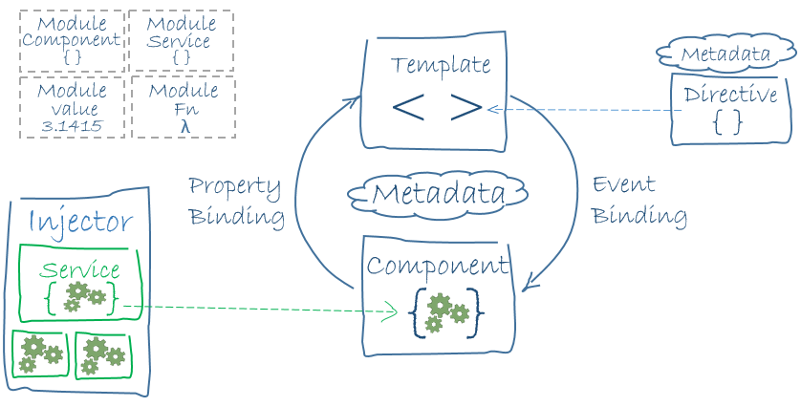
Architecture diagram

Slide 5
Angular 2 is For everyone
Angular 2 is a complete re-write of the super popular web framework AngularJS
Front end developers as well as backend developers can participate
Angular 2 is present in Three flavours now
TypeScript
JavaScript
Dart

Slide 6
Using TypeScript
TypeScript is a typed superset of JavaScript that compiles to plain JavaScript
Optional tipization and object oriented
Where does Typescript fits in
Typescript supports ECMAScript 2015 features like async functions and decorators

Slide 7
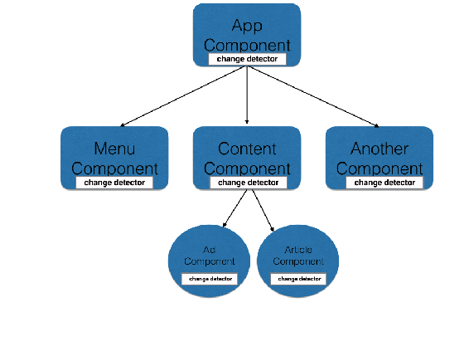
5 . Angular 5 is using Hierarchical Dependency Injection system and implements unidirectional tree based change detection which performance booster

Slide 8
Internal working of Angular 5 application
Angular application is collection of modules and component ...it should have at least one module
Angular Cli Project structure angular-cli.json and package.json
Modules exports parts of Angular application (components, services) so they can be used in other parts of the application using keywords Export / Import.
The way we move through the application using <base href=“/”>
https://medium.com/codingthesmartway-com-blog/angular-5-service-worker-b722e571e306

Slide 9

May The Angular 5+ Be with You.... Thank You!

