Slide 1




design
deliver
engineer

Slide 2
Spring boot and Angular 5 Integration
Team
Clairvoyant India Pvt. Ltd.

Slide 3
Agenda
Monolithic vs Microservices
Example Application
Start
End
Introduction
Conclusion
Benefits

Slide 4
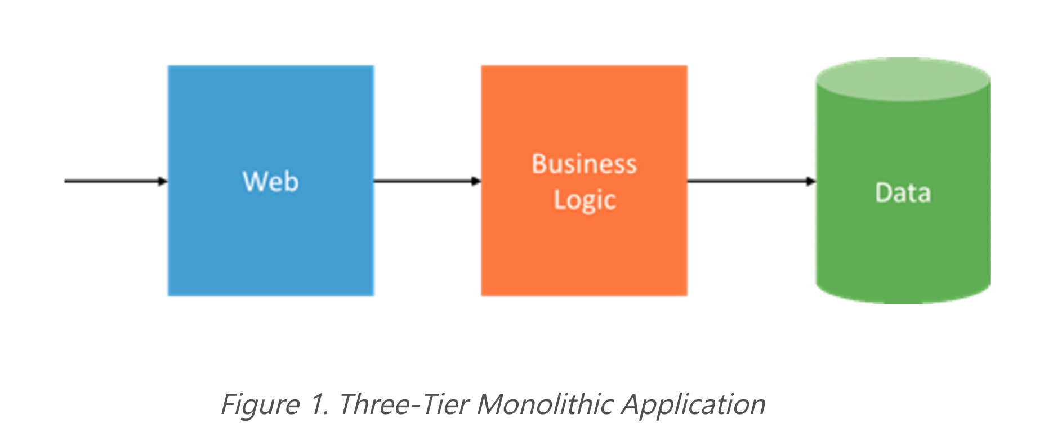
Monolithic Architecture

Slide 5
Benefits of Monolithic Architecture
Simple to test
Simple to deploy.
Simple to scale horizontally by running multiple copies behind a load balancer.

Slide 6
Drawbacks of Monolithic Architecture
Application is too large and complex to fully understand and made changes fast and correctly.
The size of the application can slow down the start-up time.
Continuous deployment is difficult.
Monolithic applications can also be difficult to scale when different modules have conflicting resource requirements.
Less Reliability - Bug in any module (e.g. memory leak) can potentially bring down the entire process. Moreover, since all instances of the application are identical, that bug will impact the availability of the entire application.
Monolithic applications has a barrier to adopting new technologies

Slide 7
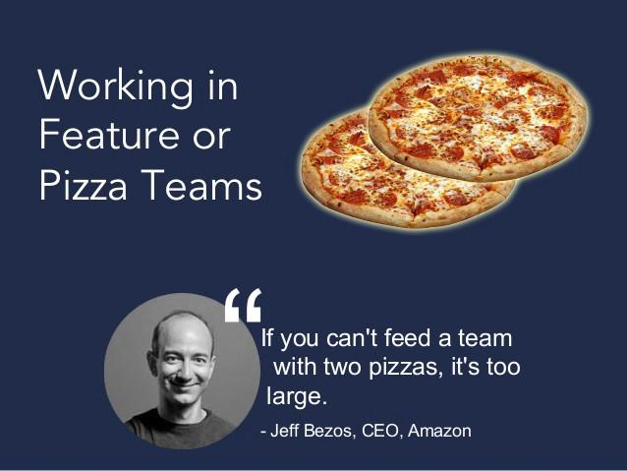
Microservices Architecture
Microservice architecture is an approach of building large enterprise application with multiple small unit called services
Each service can be developed, tested and deployed individually.

Slide 8
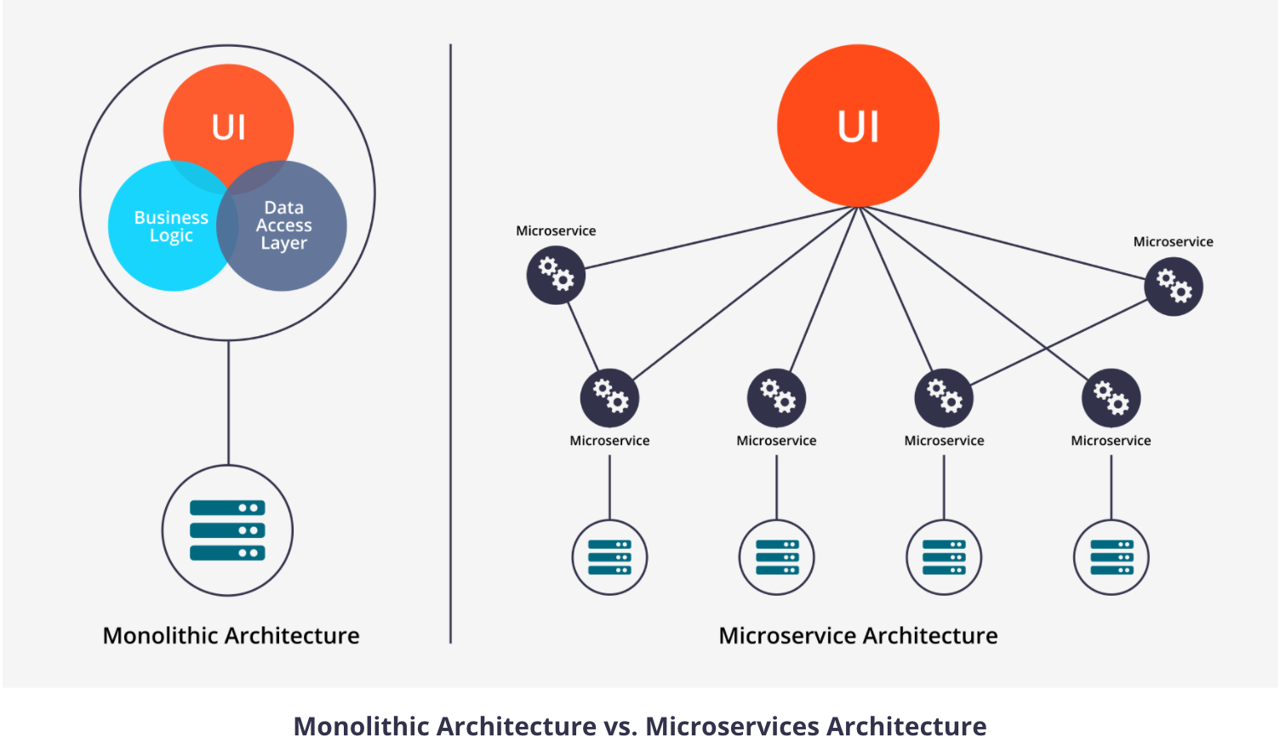
Monolithic vs Microservices Architecture

Slide 9
Benefits of Microservices Architecture
It tackles the problem of complexity by decomposing application into a set of manageable services which are much faster to develop, and much easier to understand and maintain.
It enables each service to be developed independently by a team that is focused on that service.
It reduces barrier of adopting new technologies.
Microservice architecture enables each microservice to be deployed & scaled independently

Slide 10
Drawbacks of Microservices Architecture ..
It is more difficult to implement changes that span multiple services.
Deploying a microservices-based application is also more complex. A monolithic application is simply deployed on a set of identical servers behind a load balancer. In contrast, a microservice application typically consists of a large number of services. Each service will have multiple runtime instances. And each instance need to be configured, deployed, scaled, and monitored.
Microservices architecture adding a complexity to the project just by the fact that a microservices application is a distributed system.
Microservices has the partitioned database architecture. Business transactions that update multiple business entities in a microservices-based application need to update multiple databases owned by different services.
Testing a microservices application is also much more complex than in case of monolithic web application.

Slide 11

What is Spring Boot?

Slide 12
Why Spring Boot ?
The primary goals of Spring Boot are:
To provide a radically faster and widely accessible ‘getting started’ experience for all Spring development
To be opinionated out of the box, but get out of the way quickly as requirements start to diverge from the defaults
To provide a range of non-functional features that are common to large classes of projects (e.g. embedded servers, security, metrics, health checks, externalized configuration)

Slide 13
What Spring Boot offers ?
Annotation based configuration.
Standardization for Microservices
Integrated Server for Development
Cloud Support
Adapt & Support for 3rd Party Library
Spring Boot has taken a significant step and widen support for 3rd Party Open Source Library like Netflix OSS, No-SQL DB, Distributed Cache etc.

Slide 14
Spring Boot features
Create stand-alone Spring applications
Embed Tomcat, Jetty, Netty, Undertow etc. directly (no need to deploy WAR files)
Provide 'starter' POMs to simplify your Maven configuration
Automatically configure Spring whenever possible
Provide production-ready features such as metrics, health checks and externalized configuration
Absolutely no code generation and no requirement for XML configuration

Slide 15
Spring Boot Components
Spring Boot AutoConfiguration
Module to auto configure a wide range of Spring projects. It will detect availability of certain frameworks (Spring Batch, Spring Data JPA, Hibernate, JDBC).
Spring Boot Core
The base for other modules, but it also provides some functionality that can be used on its own, eg. using command line arguments and YAML files as Spring Environment property sources and automatically binding environment properties to Spring bean properties.
Spring Boot CLI
A command line interface, based on ruby, to start/stop spring boot created applications.

Slide 16
Spring Boot Components
Spring Boot Actuator
Actuators enable production-ready features to a Spring Boot application – without having to actually implement these things yourself.They’re mainly used to expose different types of information about the running application – health, metrics, info, dump, env etc. And while these are no replacement for a production-grade monitoring solution – they’re a very good starting point.
Spring Boot Starters(https://github.com/spring-projects/spring-boot/tree/master/spring-boot-starters)
Different quick start projects to include as a dependency in your maven or gradle build file.

Slide 17


Slide 18


Slide 19
Copyright and References
https://articles.microservices.com
https://dzone.com/articles/monolithic-vs-microservice-architecture
Monolithic Architecture vs. Microservices Architecture: https://www.weave.works/what-are-microservices/
https://projects.spring.io/spring-boot/
http://www.adeveloperdiary.com/java/spring-boot/an-introduction-to-spring-boot/
Figure 1. Three-Tier Monolithic Application: https://azure.microsoft.com/en-gb/blog/microservices-an-application-revolution-powered-by-the-cloud/
https://spring.io/blog/2013/08/06/spring-boot-simplifying-spring-for-everyone
Two Pizza Team: https://cdn-images-1.medium.com/max/800/1*rHsaQkS44QV6bEQL11uU7w.jpeg
http://wallpaper-gallery.net/images/demo/demo-6.png
https://img.clipartfox.com/90ea1af4da186434a0a033a16e9516cd_-church-whats-next-whats-next-clipart_842-527.jpeg

