Slide 1
Student Performance Prediction Using ML
Project Final presentation

Slide 2
Group mambers
# | Name | ID | Role
1 | Ahmad jabali | 2190009080 | Leader
2 | Hussam Ziad | 2190005458 | Member
3 | Adam Almeedani | 2190003266 | Member
4 | Mohammed Aljbali | 2190005704 | Member
5 | Abdulrahman aljallal | 2180005883 | Member

Slide 3
INTRODUCTION
In 2020, the pandemic Covid-19 affect negatively on Students performance, the classes shift from in campus classes to studying through online meetings. Students’ performance is determined by several factors. For instance, the amount of study time and the current health of the students.

Slide 4
Description of dataset
The data set that was used in this project is the Student Performance Data Set and it contains two subjects: Mathematics and Portuguese. We combined them together and obtained 33 Attributes and 1044 cases.
70 % Train
30 % test

Slide 5
Statistical Analysis of the dataset
index | count | mean | std | min | 0.25 | 0.5 | 0.75 | max
age | 1044 | 16.72605 | 1.239975 | 15 | 16 | 17 | 18 | 22
mother_education | 1044 | 2.603448 | 1.124907 | 0 | 2 | 3 | 4 | 4
father_education | 1044 | 2.387931 | 1.099938 | 0 | 1 | 2 | 3 | 4
commute_time | 1044 | 1.522989 | 0.731727 | 1 | 1 | 1 | 2 | 4
study_time | 1044 | 1.970307 | 0.834353 | 1 | 1 | 2 | 2 | 4
failures | 1044 | 0.264368 | 0.656142 | 0 | 0 | 0 | 0 | 3
family_quality | 1044 | 3.935824 | 0.933401 | 1 | 4 | 4 | 5 | 5
free_time | 1044 | 3.201149 | 1.031507 | 1 | 3 | 3 | 4 | 5
go_out | 1044 | 3.15613 | 1.152575 | 1 | 2 | 3 | 4 | 5
weekday_alcohol_usage | 1044 | 1.494253 | 0.911714 | 1 | 1 | 1 | 2 | 5
weekend_alcohol_usage | 1044 | 2.284483 | 1.285105 | 1 | 1 | 2 | 3 | 5
health | 1044 | 3.543103 | 1.424703 | 1 | 3 | 4 | 5 | 5
absences | 1044 | 4.434866 | 6.210017 | 0 | 0 | 2 | 6 | 75
period1_score | 1044 | 11.2136 | 2.983394 | 0 | 9 | 11 | 13 | 19
period2_score | 1044 | 11.24617 | 3.285071 | 0 | 9 | 11 | 13 | 19
final_grade | 1044 | 0.636015 | 0.820218 | 0 | 0 | 0 | 1 | 2

Slide 6
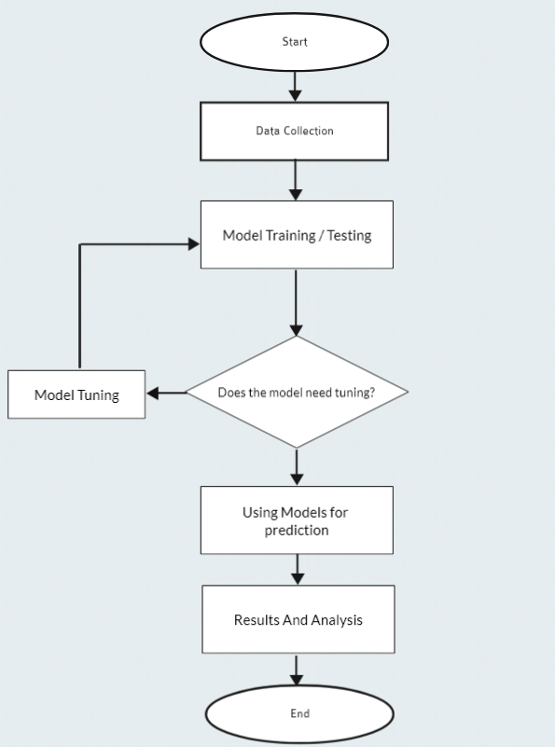
Experimental Setup

Slide 7
Confusion Matrices
TP: If it is expected that the student will succeed and actually succeed
TN : If the expectation is that the student will fail and he has already failed
FP: If a student is expected to fail, but succeeds
FN: If the student is expected to fail and actually fail.

Slide 8
we used accuracy equal to ((TP+TN))/((TP+FP+FN+TN)) We aim to increase TP and decrease FN

Slide 9
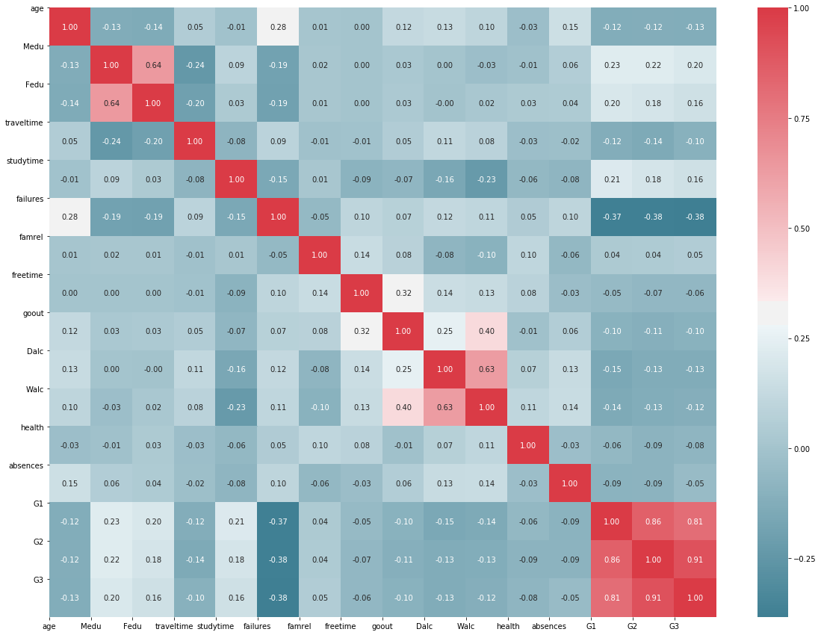
Correlation Plot

Slide 10
Result and discussion

Slide 11
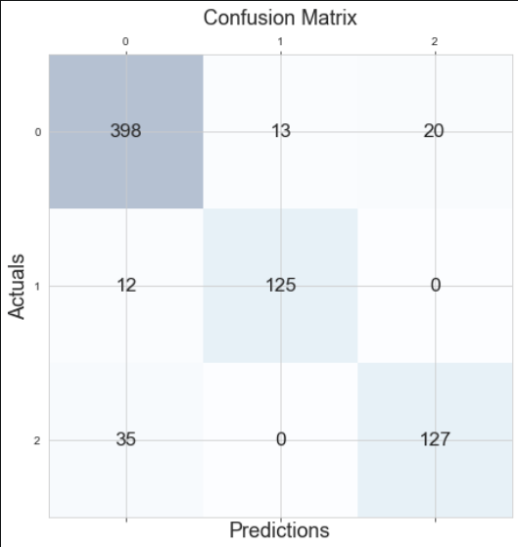
techniques used
Random Forest Classifier
87%
Decision Tree Classifier
85%
Logistic Regression
89%

Slide 12
Conclusion

Slide 13
THANKS!
DO YOU HAVE ANY QUESTIONS?

